Slide 1
CS598:Visual information Retrieval
Lecture IV: Image Representation:
Semantic and Attribute based Representation

Slide 2
Rcapt of Lecture IV
Histogram of local features
Bag of words model
Soft quantization and sparse coding
Supervector with Gaussian mixture model

Slide 3
Lecture V: Part I
Image classification basics

Slide 4
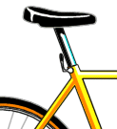
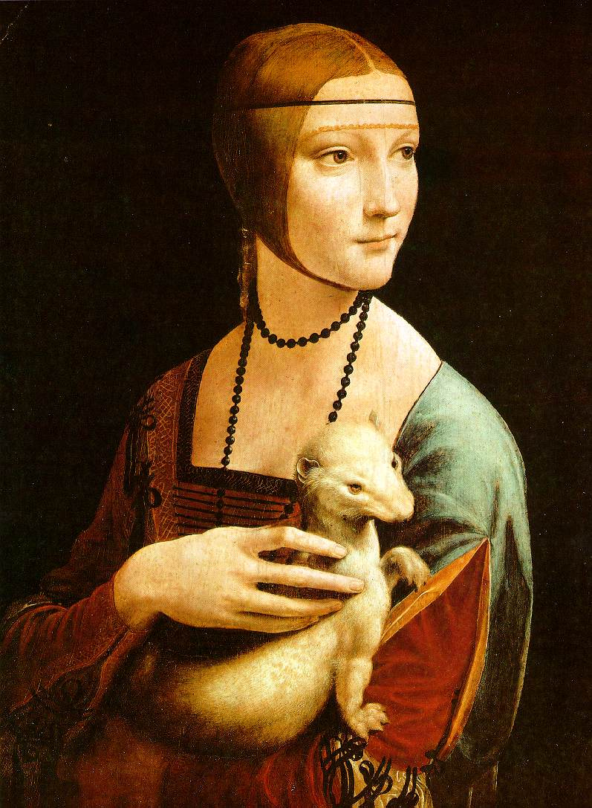
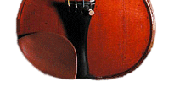
Image classification
Given the image representation, e.g., color, texture, shape, local descriptors, of images from different classes, how do we learn a model for distinguishing them?

Slide 5
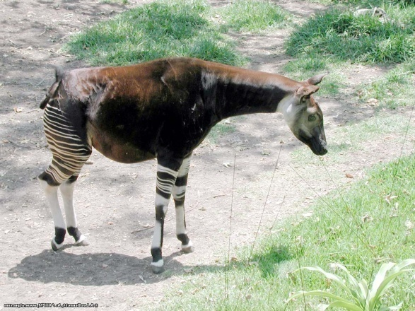
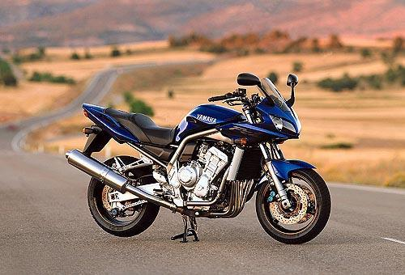
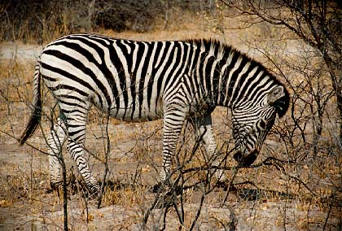
Classifiers
Learn a decision rule assigning bag-of-features representations of images to different classes
Decision
boundary
Zebra
Non-zebra

Slide 6
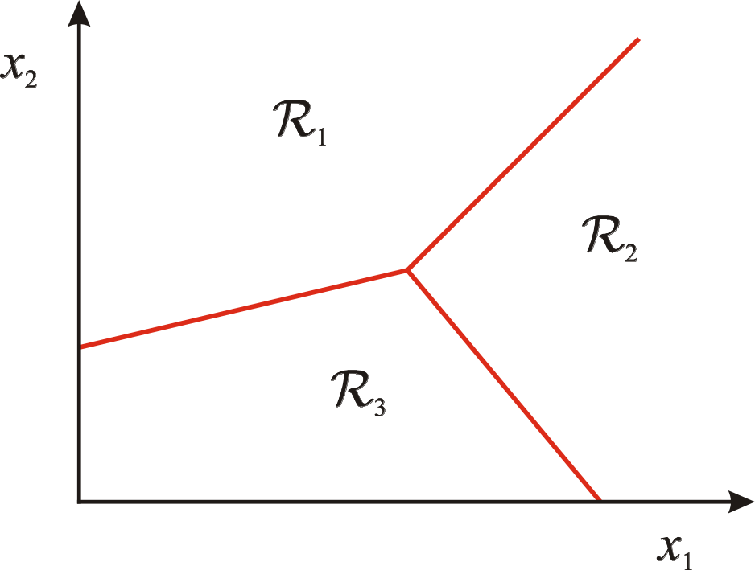
Classification
Assign input vector to one of two or more classes
Any decision rule divides input space into decision regions separated by decision boundaries

Slide 7
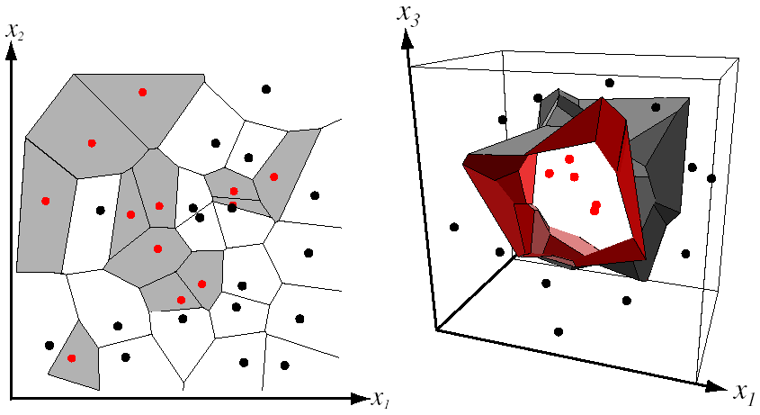
Nearest Neighbor Classifier
Assign label of nearest training data point to each test data point
from Duda et al.
Voronoi partitioning of feature space
for two-category 2D and 3D data
Source: D. Lowe

Slide 8
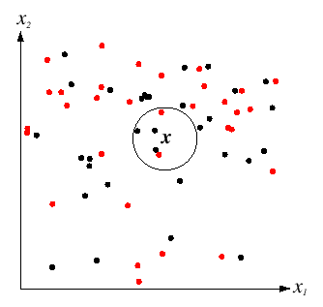
K-Nearest Neighbors
For a new point, find the k closest points from training data
Labels of the k points “vote” to classify
Works well provided there is lots of data and the distance function is good
k = 5
Source: D. Lowe

Slide 9
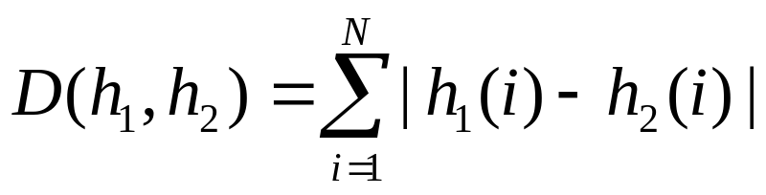
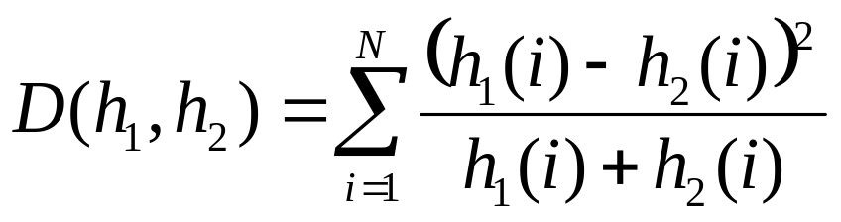
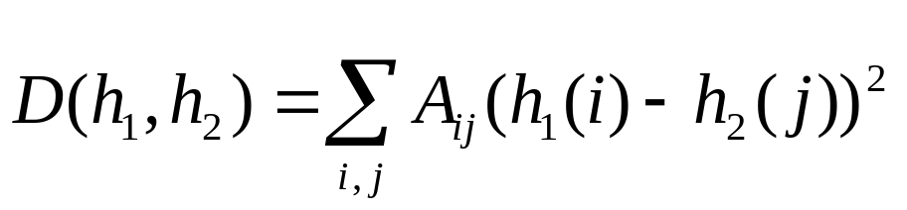
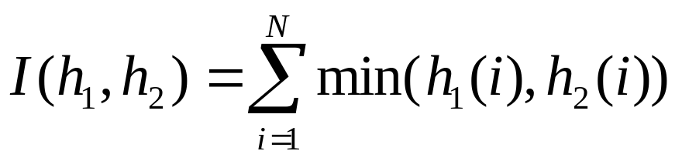
Functions for comparing histograms
L1 distance:
χ² distance:
Quadratic distance (cross-bin distance):
Histogram intersection (similarity function):

Slide 10
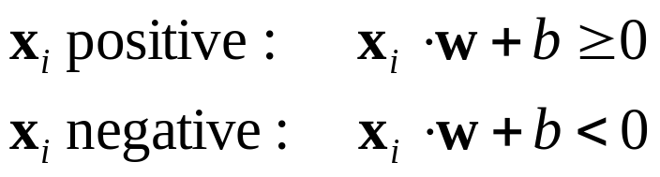
Linear classifiers
Find linear function (hyperplane) to separate positive and negative examples
Which hyperplane
is best?

Slide 11
Support vector machines
Find hyperplane that maximizes the margin between the positive and negative examples
C. Burges, A Tutorial on Support Vector Machines for Pattern Recognition, Data Mining and Knowledge Discovery, 1998

Slide 12
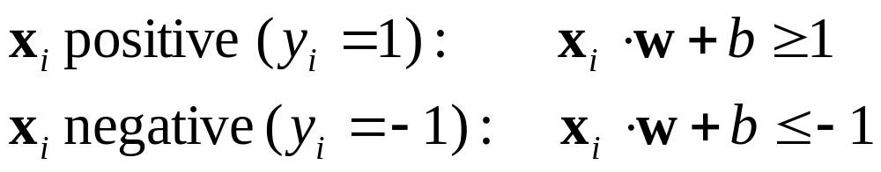

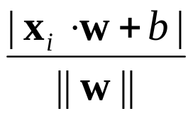
Support vector machines
Find hyperplane that maximizes the margin between the positive and negative examples
For support vectors,
Distance between point and hyperplane:
Therefore, the margin is 2 / ||w||
Support vectors
Margin
C. Burges, A Tutorial on Support Vector Machines for Pattern Recognition, Data Mining and Knowledge Discovery, 1998

Slide 13
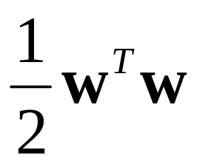
Finding the maximum margin hyperplane
Maximize margin 2/||w||
Correctly classify all training data:
Quadratic optimization problem:
Minimize
Subject to y_{i}(w·x_{i}+b) ≥ 1
C. Burges, A Tutorial on Support Vector Machines for Pattern Recognition, Data Mining and Knowledge Discovery, 1998

Slide 14
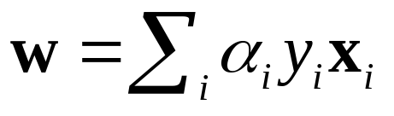
Finding the maximum margin hyperplane
Solution:
learned
weight
Support
vector
C. Burges, A Tutorial on Support Vector Machines for Pattern Recognition, Data Mining and Knowledge Discovery, 1998

Slide 15
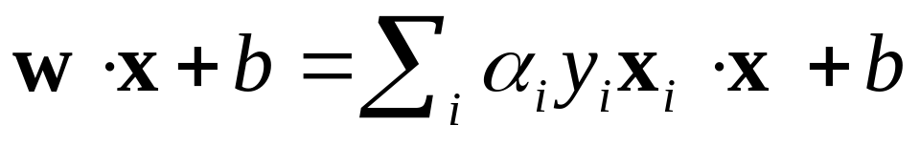
Finding the maximum margin hyperplane
Solution:
b = y_{i} – w·x_{i} for any support vector
Classification function (decision boundary):
Notice that it relies on an inner product between the test point x and the support vectors x_{i}
Solving the optimization problem also involves computing the inner products x_{i} · x_{j} between all pairs of training points
C. Burges, A Tutorial on Support Vector Machines for Pattern Recognition, Data Mining and Knowledge Discovery, 1998

Slide 16
Nonlinear SVMs
Datasets that are linearly separable work out great:
But what if the dataset is just too hard?
We can map it to a higher-dimensional space:
0
x
0
x
x²
0
x
Slide credit: Andrew Moore

Slide 17
Nonlinear SVMs
General idea: the original input space can always be mapped to some higher-dimensional feature space where the training set is separable:
Φ: x → φ(x)
Slide credit: Andrew Moore

Slide 18
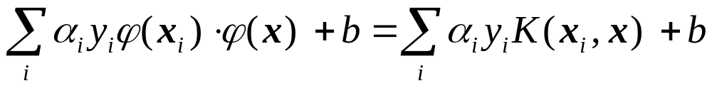
Nonlinear SVMs
The kernel trick: instead of explicitly computing the lifting transformation φ(x), define a kernel function K such that
K(x_{i} , x_{j}) = φ(x_{i} ) · φ(x_{j})
(to be valid, the kernel function must satisfy Mercer’s condition)
This gives a nonlinear decision boundary in the original feature space:
C. Burges, A Tutorial on Support Vector Machines for Pattern Recognition, Data Mining and Knowledge Discovery, 1998

Slide 19
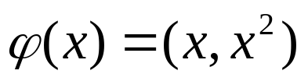
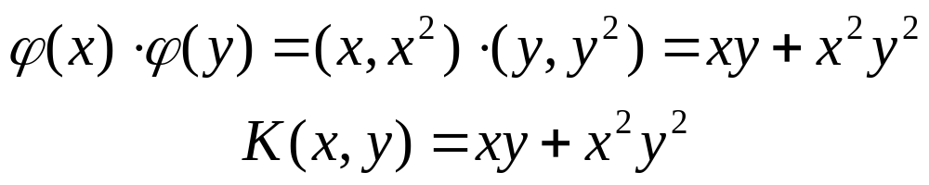
Nonlinear kernel: Example
Consider the mapping
x²

Slide 20
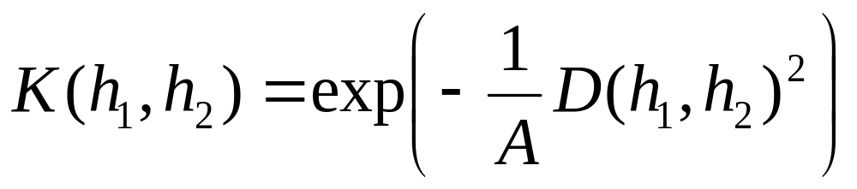
Kernels for bags of features
Histogram intersection kernel:
Generalized Gaussian kernel:
D can be L1 distance, Euclidean distance,
χ² distance, etc.
J. Zhang, M. Marszalek, S. Lazebnik, and C. Schmid, Local Features and Kernels for Classifcation of Texture and Object Categories: A Comprehensive Study, IJCV 2007

Slide 21
Summary: SVMs for image classification
Pick an image representation (in our case, bag of features)
Pick a kernel function for that representation
Compute the matrix of kernel values between every pair of training examples
Feed the kernel matrix into your favorite SVM solver to obtain support vectors and weights
At test time: compute kernel values for your test example and each support vector, and combine them with the learned weights to get the value of the decision function

Slide 22
What about multi-class SVMs?
Unfortunately, there is no “definitive” multi-class SVM formulation
In practice, we have to obtain a multi-class SVM by combining multiple two-class SVMs
One vs. others
  Traning: learn an SVM for each class vs. the others
  Testing: apply each SVM to test example and assign to it the class of the SVM that returns the highest decision value
One vs. one
  Training: learn an SVM for each pair of classes
  Testing: each learned SVM “votes” for a class to assign to the test example

Slide 23
SVMs: Pros and cons
Pros
  Many publicly available SVM packages:
  http://www.kernel-machines.org/software
  Kernel-based framework is very powerful, flexible
  SVMs work very well in practice, even with very small training sample sizes
Cons
  No “direct” multi-class SVM, must combine two-class SVMs
  Computation, memory
    During training time, must compute matrix of kernel values for every pair of examples
    Learning can take a very long time for large-scale problems

Slide 24
Summary: Classifiers
Nearest-neighbor and k-nearest-neighbor classifiers
  L1 distance, χ² distance, quadratic distance, histogram intersection
Support vector machines
  Linear classifiers
  Margin maximization
  The kernel trick
  Kernel functions: histogram intersection, generalized Gaussian, pyramid match
  Multi-class
Of course, there are many other classifiers out there
  Neural networks, boosting, decision trees, …

Slide 25
Lecture IV: Part II
Semantic and Attribute Features
Slides adapted from Feris.

Slide 26




Semantic Features
  Use the scores of semantic classifiers as high-level features
Input Image
Off-the-shelf
Classifiers
…
Sky Classifier
Sand Classifier
Water Classifier
Score
Score
Score
Compact / powerful
descriptor with semantic
meaning (allows
“explaining” the decision)
Semantic Features
Beach Classifier

Slide 27
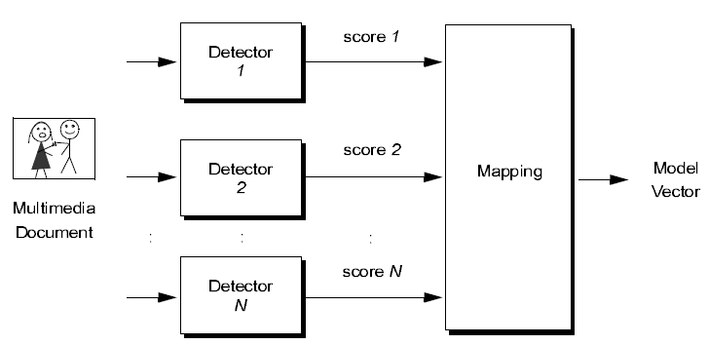
Frame level semantic features (1)
Early IBM work from multimedia community
  [Smith et al., ICME2003]
Concatenation/
Dimensionality Reduction

Slide 28
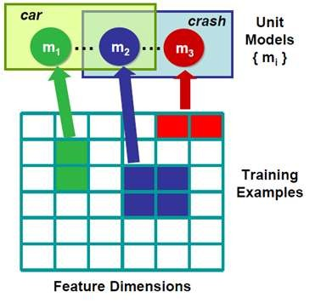
Frame level semantic features (2)
IMARS: IBM Multimedia Analysis and Retrieval System
Discriminative semantic basis
[Yan et al, KDD 2007]
Ensemble Learning
Rapid event modeling,
e.g., “accident with high-
speed skidding”

Slide 29
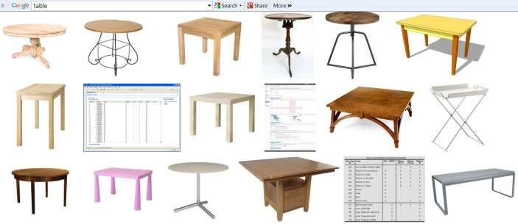
Frame level Semantic features (3)
ClASSME: descriptor is formed by concatenating the outputs of weakly trained classifiers with noisy labels
[Torresani et al, ECCV2010]
Images used to train the “table” classeme (from Google image search)
Noisy
Labels

Slide 30
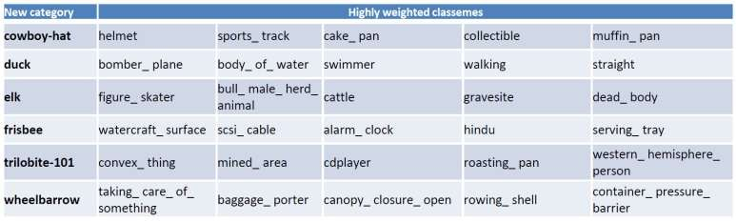

Frame level semantic features (3)
CLASSMES
Compact and Efficient Descriptor, useful for large-scale classification
Features are not really semantic!

Slide 31
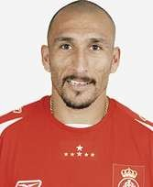
Semantic attributes
Naming
Describing
?
Bald
Beard
Red Shirt
Modifiers rather than (or in addition to) nouns
Semantic properties that are shared among objects
Attributes are category independent and trasferrable

Slide 32
People search in surveillance videos
Traditional approaches: face recognition (naming)
  Confronted by lighting, pose, and low SNR in surveillance
Attribute based people search (describing)
  Semantic attributes based search
  Example:
    Show me all bald people at the 42nd street station last month with dark skin, wearing sunglasses, wearing a red jacket

Slide 33
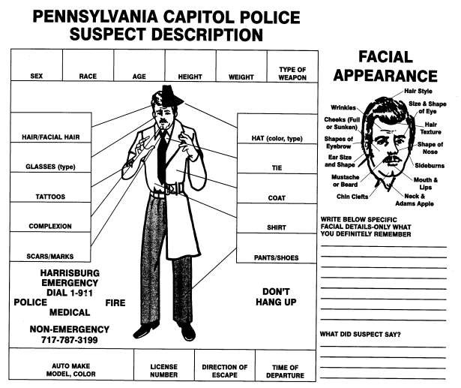
People search in surveillance videos

Slide 34
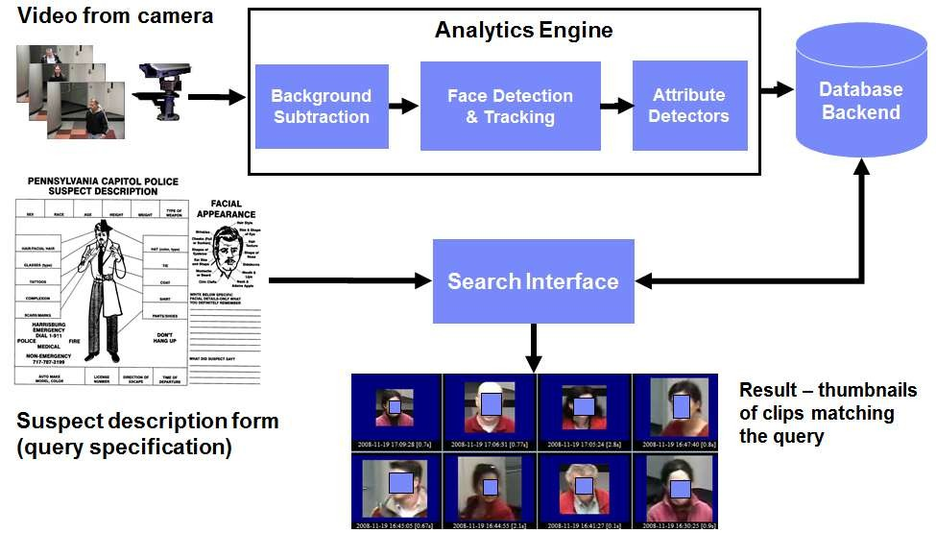
People search in surveillance videos

Slide 35
People search in surveillance videos
People Search based on textual descriptions - It does not require
training images for the target suspect.
Robustness: attribute detectors are trained using lots of training
images covering different lighting conditions, pose variation, etc.
Works well in low-resolution imagery (typical in video surveillance
scenarios)

Slide 36
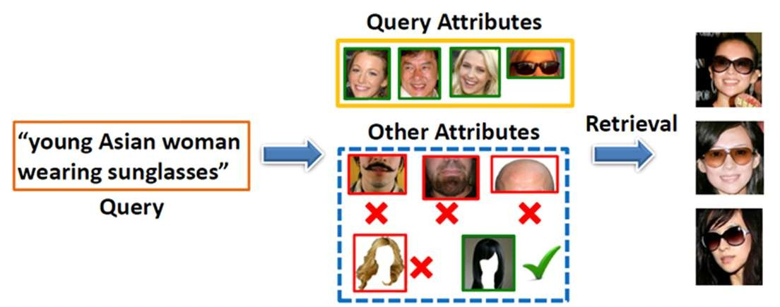
People search in surveillance videos
Modeling attribute correlations
[Siddiquie et al., “Image Ranking and Retrieval Based on Multi-Attribute Queries”, CVPR 2011]

Slide 37
Attribute-Based Classification

Slide 38
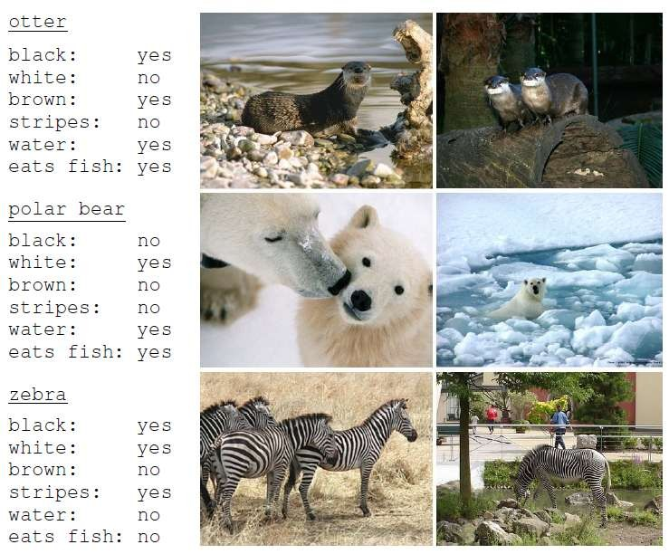
Attribute-based classification
Recognition of Unseen Classes (Zero-Shot Learning)
[Lampert et al., Learning To Detect Unseen Object Classes by Between-Class Attribute Transfer, CVPR 2009]
(1). Train semantic attribute classifiers
(2). Obtain a classifier for an unseen object (no training samples) by just specifying which attributes it has

Slide 39
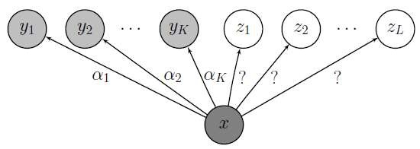
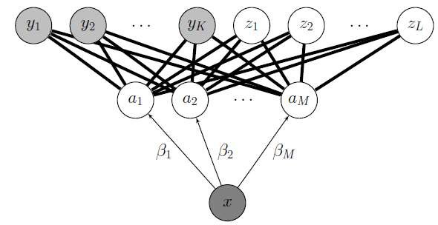
Attribute-based classification
Unseen categories
Flat multi-class classification
Unseen categories
Semantic Attribute
Classifiers
Attribute-based
classification

Slide 40
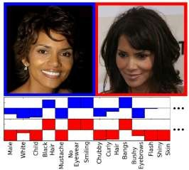
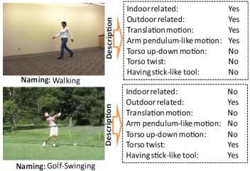
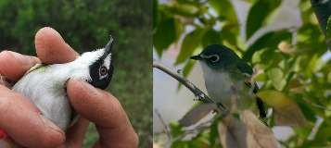
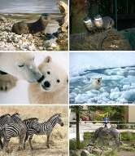
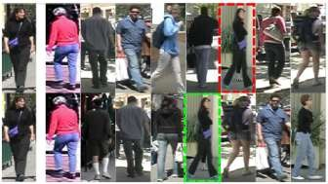
Attribute-based classification
Action recognition [Liu al, CVPR2011]
Face verification [Kumar et al, ICCV 2009]
Animal Recognition
[Lampert et al, CVPR 2009]
Bird Categorization [Farrell et al, ICCV 2011]
Person Re-identification
[Layne et al, BMVC 2012]
Many more! Significant
growth in the past few years

Slide 41
Attribute-based classification
Note: Several recent methods use the term “attributes” to refer to non-semantic model outputs
In this case attributes are just mid-level features, like PCA, hidden layers in neural nets, … (non-interpretable splits)

Slide 42
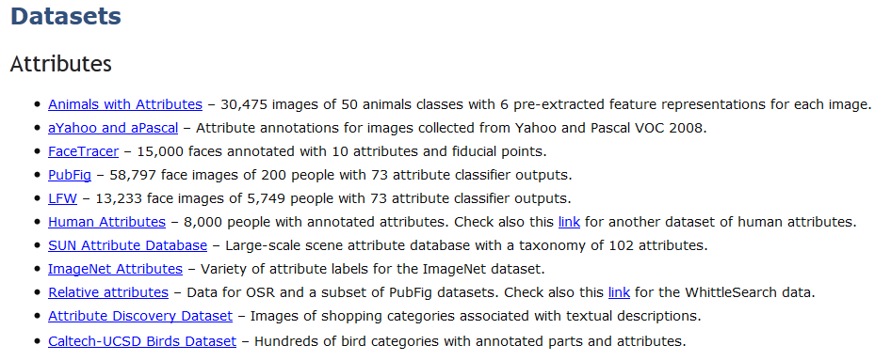
Attribute-based classification
http://rogerioferis.com/VisualRecognitionAndSearch/Resources.html

Slide 43
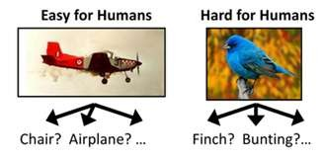
Attributes for Fine-Grained
Categorization

Slide 44
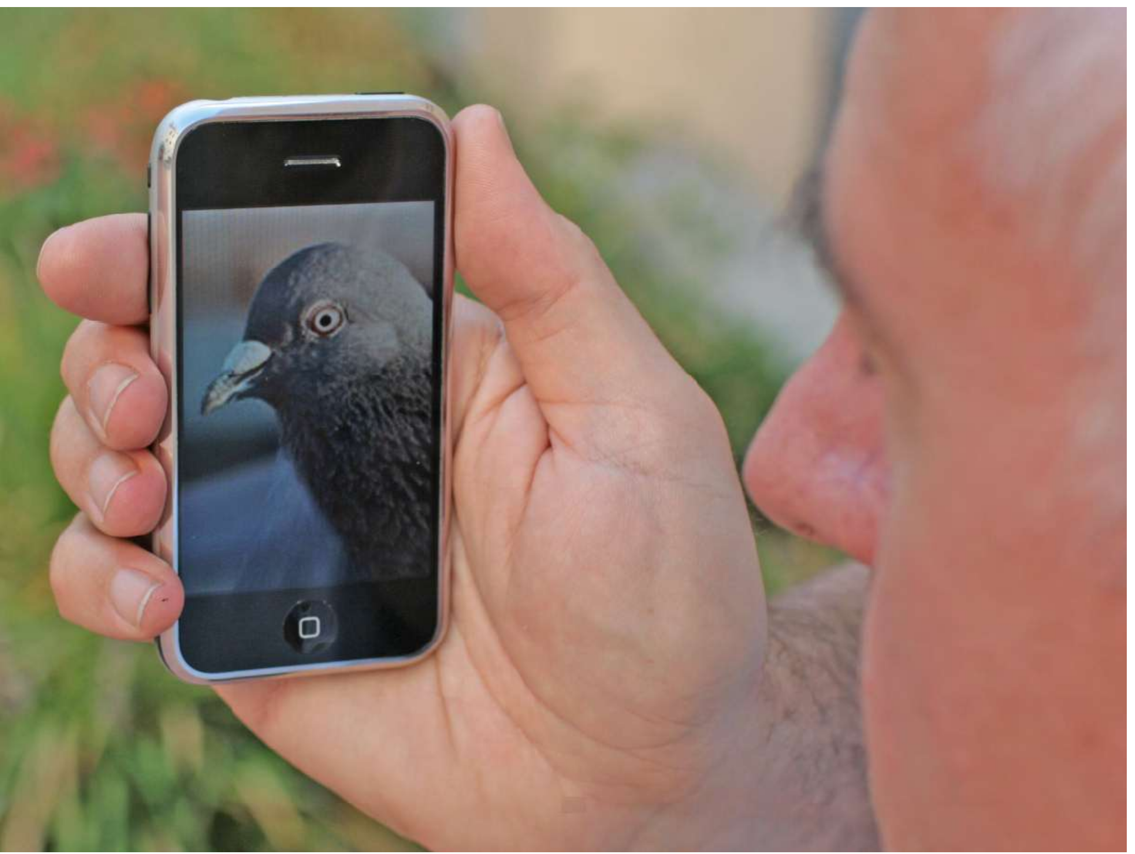
Fine-Grained Categorization
Visual Recognition And Search Columbia University, Spring 2013

Slide 45
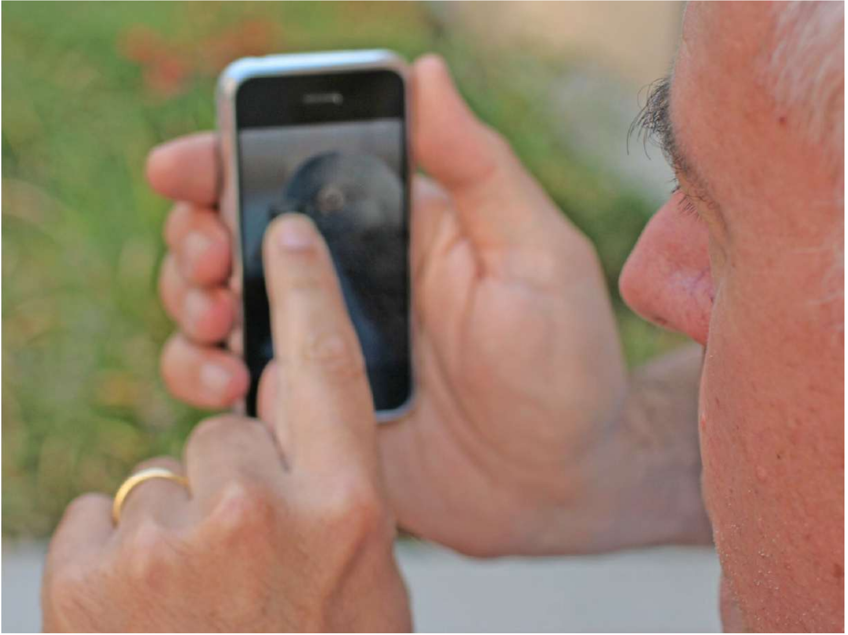
Fine-Grained Categorization
Visual Recognition And Search Columbia University, Spring 2013

Slide 46
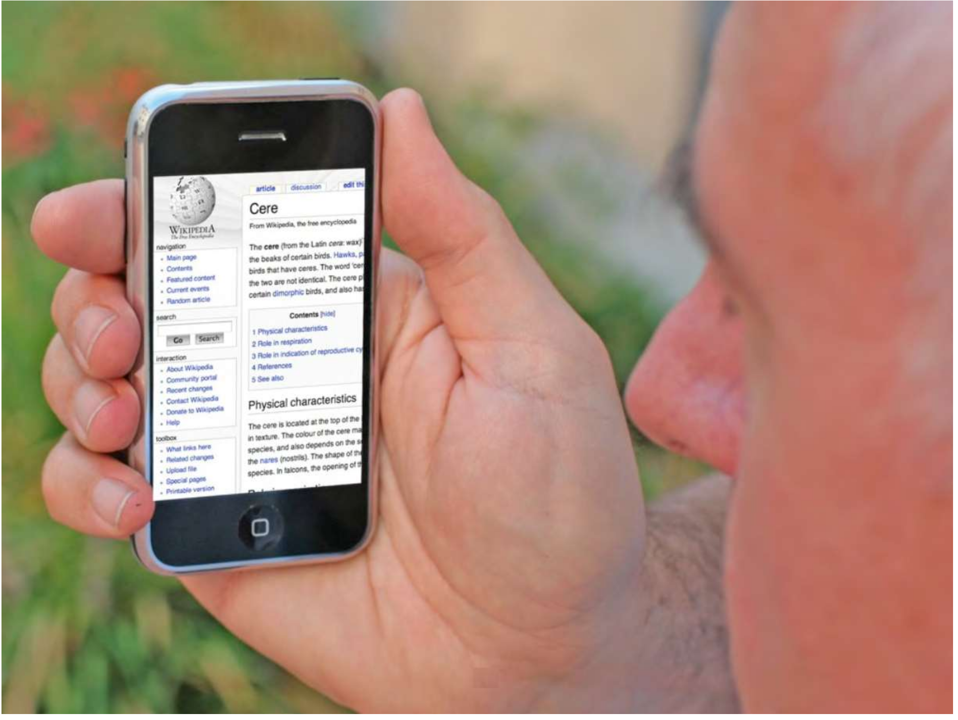
Fine-Grained Categorization
Visual Recognition And Search Columbia University, Spring 2013

Slide 47
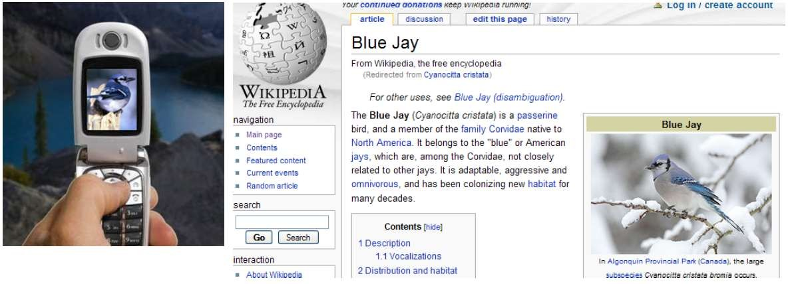
Fine-grained categorization
Visipedia (http://http://visipedia.org /)
❑ Machines collaborating with humans to organize visual knowledge, connecting text to images, images to text, and images to images
❑ Easy annotation interface for experts (powered by computer vision)
Visual Query: Fine-grained Bird Categorization
Picture credit: Serge Belongie

Slide 48

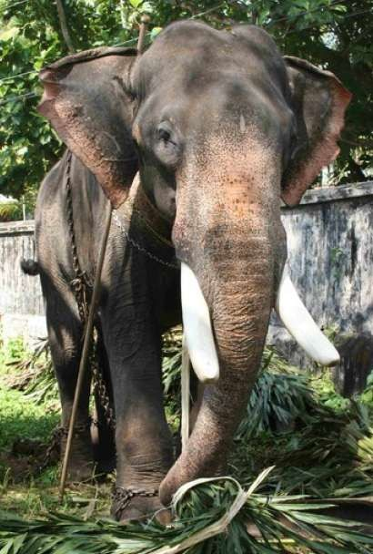







Fine-grained categorization
African
Is it an African or Indian Elephant?
Indian
Example-based Fine-Grained Categorization is Hard!!
Slide Credit: Christoph Lampert

Slide 49
Fine-grained categorization
African
Is it an African or Indian Elephant?
Indian
Larger Ears
Smaller Ears
Visual distinction of subordinate categories may be quite subtle, usually based on Attributes

Slide 50
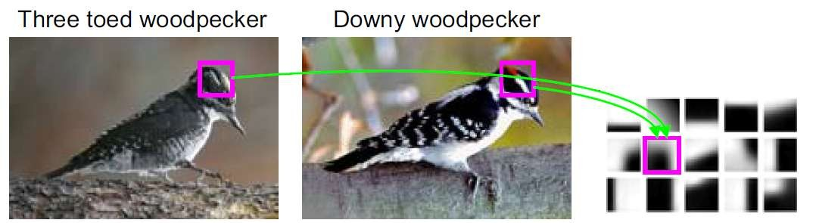
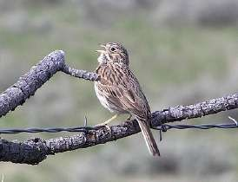
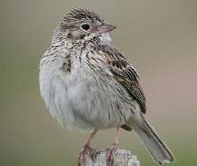
Fine-grained categorization
❑ Standard classification methods may not be suitable because the variation between classes is small …
[B. Yao, CVPR 2012]
Codebook
❑ … and intra-class variation is still high.

Slide 51

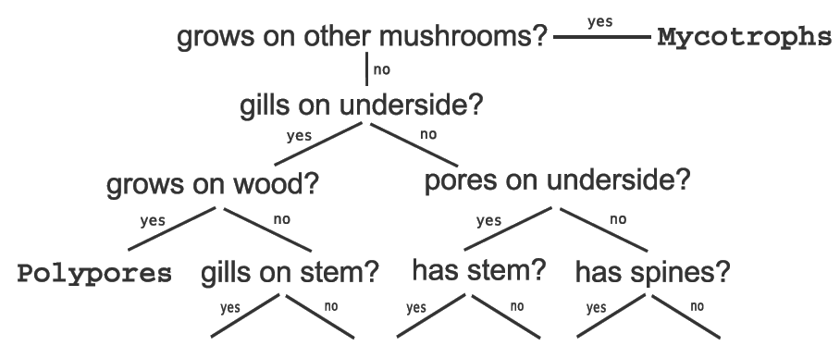
Fine-grained categorization
❑ Humans rely on field guides!
❑ Field guides usually refer to parts and attributes of the object
Slide Credit: Pietro Perona

Slide 52

Fine-grained categorization
[Branson et al, Visual Recognition with Humans in the Loop, ECCV 2010]

Slide 53

Fine-grained categorization
[Branson et al, Visual Recognition with Humans in the Loop, ECCV 2010]
❑ Computer vision reduces the amount of human-interaction (minimizes the dnumber of questions)

Slide 54




Fine-grained categorization
[Wah et al, Multiclass Recognition and Part Localization with Humans in
the Loop, ICCV 2011]
❑ Localized part and attribute detectors.
❑ Questions include asking the user to localize parts.

Slide 55

Fine-grained categorization
❑ http://www.vision.caltech.edu/visipedia/CUB-200-2011.html

Slide 56

Fine-grained categorization
Video Demo:
http://www.youtube.com/watch?v=_ReKVqnDXzA

Slide 57



Like a normal field guide…
▪
▪
that
and
you can search and sort
with
visual recognition
See N. Kumar et al,
"Leafsnap: A Computer Vision System for Automatic Plant Species Identification, ECCV 2012

Slide 58



▪
Nearly 1 million downloads
▪
▪
1.7
▪
▪
40k new users per month
100k active users
million images taken
100k new images/month
100k users with > 5 images
▪
▪
▪
Users from all over the world
Botanists, educators, kids, hobbyists,
photographers, …
Slide Credit: Neeraj Kumar

Slide 59




Fine-grained categorization
Check the fine-grained visual categorization workshop:
http://www.fgvc.org/

Slide 60
Relative Attributes

Slide 61






Relative attributes
[Parikh & Grauman, Relative Attributes, ICCV 2011]
Smiling
???
Not
smiling
Natural
???
Not natural
Slide credit: Parikh &Grauman

Slide 62











Learning Relative attributes
For each attribute
e.g.,
“openness”
Supervision
consists
of:
Ordered pairs
Similar pairs
Slide credit: Parikh &Grauman

Slide 63



Learning Relative attributes
Learn a ranking function
Image features
Learned parameters
that
best
satisfies
the
constraints:
Slide credit: Parikh &Grauman

Slide 64






Learning Relative attributes
Max-margin
learning
to
rank
formulation
2
1
4
3
6
5
Based
on [Joachims 2002]
Rank Margin
Image
Relative Attribute Score
Slide credit: Parikh &Grauman

Slide 65


Relative Zero-shot learning
❑
Each image is converted into a vector of relative attribute scores indicating the strength of each attribute
❑
A Gaussian distribution for each category is built in the relative attribute space. The distribution of unseen categories is estimated based on the
specified constraints and the distributions of seen categories
❑
Max-likelihood is then used for classification
Blue: Seen class
Green: Unseen class

Slide 66

Relative image description
Slide credit: Parikh &Grauman

Slide 67

Whittle search
Slide credit: Kristen Grauman

Slide 68

Summary
Semantic attribute classifiers can be useful for:
Describing images of unknown objects [Farhadi et al, CVPR 2009]
Recognizing unseen classes [Lampert et al, CVPR 2009]
Reducing dataset bias (trained across classes)
Effective object search in surveillance videos [Vaquero et al, WACV 2009]
Compact descriptors / Efficient image retrieval [Douze et al, CVPR 2011]
Fine-grained object categorization [Wah et al, ICCV 2011]
Face verification [Kumar et al, 2009], Action recognition [Liu et al, CVPR
2011], Person re-identification [Layne et al, BMVC 2012] and other
classification tasks.
Other applications, such as sentence generation from images [Kulkarni et al, CVPR 2011], image aesthetics prediction [Dhar et al CVPR 2011], …

