Slide 1
CS598:Visual information Retrieval
Lecture IV: Image Representation:
Feature Coding and Pooling

Slide 2
Recap of Lecture III
Blob detection
  Brief of Gaussian filter
  Scale selection
  Lapacian of Gaussian (LoG) detector
  Difference of Gaussian (DoG) detector
  Affine co-variant region
Learning local image descriptors (optional reading)

Slide 3
Outline
Histogram of local features
Bag of words model
Soft quantization and sparse coding
Supervector with Gaussian mixture model

Slide 4
Lecture IV: Part I

Slide 5
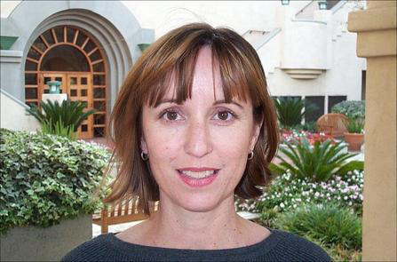
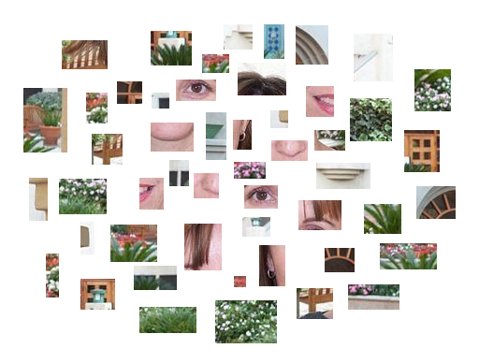
Bag-of-features models

Slide 6

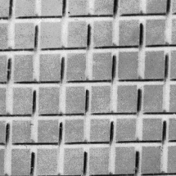
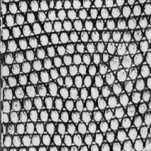



Origin 1: Texture recognition
Texture is characterized by the repetition of basic elements or textons
For stochastic textures, it is the identity of the textons, not their spatial arrangement, that matters
Julesz, 1981; Cula & Dana, 2001; Leung & Malik 2001; Mori, Belongie & Malik, 2001; Schmid 2001; Varma & Zisserman, 2002, 2003; Lazebnik, Schmid & Ponce, 2003

Slide 7




Origin 1: Texture recognition
histogram
Universal texton dictionary
Julesz, 1981; Cula & Dana, 2001; Leung & Malik 2001; Mori, Belongie & Malik, 2001; Schmid 2001; Varma & Zisserman, 2002, 2003; Lazebnik, Schmid & Ponce, 2003

Slide 8
Origin 2: Bag-of-words models
Orderless document representation: frequencies of words from a dictionary Salton & McGill (1983)

Slide 9

Origin 2: Bag-of-words models
Orderless document representation: frequencies of words from a dictionary Salton & McGill (1983)
US Presidential Speeches Tag Cloud
http://chir.ag/phernalia/preztags/

Slide 10
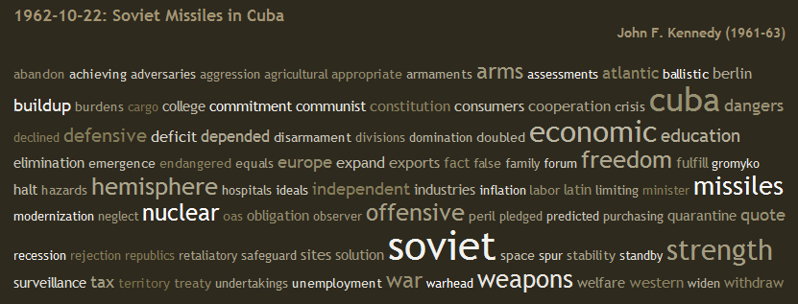
Origin 2: Bag-of-words models
Orderless document representation: frequencies of words from a dictionary Salton & McGill (1983)
US Presidential Speeches Tag Cloud
http://chir.ag/phernalia/preztags/

Slide 11
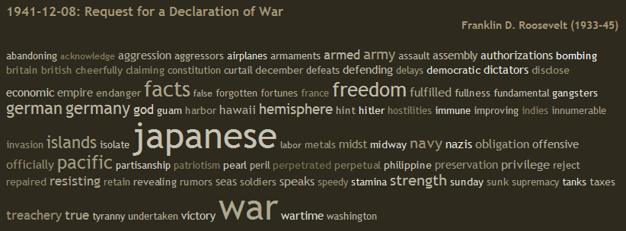
Origin 2: Bag-of-words models
Orderless document representation: frequencies of words from a dictionary Salton & McGill (1983)
US Presidential Speeches Tag Cloud
http://chir.ag/phernalia/preztags/

Slide 12
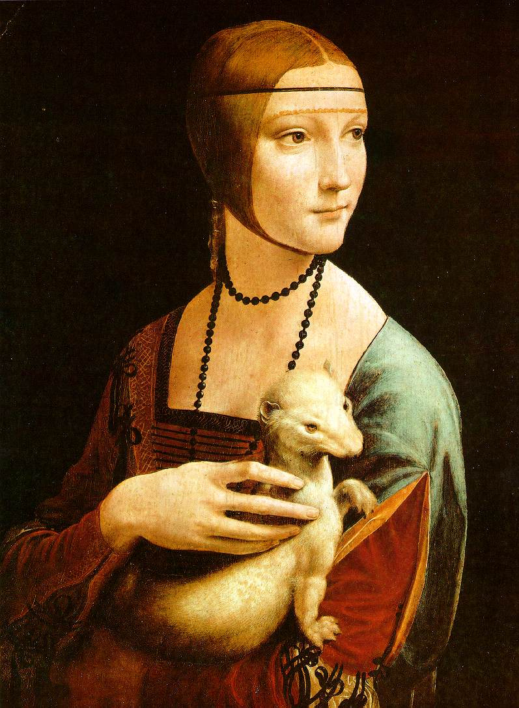
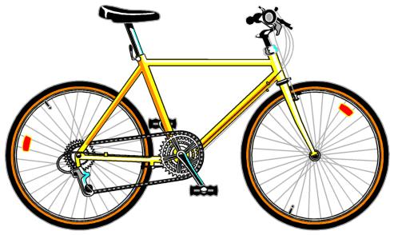
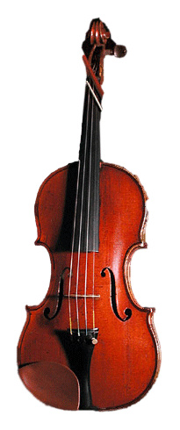
Bag-of-features steps
Extract features
Learn “visual vocabulary”
Quantize features using visual vocabulary
Represent images by frequencies of “visual words”

Slide 13
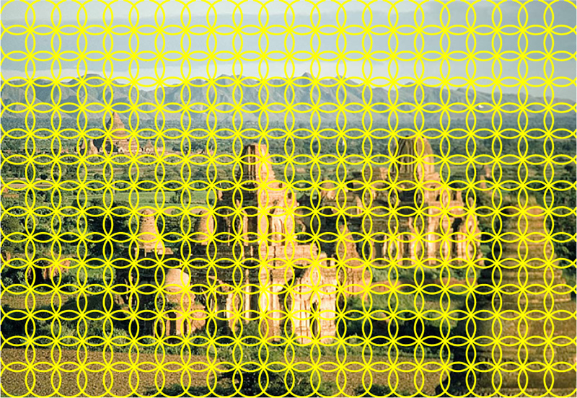
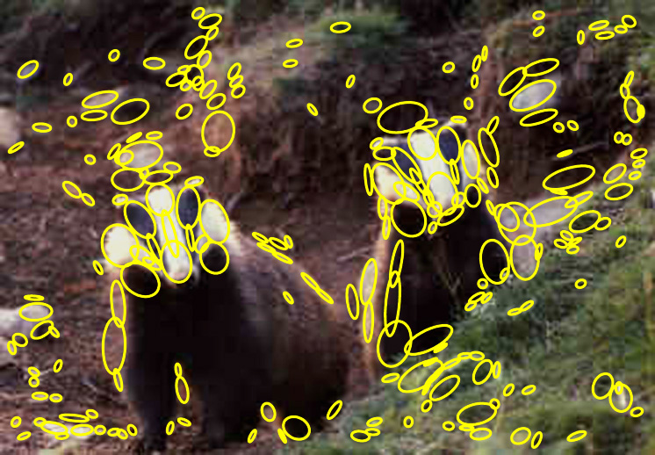
1. Feature extraction
Regular grid or interest regions

Slide 14
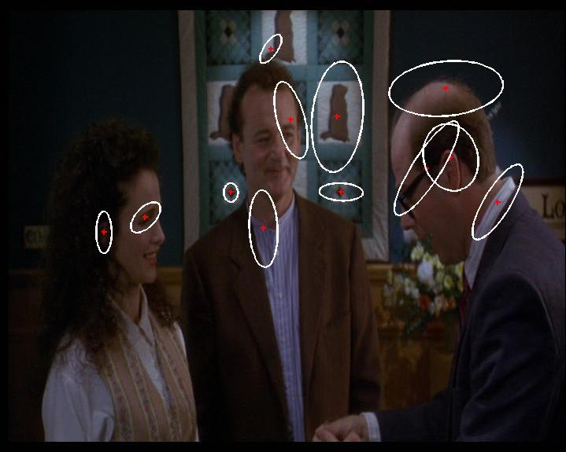
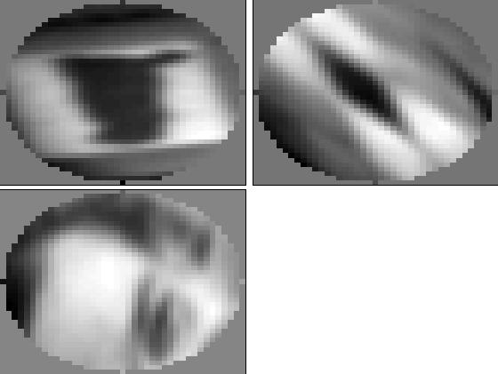
1. Feature extraction
Compute descriptor
Normalize patch
Detect patches
Slide credit: Josef Sivic

Slide 15
1. Feature extraction
…
Slide credit: Josef Sivic

Slide 16
2. Learning the visual vocabulary
…
Slide credit: Josef Sivic

Slide 17
2. Learning the visual vocabulary
…
Clustering
Slide credit: Josef Sivic

Slide 18
2. Learning the visual vocabulary
Visual vocabulary
…
Clustering
Slide credit: Josef Sivic

Slide 19
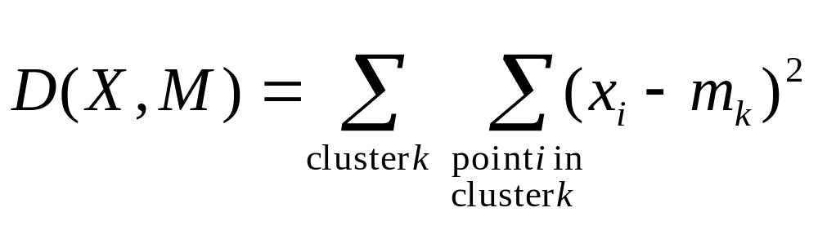
K-means clustering
Want to minimize sum of squared Euclidean distances between points x_{i} and their nearest cluster centers m_{k}
Algorithm:
Randomly initialize K cluster centers
Iterate until convergence:
  Assign each data point to the nearest center
  Recompute each cluster center as the mean of all points assigned to it

Slide 20
Clustering and vector quantization
Clustering is a common method for learning a visual vocabulary or codebook
  Unsupervised learning process
  Each cluster center produced by k-means becomes a codevector
  Codebook can be learned on separate training set
  Provided the training set is sufficiently representative, the codebook will be “universal”
The codebook is used for quantizing features
  A vector quantizer takes a feature vector and maps it to the index of the nearest codevector in a codebook
  Codebook = visual vocabulary
  Codevector = visual word

Slide 21
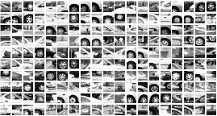
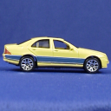
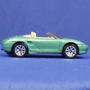

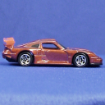
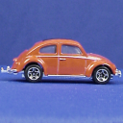
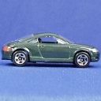
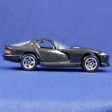
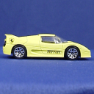
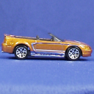
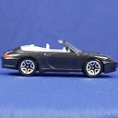






Example codebook
…
Appearance codebook
Source: B. Leibe

Slide 22
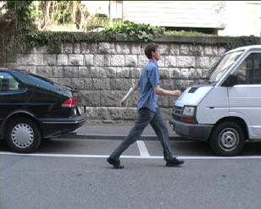
Another codebook
…
…
…
…
…
Appearance codebook
Source: B. Leibe

Slide 23
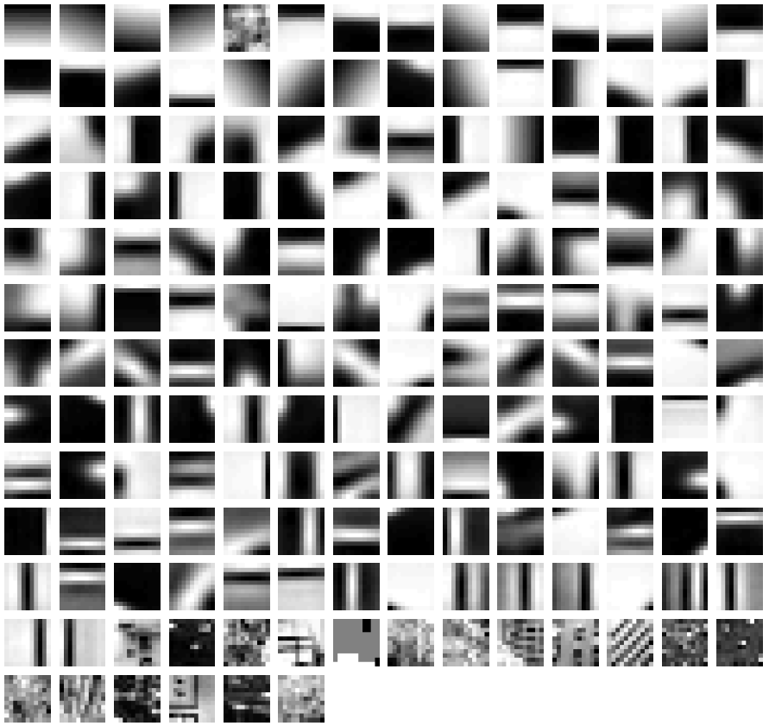
Yet another codebook
Fei-Fei et al. 2005

Slide 24
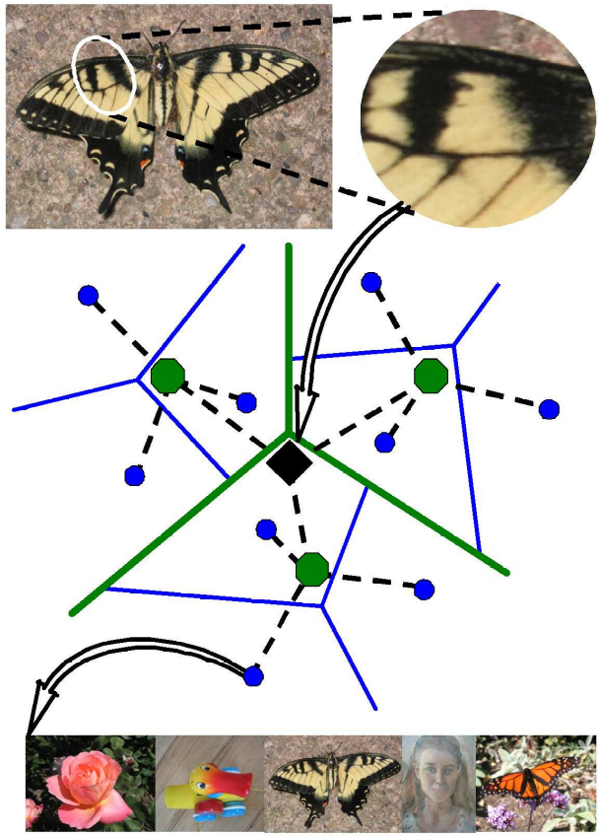
Visual vocabularies: Issues
How to choose vocabulary size?
  Too small: visual words not representative of all patches
  Too large: quantization artifacts, overfitting
Computational efficiency
  Vocabulary trees
  (Nister & Stewenius, 2006)

Slide 25
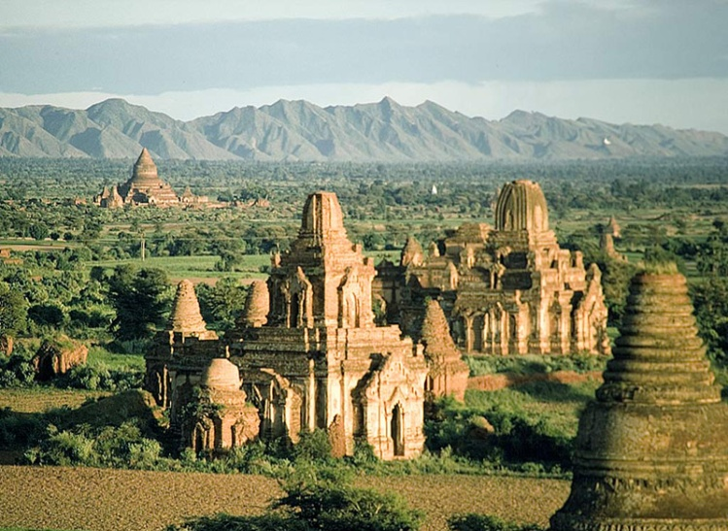
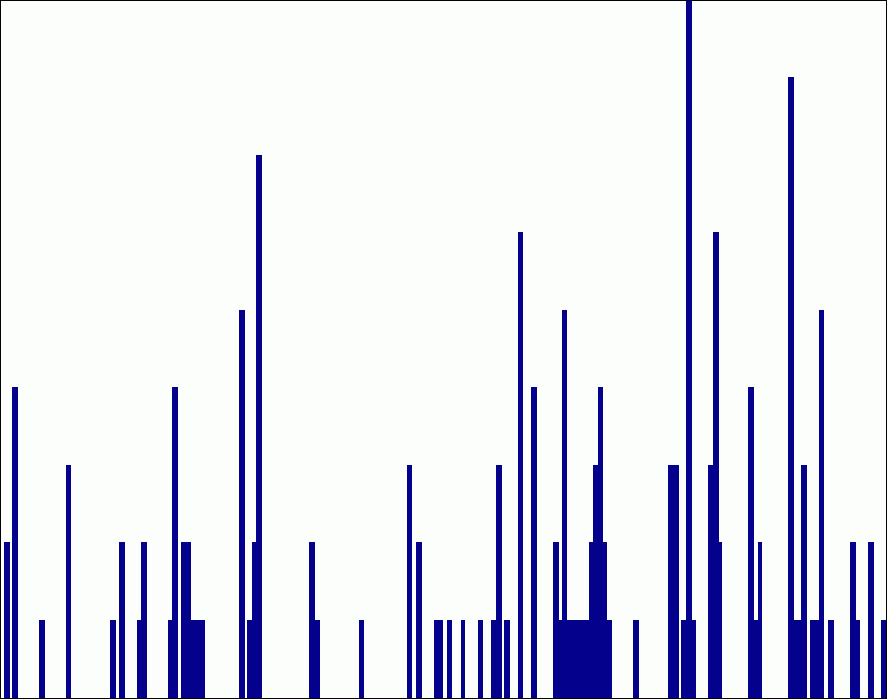
Spatial pyramid representation
Extension of a bag of features
Locally orderless representation at several levels of resolution
level 0
Lazebnik, Schmid & Ponce (CVPR 2006)

Slide 26


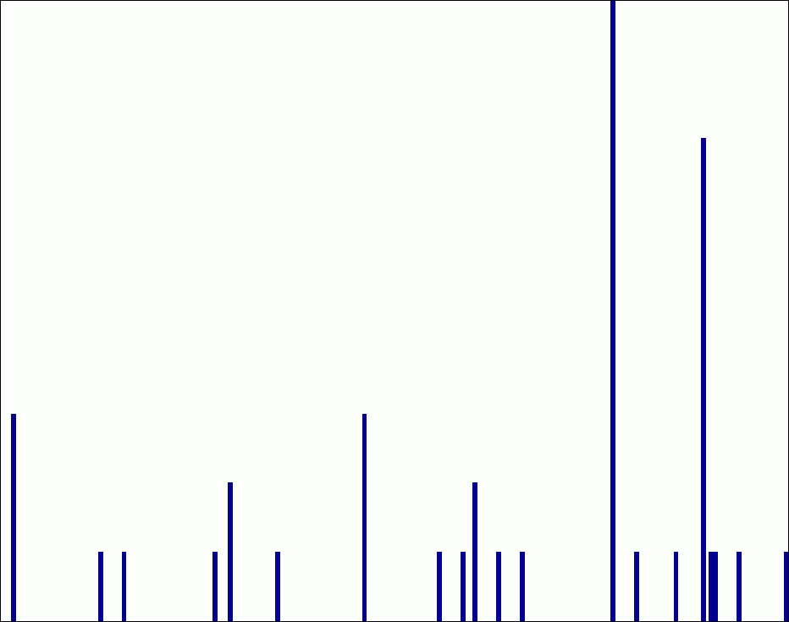
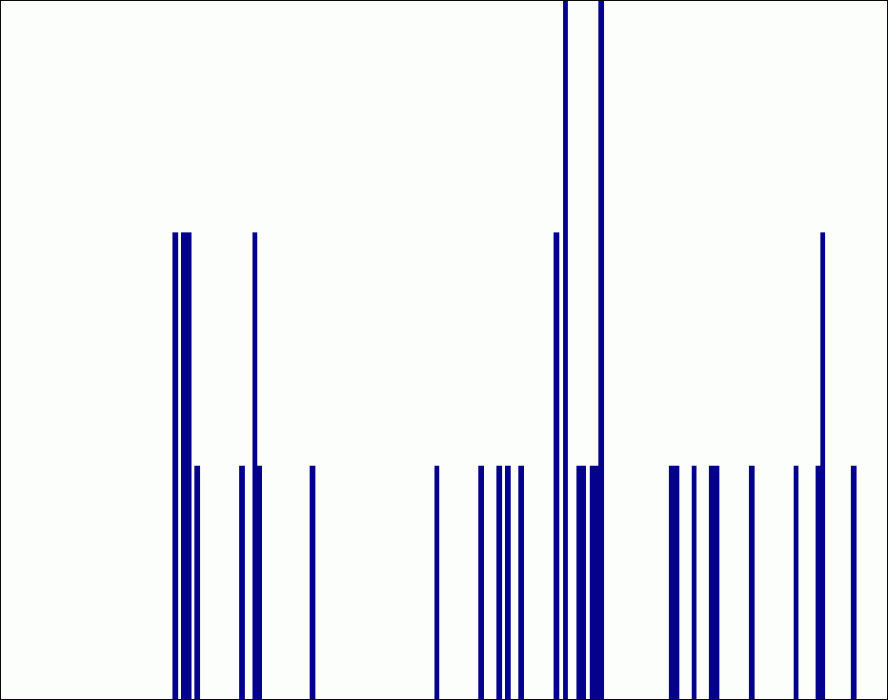
Spatial pyramid representation
Extension of a bag of features
Locally orderless representation at several levels of resolution
level 0
level 1
Lazebnik, Schmid & Ponce (CVPR 2006)

Slide 27
















Spatial pyramid representation
Extension of a bag of features
Locally orderless representation at several levels of resolution
level 0
level 1
level 2
Lazebnik, Schmid & Ponce (CVPR 2006)

Slide 28
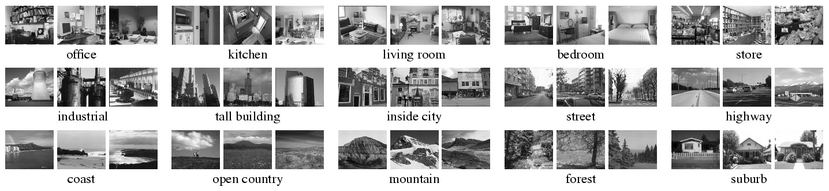
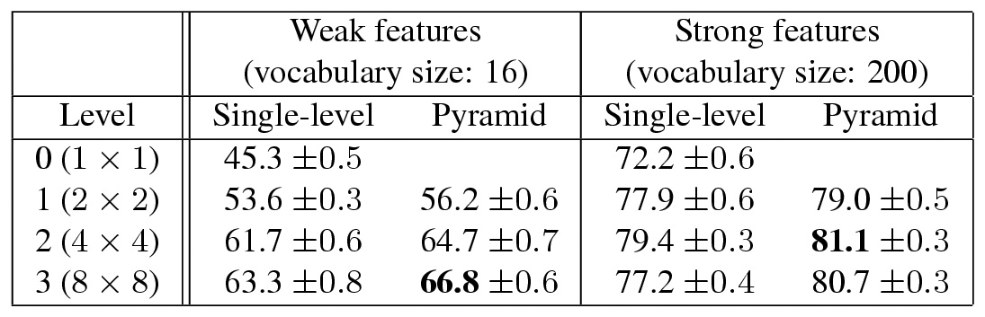
Scene category dataset
Multi-class classification results
(100 training images per class)

Slide 29
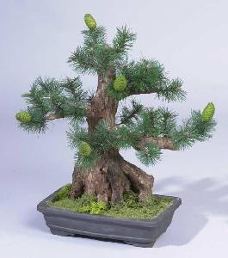
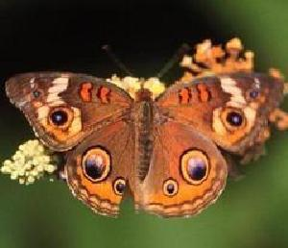
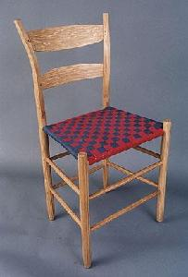
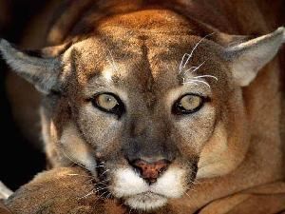

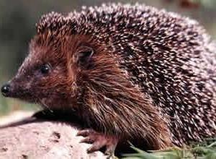
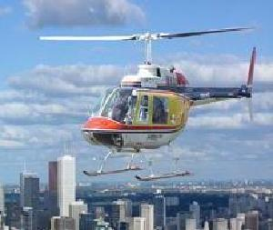
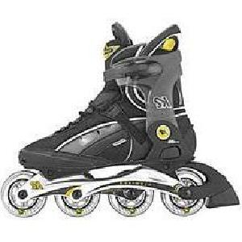
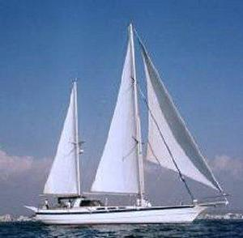

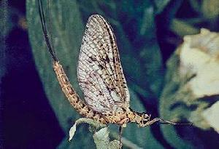
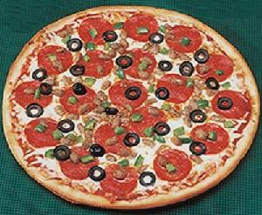
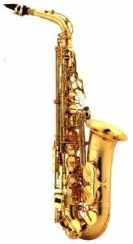
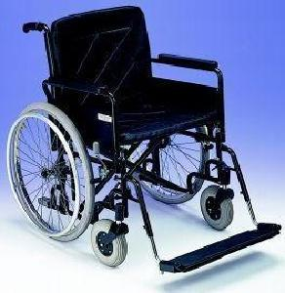
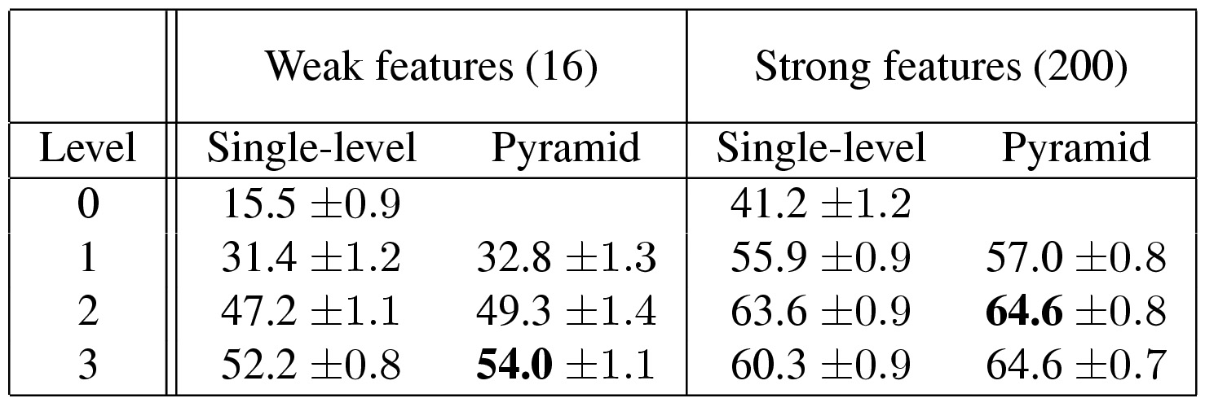
Caltech101 dataset
http://www.vision.caltech.edu/Image_Datasets/Caltech101/Caltech101.html
Multi-class classification results (30 training images per class)

Slide 30
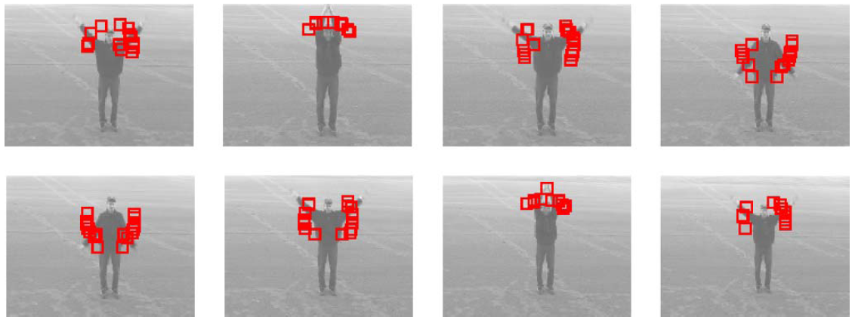
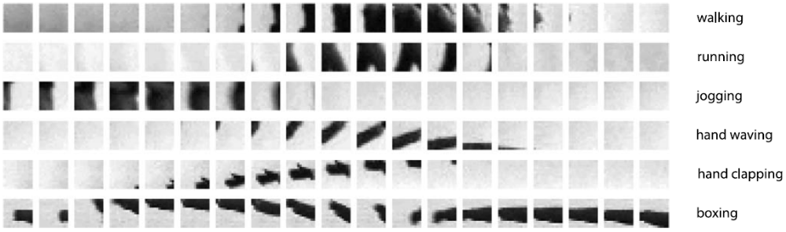
Bags of features for action recognition
Space-time interest points
Juan Carlos Niebles, Hongcheng Wang and Li Fei-Fei, Unsupervised Learning of Human Action Categories Using Spatial-Temporal Words, IJCV 2008.

Slide 31
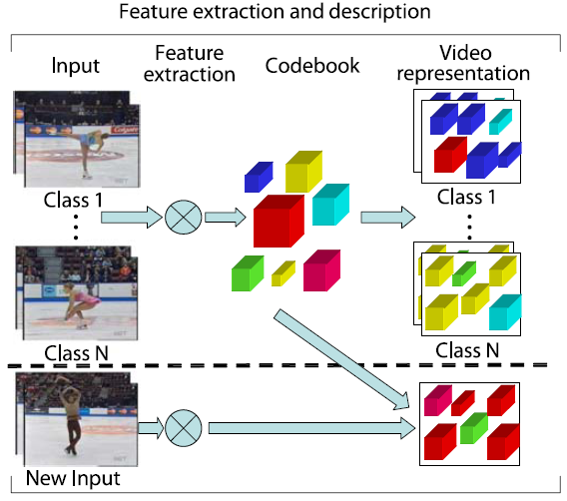
Bags of features for action recognition
Juan Carlos Niebles, Hongcheng Wang and Li Fei-Fei, Unsupervised Learning of Human Action Categories Using Spatial-Temporal Words, IJCV 2008.

Slide 32
Image classification
Given the bag-of-features representations of images from different classes, how do we learn a model for distinguishing them?

Slide 33
Lecture IV: Part II

Slide 34
Outline
Histogram of local features
Bag of words model
Soft quantization and sparse coding
Supervector with Gaussian mixture model

Slide 35
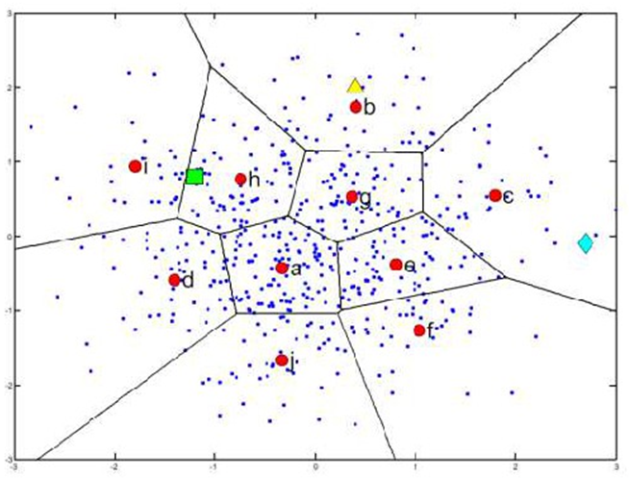

Hard quantization
$$H\left(w\right)=\frac{1}{n}\sum_{i=1}^{n}{\left\{\begin{aligned}1, if w=argmin_{v∈V}(D\left(v,r_{i}\right)) \\ 0, otherwise \end{aligned}\right.}$$
Slides credit: Cao & Feris

Slide 36


Soft quantization based on uncertainty
Quantize each local feature into multiple code-words that are closest to it by appropriately splitting its weight
$$K_{σ}\left(x\right)=\frac{1}{\sqrt{2π}σ}exp⁡(−\frac{x^{2}}{2σ^{2}})$$
$$UNC\left(w\right)=\frac{1}{n}\sum_{i=1}^{n}{\frac{K_{σ}(D\left(w,f\right))}{\sum_{j=1}^{|V|}{K_{σ}(D\left(v_{j},r_{i}\right))}}}$$
Gemert et at., Visual Word Ambiguity, PAMI 2009

Slide 37



Soft Quantization
Hard quantization
Soft quantization

Slide 38

Some experiments on soft quantization
Improvement on classification rate from soft quantization

Slide 39

Sparse coding
Hard quantization is an “extremely sparse representation
Generalizing from it, we may consider to solve
for soft quantization, but it is hard to solve
In practice, we consider solving the sparse coding as
for quantization
$min{\left\|x−Dz\right\|}_{2}^{2}$ s.t. ${\left\|z\right\|}_{0}=1$
$$min{\left\|x−Dz\right\|}_{2}^{2}+λ{\left\|z\right\|}_{0}$$
$$min{\left\|x−Dz\right\|}_{2}^{2}+λ{\left\|z\right\|}_{1}$$

Slide 40

Soft quantization and pooling
[Yang et al, 2009]:
Linear Spatial Pyramid Matching using Sparse Coding for Image Classification

Slide 41
Outline
Histogram of local features
Bag of words model
Soft quantization and sparse coding
Supervector with Gaussian mixture model

Slide 42
Quiz
What is the potential shortcoming of bag-of-feature representation based on quantization and pooling?

Slide 43

Modeling the feature distribution
The bag-of-feature histogram represents the distribution of a set of features
  The quantization steps introduces information loss!
How about modeling the distribution without quantization?
  Gaussian mixture model

Slide 44

Quiz
Given a set of features $\left\{x_{1},x_{2}, …,x_{n}\right\},$how can we fit the GMM distribution?

Slide 45


The Gaussian Distribution
Multivariate Gaussian
Define precision to be the inverse of the covariance
In 1-dimension
mean
covariance

Slide 46

Likelihood Function
Data set
Assume observed data points generated independently
Viewed as a function of the parameters, this is known as the likelihood function

Slide 47

Maximum Likelihood
Set the parameters by maximizing the likelihood function
Equivalently maximize the log likelihood

Slide 48


Maximum Likelihood Solution
Maximizing w.r.t. the mean gives the sample mean
Maximizing w.r.t covariance gives the sample covariance

Slide 49

Bias of Maximum Likelihood
Consider the expectations of the maximum likelihood estimates under the Gaussian distribution
The maximum likelihood solution systematically under-estimates the covariance
This is an example of over-fitting

Slide 50

Intuitive Explanation of Over-fitting

Slide 51


Unbiased Variance Estimate
Clearly we can remove the bias by using
since this gives
For an infinite data set the two expressions are equal

Slide 52


Gaussian Mixtures
Linear super-position of Gaussians
Normalization and positivity require
Can interpret the mixing coefficients as prior probabilities

Slide 53

Example: Mixture of 3 Gaussians

Slide 54

Contours of Probability Distribution

Slide 55

Surface Plot

Slide 56


Sampling from the Gaussian
To generate a data point:
  first pick one of the components with probability
  then draw a sample from that component
Repeat these two steps for each new data point

Slide 57

Synthetic Data Set

Slide 58
Fitting the Gaussian Mixture
We wish to invert this process – given the data set, find the corresponding parameters:
  mixing coefficients, means, and covariances
If we knew which component generated each data point, the maximum likelihood solution would involve fitting each component to the corresponding cluster
Problem: the data set is unlabelled
We shall refer to the labels as latent (= hidden) variables

Slide 59

Synthetic Data Set Without Labels

Slide 60


Posterior Probabilities
We can think of the mixing coefficients as prior probabilities for the components
For a given value of we can evaluate the corresponding posterior probabilities, called responsibilities
These are given from Bayes’ theorem by

Slide 61

Posterior Probabilities (colour coded)

Slide 62

Posterior Probability Map

Slide 63

Maximum Likelihood for the GMM
The log likelihood function takes the form
Note: sum over components appears inside the log
There is no closed form solution for maximum likelihood!

Slide 64


Over-fitting in Gaussian Mixture Models
Singularities in likelihood function when a component ‘collapses’ onto a data point:
then consider
Likelihood function gets larger as we add more components (and hence parameters) to the model
  not clear how to choose the number K of components

Slide 65
Problems and Solutions
How to maximize the log likelihood
  solved by expectation-maximization (EM) algorithm
How to avoid singularities in the likelihood function
  solved by a Bayesian treatment
How to choose number K of components
  also solved by a Bayesian treatment

Slide 66



EM Algorithm – Informal Derivation
Let us proceed by simply differentiating the log likelihood
Setting derivative with respect to equal to zero gives
giving
which is simply the weighted mean of the data

Slide 67


EM Algorithm – Informal Derivation
Similarly for the co-variances
For mixing coefficients use a Lagrange multiplier to give

Slide 68
EM Algorithm – Informal Derivation
The solutions are not closed form since they are coupled
Suggests an iterative scheme for solving them:
  Make initial guesses for the parameters
  Alternate between the following two stages:
    E-step: evaluate responsibilities
    M-step: update parameters using ML results

Slide 69


Slide 70


Slide 71


Slide 72


Slide 73


Slide 74


Slide 75

The supervector representation (1)
Given a set of features from a set of images, train a Gaussian mixture model. This is called a Universal Background Model.
Given the UBM and a set of features from a single image, adapt the UBM to the image feature set by Bayesian EM (check equations in paper below).
Origin distribution
New distribution
Zhou et al, “A novel Gaussianized vector representation for natural scene categorization”, ICPR2008

Slide 76

The supervector representation (2)
Supervector:
$[m_{1}\text{,}m_{2}$,…,$m_{K}]$
Normalized supervector:
$[{\sqrt{ω_{1}}Σ_{1}^{−1/2}m}_{1}\text{,}{\sqrt{ω_{2}}Σ_{2}^{−1/2}m}_{2}$,…,$\sqrt{ω_{K}}Σ_{K}^{−1/2}m_{K}]$
Centralized and normalized supervector
$\left[{\sqrt{ω_{1}}Σ_{1}^{−\frac{1}{2}}(m}_{1}−μ_{1}\right)\text{,}{\sqrt{ω_{2}}Σ_{2}^{−1/2}(m}_{2}−μ_{2}$),…,$\sqrt{ω_{K}}Σ_{K}^{−\frac{1}{2}}(m_{K}−−μ_{K})]$
Zhou et al, “A novel Gaussianized vector representation for natural scene categorization”, ICPR2008

