Slide 1
CS598:Visual information Retrieval
Lecture III: Image Representation:
Invariant Local Image Descriptors

Slide 2
Recap of Lecture II
Color, texture, descriptors
  Color histogram
  Color correlogram
  LBP descriptors
  Histogram of oriented gradient
  Spatial pyramid matching
Distance & Similarity measure
  L_{p} distances
  Chi-Square distances
  KL distances
  EMD distances
  Histogram intersection

Slide 3
Lecture III: Part I
Local Feature Detector

Slide 4
Outline
Blob detection
  Brief of Gaussian filter
  Scale selection
  Lapacian of Gaussian (LoG) detector
  Difference of Gaussian (DoG) detector
  Affine co-variant region

Slide 5
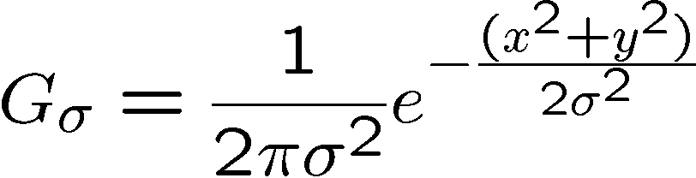
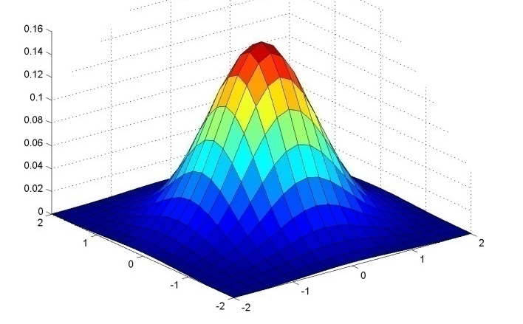
Gaussian Kernel
0.003 0.013 0.022 0.013 0.003
0.013 0.059 0.097 0.059 0.013
0.022 0.097 0.159 0.097 0.022
0.013 0.059 0.097 0.059 0.013
0.003 0.013 0.022 0.013 0.003
5 x 5, σ = 1
Constant factor at front makes volume sum to 1 (can be ignored when computing the filter values, as we should renormalize weights to sum to 1 in any case)
Source: C. Rasmussen

Slide 6
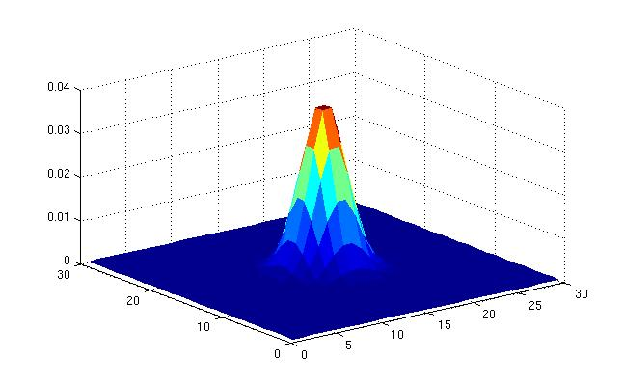
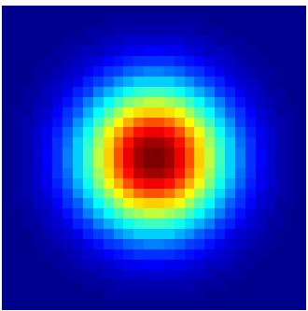
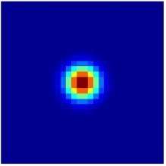
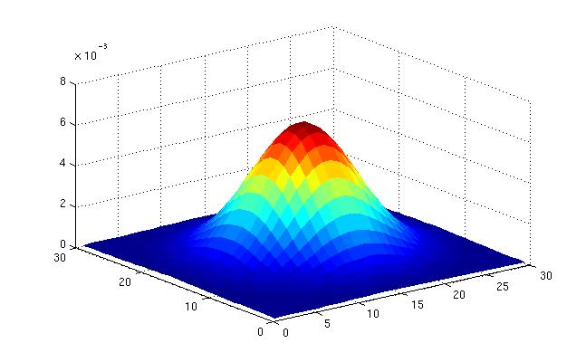
Gaussian Kernel
σ = 2 with 30 x 30 kernel
σ = 5 with 30 x 30 kernel
Standard deviation σ: determines extent of smoothing
Source: K. Grauman

Slide 7
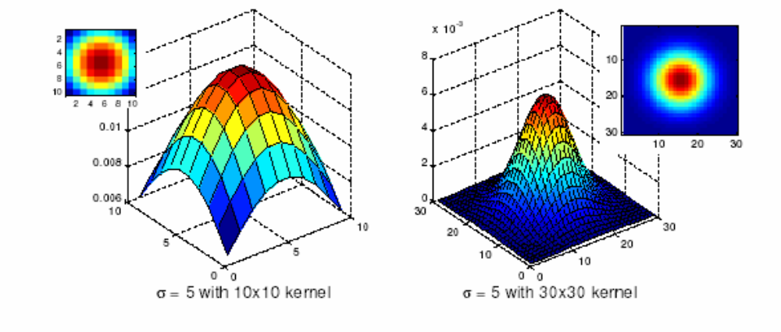
Choosing kernel width
The Gaussian function has infinite support, but discrete filters use finite kernels
Source: K. Grauman

Slide 8
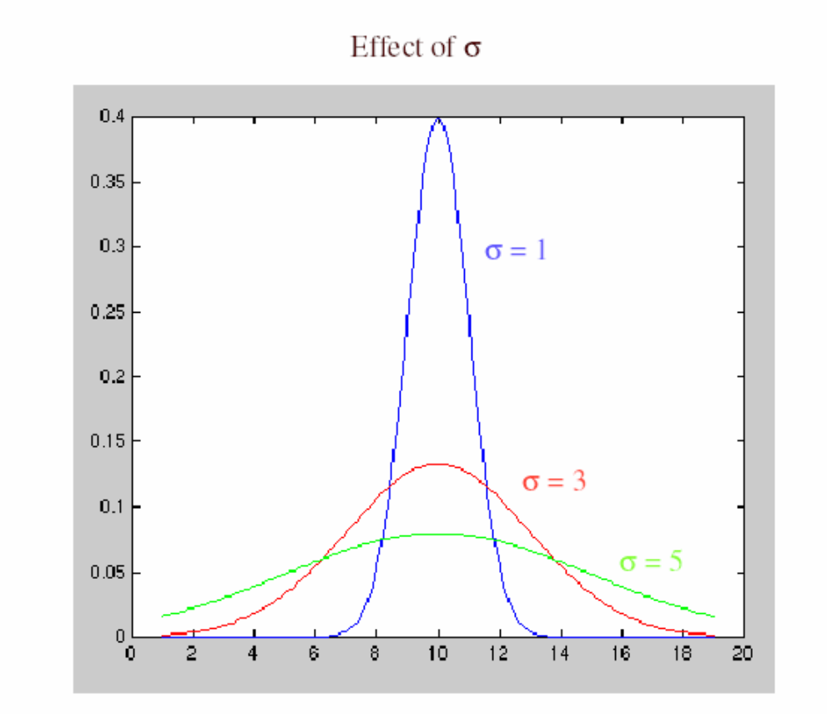
Choosing kernel width
Rule of thumb: set filter half-width to about 3σ

Slide 9
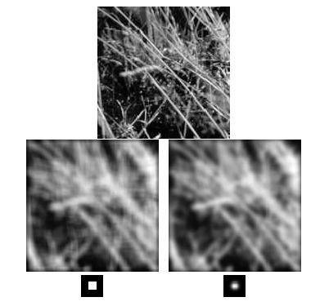
Gaussian vs. box filtering

Slide 10

Gaussian filters
Remove “high-frequency” components from the image (low-pass filter)
Convolution with self is another Gaussian
  So can smooth with small-σ kernel, repeat, and get same result as larger-σ kernel would have
  Convolving two times with Gaussian kernel with std. dev. σ
  is same as convolving once with kernel with std. dev.
Separable kernel
  Factors into product of two 1D Gaussians
Source: K. Grauman
Notes:
Linear vs. quadratic in mask size

Slide 11
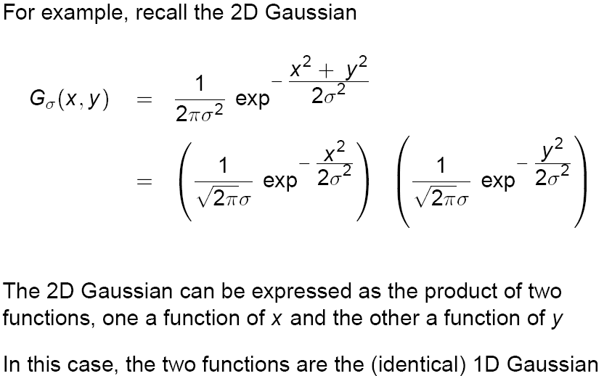
Separability of the Gaussian filter
Source: D. Lowe

Slide 12
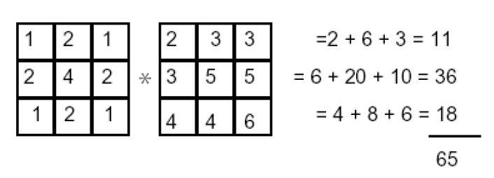
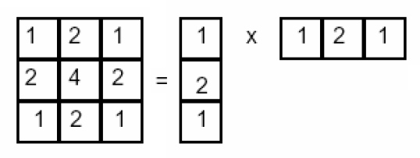
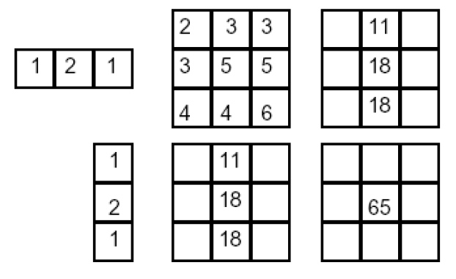
Separability example
2D convolution
(center location only)
The filter factors
into a product of 1D
filters:
Perform convolution
along rows:
*
=
Followed by convolution
along the remaining column:
*
=
Source: K. Grauman

Slide 13
Why is separability useful?
What is the complexity of filtering an n×n image with an m×m kernel?
  O(n² m²)
What if the kernel is separable?
  O(n² m)

Slide 14
Outline
Blob detection
  Brief of Gaussian filter
  Scale selection
  Lapacian of Gaussian (LoG) detector
  Difference of Gaussian (DoG) detector
  Affine co-variant region

Slide 15
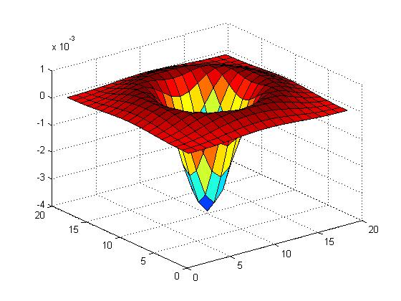
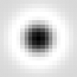
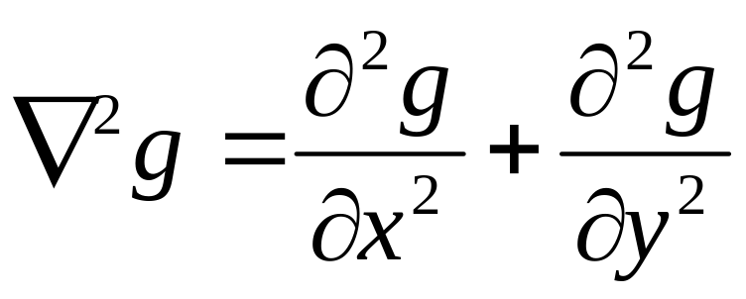
Blob detection in 2D
Laplacian of Gaussian: Circularly symmetric operator for blob detection in 2D

Slide 16
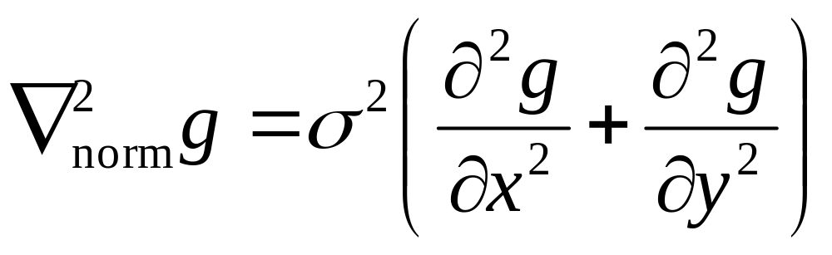
Blob detection in 2D
Laplacian of Gaussian: Circularly symmetric operator for blob detection in 2D
Scale-normalized:

Slide 17
Scale selection
At what scale does the Laplacian achieve a maximum response to a binary circle of radius r?
r
image
Laplacian

Slide 18
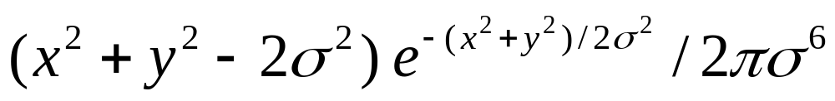

Scale selection
At what scale does the Laplacian achieve a maximum response to a binary circle of radius r?
To get maximum response, the zeros of the Laplacian have to be aligned with the circle
The Laplacian is given by:
Therefore, the maximum response occurs at
r
0
circle
image
Laplacian

Slide 19
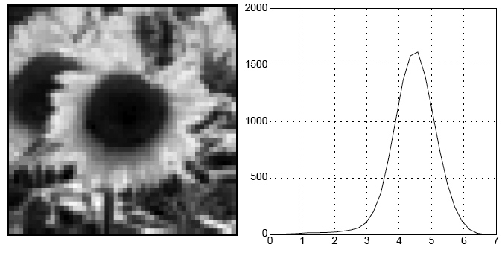
Characteristic scale
We define the characteristic scale of a blob as the scale that produces peak of Laplacian response in the blob center
characteristic scale
T. Lindeberg (1998). "Feature detection with automatic scale selection." International Journal of Computer Vision 30 (2): pp 77--116.

Slide 20
Scale-space blob detector
Convolve image with scale-normalized Laplacian at several scales

Slide 21
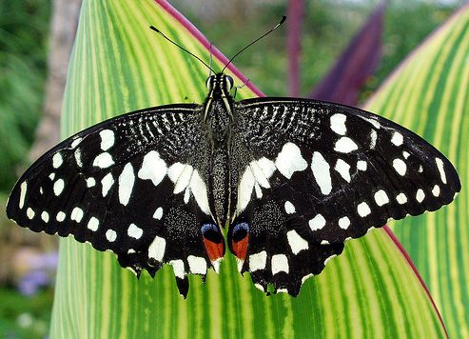
Scale-space blob detector: Example

Slide 22
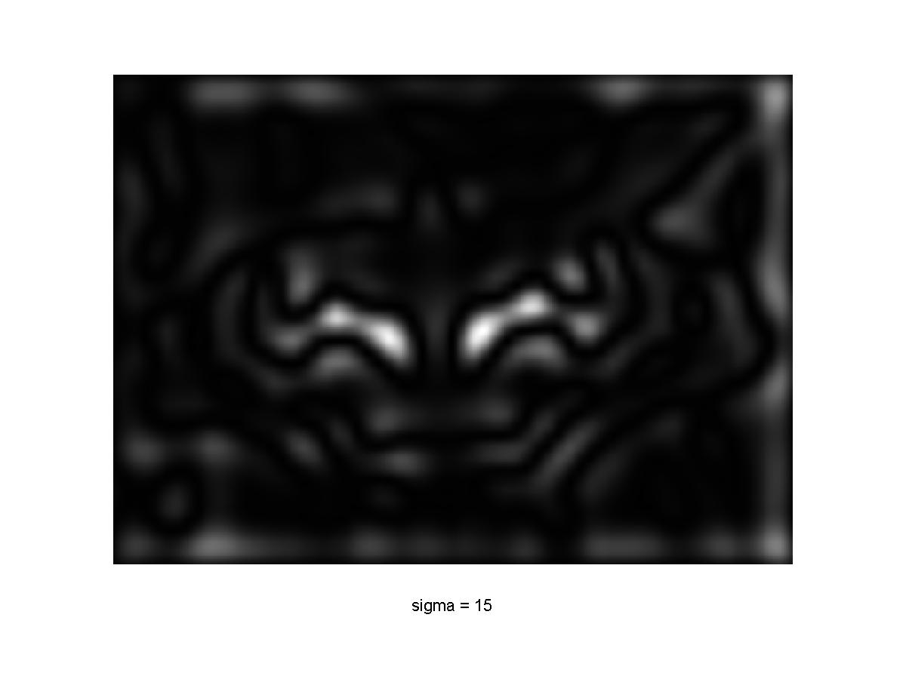
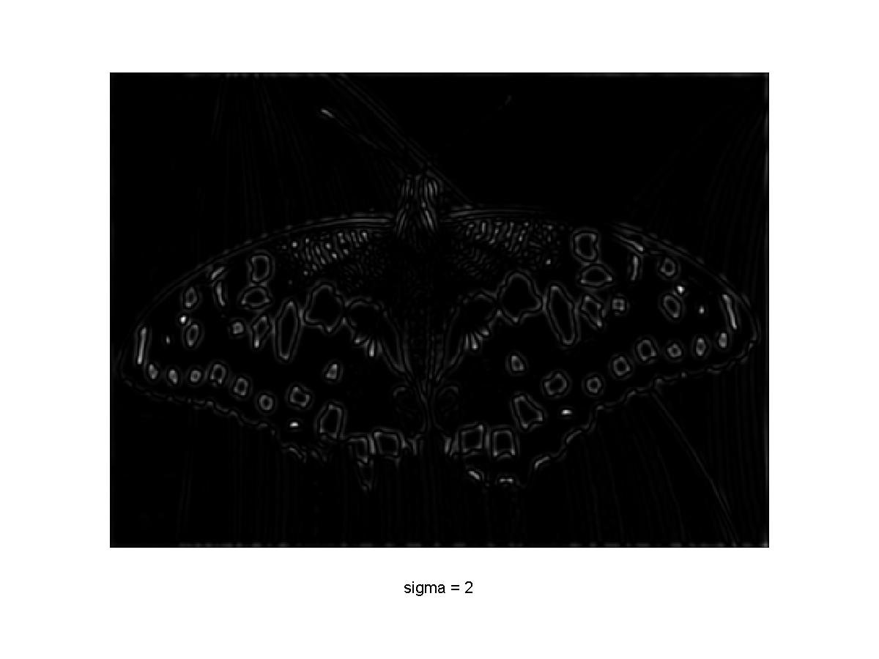
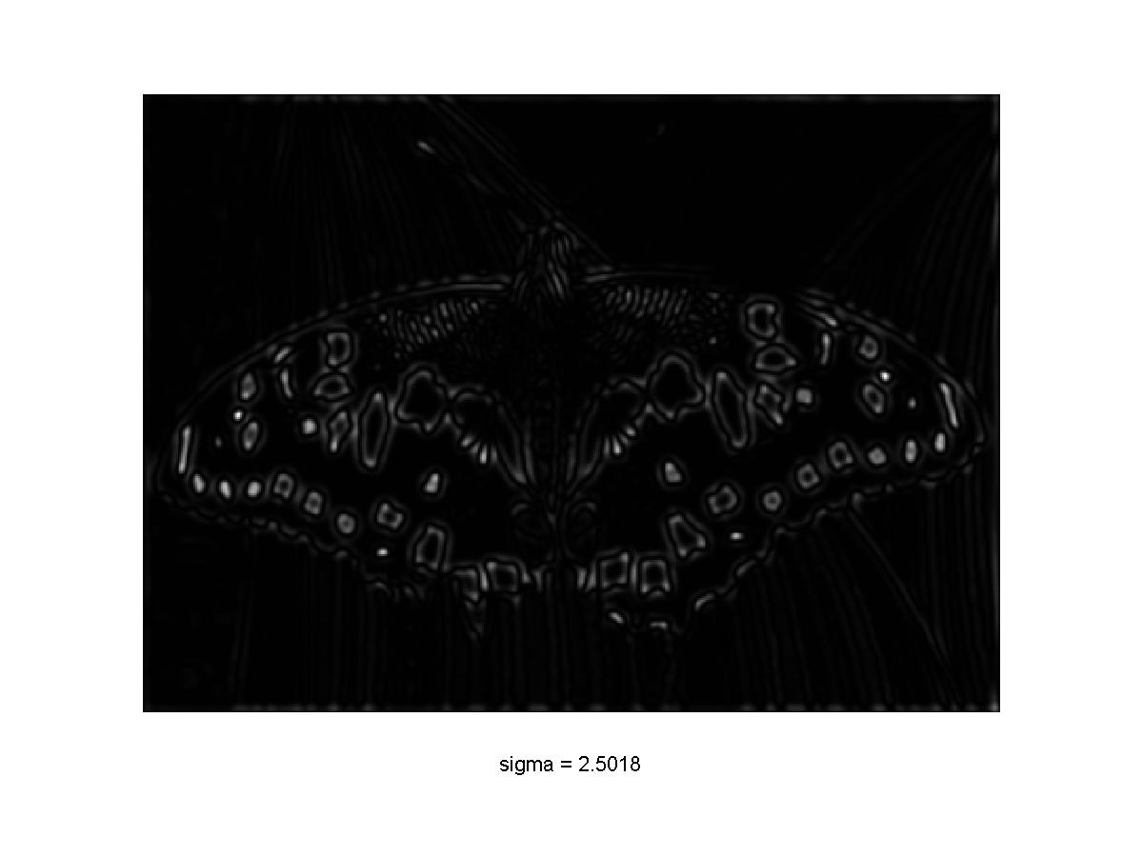
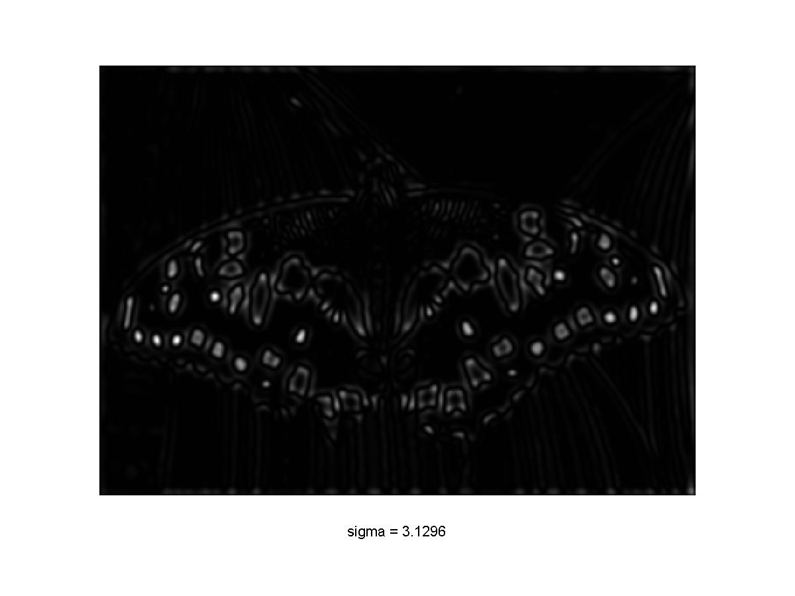
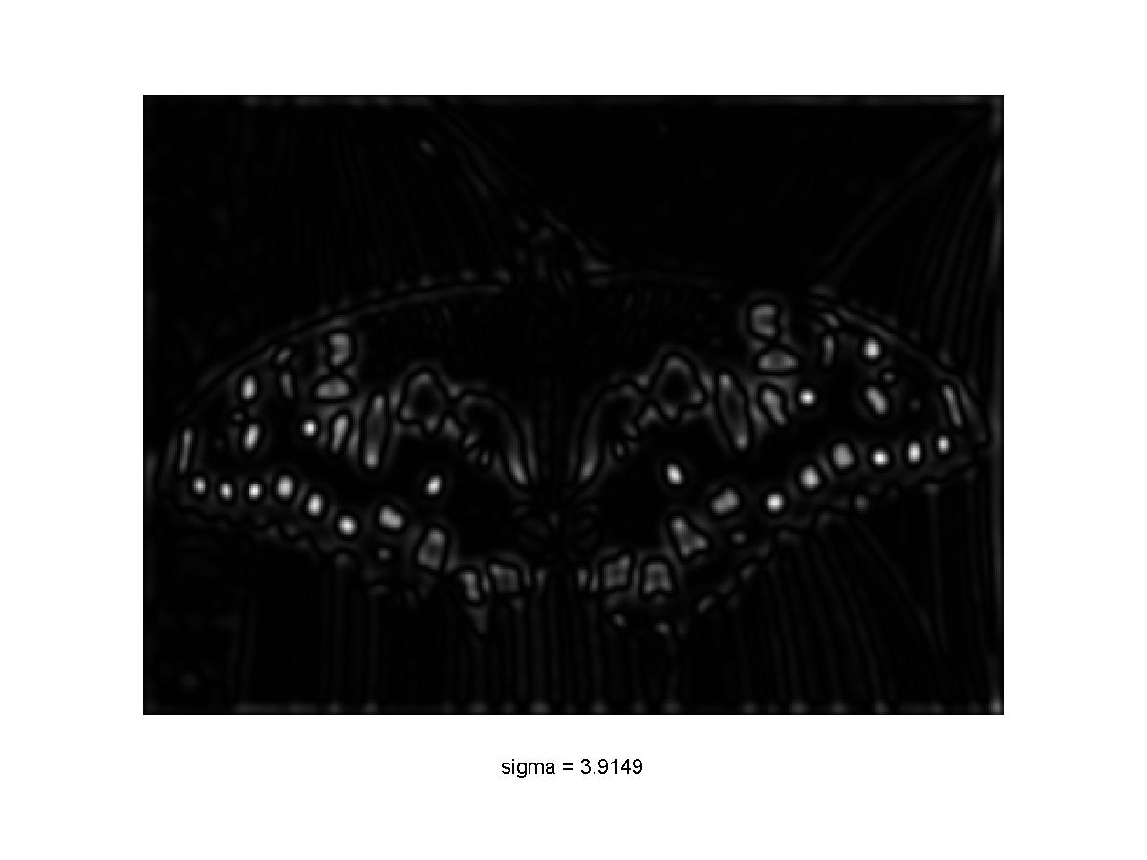
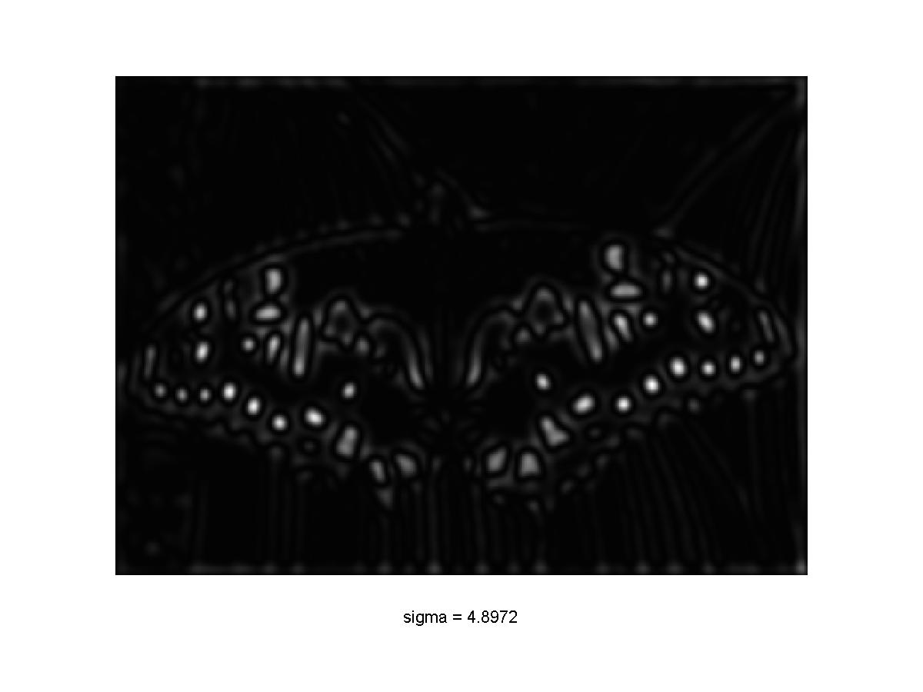

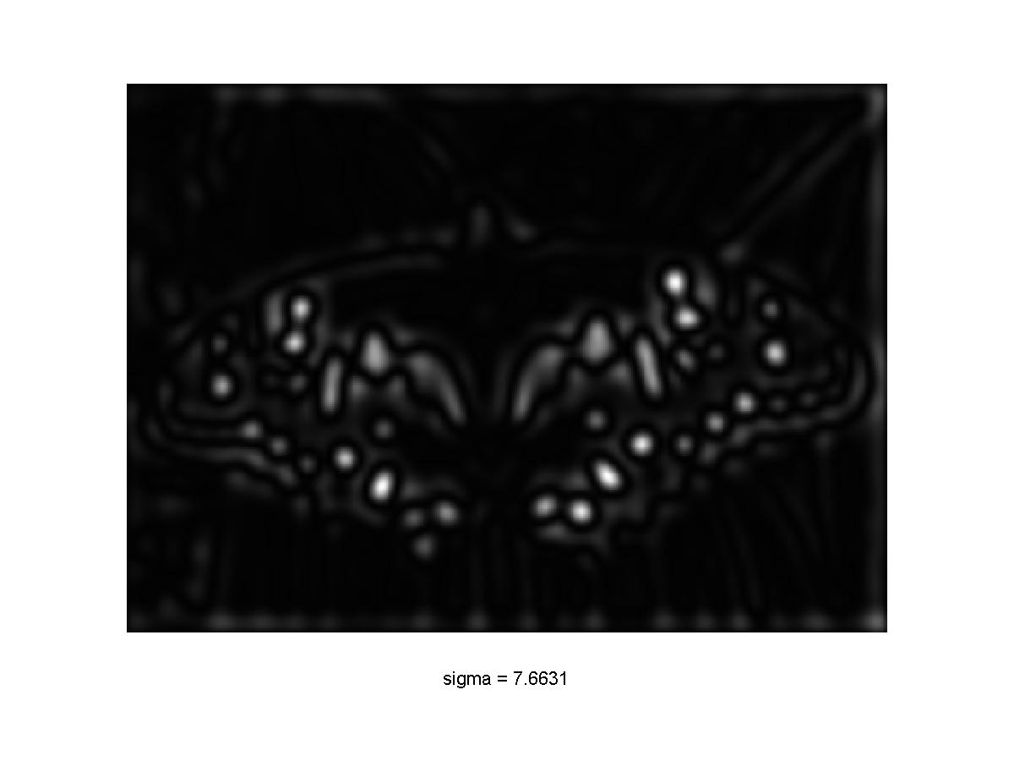
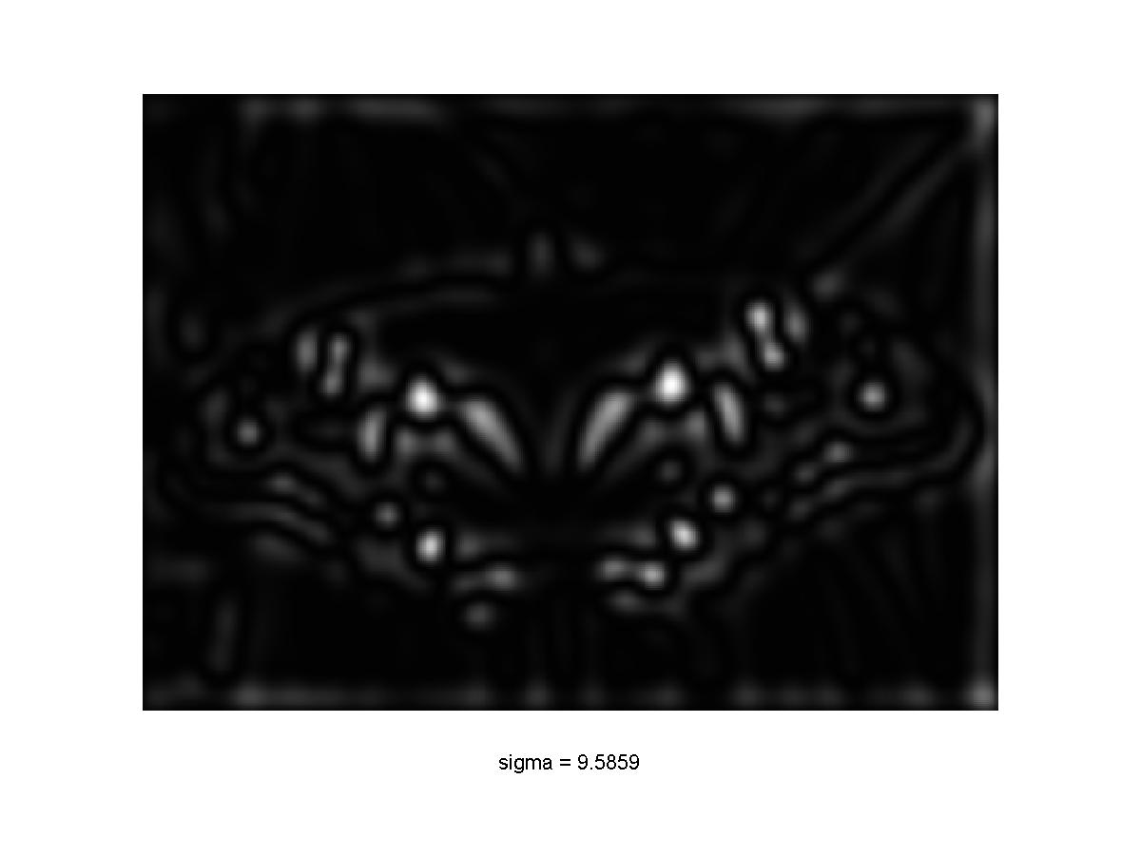
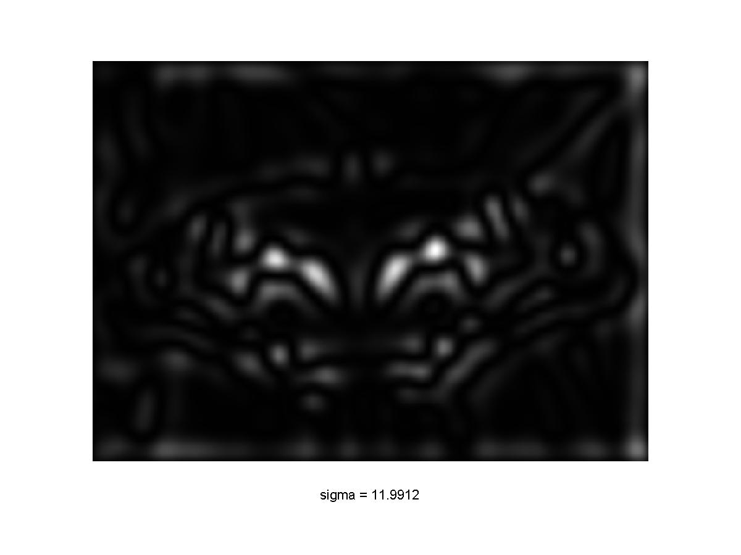
Scale-space blob detector: Example

Slide 23
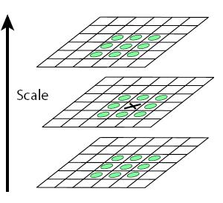
Scale-space blob detector
Convolve image with scale-normalized Laplacian at several scales
Find maxima of squared Laplacian response in scale-space

Slide 24
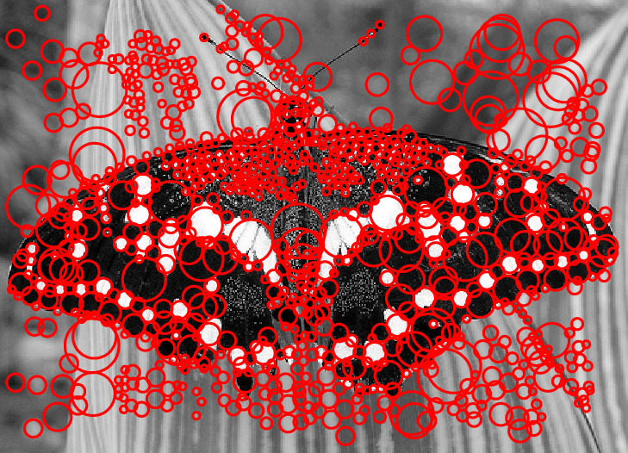
Scale-space blob detector: Example

Slide 25
Outline
Blob detection
  Brief of Gaussian filter
  Scale selection
  Lapacian of Gaussian (LoG) detector
  Difference of Gaussian (DoG) detector
  Affine co-variant region

Slide 26
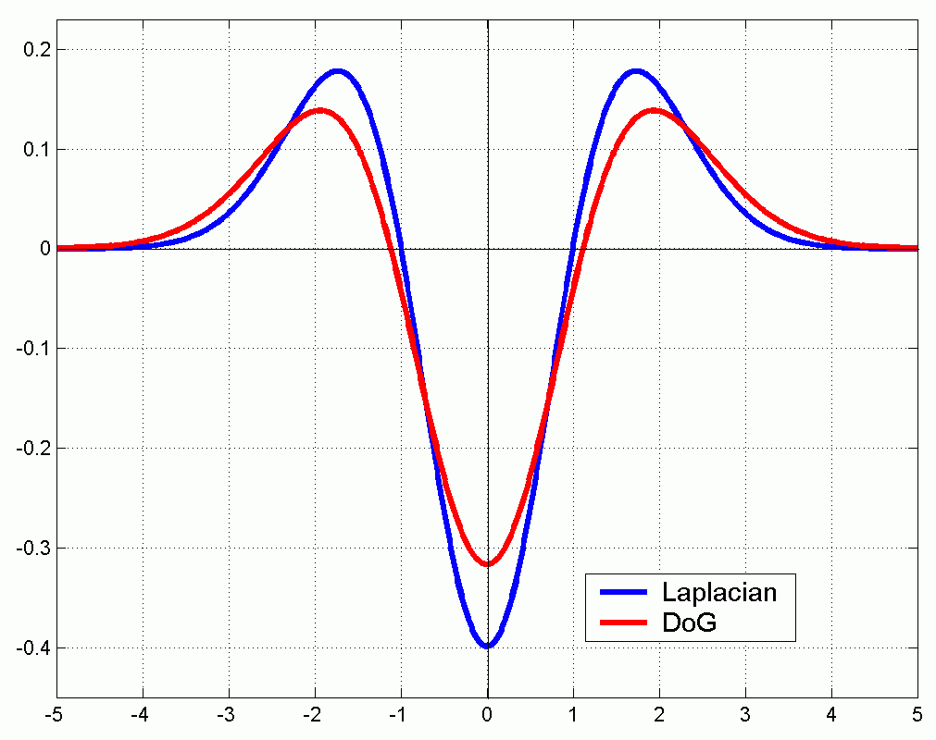
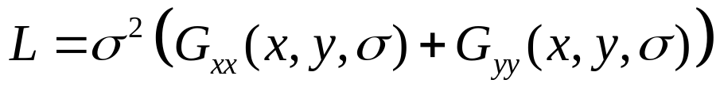

Efficient implementation
Approximating the Laplacian with a difference of Gaussians:
(Laplacian)
(Difference of Gaussians)

Slide 27
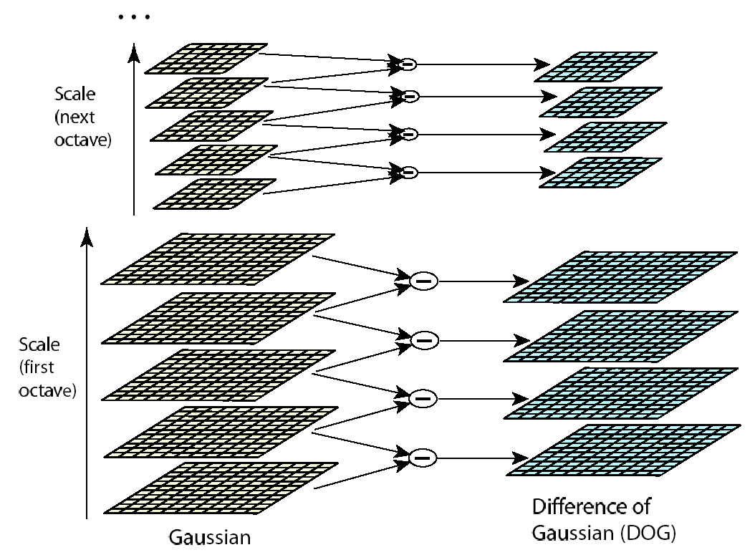
Efficient implementation
David G. Lowe. "Distinctive image features from scale-invariant keypoints.” IJCV 60 (2), pp. 91-110, 2004.

Slide 28
Invariance and covariance properties
Laplacian (blob) response is invariant w.r.t. rotation and scaling
Blob location and scale is covariant w.r.t. rotation and scaling
What about intensity change?

Slide 29
Outline
Blob detection
  Brief of Gaussian filter
  Scale selection
  Lapacian of Gaussian (LoG) detector
  Difference of Gaussian (DoG) detector
  Affine co-variant region

Slide 30
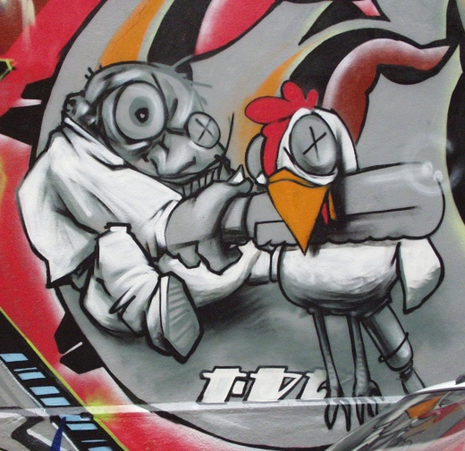
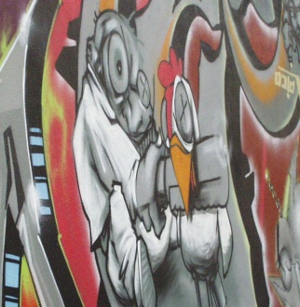
Achieving affine covariance
Affine transformation approximates viewpoint changes for roughly planar objects and roughly orthographic cameras

Slide 31
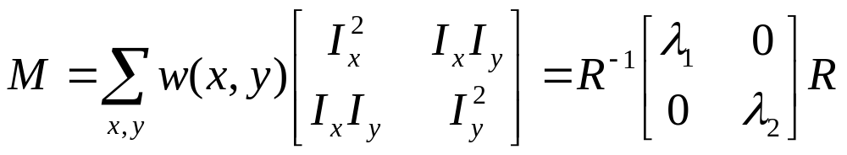
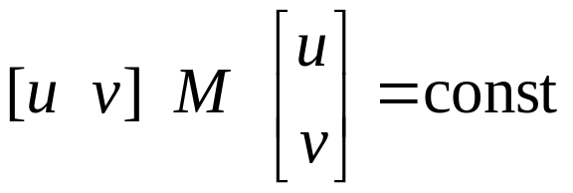
Achieving affine covariance
Consider the second moment matrix of the window containing the blob:
direction of the fastest change
Recall:
direction of the slowest change
(λ_{max})^{-1/2}
(λ_{min})^{-1/2}
This ellipse visualizes the “characteristic shape” of the window

Slide 32
Affine adaptation example
Scale-invariant regions (blobs)

Slide 33
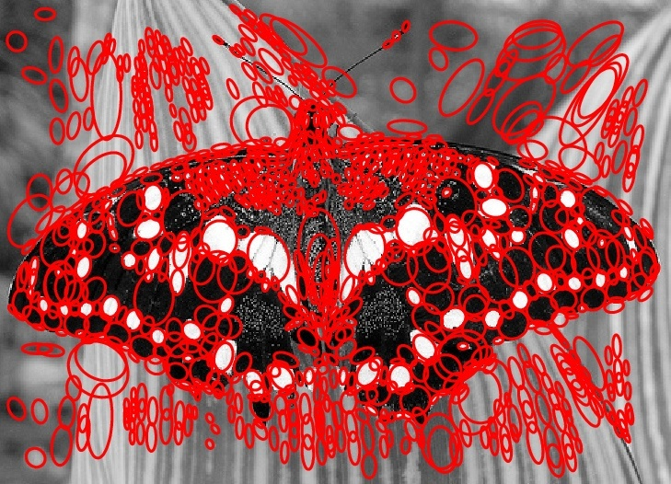
Affine adaptation example
Affine-adapted blobs

Slide 34
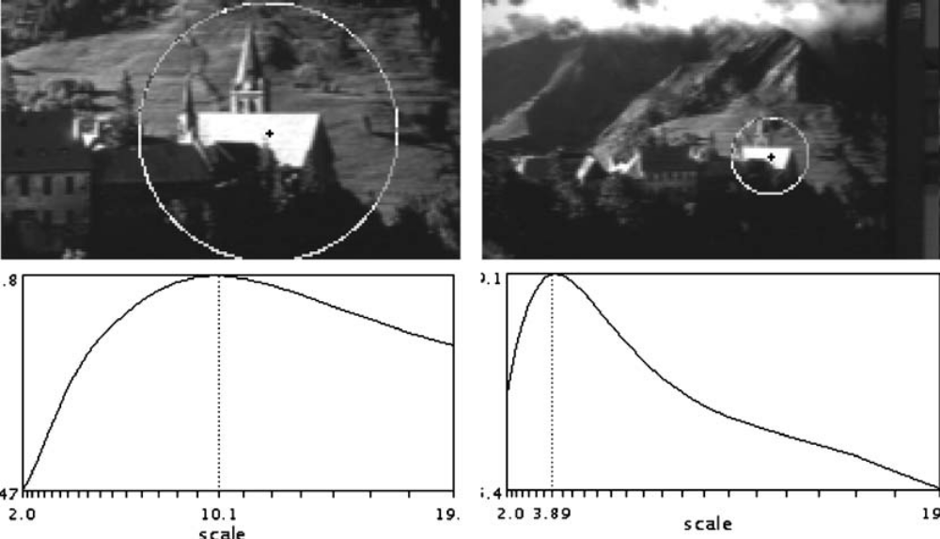
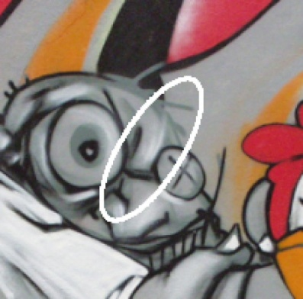
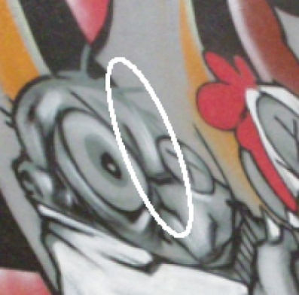
From covariant detection to invariant description
Geometrically transformed versions of the same neighborhood will give rise to regions that are related by the same transformation
What to do if we want to compare the appearance of these image regions?
  Normalization: transform these regions into same-size circles

Slide 35
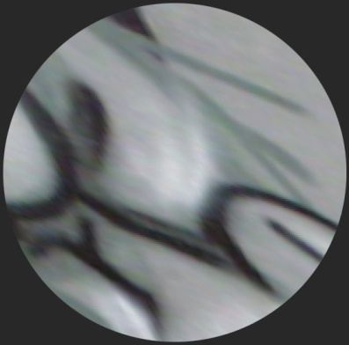
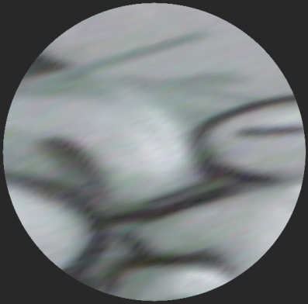
Affine normalization
Problem: There is no unique transformation from an ellipse to a unit circle
  We can rotate or flip a unit circle, and it still stays a unit circle

Slide 36
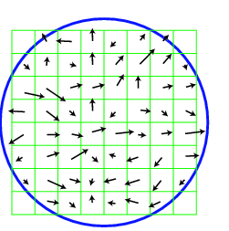
Eliminating rotation ambiguity
To assign a unique orientation to circular image windows:
  Create histogram of local gradient directions in the patch
  Assign canonical orientation at peak of smoothed histogram
0
2
π

Slide 37

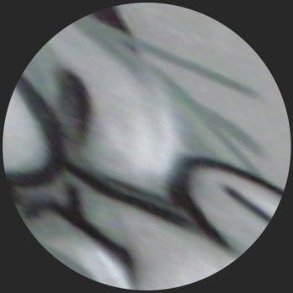
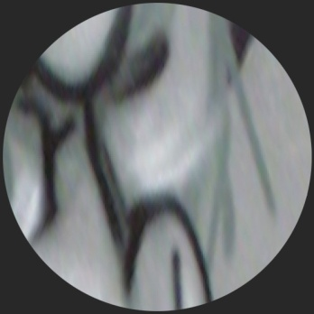
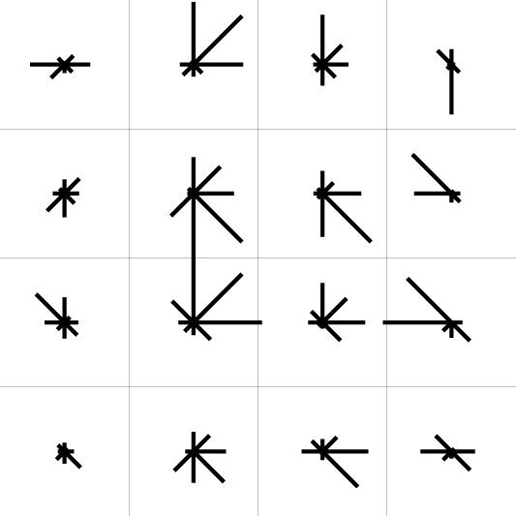
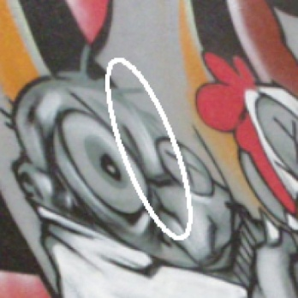
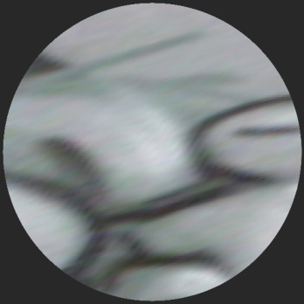


From covariant regions to invariant features
Eliminate rotational
ambiguity
Compute appearance
descriptors
Extract affine regions
Normalize regions
SIFT (Lowe ’04)

Slide 38

Invariance vs. covariance
Invariance:
  features(transform(image)) = features(image)
Covariance:
  features(transform(image)) =transform(features(image))
Covariant detection => invariant description

Slide 39
Lecture III: Part I
David G. Lowe, “Distinctive Image Features from Scale-Invariant Keypoints”, International Journal of Computer Vision, Vol. 60, No. 2, pp. 91-110
  6291 as of 02/28/2010; 22481 as of 02/03/2014
  Our goal is to design the best local image descriptors in the world.
Learning Local Feature Descriptor

Slide 40






























  Panoramic stitching [Brown et al. CVPR05]
  Real-worldFace recognition
  [Wright & Hua CVPR09]
  [Hua & Akbarzadeh ICCV09]
  Image databases
  [Mikolajczyk & Schmid ICCV01]
Courtesy of Seitz & Szeliski
  Object or location recognition
  [Nister & Stewenius CVPR06]
  [Schindler et al. CVPR07]
  Robot navigation
  [Deans et al. AC05]
  3D reconstruction
  [Snavely et al. SIGGRAPH06]
Notes:
For a brief introduction, local image descriptor based matching has been widely used for solving various computer vision problems, such as Panoramic stitching, 3D reconstruction, Image databases for content based image retrieval, object and location recognition, robot navigation, and face recognition.

Slide 41




Typical matching process
Image 1
Image 2
Image 1
Image 2
Dense sampling of image patches
Interest point/region detection (sparse)
Notes:
Typical local image descriptor based matching process firstly summarize the image as a set of image patches. This could be achieved either by detecting salient points or regions in the image, and then extract a scale and orientation normalized image patch around the point or region, or by densely sampling image patches from the target images.

Slide 42












Typical matching process
Image 1
Image 2
Q
P
Descriptor space
Notes:
Then, each image patch will be processed by a descriptor algorithm to form a visual descriptor, which is usually a numerical vector of certain dimensions. For matching, if the distance between two descriptors are smaller than a threshold Epsilon, we declare that they are a match, otherwise, we declare that they are non-matches.

Slide 43

Problem to solve
Learning a function of a local image patch
descriptor = f ( )
s.t. a nearest neighbor classifier is optimal
To obtain the most discriminative, compact, and computationally efficient local image descriptors.
  How can we get ground truth data?
  What is the form of the descriptor function f(.)?
  What is the measure for optimality?
Notes:
So our goal is to obtain the most discriminative, compact, and computationally efficient local image descriptors. We formulate it as a machine learning problem where we want to learn a function of a local image patch such that a nearest neighbor classifier is optimal.
There are three questions we need to address in such a formulation. Firstly, we need to build a dataset with ground truth match and non-match labels between different local image patches. Secondly, we need to determine the specific form of the descriptor function. Thirdly, we also need to come out with a optimality criterion for evaluating the performance of descriptor under the nearest neighbor classification setting. We will address all these questions in the following slides.

Slide 44
How can we get ground truth data?
Notes:
So how can we get ground truth data?

Slide 45




Training data
3D Point
Cloud
Multiview stereo = Training data
[Goesele et al. - ICCV’07] [Snavely et al. - SIGGRAPH’06 ]
Notes:
Our dataset is obtained from modern multi-view stereo systems. Given a photo collection of certain scenes such as the Notre Dame showing in this slide. We leverage the multi-view stereo pipeline proposed by Goesele et al to build dense stereo map for each image. The pipeline first runs a structure from motion system presented by Snavely et al to build sparse correspondences and 3D points clouds for the photo collections. A region growing matching scheme is further developed to build the dense stereo maps for each of the images. Some example stereo maps are shown in this slide.

Slide 46






Training data
3D Point
Cloud
[Goesele et al. - ICCV’07] [Snavely et al. - SIGGRAPH’06 ]
Notes:
With these dense multi-view stereo data, we detect interest or salient points from each image. For each interest point in a reference image, we transfer it to neighboring images. If the transferred point is visible, we look for interest points within specific ranges in positions, orientations, and scales. We declare those interest points to be matches. We extract rectified and normalized image patches around the matched interest points, and therefore obtain a matched image patch group. If the closest interest points are out of range, we simply skip them. Any pairs of images from the same group are considered to be matched.

Slide 47





Training data
3D Point
Cloud
[Goesele et al. - ICCV’07] [Snavely et al. - SIGGRAPH’06 ]

Slide 48







Training data
3D Point
Cloud
[Goesele et al. - ICCV’07] [Snavely et al. - SIGGRAPH’06 ]
Notes:
This process is repeated until we gather enough number of local image patches and match groups we want. A pair of image patches from different groups are regarded as non-match.

Slide 49


Liberty
Yosemite
Statue of liberty (New York) – Liberty
Notre Dame (Paris) – Notre Dame
Half Dome (Yosemite) - Yosemite
http://www.cs.ubc.ca/~mbrown/patchdata/patchdata.html
Notes:
We generated 3 image patch datasets with ground-truth labeling from publicly available real-world photo collections such as Statue of Liberty, Notre Dame, and Half Dome. We call them as Liberty, Notre Dame, and Yosemite, respectively. To get a copy of the dataset for your research, please refer to the url in this slide.

Slide 50
What is the form of the descriptor function?
Notes:
Now we have built our data set, the next question is what is the form of the descriptor function.

Slide 51
Descriptor algorithms
Algorithm
Normalized
image patch
Descriptor
vector
Gradients
quantized to
k orientations
Normalize
Summation
n grid region
k × n vector
[ SIFT – Lowe ICCV’99 ]
Notes:
An algorithm for local image descriptor takes a normalized image patch as the input, and output a descriptor vector of certain dimensionality. Before we reveal the specific descriptor function we adopt, let’s briefly review what the previous descriptors look like. The first descriptor function we review is the seminal work of Prof. David Lowe, the SIFT descriptors.
The SIFT descriptor takes a image patch, extract the gradient vector for each pixel, and then bilinear quantize the gradient vector to k orientations. Then each pixel in the image patch will be corresponding to an k dimensional vector with at most 2 elements being non-zero. These vectors are aggregated separately in n local regions arranged in the image grid in a raster scan fashion. The aggregated k dimensional vector from different grid regions are concatenated and normalized to form a descriptor of k x n dimension.

Slide 52
Descriptor algorithms
Algorithm
Normalized
image patch
Descriptor
vector
Gradients
Quantized to k Orientations
Normalize
(plus PCA)
Summation
n Log-Polar region
[ GLOH – Mikolajzcyk & Schmid PAMI’05 ]
Notes:
The second descriptor algorithm we summarize here is the GLOH descriptor, the difference between GLOH and SIFT descriptors is the way the summation region is arranged. The GLOH descriptor arranges the summation region in a Log-Polar coordinate as shown in the middle of this figure. Again, the summed vectors are concatenated and normalized to be a single k x n dimensional descriptor vectors with an option to perform Principle Component Analysis to reduce the dimensionality of the descriptor vector.

Slide 53
Descriptor algorithms
Algorithm
Normalized
image patch
Descriptor
vector
Create
Edge Map
Normalize
Summation
n Log-Polar region
[ Shape Context – Belongie et al, NIPS’00 ]
Notes:
Next, we review the Shape Context descriptor, similar to GLOH, it also uses summation region arranged in the Log-Ploar coordniate, but instead of using the quantized gradient, it directly utilizes the edge map, in order to describe the shape of the target object.

Slide 54
Descriptor algorithms
Algorithm
Normalized
image patch
Descriptor
vector
Grey value quantized into k bins
Normalize
Summation
n circular region
[ Spin Image – Lazebnik et al, CVPR’03 ]
Notes:
The spin image descriptor quantizes the grey pixel value into k bins, and aggregate them in n concentric circular regions, which are again, concatenated and normalized to form the final k x n dimensional descriptors.

Slide 55
Descriptor algorithms
Algorithm
Normalized
image patch
Descriptor
vector
T
S
N
Feature
detector
Normalize
Summation
n Gaussian region
[ Geometric Blur – Berg& Malik CVPR’01 ]
[ DAISY - Tola et al. CVPR’08]
Notes:
The geometric blur descriptor presents a different spatial summation region. It employs a set of Gaussian weighted spatial summation regions, and again arranged in a Log-Polar coordinate system. It is flexible to take any feature extracted from the image patch for spatial aggregation. In Tola et al.’s CVPR’08 paper, they called this type of aggregation region to be DAISY shape. It is manifested that there exists efficient schemes to compute this type of “DAISY” configured local image descriptors, especially when we want to extract the descriptors densely from an image.
In summary, it is obvious to see that all these descriptor algorithms incorporates three processing unit. That is, the feature extraction unit, which we call the T-Block, the spatial aggregation unit, which we call, the S-Bolck, and the N-Block, which normalize the descriptor vector.

Slide 56
Our descriptor algorithm
T
S
N
E
Q
Descriptor
vector
Notes:
Our descriptor function also employs a T-block, an S-block, and an N-Block. Similar to the GLOH descriptor, we also put an optional dimensionality reduction block, which we call E-Block in our descriptor algorithm. The unique processing unit we have in our descriptor algorithm is the quantization Q-block, in which we try to research on how many bits we really need to encode each dimension of the descriptor to maintain the discriminative power. This unit is indispensible to achieve our goal of obtaining the most compact local image descriptors.

Slide 57
S-Block: Picking the best DAISY
T
S
N
E
Q
Descriptor
vector
S-Block: DAISY
1r6s
1r8s
2r6s
2r8s
Notes:
In our previous study, Gaussian weighted spatial pooling generated the most discriminative descriptor, and also motivated by the efficient computational scheme presented in Tola et al’s CVPR’08 paper, in this work, we extensively studied the effects of the different DAISY configurations to the discriminative power of the final descriptors. What we have explored include the configuration of 1 ring 6 segments or in short 1r6s, 1 ring 8 segments, 2 ring 6 segments, and 2 ring 8 segments. Parameters to learn for the S-Block include the position of the Gaussian window as well as the spatial span or variances of the window.

Slide 58



T-Block
T
S
N
E
Q
Descriptor
Vector
T-Block:
  T1: Gradient bi-linearly weighted orientation binning
  T2: Rectified gradient {| _{x}|- _{x} , | _{x}|+ _{x} , | _{y}|- _{y} , | _{y}|+ _{y}}
  T3: Steerable filters
<
0
*
>
T3-4th-4
Notes:
We have also performed extensive analysis on a couple of different non-linear transformations in T-Block. We number them as T1, T2 and T3. T1 carries out bi-linearly weighted orientation binning of the gradient magnitude. The same operation is adopted in both the SIFT and the GLOH descriptors. T2 is the rectified gradient, which produces a natural sine weighted quantization of gradient orientation into a 4 dimensional vector. With T3, we extensively study different steerable filters for obtaining the best local image descriptors. The figure shows a concrete example of T3 transformation, which convolves the image patch with 4th order steerable filter quadrature pairs in 4 orientations and thresholded into 16 binary maps. We name it T3-4th – 4. The scale of the filter is a parameter we learn from the data.

Slide 59
N-E-Q Blocks
T
S
N
E
Q
Descriptor
Vector
N-Block: Uniform v.s. SIFT-like normalization
E-Block: Principle component analysis (PCA)
Q-block: q_{i} = βLv_{i} + α, β is learnt from data, α = 0.5 if L is an odd number and α = 0 otherwise.
Notes:
In the normalization block, we compare two options, the uniform normalization and the SIFT-like normalization, which involves a threshold clipping and re-normalization process to increase the robustness of the descriptors. In the E-Block, we just perform principle component analysis similar to that of GLOH. As an additional note, we have also extensively tested different discriminative embedding methods in this block, but found that they are not better than PCA when the parameters of T, S, and N Blocks are optimized. Q blocks performs a quantization step following the common practice of encoding transforming coefficients in image and video compression, which fits in each dimension of the descriptor into Log L bits. \beta is the scaling factor needed to be learnt from data.

Slide 60
What is the optimal criterion?

Slide 61
Discriminative learning and optimal criterion
T
S
N
100,000 match/non-match
training pairs
Parameters
Descriptor distances
95
Update Parameters
(Powell)
True positive %
E-Block and Q-Block are optimized independently
α (error rate)
False positive%
Notes:
Our learning pipeline takes training image pairs with match or non-match ground-truth labels. After passing the T-S-N pipeline, the pair of image patches corresponds to a pair of descriptor vectors. The distance between the descriptor vectors, such as L2 distance, is then evaluated.
If the distance is smaller than a threshold, then we predict the pair of image patches to be matched from our descriptor algorithm, otherwise we predict them to be non-match. The predicted result is then compared against the ground truth label, based on which we count the true positives and false positives from a set of training image pairs. Based on different decision threshold in the descriptor space, we can draw a ROC curve for this verification task. It is obvious that the larger the area under the ROC curve, the better the performance of the descriptor. So our learning algorithm is designed to maximize the area under the ROC curve. This is achieved by leveraging Powell minimization, which is a variation of line search gradient descent to update the parameters of the descriptors. We iterate until the parameters converge to an optimal setting. We shall clarify here that the E-Block is optimized by performing a simple Eigen value decomposition, while the Q-Block is simply optimized by exhaustive evaluation of the parameter settings. Both are performed after we fixed the parameters for the T-S-N blocks.
In our experiments, we random sample 100,000 match/non-match pairs from the Yosemite dataset for training and another 100,000 match/non-match pairs for reporti test errors. Since the area under the ROC curve is not a straightforward for interpreting the error rate, we also use another performance criterion, which is the false positive rate under 95% true positive rate.
Powell minimisation: variation on line search where the latest step is added to a set of direction vectors. Do line search on all the direction vectors and add the latest step to the direction set, throwing away oldest direction vector.

Slide 62


SIFT-like normalization & PCA
Uniform
normalization
SIFT like normalization has a clear sweet spot.
PCA can usually reduce the dimension to 30~50.
Notes:
We have performed a lot experiments which we will not be able to present all the results. Therefore we will highlight some of the key results as take home message for you. The first conclusion which we want to draw is that SIFT-like normalization obviously outperforms uniform normalization, as clearly shown in the figure on the left side, where the “infinity” point represents the error rate achieved by uniform normalization. It is clear that SIFT-like normalization has a clear sweet spot which achieves significantly lower error rate than uniform normalization in all our evaluations. Another result we obtain is that PCA can usually reduce the dimension of the different descriptors to be between 30~50. This is clearly shown in the figure on the right side. It suggests that most existing high dimensional local image descriptors do not really need to be that high dimensional.

Slide 63

The most discriminative DAISY
2r6s
Steerable filters at two spatial scales with PCA
  T3-2nd-6-2r6s + 2-scale + PCA: 42 dimension, 9.5%
  2 × 6 × 2 × 2 × (2 × 6+1) = 624 dimensions before PCA
Notes:
Here we present the most discriminative descriptors we obtained from our learning algorithm. It runs second order steerable filters in 6 orientations, and at 2 spatial scales, the spatial summation configuration follows the setting of 2 ring 6 segments, with SIFT-like normalization. The final descriptor algorithm produces 42 dimensional descriptors with the lowest error rate of 9.5%. The figure presents the ROC curves of this descriptor with, and without PCA. As we can clearly observe, with PCA, the descriptor achieves slightly better error rate with significantly less dimensionality. Both achieve significantly lower error rate compared with the most popular SIFT descriptor baseline.

Slide 64

The most compact DAISY
T3-2nd-4-2r8s
  13 bytes, 13.2%
T2-4-1r8s-PCA
  7.5 bytes, 24.4%
SIFT
  128 bytes, 26.1%
2 bits /dimension is sufficient before PCA
4 bits /dimension is needed after PCA
http://www.cs.ubc.ca/~mbrown/patchdata/patchdata.html
Notes:
Here we present the most compact local image descriptors. We have performed extensive study on the dynamic range of the descriptors, as shown in the figure. The horizontal axis represents the number of bits we allocate for each dimension of the descriptor, and the vertical axis shows the error rate on the testing dataset. As we can clearly observe, before PCA, 2 bit per dimension is sufficient to maintain the discriminative power of the descriptor, and after PCA, 4 bits are needed to maintian the discriminative power. With these conclusion, we present two very compact local image descriptors. The first is T3-2nd-4-2r8s. It runs 2nd order steerable filters in four orientations, and the responses are aggregated with 2 ring 8 segment. It achieves an error rate of 13.2% and only consumes 13 bytes per descriptor. While another very compact descriptor is T2-4-1r8s with post PCA for dimension reduction, which leverage 4 dimensional sine weighted rectified gradient. It achieves an error rate of 24.4% and only accounts for 7.5 bytes. Both descriptors consumes nearly 10 times less memory and achieves better matching quality than the most utilized SIFT descriptor.

Slide 65

Some of the errors made … …
The world is repeating itself….

Slide 66
Summary
Blob detection
  Brief of Gaussian filter
  Scale selection
  Lapacian of Gaussian (LoG) detector
  Difference of Gaussian (DoG) detector
  Affine co-variant region
Learning local descriptors
  How can we get ground-truth data?
  What is the form of the descriptor function?
  What is the optimal criterion?
  How do we optimize it?

