Slide 1
CS558 Computer Vision
Lecture XII: Face Detection and Recognition
First part adapted from S. Lazebnik

Slide 2
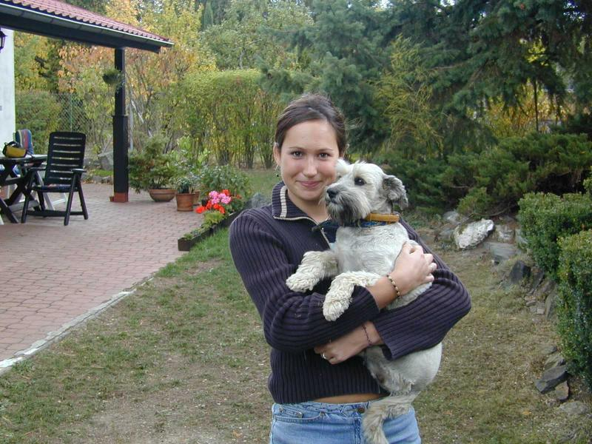
Face detection and recognition
Detection
Recognition
“Sally”

Slide 3
Outline
Face Detection
Face Recognition

Slide 4
Outline
Face Detection
Face Recognition

Slide 5
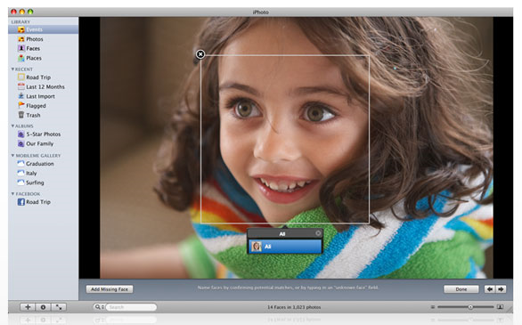
Consumer application: Apple iPhoto
http://www.apple.com/ilife/iphoto/

Slide 6
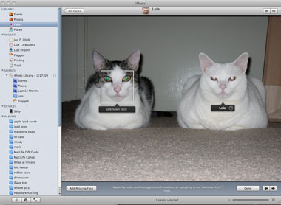
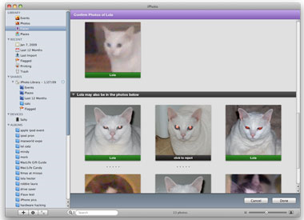
Consumer application: Apple iPhoto
Can be trained to recognize pets!
http://www.maclife.com/article/news/iphotos_faces_recognizes_cats

Slide 7
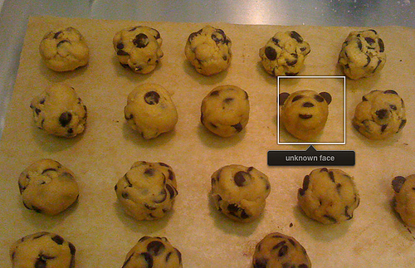
Consumer application: Apple iPhoto
Things iPhoto thinks are faces

Slide 8
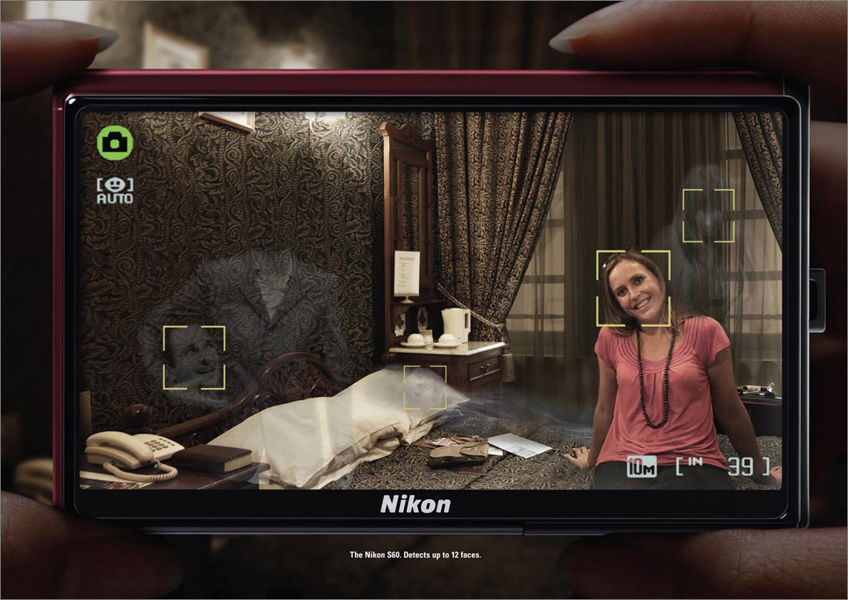
Funny Nikon ads
"The Nikon S60 detects up to 12 faces."

Slide 9
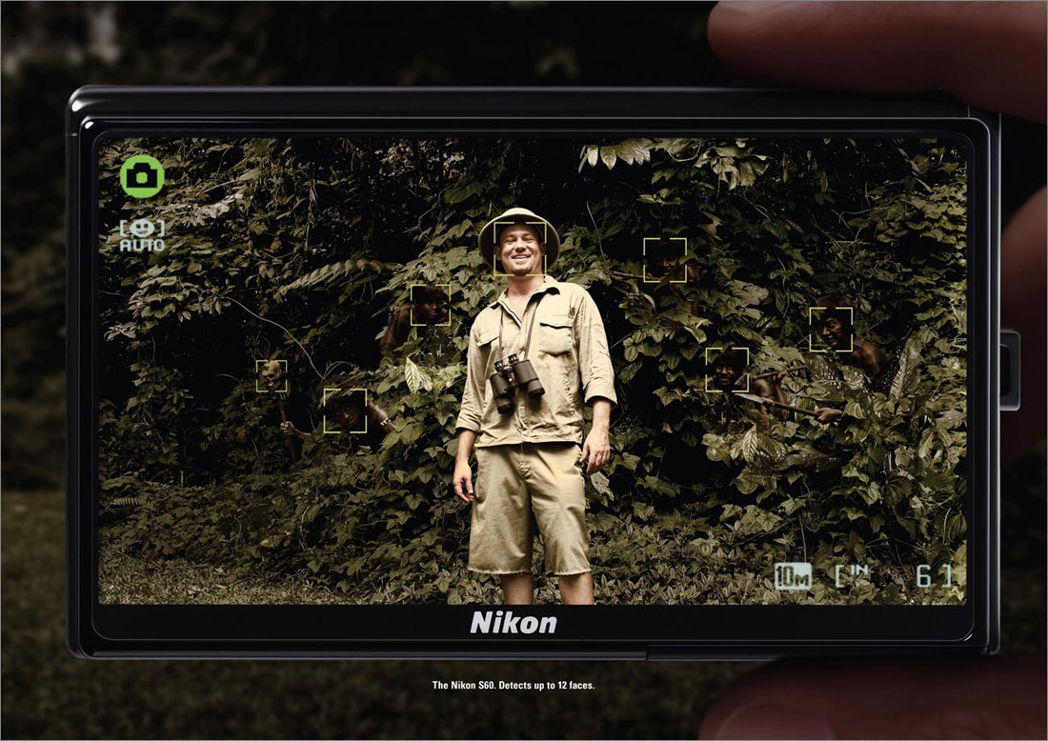
Funny Nikon ads
"The Nikon S60 detects up to 12 faces."

Slide 10
Challenges of face detection
Sliding window detector must evaluate tens of thousands of location/scale combinations
Faces are rare: 0–10 per image
  For computational efficiency, we should try to spend as little time as possible on the non-face windows
  A megapixel image has ~10⁶ pixels and a comparable number of candidate face locations
  To avoid having a false positive in every image, our false positive rate has to be less than 10⁻⁶

Slide 11
The Viola/Jones Face Detector
A seminal approach to real-time object detection
Training is slow, but detection is very fast
Key ideas
  Integral images for fast feature evaluation
  Boosting for feature selection
  Attentional cascade for fast rejection of non-face windows
P. Viola and M. Jones. Rapid object detection using a boosted cascade of simple features. CVPR 2001.
P. Viola and M. Jones. Robust real-time face detection. IJCV 57(2), 2004.

Slide 12
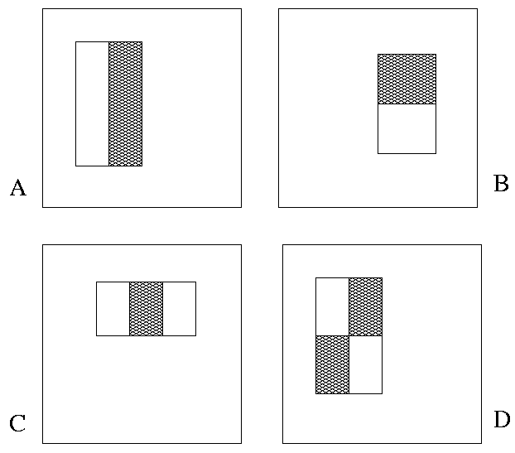
Image Features
“Rectangle filters”
Value =
∑ (pixels in white area) –
∑ (pixels in black area)
Notes:
For real problems results are only as good as the features used...
This is the main piece of ad-hoc (or domain) knowledge
Rather than the pixels, we have selected a very large set of simple functions
Sensitive to edges and other critcal features of the image
** At multiple scales
Since the final classifier is a perceptron it is important that the features be non-linear… otherwise the final classifier will be a simple perceptron.
We introduce a threshold to yield binary features

Slide 13
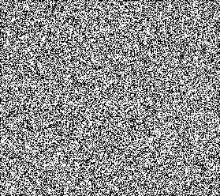



Example
Source
Result

Slide 14
Fast computation with integral images
The integral image computes a value at each pixel (x,y) that is the sum of the pixel values above and to the left of (x,y), inclusive
This can quickly be computed in one pass through the image
(x,y)

Slide 15
Computing the integral image

Slide 16
Computing the integral image
ii(x, y-1)
s(x-1, y)
i(x, y)
Cumulative row sum: s(x, y) = s(x–1, y) + i(x, y)
Integral image: ii(x, y) = ii(x, y−1) + s(x, y)
MATLAB: ii = cumsum(cumsum(double(i)), 2);

Slide 17
Computing sum within a rectangle
Let A,B,C,D be the values of the integral image at the corners of a rectangle
Then the sum of original image values within the rectangle can be computed as:
  sum = A – B – C + D
Only 3 additions are required for any size of rectangle!
D
B
C
A

Slide 18
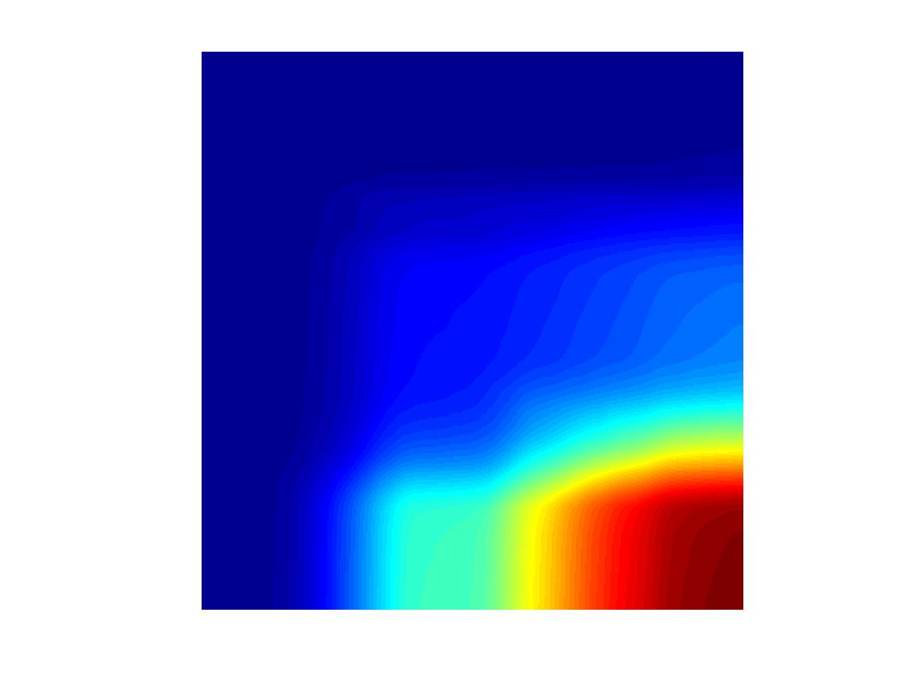
Example
Integral Image
-1
+1
+2
-2
-1
+1

Slide 19
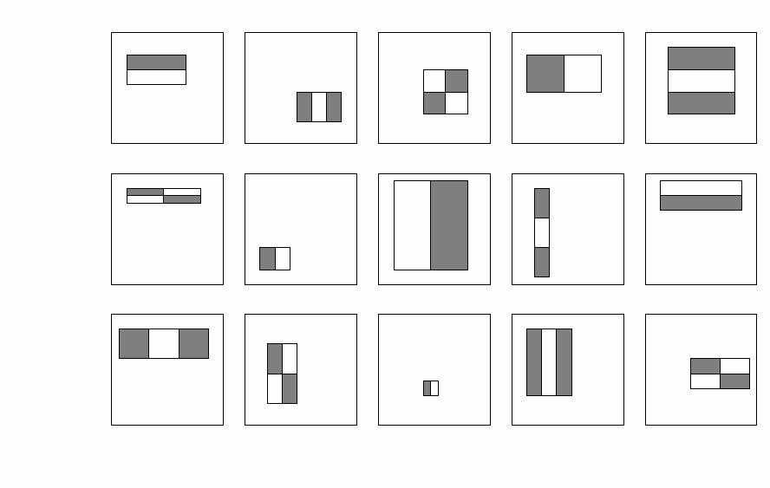
Feature selection
For a 24x24 detection region, the number of possible rectangle features is ~160,000!

Slide 20
Feature selection
For a 24x24 detection region, the number of possible rectangle features is ~160,000!
At test time, it is impractical to evaluate the entire feature set
Can we create a good classifier using just a small subset of all possible features?
How to select such a subset?

Slide 21
Boosting
Boosting is a classification scheme that combines weak learners into a more accurate ensemble classifier
Training procedure
  Initially, weight each training example equally
  In each boosting round:
    Find the weak learner that achieves the lowest weighted training error
    Raise the weights of training examples misclassified by current weak learner
  Compute final classifier as linear combination of all weak learners (weight of each learner is directly proportional to its accuracy)
    Exact formulas for re-weighting and combining weak learners depend on the particular boosting scheme (e.g., AdaBoost)
Y. Freund and R. Schapire, A short introduction to boosting, Journal of Japanese Society for Artificial Intelligence, 14(5):771-780, September, 1999.

Slide 22
Boosting for face detection
Define weak learners based on rectangle features
For each round of boosting:
  Evaluate each rectangle filter on each example
  Select best filter/threshold combination based on weighted training error
  Reweight examples
value of rectangle feature
parity
threshold
window

Slide 23
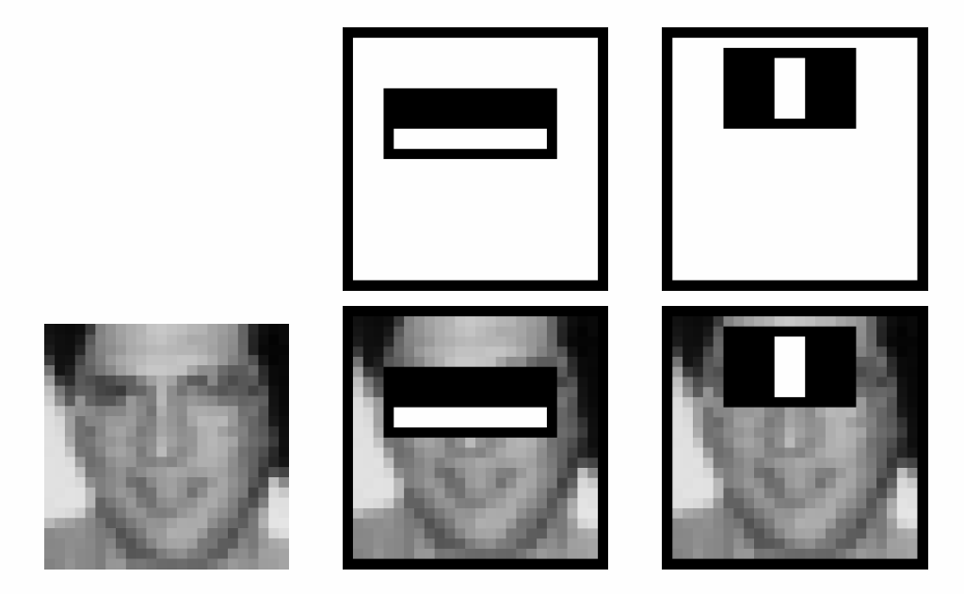
Boosting for face detection
First two features selected by boosting:
This feature combination can yield 100% detection rate and 50% false positive rate

Slide 24
Boosting vs. SVM
Advantages of boosting
  Integrates classifier training with feature selection
  Complexity of training is linear instead of quadratic in the number of training examples
  Flexibility in the choice of weak learners, boosting scheme
  Testing is fast
  Easy to implement
Disadvantages
  Needs many training examples
  Training is slow
  Often doesn’t work as well as SVM (especially for many-class problems)

Slide 25
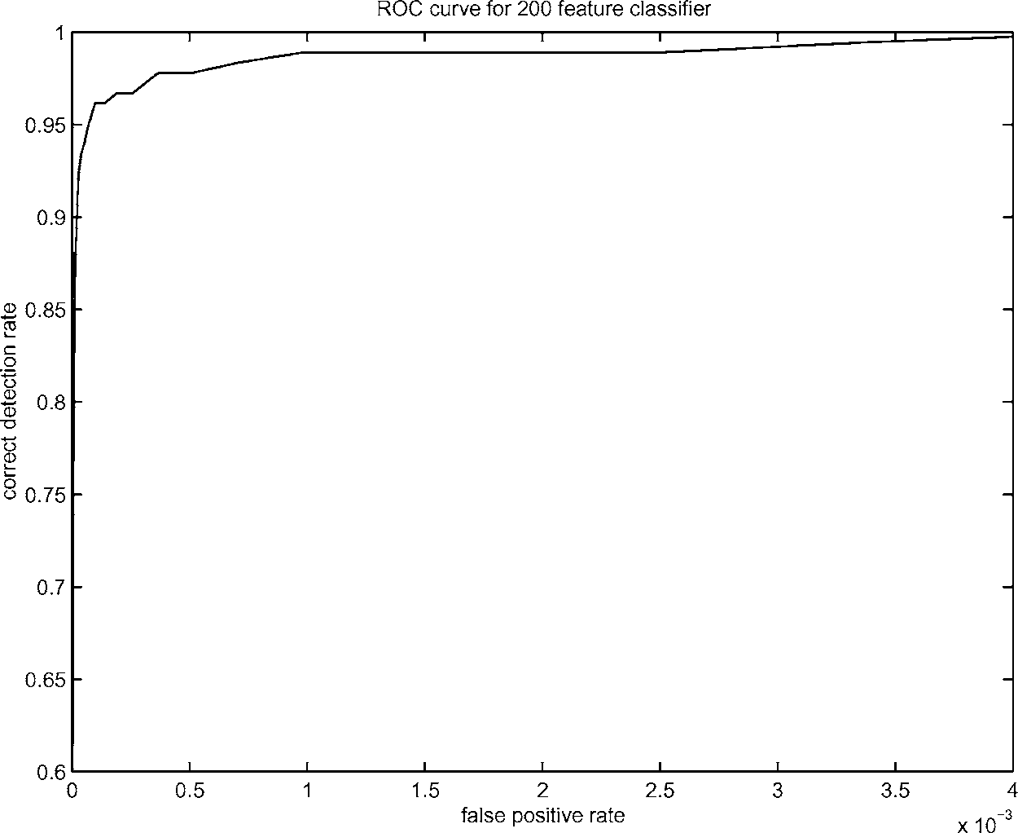
Boosting for face detection
A 200-feature classifier can yield 95% detection rate and a false positive rate of 1 in 14084
Not good enough!
Receiver operating characteristic (ROC) curve

Slide 26
Attentional cascade
We start with simple classifiers which reject many of the negative sub-windows while detecting almost all positive sub-windows
Positive response from the first classifier triggers the evaluation of a second (more complex) classifier, and so on
A negative outcome at any point leads to the immediate rejection of the sub-window
T
T
T
IMAGE
SUB-WINDOW
T
FACE
Classifier 1
Classifier 2
Classifier 3
F
F
F
NON-FACE
NON-FACE
NON-FACE

Slide 27
Attentional cascade
Chain classifiers that are progressively more complex and have lower false positive rates:
Receiver operating characteristic
% False Pos
0
50
vs
false
neg
determined by
0 100
% Detection
T
T
T
IMAGE
SUB-WINDOW
T
FACE
Classifier 1
Classifier 2
Classifier 3
F
F
F
NON-FACE
NON-FACE
NON-FACE
Notes:
In general simple classifiers, while they are more efficient, they are also weaker.
We could define a computational risk hierarchy (in analogy with structural risk minimization)…
A nested set of classifier classes
The training process is reminiscent of boosting…
- previous classifiers reweight the examples used to train subsequent classifiers
The goal of the training process is different
- instead of minimizing errors minimize false positives

Slide 28
Attentional cascade
The detection rate and the false positive rate of the cascade are found by multiplying the respective rates of the individual stages
A detection rate of 0.9 and a false positive rate on the order of 10⁻⁶ can be achieved by a
10-stage cascade if each stage has a detection rate of 0.99 (0.99¹⁰ ≈ 0.9) and a false positive rate of about 0.30 (0.3¹⁰ ≈ 6×10⁻⁶)
T
T
T
IMAGE
SUB-WINDOW
T
FACE
Classifier 1
Classifier 2
Classifier 3
F
F
F
NON-FACE
NON-FACE
NON-FACE

Slide 29
Training the cascade
Set target detection and false positive rates for each stage
Keep adding features to the current stage until its target rates have been met
  Need to lower AdaBoost threshold to maximize detection (as opposed to minimizing total classification error)
  Test on a validation set
If the overall false positive rate is not low enough, then add another stage
Use false positives from current stage as the negative training examples for the next stage

Slide 30
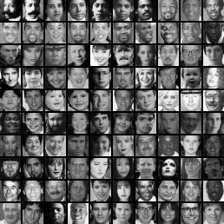
The implemented system
Training Data
  5000 faces
    All frontal, rescaled to
    24x24 pixels
  300 million non-faces
    9500 non-face images
  Faces are normalized
    Scale, translation
Many variations
  Across individuals
  Illumination
  Pose
Notes:
This situation with negative examples is actually quite common… where negative examples are free.

Slide 31
System performance
Training time: “weeks” on 466 MHz Sun workstation
38 layers, total of 6061 features
Average of 10 features evaluated per window on test set
“On a 700 Mhz Pentium III processor, the face detector can process a 384 by 288 pixel image in about .067 seconds”
  15 Hz
  15 times faster than previous detector of comparable accuracy (Rowley et al., 1998)

Slide 32
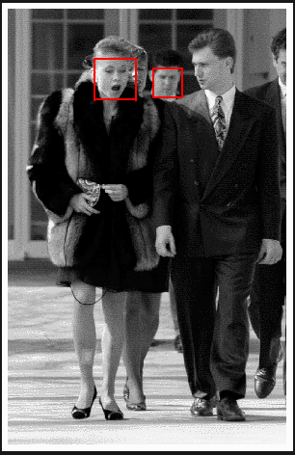
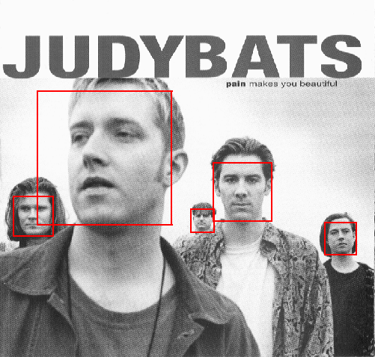
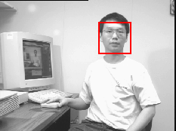
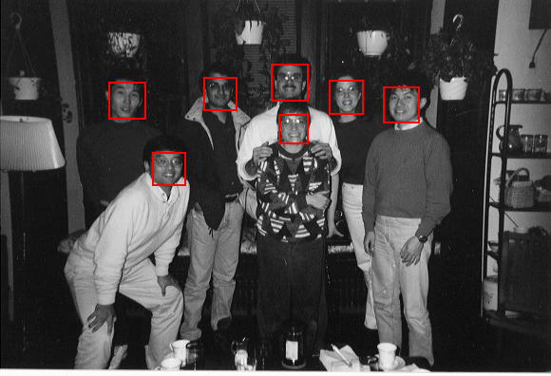
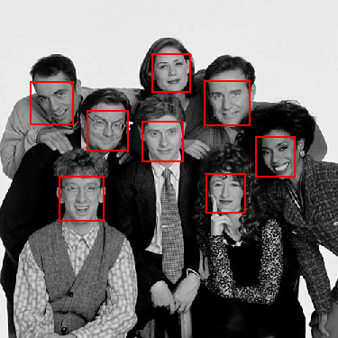
Output of Face Detector on Test Images

Slide 33
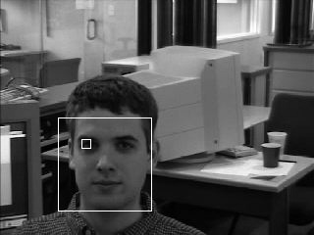
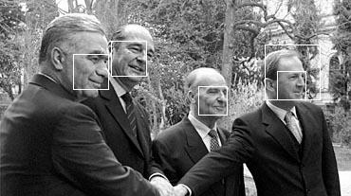
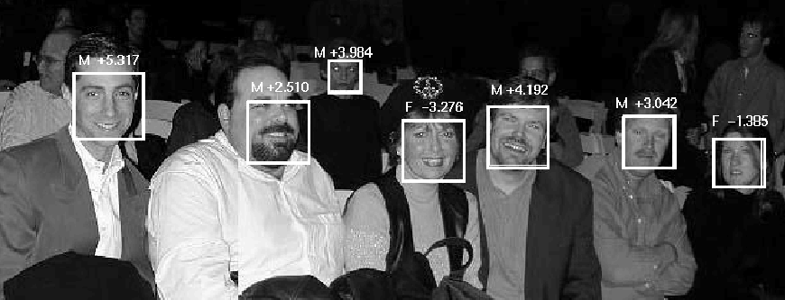
Other detection tasks
Facial Feature Localization
Profile Detection
Male vs.
female

Slide 34
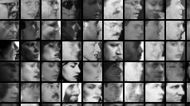
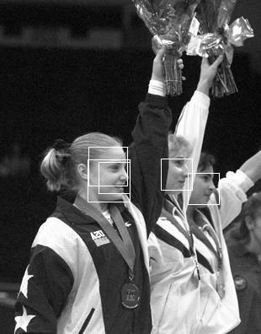
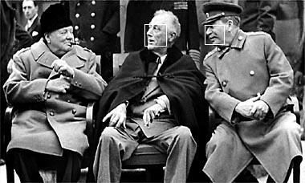
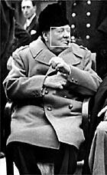
Profile Detection

Slide 35
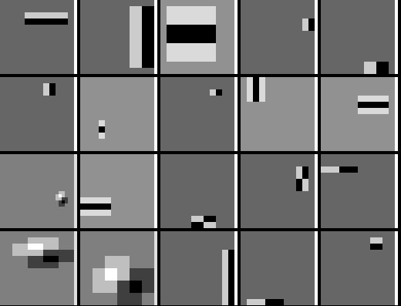
Profile Features

Slide 36
Summary: Viola/Jones detector
Rectangle features
Integral images for fast computation
Boosting for feature selection
Attentional cascade for fast rejection of negative windows

Slide 37
Outline
Face Detection
Face Recognition
  Eigen vs. Fisher faces
  Implicit elastic matching

Slide 38
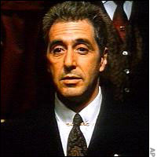
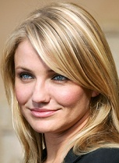
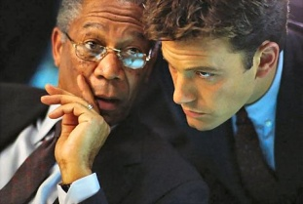
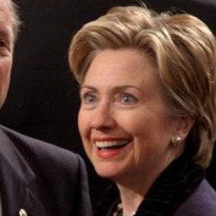
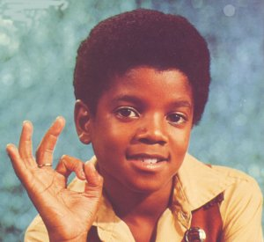
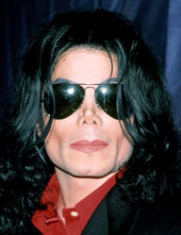
Photos->People->Tags->Social
Photo sharing has become a main online social activity
  FaceBook receives 850 million photo uploads/month
Users care about who are in which photos
  Tagging faces is common in Picasa, iPhoto, WLPG, FaceBook.
Face recognition in real life photos is challenging
  FRGC (controlled): >99.99% accuracy with FAR<0.01%
  LFW [Huang et al. 2007]: ~75% recognition accuracy
Notes:
Why is this problem interesting? Let’s firstly briefly review some of the facts in the online space. First, photo sharing has become a main online social activity. As a matter of fact, FaceBook receives 850 million photo uploads every month and has become the number 1 photo sharing sites. In this context, users care about who are in which photos. That is why tagging faces has become a standard feature for different photo management systems. It is obvious that face detection/recognition can help automate the tagging tasks here. On the research side, face recognition in controlled environment can more or less be regarded as solved problem. For example, according the FRGC2006, the research community has pushed the recognition accuracy to be higher than 99.99% with false acceptance rate less than 0.01%. On the other hand, the research on face recognition in uncontrolled real life photos is not quite there yet.

Slide 39




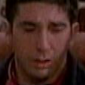





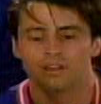
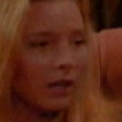
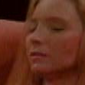







What compose a face recognition system?
Gallery faces
?
… …
… …
… …
Poses, lighting and facial expressions confront recognition
Efficiently matching against large gallery dataset is nontrivial
Large number of subjects matters
Notes:
So what are challenges in real-world face recognition? In a standard face recognition task, one build a set of gallery database of faces with known identities. Then for a new face, we match it against the database and use identity of the best matched face as the potential suggested identity of the new face. In addition to the challenges induced from visual variations such as pose, lighting, and facial expression variations, I would like to raise your attention on two other issues. Firstly, it is known that the more faces you have in the gallery database, the more accurate your face recognition algorithm could be, however, efficiently matching against large gallery dataset is a simple task. Second, if we need to recognize the face of a large number of subjects, and the gallery face database contains a lot of different person with different identities, it will degrade face recognition accuracy, that is simply because the chances of two person to have similar faces will increase. So how are we going to address these issues?

Slide 40
Outline
Face Detection
Face Recognition
  Eigen vs. Fisher faces
  Implicit elastic matching
Turk, M., Pentland, A.: Eigenfaces for recognition. J. Cognitive Neuroscience 3 (1991) 71–86.
Belhumeur, P.,Hespanha, J., Kriegman, D.: Eigenfaces vs. Fisherfaces: recognition using class specific linear projection. IEEE Transactions on Pattern Analysis and Machine Intelligence 19 (1997) 711–720.

Slide 41
Principal Component Analysis
A N x N pixel image of a face, represented as a vector occupies a single point in N²-dimensional image space.
Images of faces being similar in overall configuration, will not be randomly distributed in this huge image space.
Therefore, they can be described by a low dimensional subspace.
Main idea of PCA for faces:
  To find vectors that best account for variation of face images in entire image space.
  These vectors are called eigen vectors.
  Construct a face space and project the images into this face space (eigenfaces).

Slide 42
Image Representation
Training set of m images of size N*N are represented by vectors of size N²
x₁,x₂,x₃,…,x_{M}
Example

Slide 43
Average Image and Difference Images
The average training set is defined by
μ= (1/m) ∑^{m}_{i=1} x_{i}
Each face differs from the average by vector
    r_{i} = x_{i} – μ

Slide 44
Covariance Matrix
The covariance matrix is constructed as
C = AA^{T} where A=[r₁,…,r_{m}]
Finding eigenvectors of N² x N² matrix is intractable. Hence, use the matrix A^{T}A of size m x m and find eigenvectors of this small matrix.
Size of this matrix is N² x N²

Slide 45
Eigenvalues and Eigenvectors - Definition
If v is a nonzero vector and λ is a number such that
Av = λv, then
v is said to be an eigenvector of A with eigenvalue λ.
Example
λ
(eigenvalues)
A
v
(eigenvectors)

Slide 46
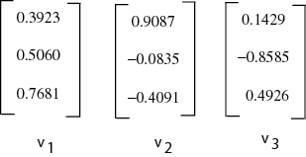
Eigenvectors of Covariance Matrix
The eigenvectors v_{i} of A^{T}A are:
Consider the eigenvectors v_{i} of A^{T}A such that
A^{T}Av_{i} = μ_{i}v_{i}
Premultiplying both sides by A, we have
AA^{T}(Av_{i}) = μ_{i}(Av_{i})

Slide 47
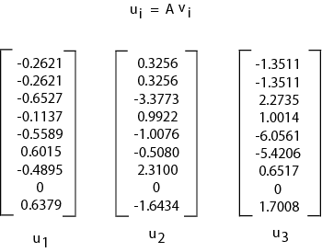
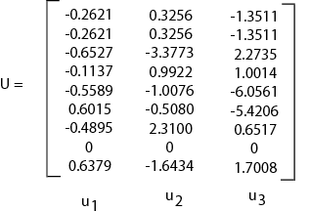
Face Space
The eigenvectors of covariance matrix are
u_{i} = Av_{i}
Face Space
u_{i} resemble facial images which look ghostly, hence called Eigenfaces

Slide 48
Projection into Face Space
A face image can be projected into this face space by
p_{k} = U^{T}(x_{k} – μ) where k=1,…,m

Slide 49
Recognition
The test image x is projected into the face space to obtain a vector p:
p = U^{T}(x – μ)
The distance of p to each face class is defined by
Є_{k}² = ||p-p_{k}||²; k = 1,…,m
A distance threshold Ө_{c}, is half the largest distance between any two face images:
Ө_{c} = ½ max_{j,k} {||p_{j}-p_{k}||}; j,k = 1,…,m

Slide 50
Recognition
Find the distance Є between the original image x and its reconstructed image from the eigenface space, x_{f},
Є² = || x – x_{f} ||² , where x_{f} = U * x + μ
Recognition process:
  IF Є≥Ө_{c}
  then input image is not a face image;
  IF Є<Ө_{c} AND Є_{k}≥Ө_{c} for all k
  then input image contains an unknown face;
  IF Є<Ө_{c} AND Є_{k}*=min_{k}{ Є_{k}} < Ө_{c}
  then input image contains the face of individual k*

Slide 51
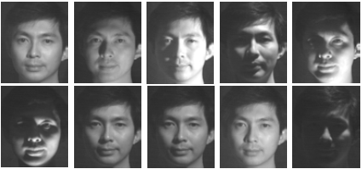
Limitations of Eigenfaces Approach
Variations in lighting conditions
  Different lighting conditions for enrolment and query.
  Bright light causing image saturation.
Differences in pose – Head orientation
  - 2D feature distances appear to distort.
Expression
  - Change in feature location and shape.

Slide 52
Linear Discriminant Analysis
PCA does not use class information
  PCA projections are optimal for reconstruction from a low dimensional basis, they may not be optimal from a discrimination standpoint.
LDA is an enhancement to PCA
  Constructs a discriminant subspace that minimizes the scatter between images of same class and maximizes the scatter between different class images

Slide 53
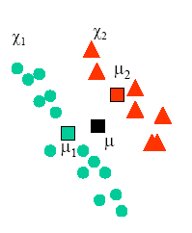
Mean Images
Let X₁, X₂,…, X_{c} be the face classes in the database and let each face class X_{i}, i = 1,2,…,c has k facial images x_{j}, j=1,2,…,k.
We compute the mean image μ_{i} of each class X_{i} as:
Now, the mean image μ of all the classes in the database can be calculated as:

Slide 54
Scatter Matrices
We calculate within-class scatter matrix as:
We calculate the between-class scatter matrix as:

Slide 55
Multiple Discriminant Analysis
We find the projection directions as the matrix W that maximizes
This is a generalized Eigenvalue problem where the columns of W are given by the vectors w_{i} that solve

Slide 56
Fisherface Projection
We find the product of S_{W}⁻¹ and S_{B} and then compute the Eigenvectors of this product (S_{W}⁻¹ S_{B}) - AFTER REDUCING THE DIMENSION OF THE FEATURE SPACE.
Use same technique as Eigenfaces approach to reduce the dimensionality of scatter matrix to compute eigenvectors.
Form a matrix W that represents all eigenvectors of S_{W}⁻¹ S_{B} by placing each eigenvector w_{i} as a column in W.
Each face image x_{j} ∈ X_{i} can be projected into this face space by the operation
      p_{i} = W^{T}(x_{j} – μ)

Slide 57
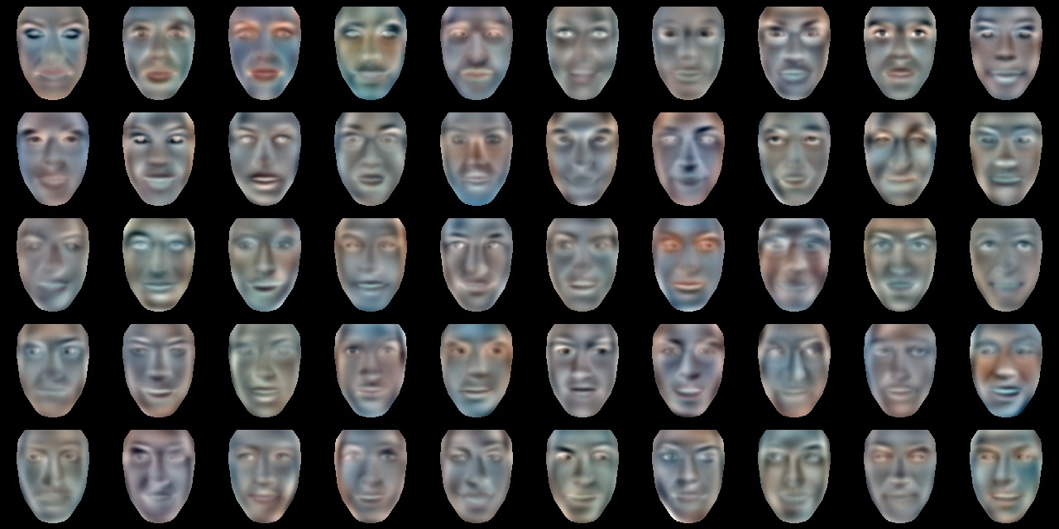

Slide 58
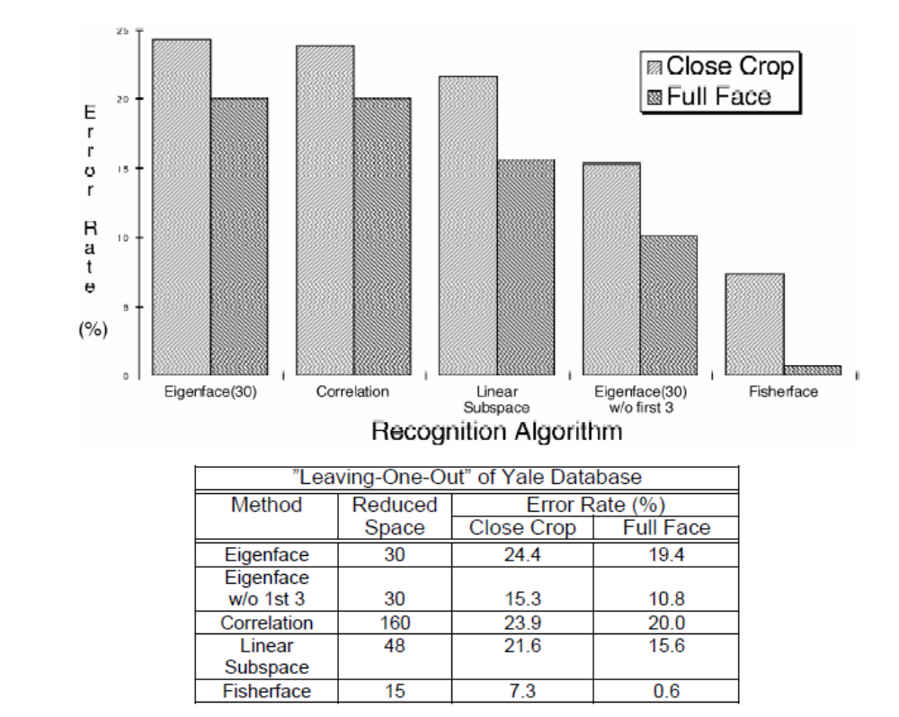
Eigen vs. Fisher faces
Results reported on Yale database

Slide 59
Outline
Face Detection
Face Recognition
  Eigen vs. Fisher faces
  Implicit elastic matching

Slide 60
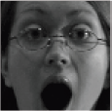
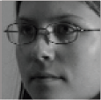

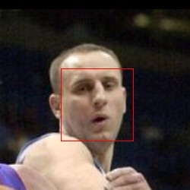



Preprocessing
Input to our algorithm
Face Detection
Boosted cascade
Eye Detection
Neural network
Face alignment
Similarity transform to canonical frame
Illumination
normalization
Self-quotient image
[Viola-Jones ‘01]
[Wang et. al. ‘04]
Notes:
We proceed to present the details of our face recognition algorithm. Just as in any other face recognition algorithm, our face recognition algorithm starts with an automatic face detector, and then we detect the eye locations of the detected the face. The face is then rectified into a canonical coordinate by nail the two eyes into some canonical positions. We then perform a illumination normalization scheme to compensate for possible lighting variations. We shall note that in these preprocessing steps, we try to compensate for as much pose variations as possible. However, it is not going to fully address these two visual variations, as demonstrated by the examples shown in the slides. Significant pose variation still present in the rectified image. So we need to further address them in our matching algorithm.

Slide 61

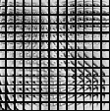
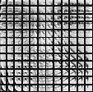
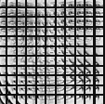




Feature extraction
Gaussian pyramid
Dense sampling in scale
Patches
8×8, extracted on a regular grid at each scale
One feature descriptor per patch:
DAISY Shape
<
0
{ f₁ … f_{n} }
*
>
f_{i} ε R⁴⁰⁰
n ≈ 500
Filtering
Convolution with 4 oriented fourth-derivative of Gaussian quadrature pairs
Spatial Aggregation
Log-polar arrangement of 25 Gaussian-weighted regions
Notes:
After preprocessing, we build a Gaussian pyramid and densely sample 8x8 small image patches out of each image level. For each image patch, we extract a local image descriptor out of it. Here we utilized a 400 dimensional descriptor from our descriptor set. We shall clarify that we just picked up one, other descriptors, such as those discussed in part one of my talk can also be used. Therefore in the end, each face is transformed into a set of 400 dimensional feature vectors.

Slide 62


Face representation & matching
Adjoin Spatial information:
f₁
x₁
y₁
f_{n}
x_{n}
y_{n}
{ f₁ … f_{n} }
…
{ g_{1,} g₂ … g_{n} }
…
Quantizating by a forest of randomized trees in Feature Space × Image Space :
T₁
T₂
T_{k}
f₁
x₁
y₁
w,
<
τ
>
…
Each feature g_{i} contributes to k bins of the combined histogram vector h.
IDF weighted L₁ norm: w_{i} = log ( #{ training h : h(i) > 0 } / #training ).
d( h, h’ ) = Σ_{i} w_{i} | h(i) – h’(i) |
Notes:
We further augment each descriptor by the (x,y) location of the image patch it is associated with. We quantize each of the augmented descriptors by a set K of randomized trees. We concatenate of the histogram in formed in the tree nodes of each of the randomized trees into a combined histogram. Obviously, each feature gi of a face will contribute to k bin of the combined histogram. The randomized trees could be trained offline by a face dataset, where at each tree nodes, we generate a random projection, and sort the projected value of all feature vectors, and split them with the median value. Due to the random projection, we can generate multiple trees. Therefore, in our algorithm, each face will be represented by a histogram. We then define the similarity metric to be an IDF weithed L1 norm, where the IDF weight is to demote those features appeared in two many faces because they are less discriminative.

Slide 63
Randomized projection trees
{ w, [f x y]’ }
<
w a random projection:
w ~ N( 0, Σ ).
Linear decision at each node:
τ
>
Normalizes spatial and feature parts
{ w, [f x y]’ }
τ = median
Can also be randomized
w
τ
Why random projections?
Simple
Interact well with high-dimensional sparse data (feature descriptors!)
Generalize trees used previously used for vision tasks (kd-trees, Extremely Randomized Forests)
[Dasgupa & Freund, Wakin et. al., ...]
[Guerts, LePetit & Fua, ...]
Additional data-dependence can be introduced through multiple trials:
Select a (w, τ) pair that minimizes a cost function (i.e., MSE, conditional entropy)
Notes:
Each randomized projection tree is induced re-cursively by generate a random projection w from a Gaussian distribution, and then the median of all the projected values in this tree node is picked up as the thresholding.

Slide 64
Ross
Query face
…
…
…
…
…
…
…
… …
Gallery faces
Notes:
To illustrate this inverted indexing and matching process, suppose we have N faces. Remember each face in the end is represented as a set of weighted integers. We can build inverted list to encode, for each integer, which faces it has presented. Then when match a new query faces, we can perform a forward look-up on the set of integers the query face encoded, as shown by the animation there. The gallery face with the maximum vote will be best match of the query face.

Slide 65

Exploring the optimal settings
A subset of PIE for exploration (11554 faces / 68 users)
  30 faces per person are used for inducing the trees
Three settings to explore
  Histogram distance metric
  Tree depth
  Number of trees
Distance metric | Reco. Rate
L2 un-weighted | 86.3%
L2 IDF-weighted | 86.7%
L1 un-weighted | 89.3%
L1 IDF-weighted | 89.4%
Forest size | 1 | 5 | 10 | 15
Reco. Rate | 89.4% | 92.4% | 93.1% | 93.6%
Notes:
We explored the best parameter setting for our algorithm, such as the depth of the tree, number of trees, as well as histogram distance metric on a benchmark dataset. Some general findings are 1) IDF weighted distance is better than un-weighted distance with a small margin. And L1 distance leads L2 distance by a significant margin. Our randomized tree depth is about 10 and we use 10 trees in all our experiments.

Slide 66








Recognition accuracy (1)
 | ORL 40 subjects Unconstrained | Ext. Yale B 38 subjects , Extreme illumination | PIE 68 subjects Pose, illumination | Multi-PIE 250 subjects Pose, illumination, expression, time
Baseline (PCA) | 88.1% | 65.4% | 62.1% | 32.1%
LDA | 93.9% | 81.3% | 89.1% | 37.0%
LPP | 93.7% | 86.4% | 89.2% | 21.9%
This work | 96.5% | 91.4% | 94.3% | 67.6%
Gallery faces:
  ORL: 5 faces/subject YaleB: 20 faces/subject
  PIE: 30 faces/subject Multi-PIE: faces in the 1st session
Notes:
We extensively explored the performance of our algorithm on four face recognition benchmarks, and compare them with different holistic appearance based methods which leverage generative or discriminative subspace to represent the face images. Obviously, our algorithm outperform our comparison algorithm in all these four databases. I shall highlight the results on the fourth benchmark, the Multi-PIE dataset, because this dataset represents the largest pose variation. As we can clearly see, our algorithm lead them by a significant margin. This validates the robustness of our algorithmic to pose variations.

Slide 67
Recognition accuracy (2)
 | PIE->ORL (ORL->ORL) | ORL->PIE (PIE->PIE) | PIE -> Multi-PIE (Multi-PIE->Multi-PIE)
Baseline (PCA) | 85.0% (88.1%) | 55.7% (62.1%) | 26.5% (32.6%)
LDA | 58.5% (93.9%) | 72.8% (89.1%) | 8.5% (37.0%)
LPP | 17.0% (93.7%) | 69.1% (89.2%) | 17.1% (21.9%)
This work | 92.5% (96.5%) | 89.7% (94.3%) | 67.2% (67.6%)
The first dataset is used for inducing the forest
The forest is then applied to test on the second dataset
Notes:
We further validate the generalization ability of the proposed method by inducing the tree in a different dataset than the test dataset. As we can clearly observe, cross dataset generalization of our algorithm is pretty good, while those discriminative subspace method presented poor generalization ability.

Slide 68








Social network scope and priors
Scope the recognition by social network
Build the prior probability of whom Rachel would like to tag
Notes:
OK, we have address the database selection issue. Any questions? Next let me show you how social network context could be leveraged to improve face recognition accuracy. The first observation is, although an online social network site may have a lot of users, for a specific user, such as Rachel, her friend network is only a very small number. As a matter of fact, on face book, the average number of friends connection a user has is around 150. So we don’t really need recognize 10000 different identities. Secondly

Slide 69









Effects of social priors
Perfect recognition
Recognition w/ Priors
Recognition w/o Priors

Slide 70

Face Recognition
N. Kumar, A. C. Berg, P. N. Belhumeur, and S. K. Nayar, "Attribute and Simile Classifiers for Face Verification," ICCV 2009.

Slide 71


Face Recognition
Attributes for training
Similes for training
N. Kumar, A. C. Berg, P. N. Belhumeur, and S. K. Nayar, "Attribute and Simile Classifiers for Face Verification," ICCV 2009.

Slide 72

Face Recognition
Results on Labeled Faces in the Wild Dataset
N. Kumar, A. C. Berg, P. N. Belhumeur, and S. K. Nayar, "Attribute and Simile Classifiers for Face Verification," ICCV 2009.

