Slide 1
CS558 Computer Vision
Lecture XI – Binocular and Multi-view Stereo
Adapted from S. Lazebnik

Slide 2
Outline
Binocular stereo
Multiview stereo

Slide 3
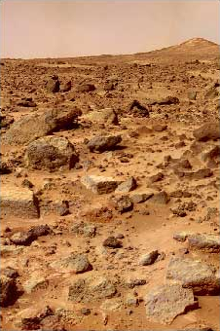
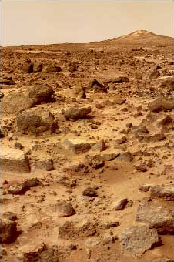
Binocular stereo
Given a calibrated binocular stereo pair, fuse it to produce a depth image
Where does the depth information come from?

Slide 4
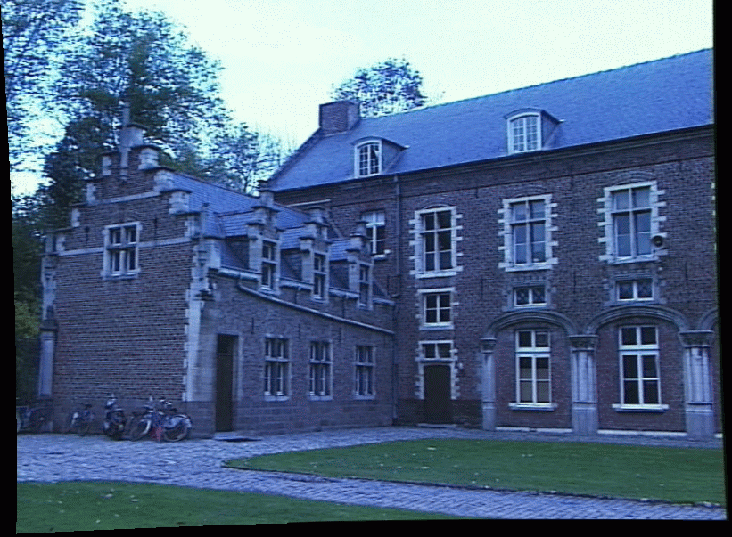
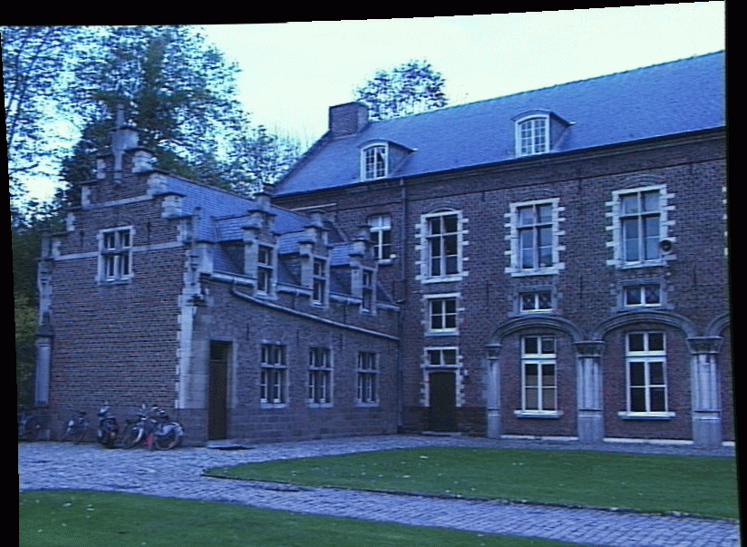
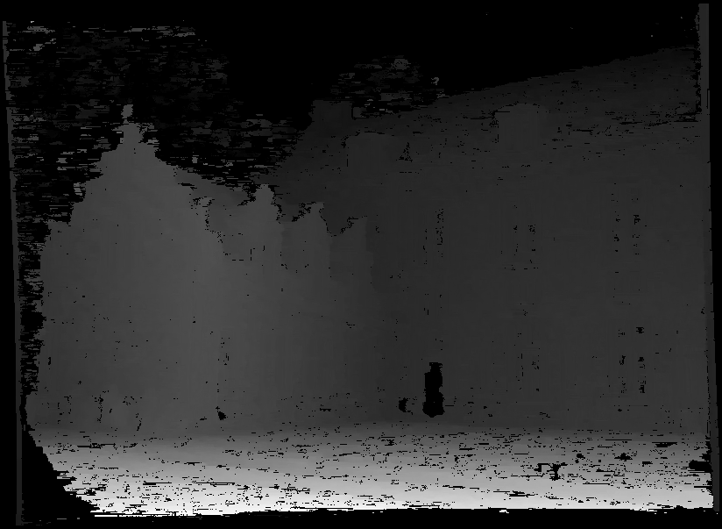
Binocular stereo
Given a calibrated binocular stereo pair, fuse it to produce a depth image
image 1
image 2
Dense depth map

Slide 5
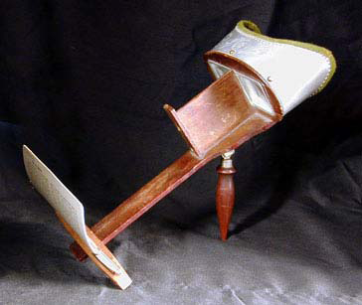
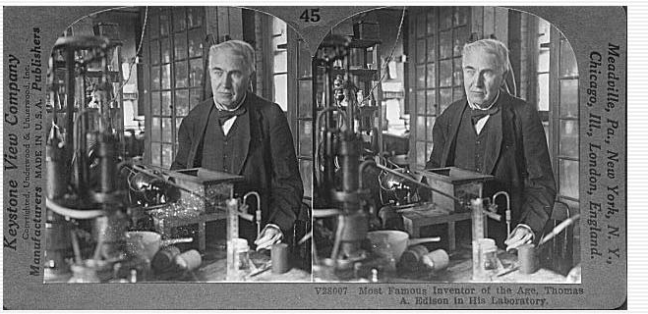
Binocular stereo
Given a calibrated binocular stereo pair, fuse it to produce a depth image
  Humans can do it
Stereograms: Invented by Sir Charles Wheatstone, 1838

Slide 6
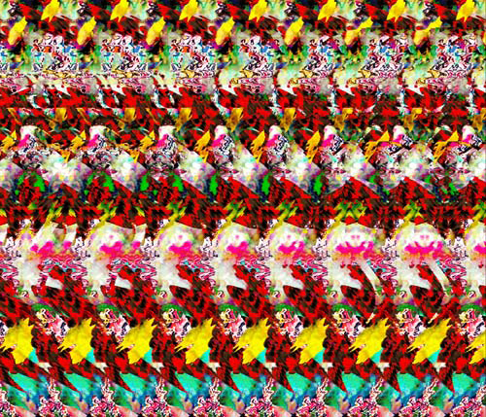
Binocular stereo
Given a calibrated binocular stereo pair, fuse it to produce a depth image
  Humans can do it
Autostereograms: www.magiceye.com

Slide 7
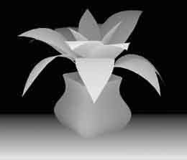
Binocular stereo
Given a calibrated binocular stereo pair, fuse it to produce a depth image
  Humans can do it
Autostereograms: www.magiceye.com

Slide 8
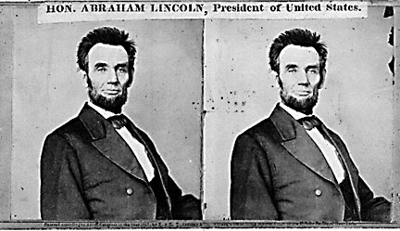
Basic stereo matching algorithm
For each pixel in the first image
  Find corresponding epipolar line in the right image
  Examine all pixels on the epipolar line and pick the best match
  Triangulate the matches to get depth information
Simplest case: epipolar lines are scanlines
  When does this happen?

Slide 9
Simplest Case: Parallel images
Image planes of cameras are parallel to each other and to the baseline
Camera centers are at same height
Focal lengths are the same

Slide 10
Simplest Case: Parallel images
Image planes of cameras are parallel to each other and to the baseline
Camera centers are at same height
Focal lengths are the same
Then, epipolar lines fall along the horizontal scan lines of the images

Slide 11
Essential matrix for parallel images
Epipolar constraint:
R = I t = (T, 0, 0)
x
x’
t

Slide 12
Essential matrix for parallel images
Epipolar constraint:
R = I t = (T, 0, 0)
x
x’
t
The y-coordinates of corresponding points are the same!

Slide 13
Depth from disparity
X
z
x
x’
f
f
O
Baseline
B
O’
Disparity is inversely proportional to depth!

Slide 14
Stereo image rectification

Slide 15
Stereo image rectification
reproject image planes onto a common
plane parallel to the line between optical centers
pixel motion is horizontal after this transformation
two homographies (3x3 transform), one for each input image reprojection
C. Loop and Z. Zhang. Computing Rectifying Homographies for Stereo Vision. IEEE Conf. Computer Vision and Pattern Recognition, 1999.

Slide 16
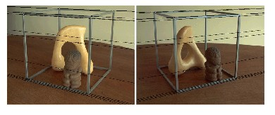
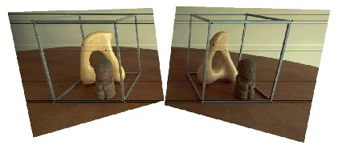
Rectification example

Slide 17
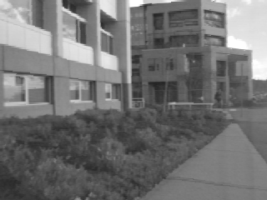
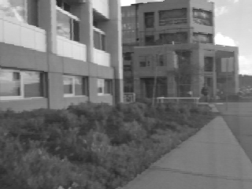
Correspondence search
Left
Right
scanline
Matching cost
disparity
Slide a window along the right scanline and compare contents of that window with the reference window in the left image
Matching cost: SSD or normalized correlation

Slide 18
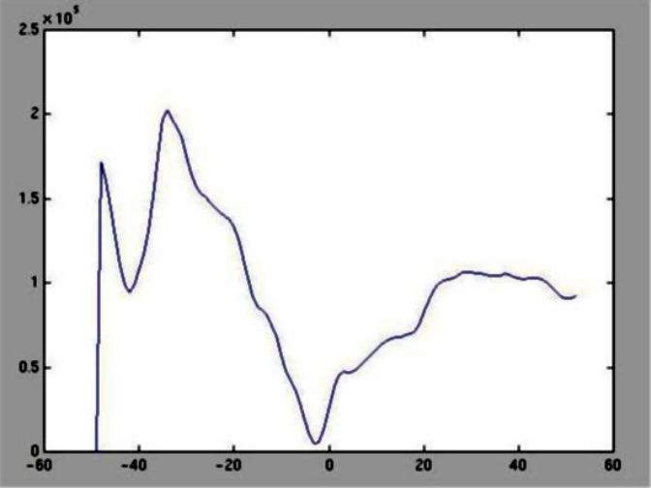
Correspondence search
Left
Right
scanline
SSD

Slide 19
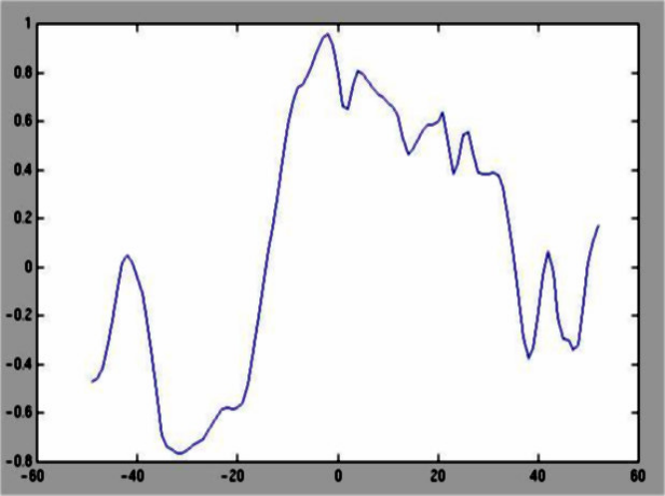
Correspondence search
Left
Right
scanline
Norm. corr

Slide 20
Basic stereo matching algorithm
If necessary, rectify the two stereo images to transform epipolar lines into scanlines
For each pixel x in the first image
  Find corresponding epipolar scanline in the right image
  Examine all pixels on the scanline and pick the best match x’
  Compute disparity x-x’ and set depth(x) = B*f/(x-x’)

Slide 21

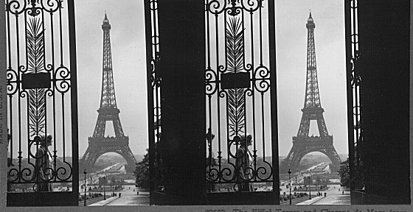

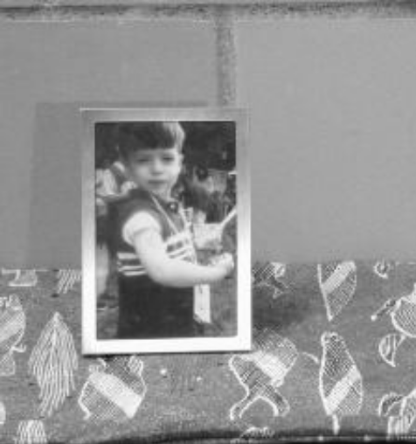
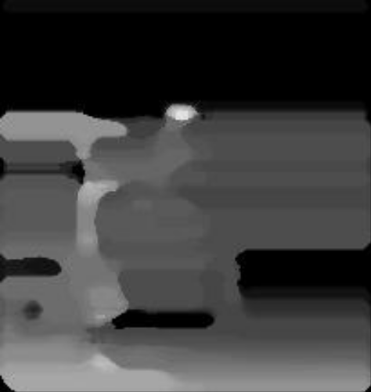
Failures of correspondence search
Textureless surfaces
Occlusions, repetition
Non-Lambertian surfaces, specularities

Slide 22
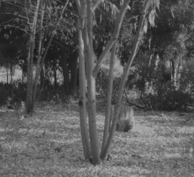
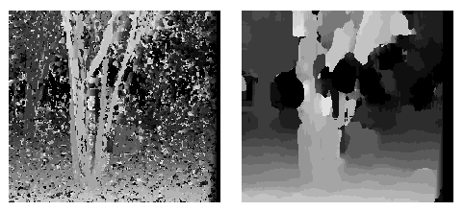
Effect of window size
W = 3
W = 20
  Smaller window
    More detail
    More noise
  Larger window
    Smoother disparity maps
    Less detail
Notes:
smaller window: more detail, more noise
bigger window: less noise, more detail

Slide 23
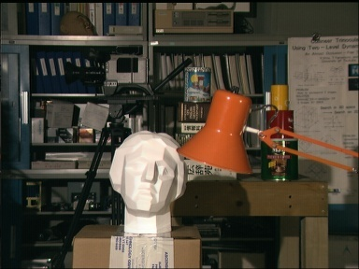
Results with window search
Data
Window-based matching
Ground truth

Slide 24
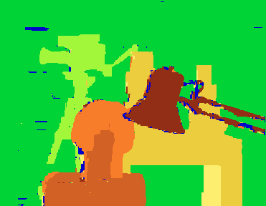
Better methods exist...
Graph cuts
Ground truth
  Y. Boykov, O. Veksler, and R. Zabih, Fast Approximate Energy Minimization via Graph Cuts, PAMI 2001
    For the latest and greatest: http://www.middlebury.edu/stereo/

Slide 25
How can we improve window-based matching?
The similarity constraint is local (each reference window is matched independently)
Need to enforce non-local correspondence constraints

Slide 26
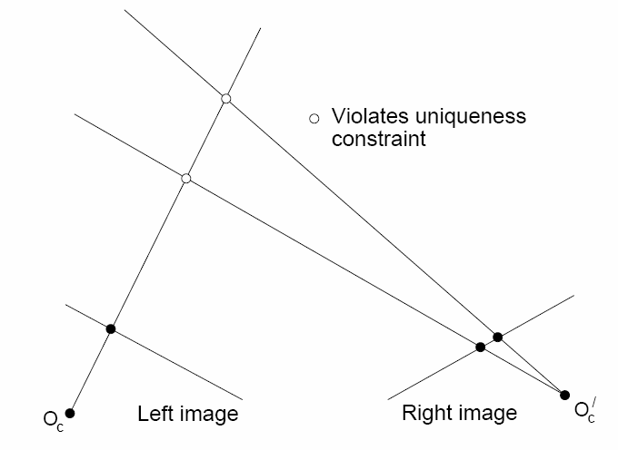
Non-local constraints
Uniqueness
  For any point in one image, there should be at most one matching point in the other image

Slide 27
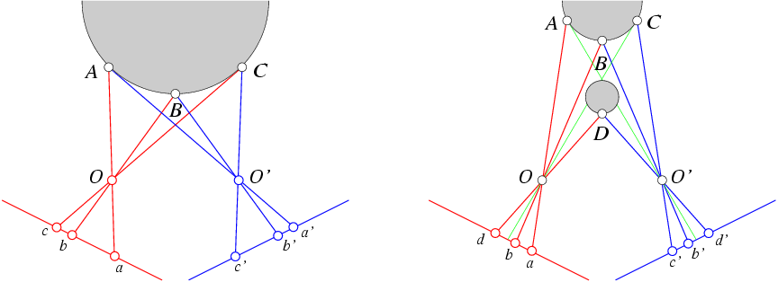
Non-local constraints
Uniqueness
  For any point in one image, there should be at most one matching point in the other image
Ordering
  Corresponding points should be in the same order in both views

Slide 28
Non-local constraints
Uniqueness
  For any point in one image, there should be at most one matching point in the other image
Ordering
  Corresponding points should be in the same order in both views
Ordering constraint doesn’t hold

Slide 29
Non-local constraints
Uniqueness
  For any point in one image, there should be at most one matching point in the other image
Ordering
  Corresponding points should be in the same order in both views
Smoothness
  We expect disparity values to change slowly (for the most part)

Slide 30
Scanline stereo
Try to coherently match pixels on the entire scanline
Different scanlines are still optimized independently
Left image
Right image

Slide 31
“Shortest paths” for scan-line stereo
Left image
Right image
Right
occlusion
q
Left occlusion
correspondence
t
s
p
  Can be implemented with dynamic programming
  Ohta & Kanade ’85, Cox et al. ‘96
Slide credit: Y. Boykov

Slide 32
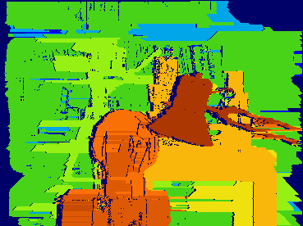
Coherent stereo on 2D grid
Scanline stereo generates streaking artifacts
Can’t use dynamic programming to find spatially coherent disparities/ correspondences on a 2D grid

Slide 33
Stereo matching as energy minimization
I₁
I₂
D
W₁(i )
W₂(i+D(i ))
D(i )
data term
smoothness term
Energy functions of this form can be minimized using graph cuts
  Y. Boykov, O. Veksler, and R. Zabih, Fast Approximate Energy Minimization via Graph Cuts, PAMI 2001

Slide 34
Stereo matching as energy minimization
I₁
I₂
D
W₁(i )
W₂(i+D(i ))
D(i )
Probabilistic interpretation: we want to find a Maximum A Posteriori (MAP) estimate of disparity image D:

Slide 35
Stereo matching as energy minimization
Note: the above formulation does not treat the two images symmetrically, does not enforce uniqueness, and does not take occlusions into account
It is possible to come up with an energy that does all these things, but it’s a bit more complex
  Defined over all possible sets of matches, not over all disparity maps with respect to the first image
  Includes an occlusion term
  The smoothness term looks different and more complicated
V. Kolmogorov and R. Zabih, Computing Visual Correspondence with Occlusions using Graph Cuts, ICCV 2001

Slide 36
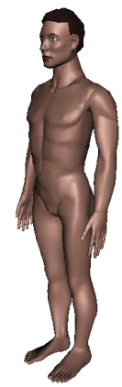
Active stereo with structured light
Project “structured” light patterns onto the object
  Simplifies the correspondence problem
  Allows us to use only one camera
camera
projector
L. Zhang, B. Curless, and S. M. Seitz. Rapid Shape Acquisition Using Color Structured Light and Multi-pass Dynamic Programming. 3DPVT 2002

Slide 37

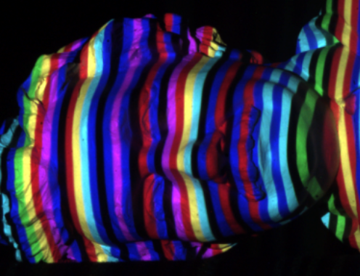
Active stereo with structured light
L. Zhang, B. Curless, and S. M. Seitz. Rapid Shape Acquisition Using Color Structured Light and Multi-pass Dynamic Programming. 3DPVT 2002

Slide 38
Active stereo with structured light
http://en.wikipedia.org/wiki/Structured-light_3D_scanner

Slide 39
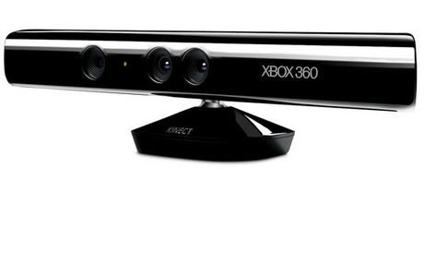
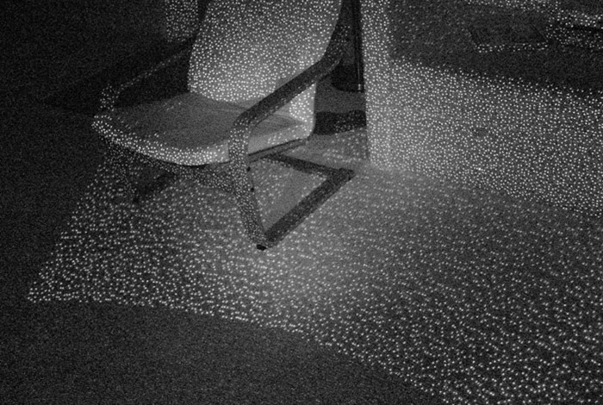
Kinect: Structured infrared light
http://bbzippo.wordpress.com/2010/11/28/kinect-in-infrared/

Slide 40
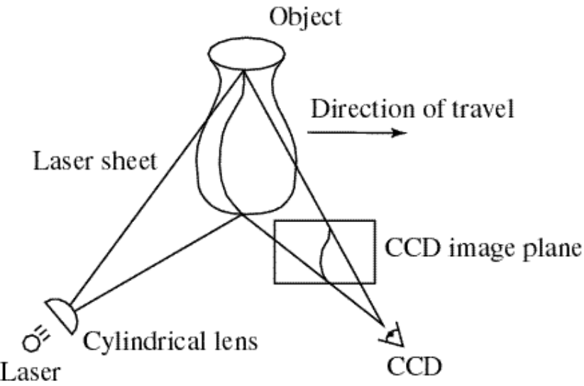
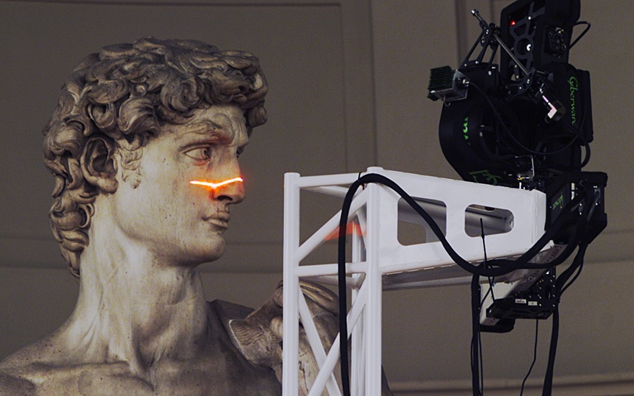
Laser scanning
Digital Michelangelo Project
Levoy et al.
http://graphics.stanford.edu/projects/mich/
Optical triangulation
  Project a single stripe of laser light
  Scan it across the surface of the object
  This is a very precise version of structured light scanning
Source: S. Seitz

Slide 41
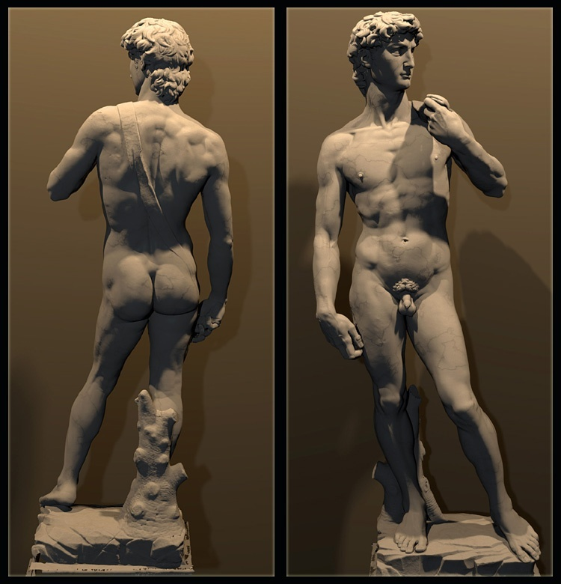
Laser scanned models
  The Digital Michelangelo Project, Levoy et al.
Source: S. Seitz

Slide 42
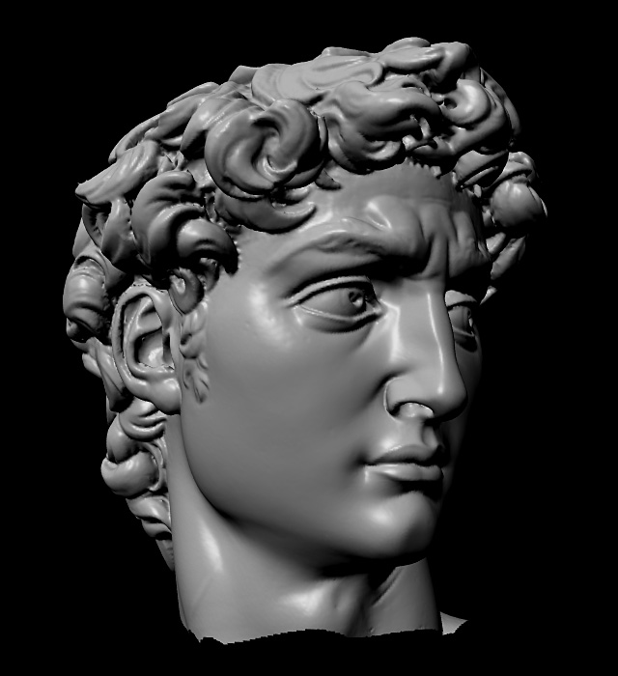
Laser scanned models
  The Digital Michelangelo Project, Levoy et al.
Source: S. Seitz

Slide 43
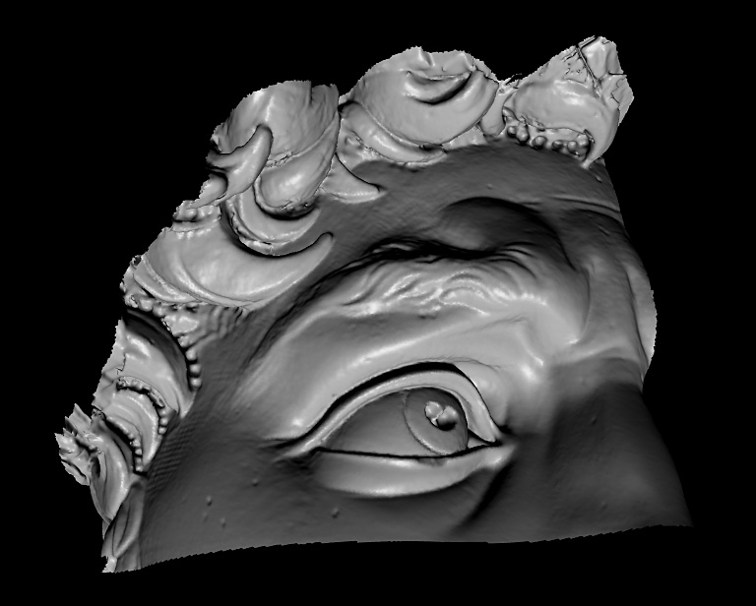
Laser scanned models
  The Digital Michelangelo Project, Levoy et al.
Source: S. Seitz

Slide 44
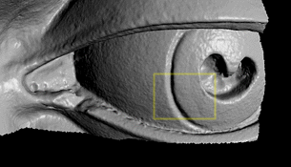
Laser scanned models
  The Digital Michelangelo Project, Levoy et al.
Source: S. Seitz

Slide 45
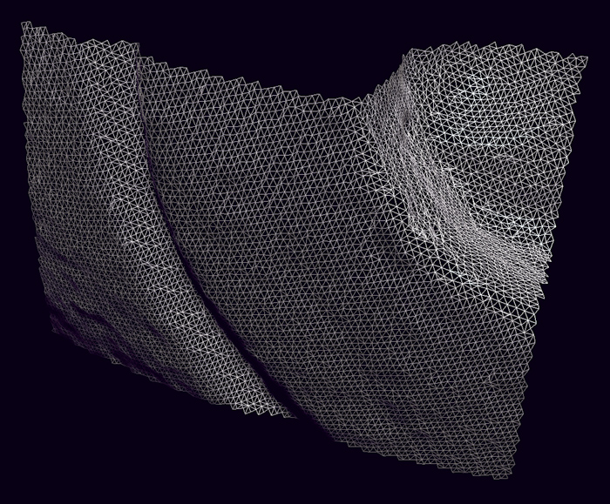
Laser scanned models
1.0 mm resolution (56 million triangles)
  The Digital Michelangelo Project, Levoy et al.
Source: S. Seitz

Slide 46
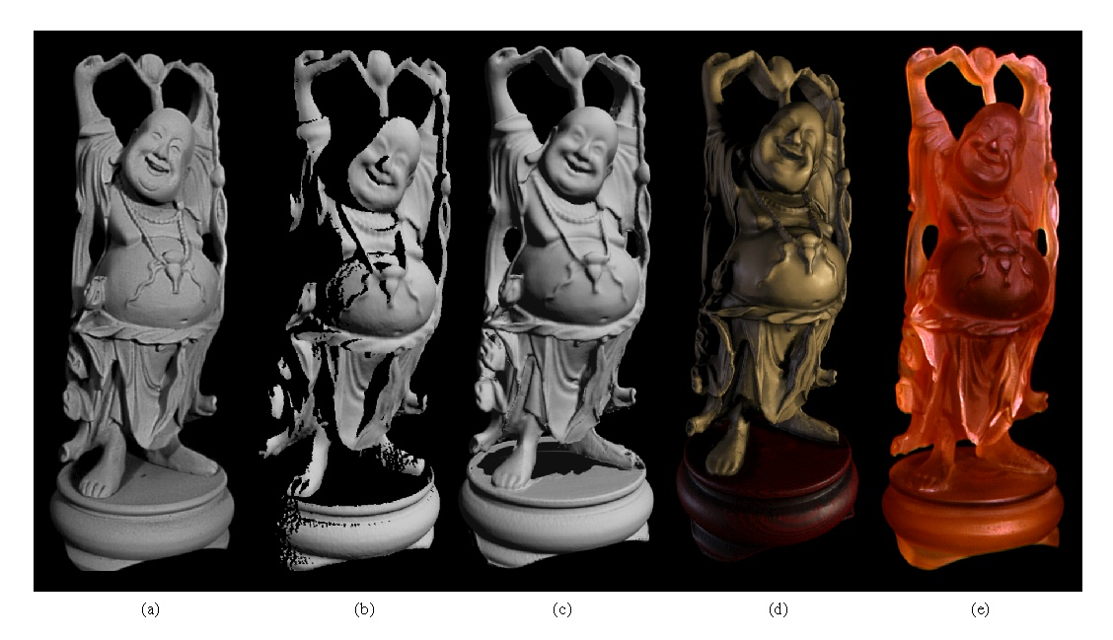
Aligning range images
A single range scan is not sufficient to describe a complex surface
Need techniques to register multiple range images
B. Curless and M. Levoy, A Volumetric Method for Building Complex Models from Range Images, SIGGRAPH 1996

Slide 47
Aligning range images
A single range scan is not sufficient to describe a complex surface
Need techniques to register multiple range images
… which brings us to multi-view stereo

Slide 48
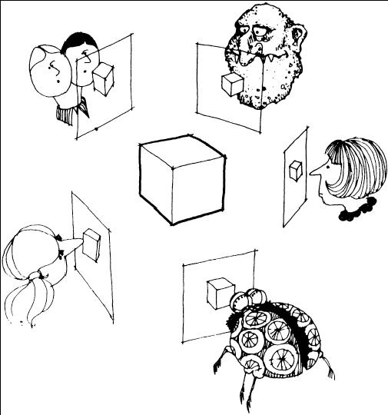
Multi-view stereo
Many slides adapted from S. Seitz

Slide 49
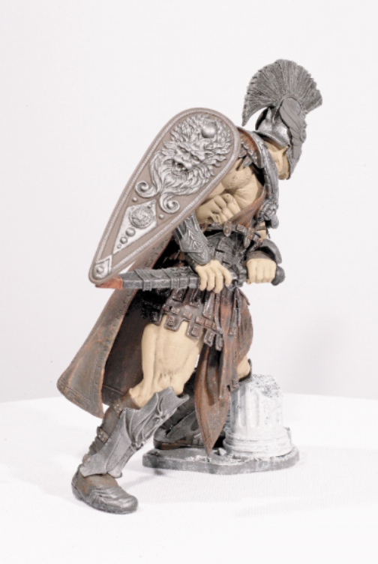
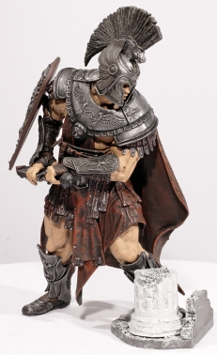
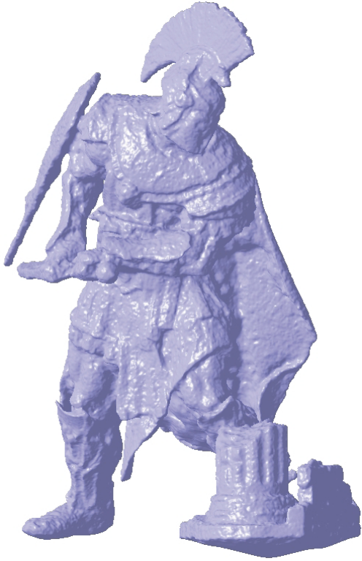
What is stereo vision?
Generic problem formulation: given several images of the same object or scene, compute a representation of its 3D shape

Slide 50
What is stereo vision?
Generic problem formulation: given several images of the same object or scene, compute a representation of its 3D shape
“Images of the same object or scene”
  Arbitrary number of images (from two to thousands)
  Arbitrary camera positions (camera network or video sequence)
  Calibration may be initially unknown
“Representation of 3D shape”
  Depth maps
  Meshes
  Point clouds
  Patch clouds
  Volumetric models
  Layered models

Slide 51
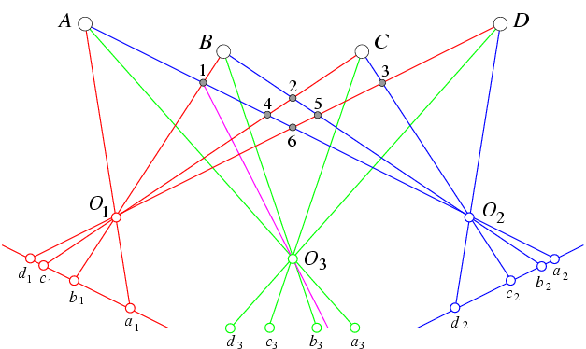
Beyond two-view stereo
The third view can be used for verification

Slide 52
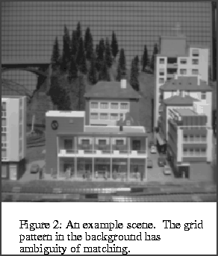
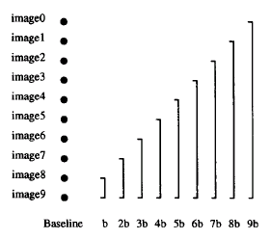
Multiple-baseline stereo
Pick a reference image, and slide the corresponding window along the corresponding epipolar lines of all other images, using inverse depth relative to the first image as the search parameter
M. Okutomi and T. Kanade, “A Multiple-Baseline Stereo System,” IEEE Trans. on Pattern Analysis and Machine Intelligence, 15(4):353-363 (1993).

Slide 53
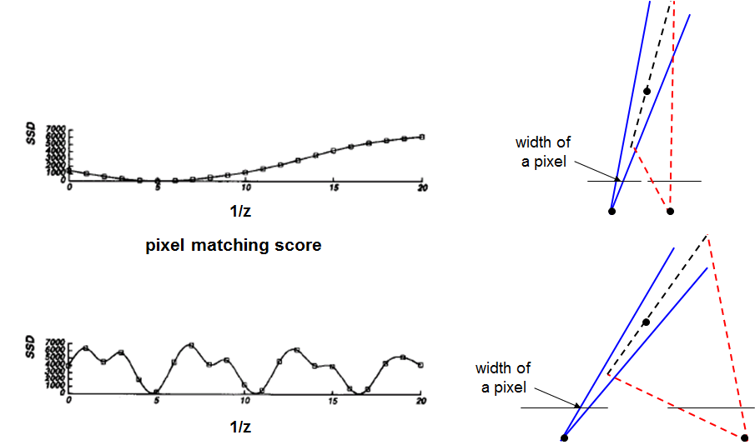
Multiple-baseline stereo
For larger baselines, must search larger
area in second image

Slide 54
Multiple-baseline stereo
Use the sum of SSD scores to rank matches

Slide 55
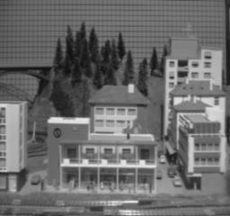

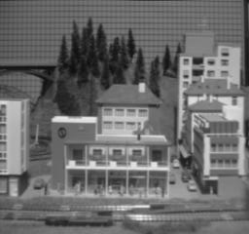
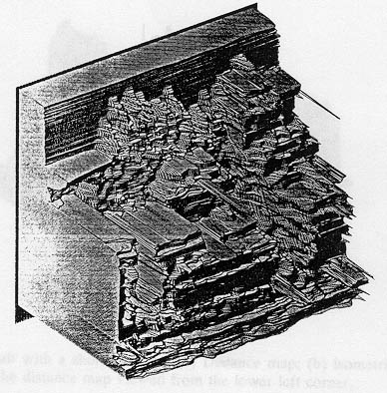
Multiple-baseline stereo results
I1
I2
I10
M. Okutomi and T. Kanade, “A Multiple-Baseline Stereo System,” IEEE Trans. on Pattern Analysis and Machine Intelligence, 15(4):353-363 (1993).

Slide 56
Plane Sweep Stereo
Choose a reference view
Sweep family of planes at different depths with respect to the reference camera
input image
input image
reference camera
  Each plane defines a homography warping each input image into the reference view
R. Collins. A space-sweep approach to true multi-image matching. CVPR 1996.

Slide 57
Plane Sweep Stereo
For each depth plane
  For each pixel in the composite image stack, compute the variance
For each pixel, select the depth that gives the lowest variance

Slide 58
Plane Sweep Stereo
For each depth plane
  For each pixel in the composite image stack, compute the variance
For each pixel, select the depth that gives the lowest variance
Can be accelerated using graphics hardware
R. Yang and M. Pollefeys. Multi-Resolution Real-Time Stereo on Commodity Graphics Hardware, CVPR 2003

Slide 59
Volumetric stereo
In plane sweep stereo, the sampling of the scene
depends on the reference view
We can use a voxel volume to get a view-
independent representation

Slide 60
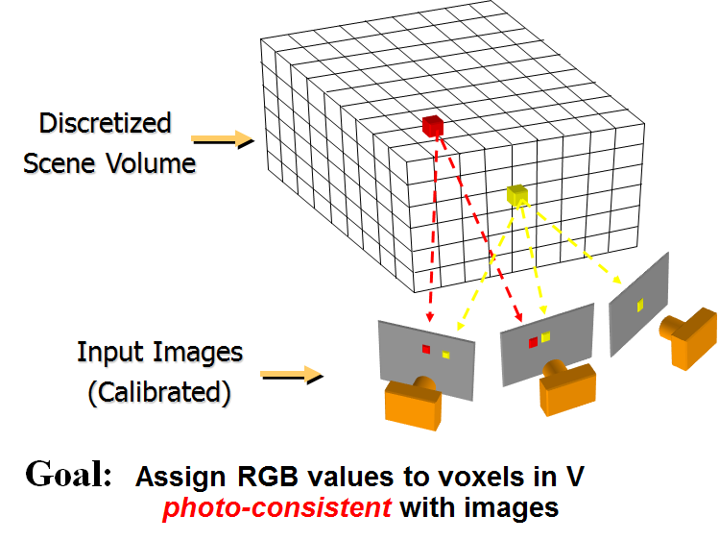
Volumetric Stereo / Voxel Coloring

Slide 61
Photo-consistency
A photo-consistent scene is a scene that exactly reproduces your input images from the same camera viewpoints
You can’t use your input cameras and images to tell the difference between a photo-consistent scene and the true scene
True
Scene
All Scenes
Photo-Consistent
Scenes

Slide 62
Space Carving
Image 1
Image N
…...
Space Carving Algorithm
  Initialize to a volume V containing the true scene
  Choose a voxel on the outside of the volume
  Project to visible input images
  Carve if not photo-consistent
  Repeat until convergence
K. N. Kutulakos and S. M. Seitz, A Theory of Shape by Space Carving, ICCV 1999

Slide 63
Which shape do you get?
V
V
True Scene
Photo Hull
The Photo Hull is the UNION of all photo-consistent scenes in V
  It is a photo-consistent scene reconstruction
  Tightest possible bound on the true scene
Source: S. Seitz

Slide 64




Space Carving Results: African Violet
Input Image (1 of 45)
Reconstruction
Reconstruction
Reconstruction
Source: S. Seitz

Slide 65



Space Carving Results: Hand
Input Image
(1 of 100)
Views of Reconstruction

Slide 66
Reconstruction from Silhouettes
The case of binary images: a voxel is photo-consistent if it lies inside the object’s silhouette in all views
Binary Images

Slide 67
Reconstruction from Silhouettes
The case of binary images: a voxel is photo-consistent if it lies inside the object’s silhouette in all views
Binary Images
Finding the silhouette-consistent shape (visual hull):
  Backproject each silhouette
  Intersect backprojected volumes

Slide 68

Volume intersection
B. Baumgart, Geometric Modeling for Computer Vision, Stanford Artificial Intelligence Laboratory, Memo no. AIM-249, Stanford University, October 1974.

Slide 69
Photo-consistency vs. silhouette-consistency
True Scene
Photo Hull
Visual Hull

Slide 70
Carved visual hulls
The visual hull is a good starting point for optimizing
photo-consistency
  Easy to compute
  Tight outer boundary of the object
  Parts of the visual hull (rims) already lie on the surface and are already photo-consistent
Yasutaka Furukawa and Jean Ponce, Carved Visual Hulls for Image-Based Modeling, ECCV 2006.

Slide 71
Carved visual hulls
Compute visual hull
Use dynamic programming to find rims and constrain them to be fixed
Carve the visual hull to optimize photo-consistency
Yasutaka Furukawa and Jean Ponce, Carved Visual Hulls for Image-Based Modeling, ECCV 2006.

Slide 72
Carved visual hulls
Yasutaka Furukawa and Jean Ponce, Carved Visual Hulls for Image-Based Modeling, ECCV 2006.

Slide 73
Carved visual hulls: Pros and cons
Pros
  Visual hull gives a reasonable initial mesh that can be iteratively deformed
Cons
  Need silhouette extraction
  Have to compute a lot of points that don’t lie on the object
  Finding rims is difficult
  The carving step can get caught in local minima
Possible solution: use sparse feature correspondences as initialization

Slide 74
From feature matching to dense stereo
Extract features
Get a sparse set of initial matches
Iteratively expand matches to nearby locations
Use visibility constraints to filter out false matches
Perform surface reconstruction
Yasutaka Furukawa and Jean Ponce, Accurate, Dense, and Robust Multi-View Stereopsis, CVPR 2007.

Slide 75

From feature matching to dense stereo
http://www.cs.washington.edu/homes/furukawa/gallery/
Yasutaka Furukawa and Jean Ponce, Accurate, Dense, and Robust Multi-View Stereopsis, CVPR 2007.

Slide 76


Stereo from community photo collections
Up to now, we’ve always assumed that camera calibration is known
For photos taken from the Internet, we need structure from motion techniques to reconstruct both camera positions and 3D points

Slide 77




Stereo from community photo collections
M. Goesele, N. Snavely, B. Curless, H. Hoppe, S. Seitz, Multi-View Stereo for Community Photo Collections, ICCV 2007
http://grail.cs.washington.edu/projects/mvscpc/

Slide 78



Stereo from community photo collections
stereo
laser scan
Comparison: 90% of points within 0.128 m of laser scan (building height 51m)
M. Goesele, N. Snavely, B. Curless, H. Hoppe, S. Seitz, Multi-View Stereo for Community Photo Collections, ICCV 2007

Slide 79

Towards Internet-Scale Multi-View Stereo
YouTube video, high-quality video
Yasutaka Furukawa, Brian Curless, Steven M. Seitz and Richard Szeliski, Towards Internet-scale Multi-view Stereo,CVPR 2010.

Slide 80


















Fast stereo for Internet photo collections
Start with a cluster of registered views
Obtain a depth map for every view using plane sweeping stereo with normalized cross-correlation
Frahm et al., “Building Rome on a Cloudless Day,” ECCV 2010.
Notes:
stereo is same as for video just NCC instead of SAD

Slide 81







Plane sweeping stereo
Need to register individual depth maps into a single 3D model
Problem: depth maps are very noisy
far
near
Frahm et al., “Building Rome on a Cloudless Day,” ECCV 2010.

Slide 82



Robust stereo fusion using a heightmap
Enforces vertical facades
One continuous surface,
no holes
Fast to compute,
low memory complexity
David Gallup, Marc Pollefeys, Jan-Michael Frahm, “3D Reconstruction using an n-Layer Heightmap”, DAGM 2010

Slide 83



Results
YouTube Video
Frahm et al., “Building Rome on a Cloudless Day,” ECCV 2010.

