Slide 1
CS 558 Computer Vision
Fitting, RANSAC, and Hough Transfrom
Adapted from S. Lazebnik

Slide 2
Outline
Fitting: concept and basics
Least square fitting: line fitting example
Random sample consensus (RANSAC)
Hough transform: line fitting example
Hough transform: applications in vision

Slide 3
Outline
Fitting: concept and basics
Least square fitting: line fitting example
Random sample consensus (RANSAC)
Hough transform: line fitting example
Hough transform: applications in vision

Slide 4
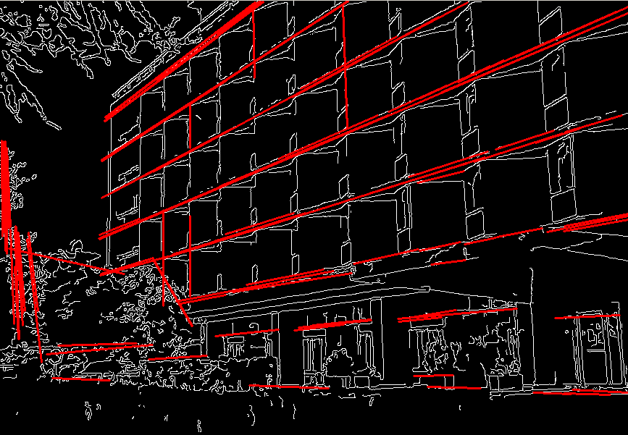
Fitting

Slide 5
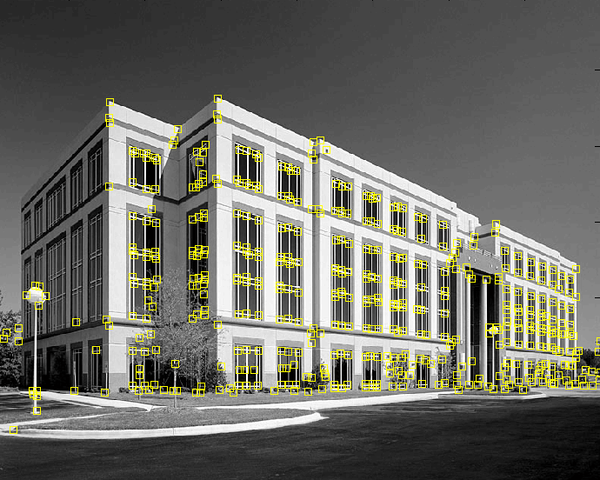
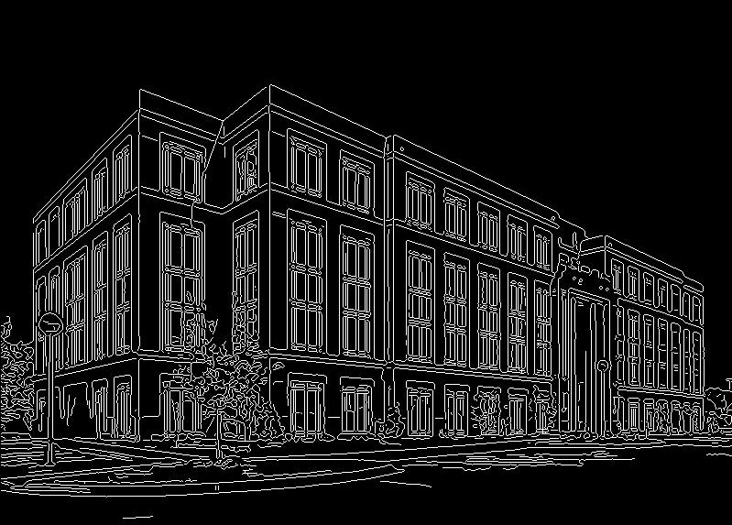
Fitting
We’ve learned how to detect edges, corners, blobs. Now what?
We would like to form a higher-level, more compact representation of the features in the image by grouping multiple features according to a simple model
9300 Harris Corners Pkwy, Charlotte, NC

Slide 6
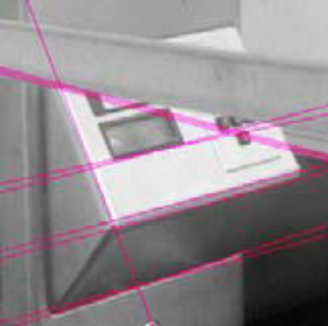
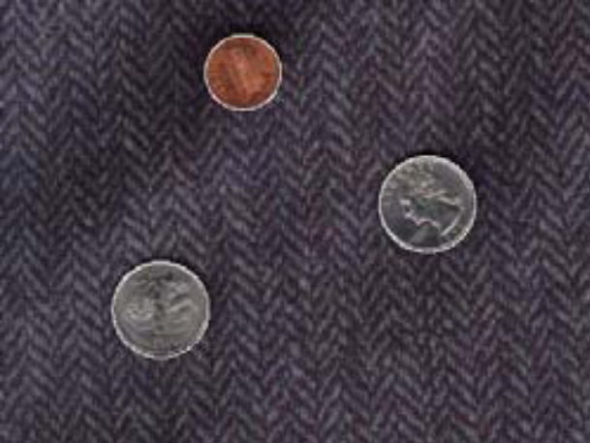
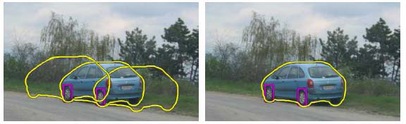
Fitting
Choose a parametric model to represent a set of features
simple model: lines
simple model: circles
complicated model: car
Source: K. Grauman

Slide 7
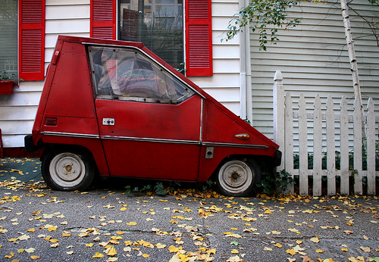
Fitting: Issues
Case study: Line detection
Noise in the measured feature locations
Extraneous data: clutter (outliers), multiple lines
Missing data: occlusions

Slide 8
Fitting: Overview
If we know which points belong to the line, how do we find the “optimal” line parameters?
  Least squares
What if there are outliers?
  Robust fitting, RANSAC
What if there are many lines?
  Voting methods: RANSAC, Hough transform
What if we’re not even sure it’s a line?
  Model selection

Slide 9
Outline
Fitting: concept and basics
Least square fitting: line fitting example
Random sample consensus (RANSAC)
Hough transform: line fitting example
Hough transform: applications in vision

Slide 10
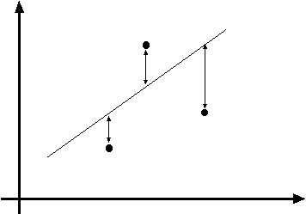
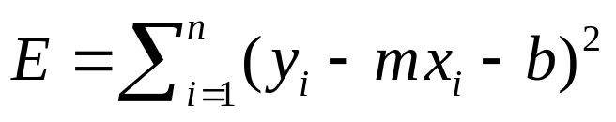
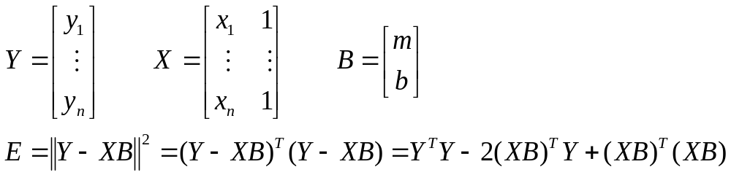
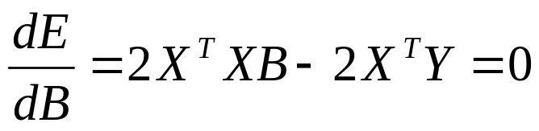

Least squares line fitting
Data: (x₁, y₁), …, (x_{n}, y_{n})
Line equation: y_{i} = m x_{i} + b
Find (m, b) to minimize
y=mx+b
(x_{i}, y_{i})
Normal equations: least squares solution to XB=Y

Slide 11
Problem with “vertical” least squares
Not rotation-invariant
Fails completely for vertical lines

Slide 12
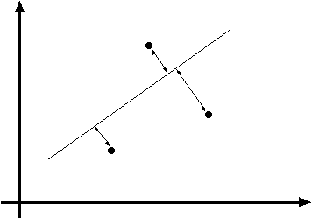
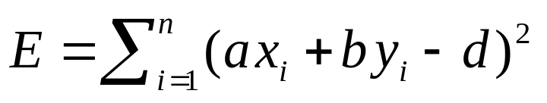
Total least squares
Distance between point (x_{i}, y_{i}) and line ax+by=d (a²+b²=1): |ax_{i} + by_{i} – d|
ax+by=d
Unit normal: N=(a, b)
(x_{i}, y_{i})

Slide 13
Total least squares
Distance between point (x_{i}, y_{i}) and line ax+by=d (a²+b²=1): |ax_{i} + by_{i} – d|
Find (a, b, d) to minimize the sum of squared perpendicular distances
ax+by=d
Unit normal: N=(a, b)
(x_{i}, y_{i})

Slide 14
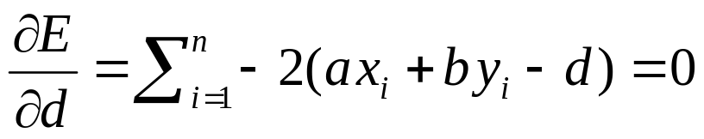
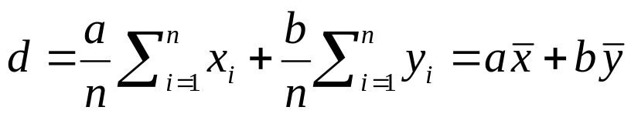
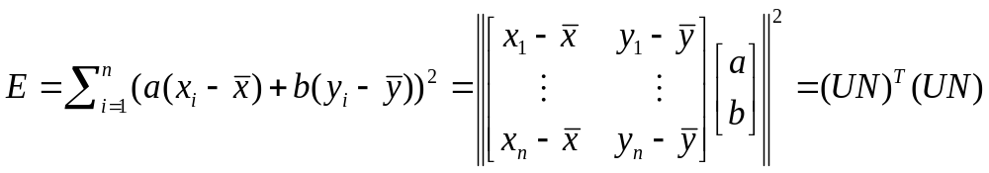
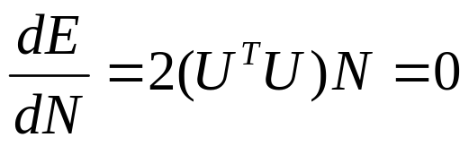
Total least squares
Distance between point (x_{i}, y_{i}) and line ax+by=d (a²+b²=1): |ax_{i} + by_{i} – d|
Find (a, b, d) to minimize the sum of squared perpendicular distances
ax+by=d
Unit normal: N=(a, b)
(x_{i}, y_{i})
Solution to (U^{T}U)N = 0, subject to ||N||² = 1: eigenvector of U^{T}U
associated with the smallest eigenvalue (least squares solution
to homogeneous linear system UN = 0)

Slide 15
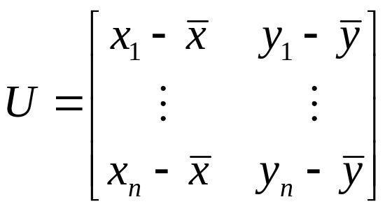
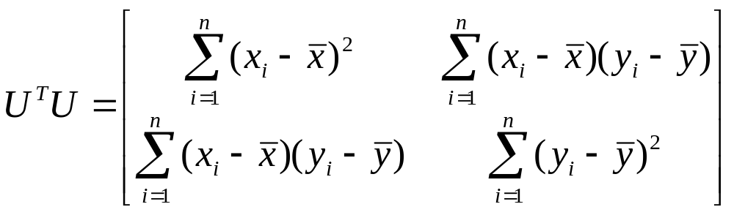
Total least squares
second moment matrix

Slide 16
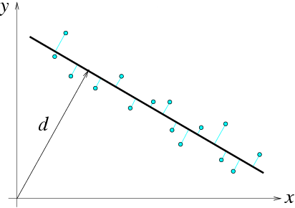


Total least squares
second moment matrix
N = (a, b)

Slide 17
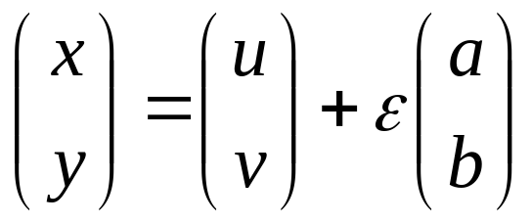
Least squares as likelihood maximization
Generative model: line points are sampled independently and corrupted by Gaussian noise in the direction perpendicular to the line
ax+by=d
(u, v)
ε
(x, y)
point on the line
normal
direction
noise:
sampled from
zero-mean
Gaussian with
std. dev. σ

Slide 18
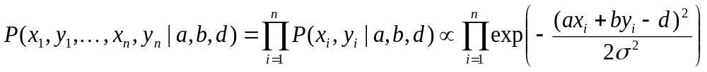
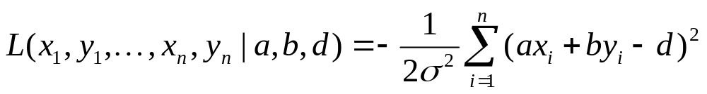
Least squares as likelihood maximization
Generative model: line points are sampled independently and corrupted by Gaussian noise in the direction perpendicular to the line
ax+by=d
(u, v)
ε
(x, y)
Likelihood of points given line parameters (a, b, d):
Log-likelihood:

Slide 19
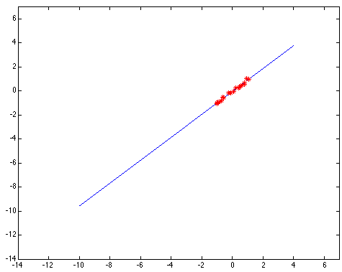
Least squares: Robustness to noise
Least squares fit to the red points:

Slide 20
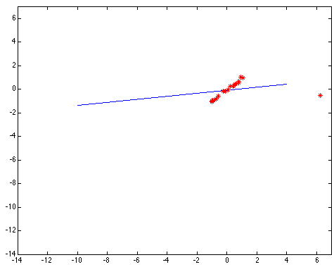
Least squares: Robustness to noise
Least squares fit with an outlier:
Problem: squared error heavily penalizes outliers

Slide 21
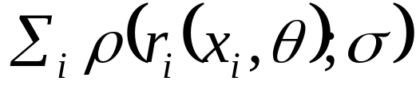
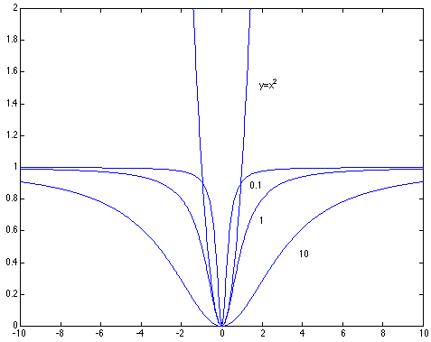

Robust estimators
General approach: find model parameters θ that minimize
r_{i} (x_{i}, θ) – residual of ith point w.r.t. model parameters θ
ρ – robust function with scale parameter σ
The robust function ρ behaves like squared distance for small values of the residual u but saturates for larger values of u

Slide 22

Choosing the scale: Just right
The effect of the outlier is minimized
Notes:
Fit to earlier data with an appropriate choice of s

Slide 23
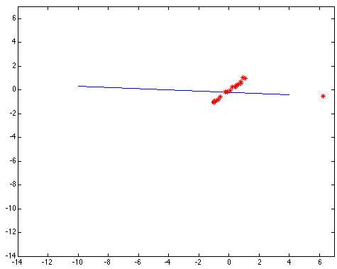
Choosing the scale: Too small
The error value is almost the same for every
point and the fit is very poor

Slide 24

Choosing the scale: Too large
Behaves much the same as least squares

Slide 25
Robust estimation: Details
Robust fitting is a nonlinear optimization problem that must be solved iteratively
Least squares solution can be used for initialization
Adaptive choice of scale: approx. 1.5 times median residual (F&P, Sec. 15.5.1)

Slide 26
Outline
Fitting: concept and basics
Least square fitting: line fitting example
Random sample consensus (RANSAC)
Hough transform: line fitting example
Hough transform: applications in vision

Slide 27
RANSAC
Robust fitting can deal with a few outliers – what if we have very many?
Random sample consensus (RANSAC):
Very general framework for model fitting in the presence of outliers
Outline
  Choose a small subset of points uniformly at random
  Fit a model to that subset
  Find all remaining points that are “close” to the model and reject the rest as outliers
  Do this many times and choose the best model
M. A. Fischler, R. C. Bolles. Random Sample Consensus: A Paradigm for Model Fitting with Applications to Image Analysis and Automated Cartography. Comm. of the ACM, Vol 24, pp 381-395, 1981.
Notes:
This algorithm contains concepts that are hugely useful; in my experience, everyone with some
experience of applied problems who doesn’t yet know RANSAC is almost immediately able to use it to simplify some problem they’ve seen.

Slide 28
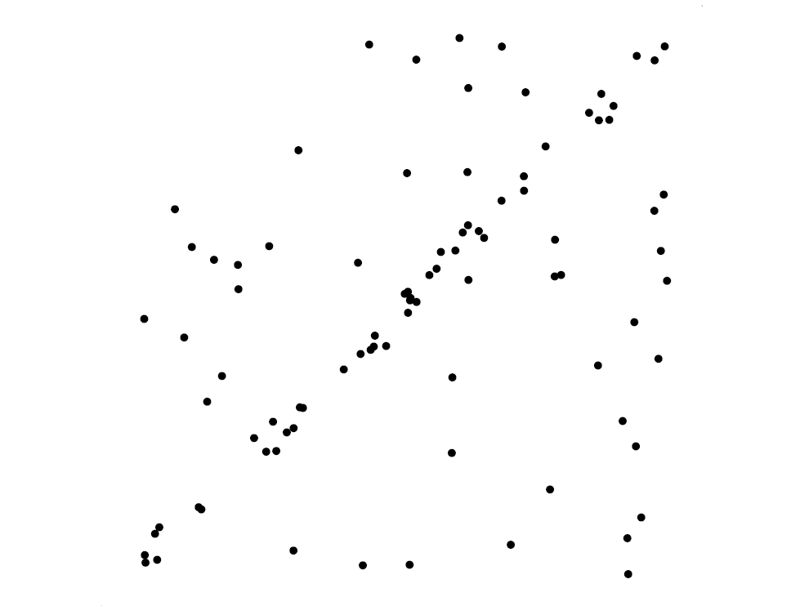
RANSAC for line fitting example
Source: R. Raguram

Slide 29
RANSAC for line fitting example
Least-squares fit
Source: R. Raguram

Slide 30
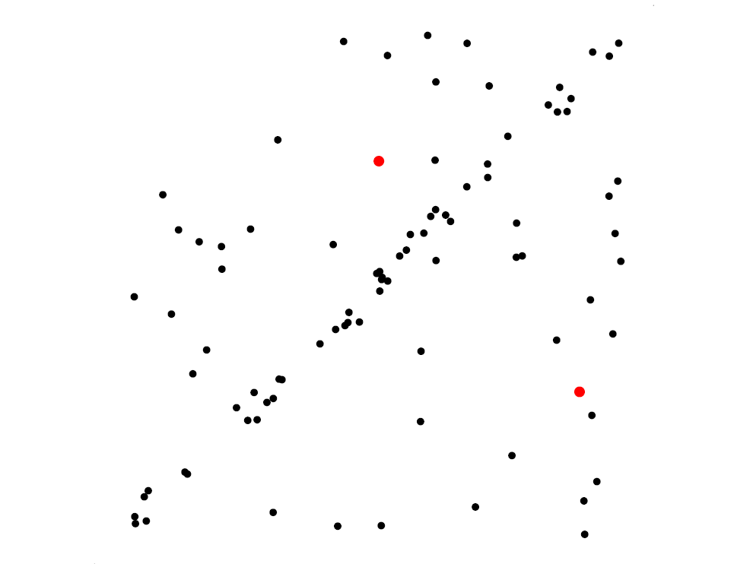
RANSAC for line fitting example
Randomly select minimal subset of points
Source: R. Raguram

Slide 31
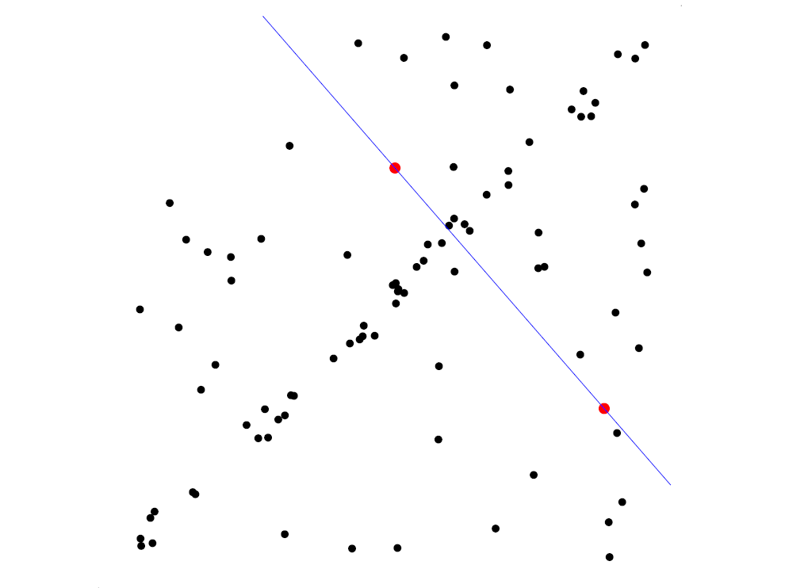
RANSAC for line fitting example
Randomly select minimal subset of points
Hypothesize a model
Source: R. Raguram

Slide 32
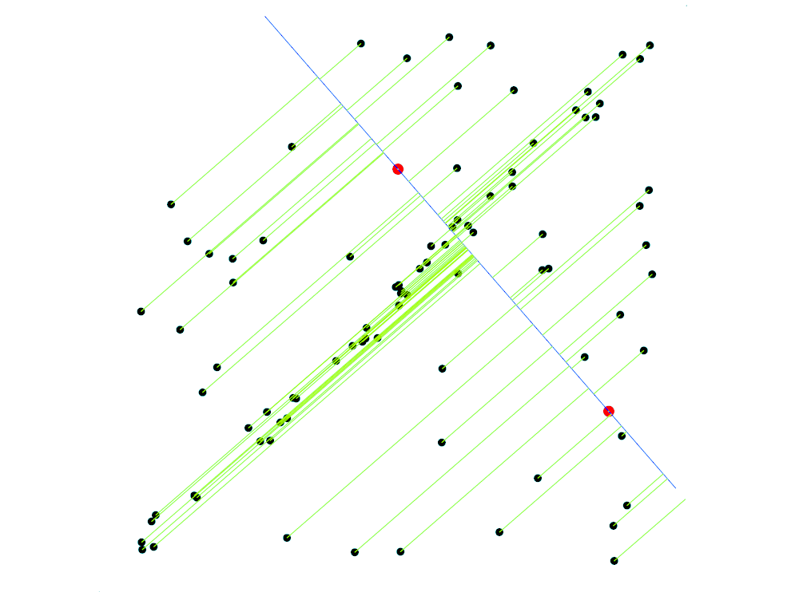
RANSAC for line fitting example
Randomly select minimal subset of points
Hypothesize a model
Compute error function
Source: R. Raguram

Slide 33
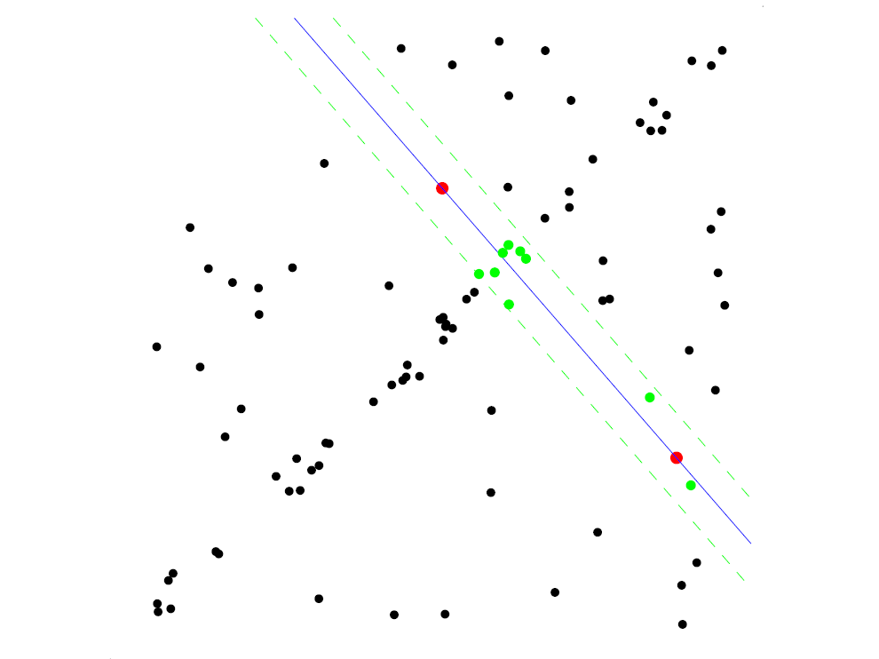
RANSAC for line fitting example
Randomly select minimal subset of points
Hypothesize a model
Compute error function
Select points consistent with model
Source: R. Raguram

Slide 34
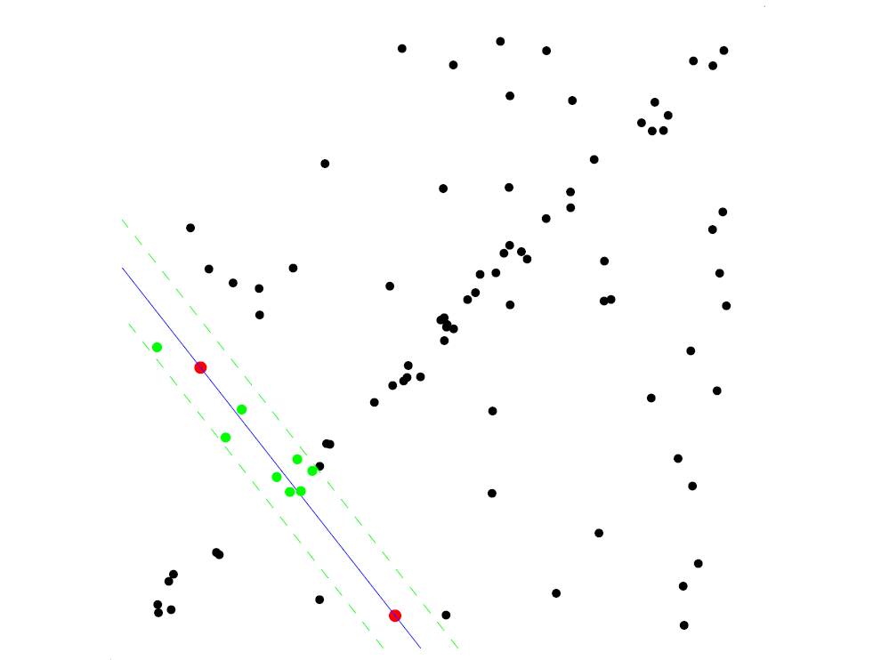
RANSAC for line fitting example
Randomly select minimal subset of points
Hypothesize a model
Compute error function
Select points consistent with model
Repeat hypothesize-and-verify loop
Source: R. Raguram

Slide 35
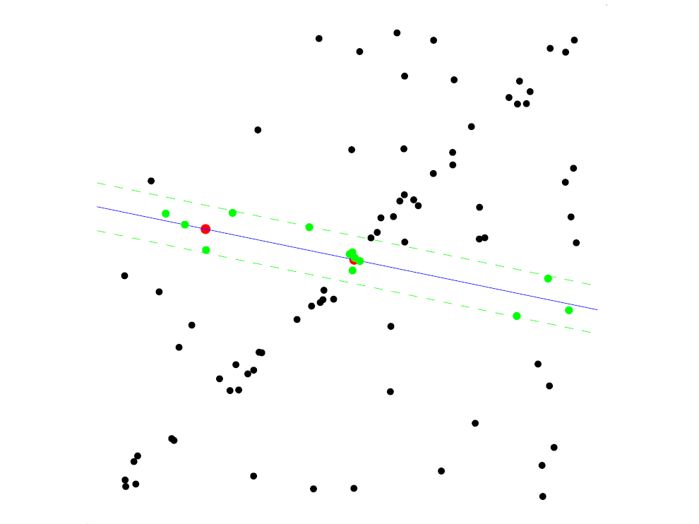
RANSAC for line fitting example
Randomly select minimal subset of points
Hypothesize a model
Compute error function
Select points consistent with model
Repeat hypothesize-and-verify loop
Source: R. Raguram

Slide 36
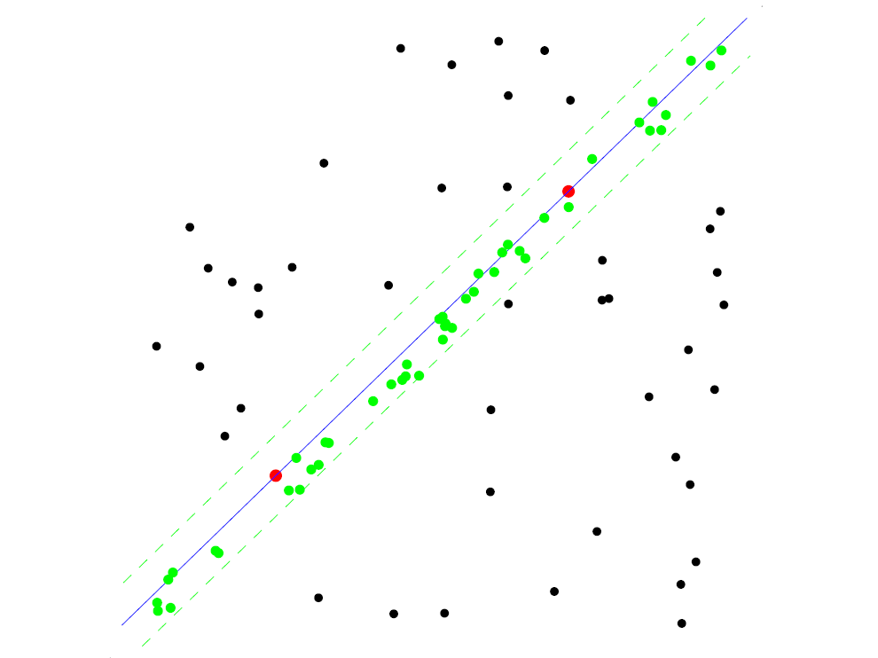
RANSAC for line fitting example
Uncontaminated sample
Randomly select minimal subset of points
Hypothesize a model
Compute error function
Select points consistent with model
Repeat hypothesize-and-verify loop
Source: R. Raguram

Slide 37
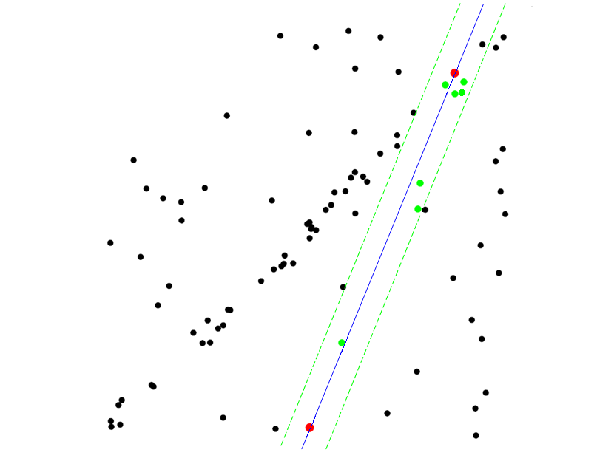
RANSAC for line fitting example
Randomly select minimal subset of points
Hypothesize a model
Compute error function
Select points consistent with model
Repeat hypothesize-and-verify loop
Source: R. Raguram
Notes:
37

Slide 38
RANSAC for line fitting
Repeat N times:
Draw s points uniformly at random
Fit line to these s points
Find inliers to this line among the remaining points (i.e., points whose distance from the line is less than t)
If there are d or more inliers, accept the line and refit using all inliers

Slide 39
Choosing the parameters
Initial number of points s
  Typically minimum number needed to fit the model
Distance threshold t
  Choose t so probability for inlier is p (e.g. 0.95)
  Zero-mean Gaussian noise with std. dev. σ: t²=3.84σ²
Number of samples N
  Choose N so that, with probability p, at least one random sample is free from outliers (e.g. p=0.99) (outlier ratio: e)
Source: M. Pollefeys

Slide 40
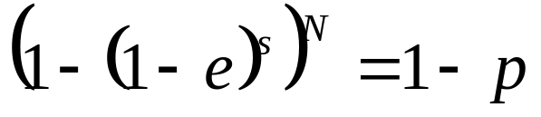

Choosing the parameters
Initial number of points s
  Typically minimum number needed to fit the model
Distance threshold t
  Choose t so probability for inlier is p (e.g. 0.95)
  Zero-mean Gaussian noise with std. dev. σ: t²=3.84σ²
Number of samples N
  Choose N so that, with probability p, at least one random sample is free from outliers (e.g. p=0.99) (outlier ratio: e)
 | proportion of outliers e
s | 5% | 10% | 20% | 25% | 30% | 40% | 50%
2 | 2 | 3 | 5 | 6 | 7 | 11 | 17
3 | 3 | 4 | 7 | 9 | 11 | 19 | 35
4 | 3 | 5 | 9 | 13 | 17 | 34 | 72
5 | 4 | 6 | 12 | 17 | 26 | 57 | 146
6 | 4 | 7 | 16 | 24 | 37 | 97 | 293
7 | 4 | 8 | 20 | 33 | 54 | 163 | 588
8 | 5 | 9 | 26 | 44 | 78 | 272 | 1177
Source: M. Pollefeys

Slide 41
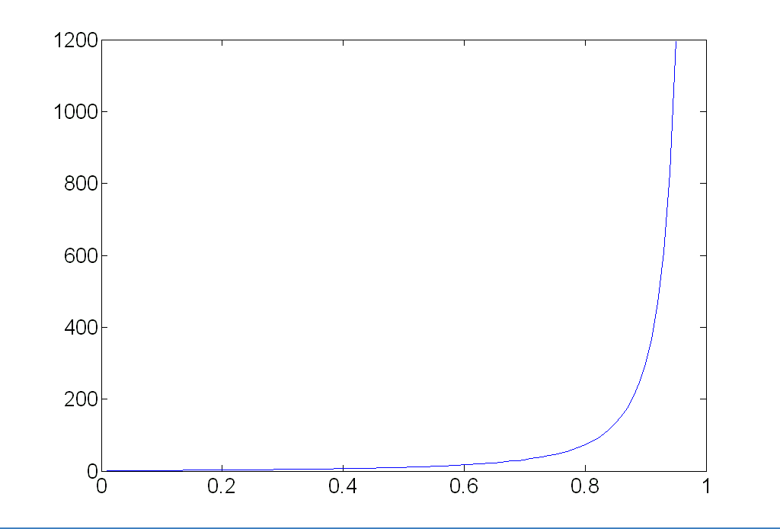
Choosing the parameters
Initial number of points s
  Typically minimum number needed to fit the model
Distance threshold t
  Choose t so probability for inlier is p (e.g. 0.95)
  Zero-mean Gaussian noise with std. dev. σ: t²=3.84σ²
Number of samples N
  Choose N so that, with probability p, at least one random sample is free from outliers (e.g. p=0.99) (outlier ratio: e)
Source: M. Pollefeys

Slide 42
Choosing the parameters
Initial number of points s
  Typically minimum number needed to fit the model
Distance threshold t
  Choose t so probability for inlier is p (e.g. 0.95)
  Zero-mean Gaussian noise with std. dev. σ: t²=3.84σ²
Number of samples N
  Choose N so that, with probability p, at least one random sample is free from outliers (e.g. p=0.99) (outlier ratio: e)
Consensus set size d
  Should match expected inlier ratio
Source: M. Pollefeys

Slide 43

Adaptively determining the number of samples
Outlier ratio e is often unknown a priori, so pick worst case, e.g. 50%, and adapt if more inliers are found, e.g. 80% would yield e=0.2
Adaptive procedure:
  N=∞, sample_count =0
  While N >sample_count
    Choose a sample and count the number of inliers
    Set e = 1 – (number of inliers)/(total number of points)
    Recompute N from e:
    Increment the sample_count by 1
Source: M. Pollefeys

Slide 44
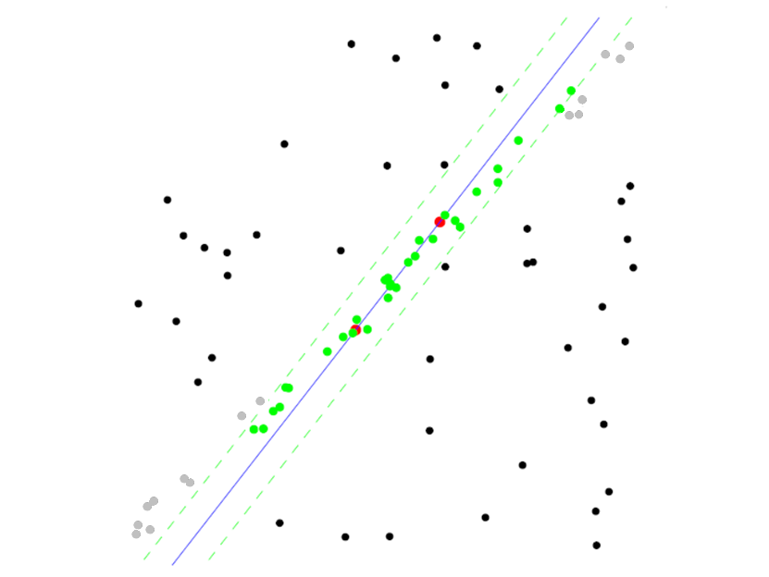
RANSAC pros and cons
Pros
  Simple and general
  Applicable to many different problems
  Often works well in practice
Cons
  Lots of parameters to tune
  Doesn’t work well for low inlier ratios (too many iterations, or can fail completely)
  Can’t always get a good initialization
  of the model based on the minimum
  number of samples

Slide 45
Outline
Fitting: concept and basics
Least square fitting: line fitting example
Random sample consensus (RANSAC)
Hough transform: line fitting example
Hough transform: applications in vision

Slide 46
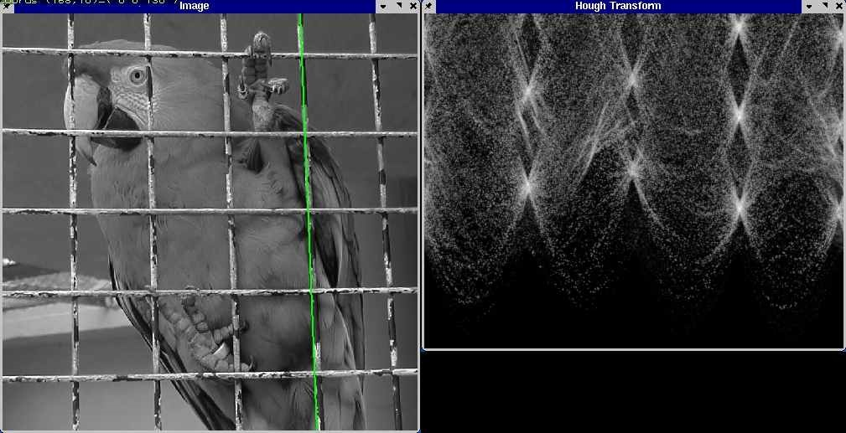
Fitting: The Hough transform

Slide 47
Voting schemes
Let each feature vote for all the models that are compatible with it
Hopefully the noise features will not vote consistently for any single model
Missing data doesn’t matter as long as there are enough features remaining to agree on a good model

Slide 48
Hough transform
An early type of voting scheme
General outline:
  Discretize parameter space into bins
  For each feature point in the image, put a vote in every bin in the parameter space that could have generated this point
  Find bins that have the most votes
Image space
Hough parameter space
P.V.C. Hough, Machine Analysis of Bubble Chamber Pictures, Proc. Int. Conf. High Energy Accelerators and Instrumentation, 1959

Slide 49
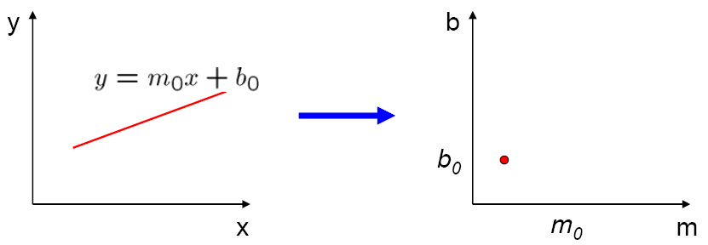
Parameter space representation
A line in the image corresponds to a point in Hough space
Image space
Hough parameter space
Source: S. Seitz

Slide 50
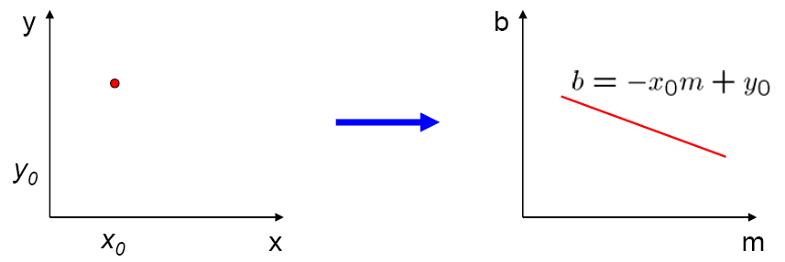
Parameter space representation
What does a point (x₀, y₀) in the image space map to in the Hough space?
Image space
Hough parameter space

Slide 51
Parameter space representation
What does a point (x₀, y₀) in the image space map to in the Hough space?
  Answer: the solutions of b = –x₀m + y₀
  This is a line in Hough space
Image space
Hough parameter space

Slide 52
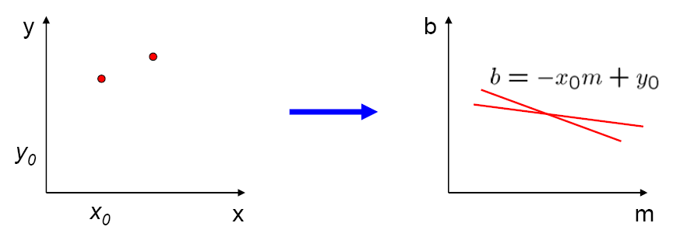
Parameter space representation
Where is the line that contains both (x₀, y₀) and (x₁, y₁)?
Image space
Hough parameter space
(x₁, y₁)
(x₀, y₀)
b = –x₁m + y₁

Slide 53
Parameter space representation
Where is the line that contains both (x₀, y₀) and (x₁, y₁)?
  It is the intersection of the lines b = –x₀m + y₀ and
  b = –x₁m + y₁
Image space
Hough parameter space
(x₁, y₁)
(x₀, y₀)
b = –x₁m + y₁

Slide 54
Parameter space representation
Problems with the (m,b) space:
  Unbounded parameter domain
  Vertical lines require infinite m

Slide 55
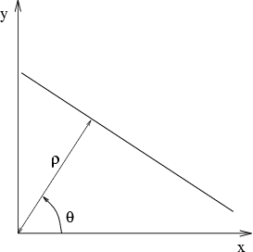
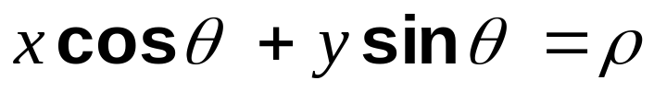
Parameter space representation
Problems with the (m,b) space:
  Unbounded parameter domain
  Vertical lines require infinite m
Alternative: polar representation
Each point will add a sinusoid in the (θ,ρ) parameter space

Slide 56
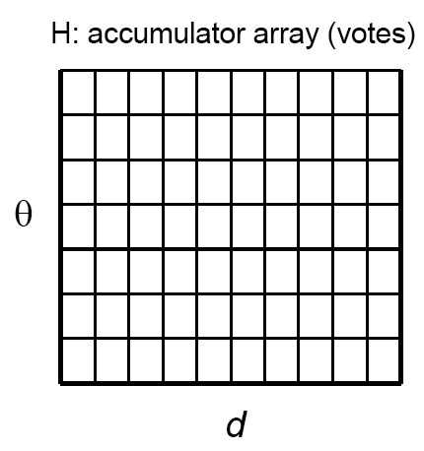
Algorithm outline
Initialize accumulator H
to all zeros
For each edge point (x,y)
in the image
For θ = 0 to 180
ρ = x cos θ + y sin θ
H(θ, ρ) = H(θ, ρ) + 1
end
end
Find the value(s) of (θ, ρ) where H(θ, ρ) is a local maximum
  The detected line in the image is given by
  ρ = x cos θ + y sin θ
ρ
θ

Slide 57
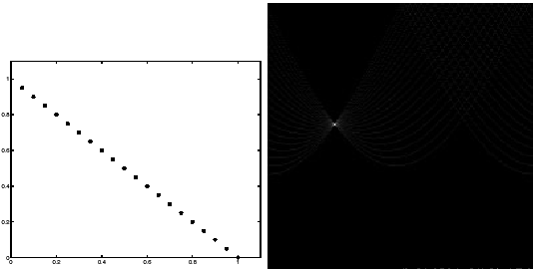
Basic illustration
features
votes
Notes:
Figure 15.1, top half. Note that most points in the vote array are very dark, because they
get only one vote.

Slide 58
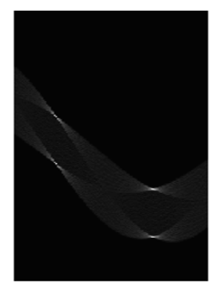
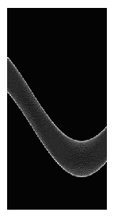
Other shapes
Square
Circle

Slide 59


Several lines

Slide 60
A more complicated image
http://ostatic.com/files/images/ss_hough.jpg

Slide 61

Effect of noise
features
votes
Notes:
This is 15.1 lower half

Slide 62
Effect of noise
features
votes
Peak gets fuzzy and hard to locate
Notes:
This is 15.1 lower half

Slide 63

Effect of noise
Number of votes for a line of 20 points with increasing noise:
Notes:
This is the number of votes that the real line of 20 points gets with increasing noise (figure15.3)

Slide 64

Random points
features
votes
Uniform noise can lead to spurious peaks in the array
Notes:
15.2; main point is that lots of noise can lead to large peaks in the array

Slide 65

Random points
As the level of uniform noise increases, the maximum number of votes increases too:
Notes:
Figure 15.4; as the noise increases in a picture without a line, the number of points in the max cell goes
up, too

Slide 66
Dealing with noise
Choose a good grid / discretization
  Too coarse: large votes obtained when too many different lines correspond to a single bucket
  Too fine: miss lines because some points that are not exactly collinear cast votes for different buckets
Increment neighboring bins (smoothing in accumulator array)
Try to get rid of irrelevant features
  Take only edge points with significant gradient magnitude

Slide 67



Incorporating image gradients
Recall: when we detect an
edge point, we also know its
gradient direction
But this means that the line
is uniquely determined!
Modified Hough transform:
For each edge point (x,y)
θ = gradient orientation at (x,y)
ρ = x cos θ + y sin θ
H(θ, ρ) = H(θ, ρ) + 1
end

Slide 68
Hough transform for circles
How many dimensions will the parameter space have?
Given an oriented edge point, what are all possible bins that it can vote for?

Slide 69


Hough transform for circles
image space
Hough parameter space
r
y
(x,y)
x
x
y

Slide 70

Hough transform for circles
Conceptually equivalent procedure: for each (x,y,r), draw the corresponding circle in the image and compute its “support”
r
x
y
Is this more or less efficient than voting with features?

Slide 71
Outline
Fitting: concept and basics
Least square fitting: line fitting example
Random sample consensus (RANSAC)
Hough transform: line fitting example
Hough transform: applications in vision

Slide 72



Application in recognition
F. Jurie and C. Schmid, Scale-invariant shape features for recognition of object categories, CVPR 2004

Slide 73


Hough circles vs. Laplacian blobs
Original images
Robustness to scale and clutter
Laplacian circles
Hough-like circles
F. Jurie and C. Schmid, Scale-invariant shape features for recognition of object categories, CVPR 2004
Notes:
Hough circles are robust to interior/exterior texture and noise, while Laplacian blobs require a “clean” center-surround pattern

Slide 74
Generalized Hough transform
We want to find a template defined by its reference point (center) and several distinct types of and mark points in stable spatial configuration
Template
c
Notes:
-The center or reference point is not necessarily a visible point, it’s just the “origin” of the shape’s coordinate system
-The landmark points don’t have to be located on the boundary, they just need to be in a stable spatial configuration w.r.t. the center
- The types of landmark points correspond to “visual words” or features that have a distinct local appearance (how to identify such visual words will be discussed later in the course)

Slide 75
Generalized Hough transform
Template representation: for each type of landmark point, store all possible displacement vectors towards the center
Model
Template

Slide 76
Generalized Hough transform
Detecting the template:
  For each feature in a new image, look up that feature type in the model and vote for the possible center locations associated with that type in the model
Model
Test image
Notes:
Note that some of the features present in the template may actually be absent in the test image. The positions of the features can move around; new “noise” or “clutter” features can be added.
The small circles represent votes for possible center location.

Slide 77


Application in recognition
Index displacements by “visual codeword”
visual codeword with
displacement vectors
training image
B. Leibe, A. Leonardis, and B. Schiele, Combined Object Categorization and Segmentation with an Implicit Shape Model, ECCV Workshop on Statistical Learning in Computer Vision 2004
Notes:
Emphasize that this is not just some useless historic idea, but is actually extensively used in modern recognition.

Slide 78

Application in recognition
Index displacements by “visual codeword”
test image
B. Leibe, A. Leonardis, and B. Schiele, Combined Object Categorization and Segmentation with an Implicit Shape Model, ECCV Workshop on Statistical Learning in Computer Vision 2004

Slide 79

Implicit shape models: Training
Build codebook of patches around extracted interest points using clustering (more on this later in the course)

Slide 80


Implicit shape models: Training
Build codebook of patches around extracted interest points using clustering
Map the patch around each interest point to closest codebook entry

Slide 81
Implicit shape models: Training
Build codebook of patches around extracted interest points using clustering
Map the patch around each interest point to closest codebook entry
For each codebook entry, store all positions it was found, relative to object center

Slide 82

Implicit shape models: Testing
Given test image, extract patches, match to codebook entry
Cast votes for possible positions of object center
Search for maxima in voting space
Extract weighted segmentation mask based on stored masks for the codebook occurrences

Slide 83












Additional examples
B. Leibe, A. Leonardis, and B. Schiele, Robust Object Detection with Interleaved Categorization and Segmentation, IJCV 77 (1-3), pp. 259-289, 2008.

Slide 84
Implicit shape models: Details
Supervised training
  Need reference location and segmentation mask for each training car
Voting space is continuous, not discrete
  Clustering algorithm needed to find maxima
How about dealing with scale changes?
  Option 1: search a range of scales, as in Hough transform for circles
  Option 2: use scale-covariant interest points
Verification stage is very important
  Once we have a location hypothesis, we can overlay a more detailed template over the image and compare pixel-by-pixel, transfer segmentation masks, etc.

Slide 85
Hough transform: Discussion
Pros
  Can deal with non-locality and occlusion
  Can detect multiple instances of a model
  Some robustness to noise: noise points unlikely to contribute consistently to any single bin
Cons
  Complexity of search time increases exponentially with the number of model parameters
  Non-target shapes can produce spurious peaks in parameter space
  It’s hard to pick a good grid size
Hough transform vs. RANSAC

