Slide 1
CS558 Computer Vision
Lecture IX: Object Recognition (1)
Slides adapted from S. Lazebnik

Slide 2
Outline
Object recognition: overview and history
Object recognition: a learning based approach
Object recognition: bag of feature representation
Object recognition: classification algorithms

Slide 3
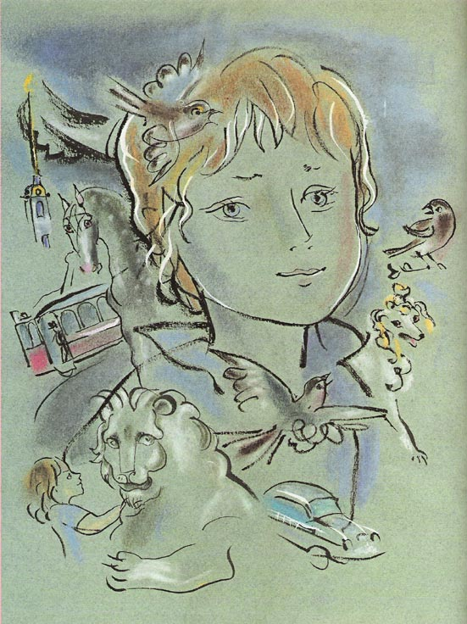
Object Recognition: Overview and History
Slides adapted from Fei-Fei Li, Rob Fergus, Antonio Torralba, and Jean Ponce

Slide 4
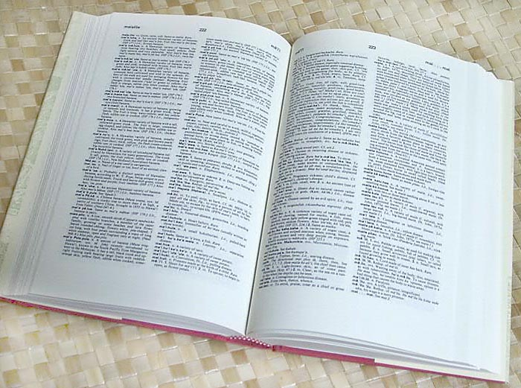

How many visual object categories are there?
~10,000 to 30,000
Biederman 1987
Notes:
1500-3000 basic-level nouns, ~10 types per basic-level category
Alternative explanation (Perona): ~1000 names per domain (broad scene category), 20-30 domains

Slide 5
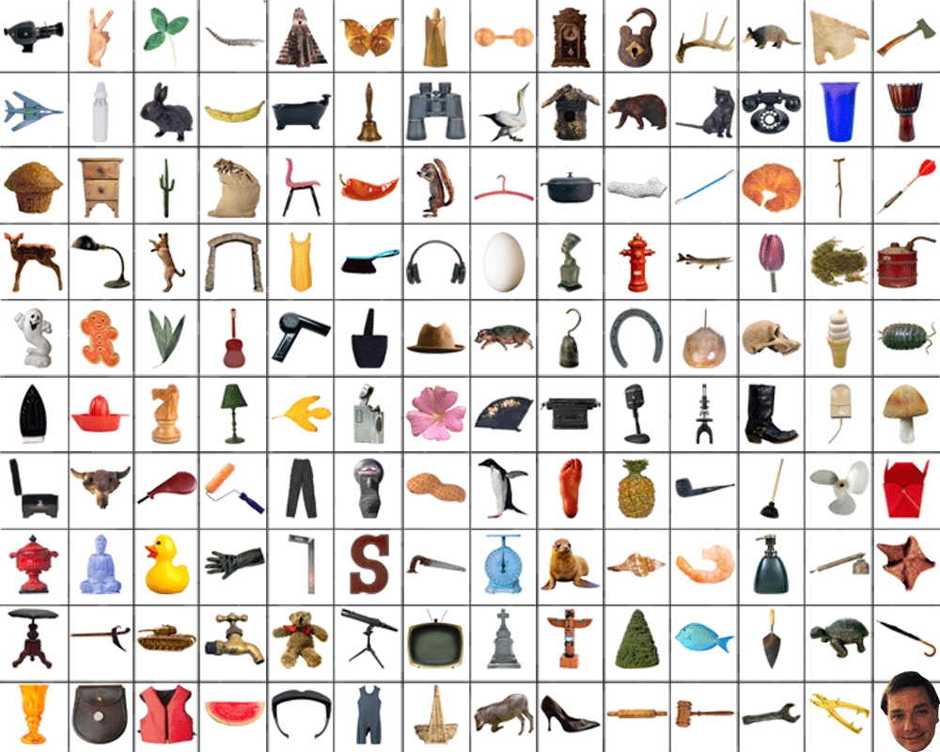
~10,000 to 30,000

Slide 6
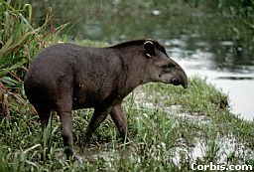
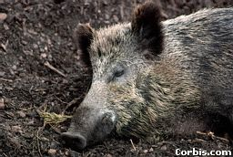
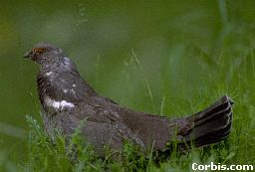
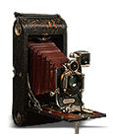
OBJECTS
ANIMALS
PLANTS
INANIMATE
NATURAL
MAN-MADE
…..
VERTEBRATE
MAMMALS
BIRDS
TAPIR
BOAR
GROUSE
CAMERA

Slide 7
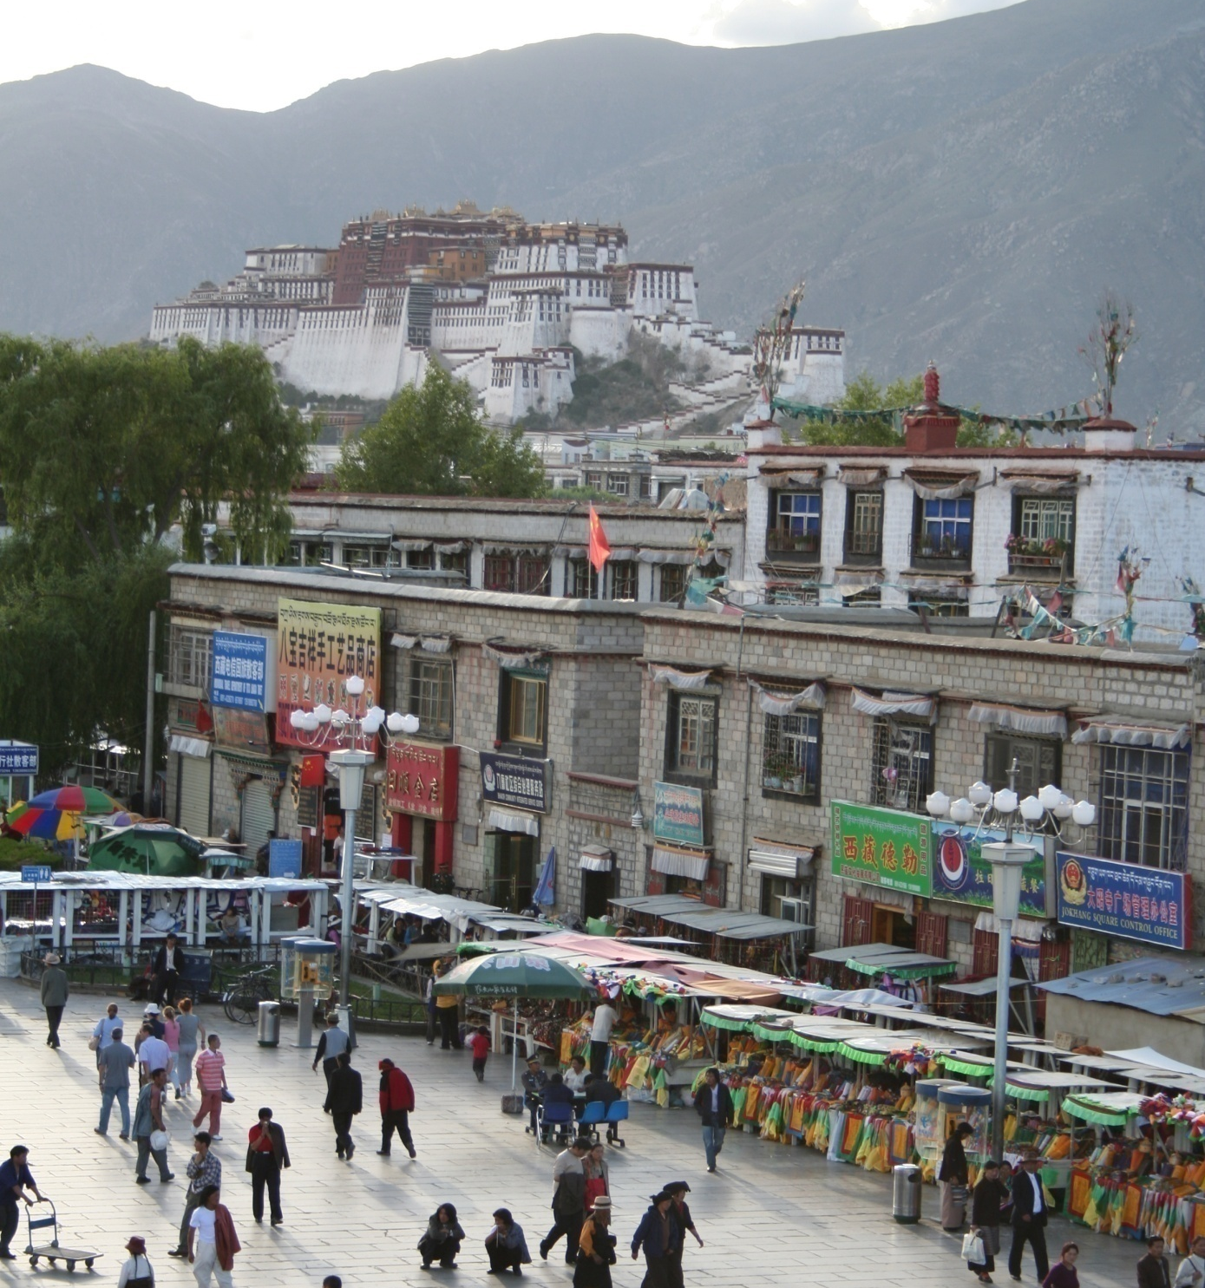
Specific recognition tasks

Slide 8
Scene categorization
outdoor/indoor
city/forest/factory/etc.

Slide 9
Image annotation/tagging
street
people
building
mountain
…

Slide 10
Object detection
find pedestrians

Slide 11
Image parsing
sky
mountain
building
tree
building
banner
street lamp
market
people

Slide 12
Image understanding?

Slide 13
Recognition is all about modeling variability
Variability:
Camera position
Illumination
Shape parameters
Within-class variations?

Slide 14
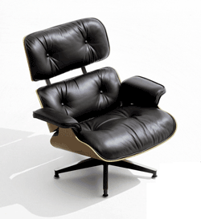
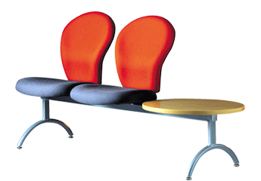
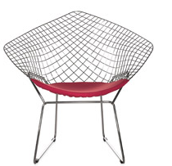
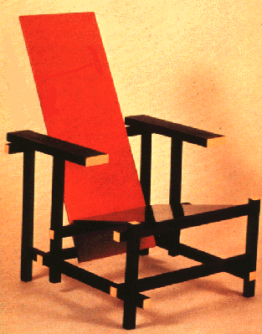
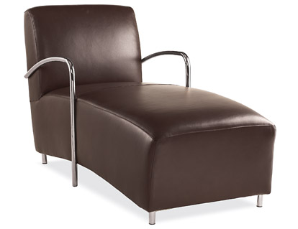
Within-class variations

Slide 15
History of ideas in recognition
1960s – early 1990s: the geometric era

Slide 16
θ
Variability:
Camera position
Illumination
Alignment
Shape: assumed known
Roberts (1965); Lowe (1987); Faugeras & Hebert (1986); Grimson & Lozano-Perez (1986); Huttenlocher & Ullman (1987)

Slide 17
Recall: Alignment
Alignment: fitting a model to a transformation between pairs of features (matches) in two images
x_{i}
x_{i}
Find transformation T
that minimizes
'
T

Slide 18
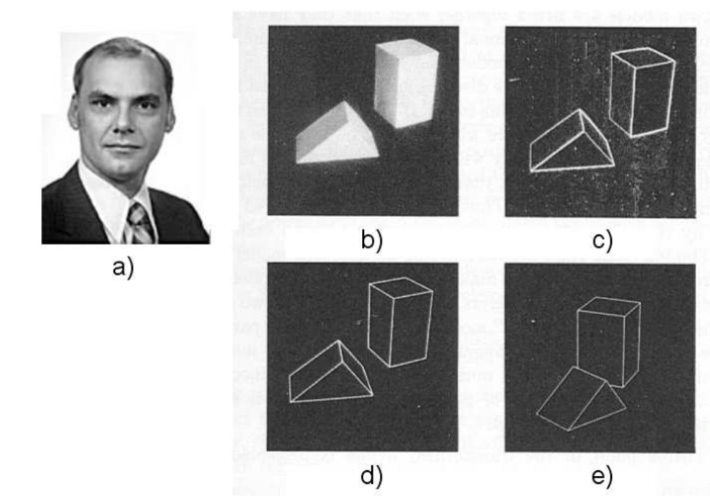
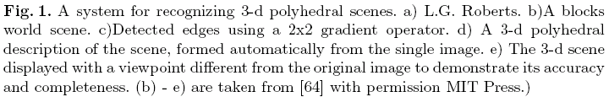
Recognition as an alignment problem:
Block world
L. G. Roberts, Machine Perception of Three Dimensional Solids, Ph.D. thesis, MIT Department of Electrical Engineering, 1963.
J. Mundy, Object Recognition in the Geometric Era: a Retrospective, 2006

Slide 19
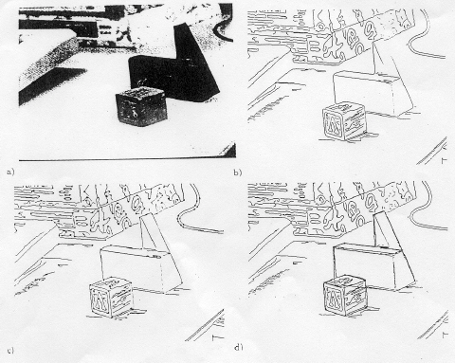
Alignment: Huttenlocher & Ullman (1987)

Slide 20
Variability
Invariance to:
Camera position
Illumination
Internal parameters
Duda & Hart ( 1972); Weiss (1987); Mundy et al. (1992-94);
Rothwell et al. (1992); Burns et al. (1993)

Slide 21
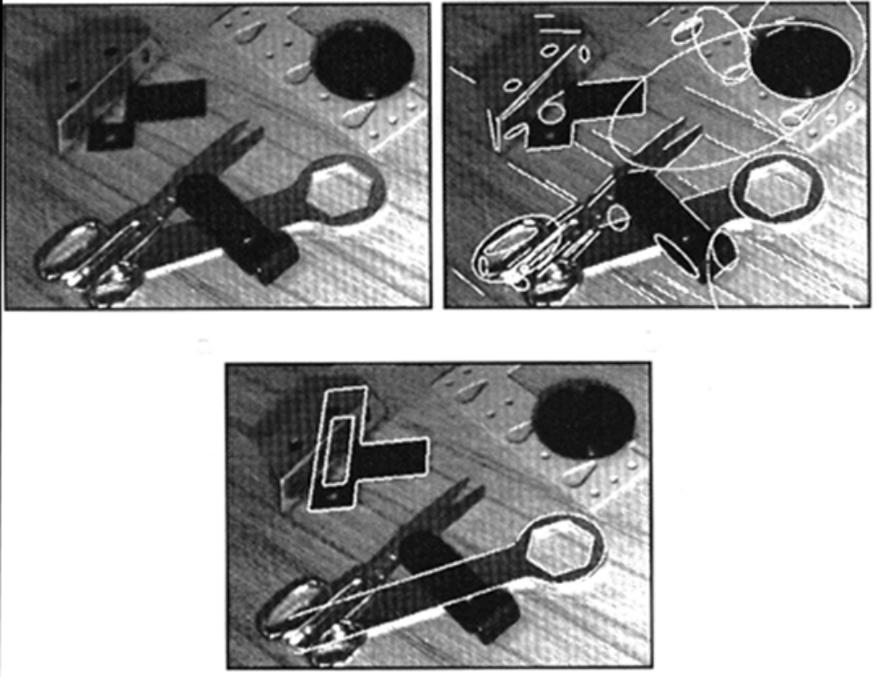
Example: invariant to similarity transformations computed from four points
B
C
D
A
Projective invariants (Rothwell et al., 1992):
General 3D objects do not admit monocular viewpoint
invariants (Burns et al., 1993)

Slide 22






Representing and recognizing object categories
is harder...
ACRONYM (Brooks and Binford, 1981)
Binford (1971), Nevatia & Binford (1972), Marr & Nishihara (1978)

Slide 23
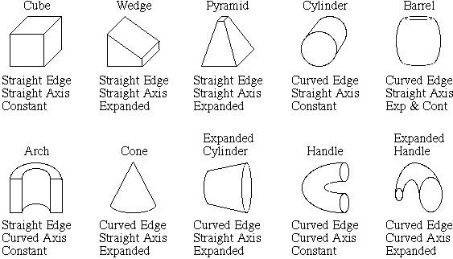
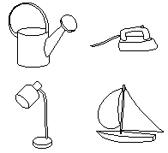
Recognition by components
Biederman (1987)
Primitives (geons)
Objects
http://en.wikipedia.org/wiki/Recognition_by_Components_Theory

Slide 24
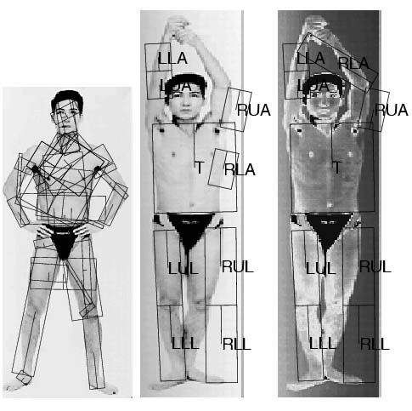
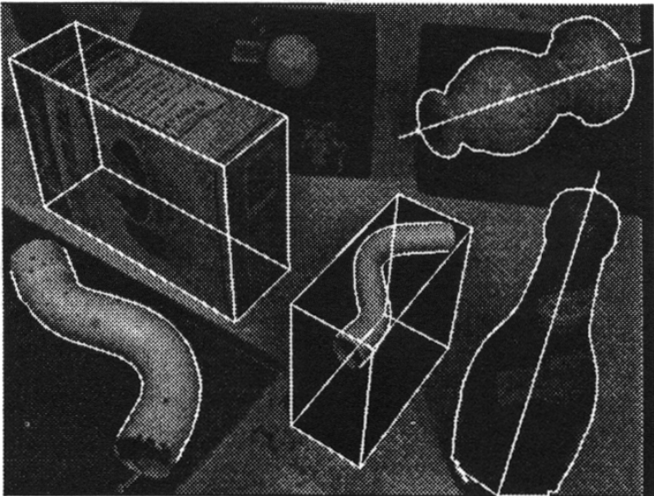
General shape primitives?
Generalized cylinders
Ponce et al. (1989)
Forsyth (2000)
Zisserman et al. (1995)

Slide 25
History of ideas in recognition
1960s – early 1990s: the geometric era
1990s: appearance-based models

Slide 26
Empirical models of image variability
Appearance-based techniques
Turk & Pentland (1991); Murase & Nayar (1995); etc.

Slide 27
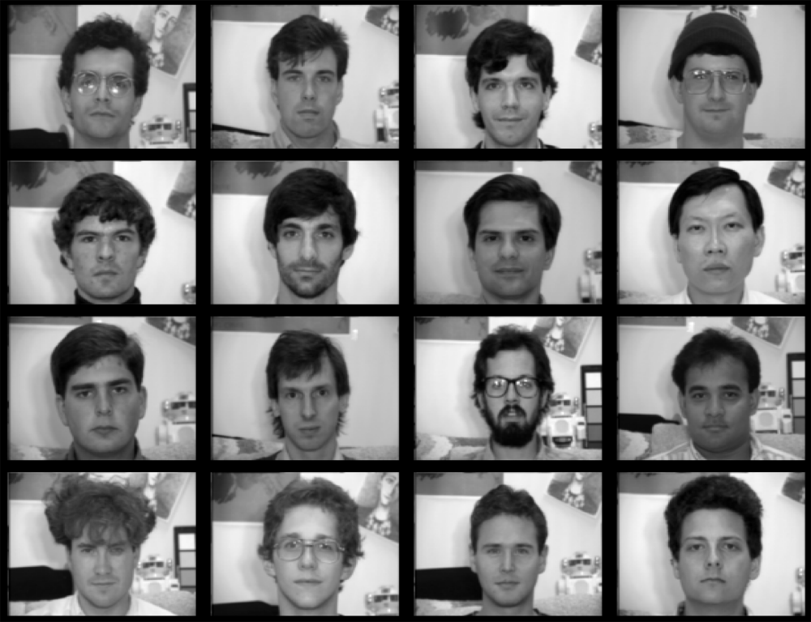
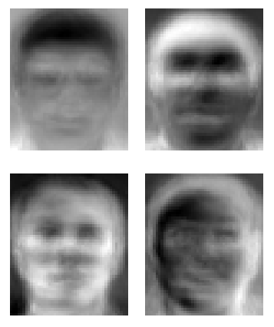
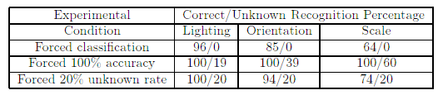
Eigenfaces (Turk & Pentland, 1991)

Slide 28
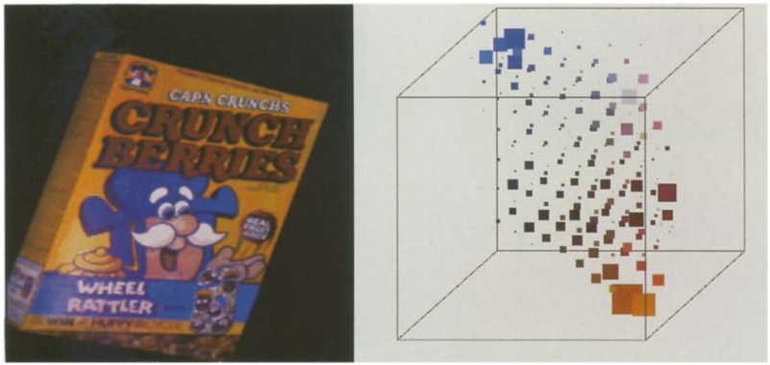
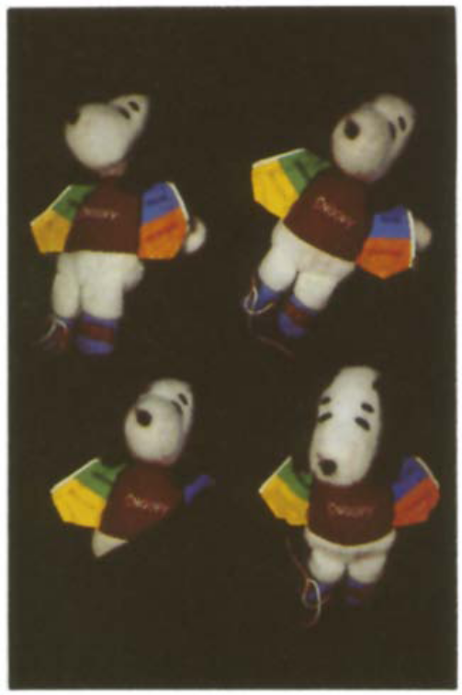
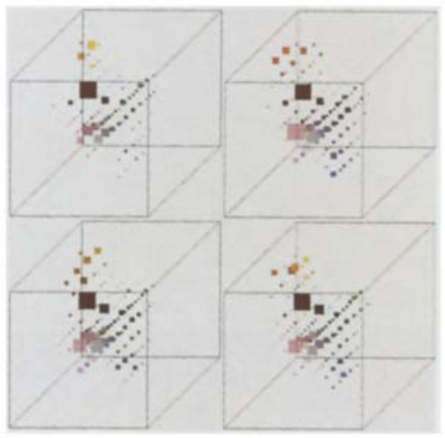
Color Histograms
Swain and Ballard, Color Indexing, IJCV 1991.

Slide 29
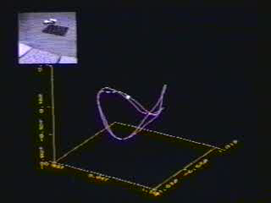
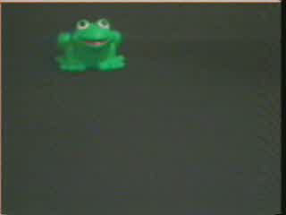
Appearance manifolds
H. Murase and S. Nayar, Visual learning and recognition of 3-d objects from appearance, IJCV 1995

Slide 30
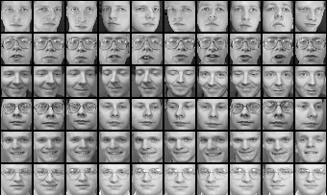
Limitations of global appearance models
Requires global registration of patterns
Not robust to clutter, occlusion, geometric transformations

Slide 31
History of ideas in recognition
1960s – early 1990s: the geometric era
1990s: appearance-based models
1990s – present: sliding window approaches

Slide 32
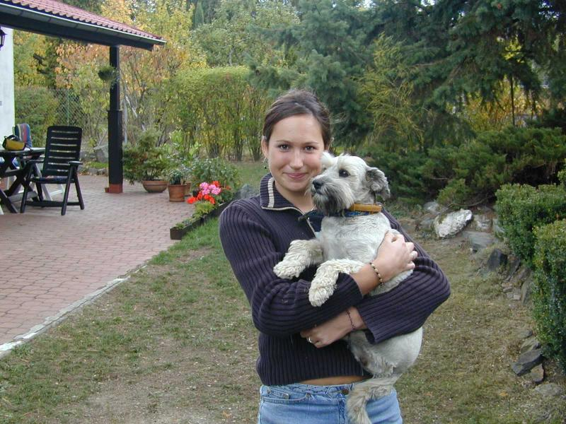
Sliding window approaches

Slide 33
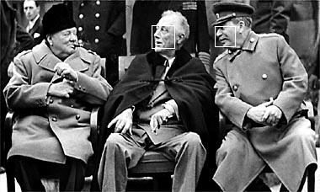
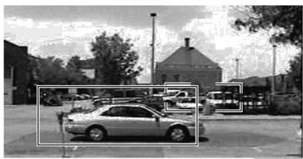
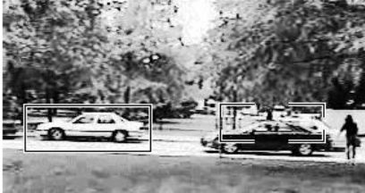
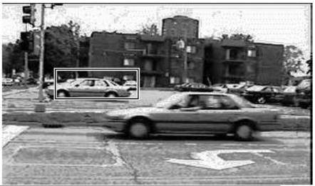
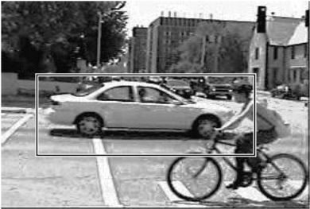
Sliding window approaches
Turk and Pentland, 1991
Belhumeur, Hespanha, & Kriegman, 1997
Schneiderman & Kanade 2004
Viola and Jones, 2000
Schneiderman & Kanade, 2004
Argawal and Roth, 2002
Poggio et al. 1993

Slide 34
History of ideas in recognition
1960s – early 1990s: the geometric era
1990s: appearance-based models
Mid-1990s: sliding window approaches
Late 1990s: local features

Slide 35
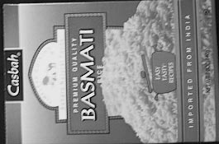
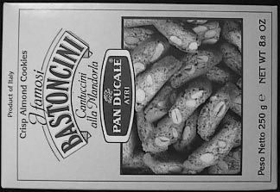
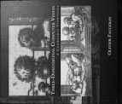
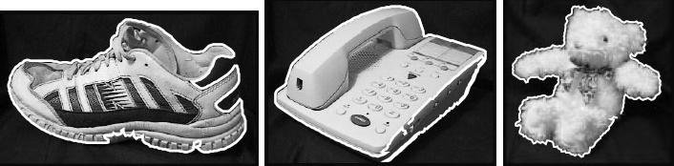
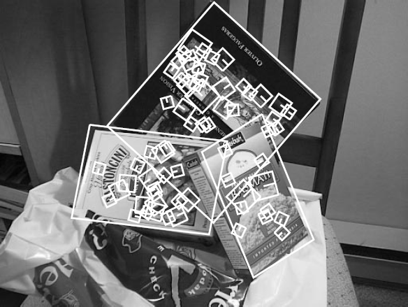
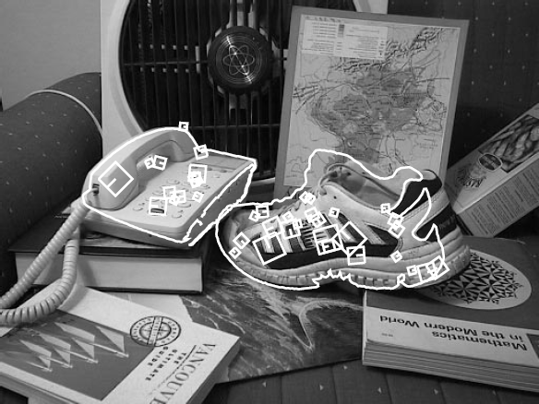
Local features for object instance recognition
D. Lowe (1999, 2004)

Slide 36
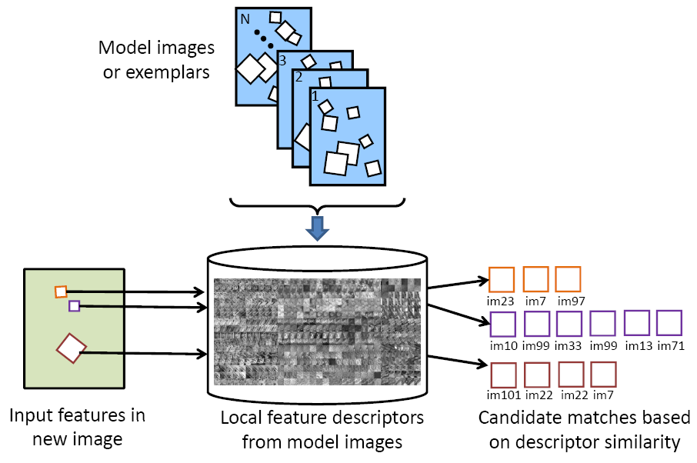
Large-scale image search
Combining local features, indexing, and spatial constraints
Image credit: K. Grauman and B. Leibe

Slide 37
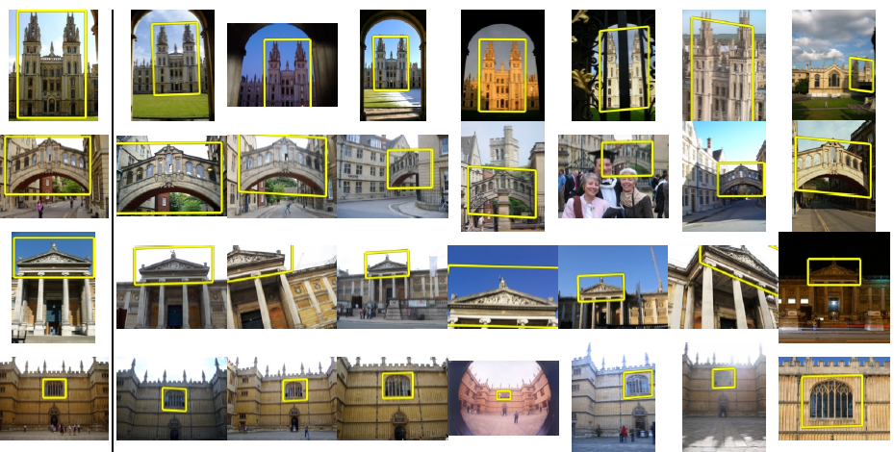
Large-scale image search
Combining local features, indexing, and spatial constraints
Philbin et al. ‘07

Slide 38
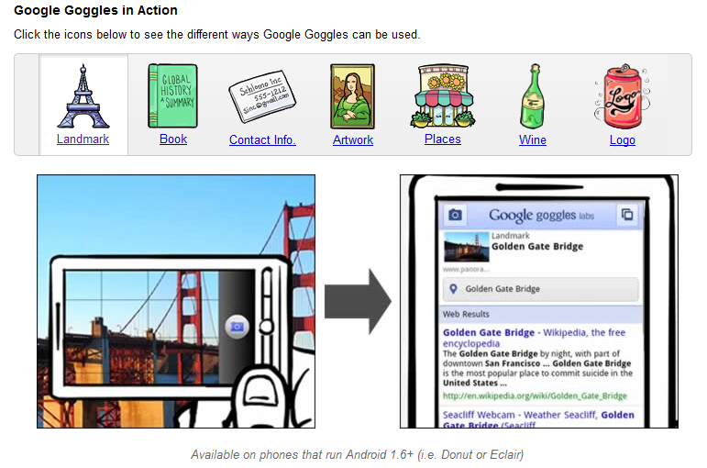
Large-scale image search
Combining local features, indexing, and spatial constraints

Slide 39
History of ideas in recognition
1960s – early 1990s: the geometric era
1990s: appearance-based models
Mid-1990s: sliding window approaches
Late 1990s: local features
Early 2000s: parts-and-shape models

Slide 40
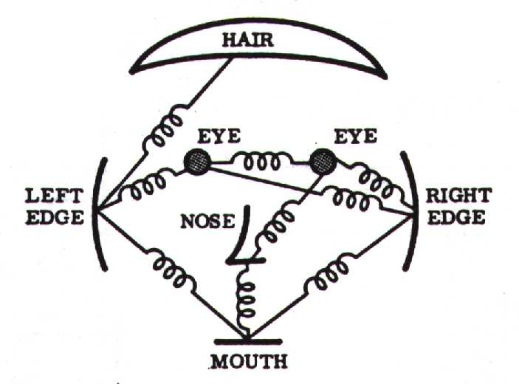
Parts-and-shape models
Model:
  Object as a set of parts
  Relative locations between parts
  Appearance of part
Figure from [Fischler & Elschlager 73]

Slide 41
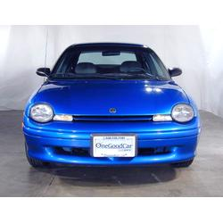
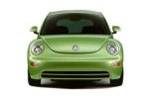
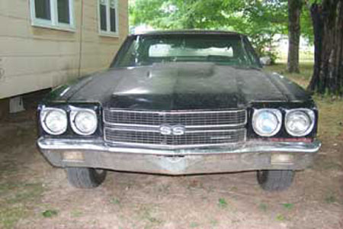
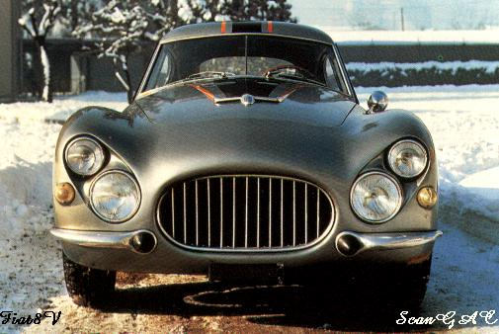
Constellation models
Weber, Welling & Perona (2000), Fergus, Perona & Zisserman (2003)
Notes:
Globally different, but have portions in common

Slide 42

Representing people

Slide 43
History of ideas in recognition
1960s – early 1990s: the geometric era
1990s: appearance-based models
Mid-1990s: sliding window approaches
Late 1990s: local features
Early 2000s: parts-and-shape models
Mid-2000s: bags of features

Slide 44



Bag-of-features models
Bag of ‘words’
Object

Slide 45
Objects as texture
All of these are treated as being the same
No distinction between foreground and background: scene recognition?
Notes:
Motivation slide. Clearly location has to help, but bag-of-words doesn’t have it…

Slide 46
History of ideas in recognition
1960s – early 1990s: the geometric era
1990s: appearance-based models
Mid-1990s: sliding window approaches
Late 1990s: local features
Early 2000s: parts-and-shape models
Mid-2000s: bags of features
Present trends: combination of local and global methods, data-driven methods, context

Slide 47



Global scene descriptors
The “gist” of a scene: Oliva & Torralba (2001)
http://people.csail.mit.edu/torralba/code/spatialenvelope/

Slide 48

Data-driven methods
J. Tighe and S. Lazebnik, ECCV 2010

Slide 49

Geometric context
D. Hoiem, A. Efros, and M. Herbert. Putting Objects in Perspective. CVPR 2006.

Slide 50

Discriminatively trained part-based models
P. Felzenszwalb, R. Girshick, D. McAllester, D. Ramanan, "Object Detection with Discriminatively Trained Part-Based Models," PAMI 2009

Slide 51
Outline
Object recognition: overview and history
Object recognition: a learning based approach
Object recognition: bag of feature representation
Object recognition: classification algorithms

Slide 52

Recognition: A machine learning approach
Slides adapted from Fei-Fei Li, Rob Fergus, Antonio Torralba, Kristen Grauman, and Derek Hoiem

Slide 53



The machine learning framework
Apply a prediction function to a feature representation of the image to get the desired output:
f( ) = “apple”
f( ) = “tomato”
f( ) = “cow”

Slide 54
The machine learning framework
y = f(x)
Training: given a training set of labeled examples {(x₁,y₁), …, (x_{N},y_{N})}, estimate the prediction function f by minimizing the prediction error on the training set
Testing: apply f to a never before seen test example x and output the predicted value y = f(x)
output
prediction function
Image feature

Slide 55

Steps
Training
Training Labels
Training Images
Image Features
Training
Learned model
Learned model
Testing
Image Features
Prediction
Test Image
Slide credit: D. Hoiem

Slide 56



Features
Raw pixels
Histograms
GIST descriptors
…

Slide 57
Classifiers: Nearest neighbor
Test example
Training examples from class 2
Training examples from class 1
f(x) = label of the training example nearest to x
All we need is a distance function for our inputs
No training required!

Slide 58
Classifiers: Linear
Find a linear function to separate the classes:
f(x) = sgn(w ⋅ x + b)

Slide 59

Recognition task and supervision
Images in the training set must be annotated with the “correct answer” that the model is expected to produce
Contains a motorbike

Slide 60
Unsupervised
“Weakly” supervised
Fully supervised
Definition depends on task

Slide 61

Generalization
Training set (labels known)
Test set (labels unknown)
How well does a learned model generalize from the data it was trained on to a new test set?

Slide 62
Generalization
Components of generalization error
  Bias: how much the average model over all training sets differ from the true model?
    Error due to inaccurate assumptions/simplifications made by the model
  Variance: how much models estimated from different training sets differ from each other
Underfitting: model is too “simple” to represent all the relevant class characteristics
  High bias and low variance
  High training error and high test error
Overfitting: model is too “complex” and fits irrelevant characteristics (noise) in the data
  Low bias and high variance
  Low training error and high test error

Slide 63
Bias-variance tradeoff
Underfitting
Overfitting
Error
Test error
Training error
High Bias
Low Variance
Complexity
Low Bias
High Variance
Slide credit: D. Hoiem

Slide 64
Bias-variance tradeoff
Few training examples
Test Error
Many training examples
High Bias
Low Variance
Complexity
Low Bias
High Variance
Slide credit: D. Hoiem
Notes:
Note: these figures don’t work in pdf

Slide 65
Effect of Training Size
Fixed prediction model
Error
Testing
Generalization Error
Training
Number of Training Examples
Slide credit: D. Hoiem

Slide 66
Datasets
Circa 2001: 5 categories, 100s of images per category
Circa 2004: 101 categories
Today: up to thousands of categories, millions of images

Slide 67


Caltech 101 & 256
http://www.vision.caltech.edu/Image_Datasets/Caltech101/
http://www.vision.caltech.edu/Image_Datasets/Caltech256/
Griffin, Holub, Perona, 2007
Fei-Fei, Fergus, Perona, 2004

Slide 68

Caltech-101: Intraclass variability

Slide 69




















The PASCAL Visual Object Classes Challenge (2005-present)
http://pascallin.ecs.soton.ac.uk/challenges/VOC/
Challenge classes:
Person: person
Animal: bird, cat, cow, dog, horse, sheep
Vehicle: aeroplane, bicycle, boat, bus, car, motorbike, train
Indoor: bottle, chair, dining table, potted plant, sofa, tv/monitor

Slide 70
The PASCAL Visual Object Classes Challenge (2005-present)
http://pascallin.ecs.soton.ac.uk/challenges/VOC/
Main competitions
  Classification: For each of the twenty classes, predicting presence/absence of an example of that class in the test image
  Detection: Predicting the bounding box and label of each object from the twenty target classes in the test image

Slide 71



The PASCAL Visual Object Classes Challenge (2005-present)
http://pascallin.ecs.soton.ac.uk/challenges/VOC/
“Taster” challenges
  Segmentation: Generating pixel-wise segmentations giving the class of the object visible at each pixel, or "background" otherwise
  Person layout: Predicting the bounding box and label of each part of a person (head, hands, feet)

Slide 72








The PASCAL Visual Object Classes Challenge (2005-present)
http://pascallin.ecs.soton.ac.uk/challenges/VOC/
“Taster” challenges
  Action classification

Slide 73

LabelMe
http://labelme.csail.mit.edu/
Russell, Torralba, Murphy, Freeman, 2008

Slide 74

80 Million Tiny Images
http://people.csail.mit.edu/torralba/tinyimages/

Slide 75

ImageNet
http://www.image-net.org/

Slide 76
Outline
Object recognition: overview and history
Object recognition: a learning based approach
Object recognition: bag of feature representation
Object recognition: classification algorithms

Slide 77


Bag-of-features models

Slide 78






Origin 1: Texture recognition
Texture is characterized by the repetition of basic elements or textons
For stochastic textures, it is the identity of the textons, not their spatial arrangement, that matters
Julesz, 1981; Cula & Dana, 2001; Leung & Malik 2001; Mori, Belongie & Malik, 2001; Schmid 2001; Varma & Zisserman, 2002, 2003; Lazebnik, Schmid & Ponce, 2003

Slide 79




Origin 1: Texture recognition
histogram
Universal texton dictionary
Julesz, 1981; Cula & Dana, 2001; Leung & Malik 2001; Mori, Belongie & Malik, 2001; Schmid 2001; Varma & Zisserman, 2002, 2003; Lazebnik, Schmid & Ponce, 2003

Slide 80
Origin 2: Bag-of-words models
Orderless document representation: frequencies of words from a dictionary Salton & McGill (1983)

Slide 81

Origin 2: Bag-of-words models
Orderless document representation: frequencies of words from a dictionary Salton & McGill (1983)
US Presidential Speeches Tag Cloud
http://chir.ag/phernalia/preztags/

Slide 82

Origin 2: Bag-of-words models
Orderless document representation: frequencies of words from a dictionary Salton & McGill (1983)
US Presidential Speeches Tag Cloud
http://chir.ag/phernalia/preztags/

Slide 83

Origin 2: Bag-of-words models
Orderless document representation: frequencies of words from a dictionary Salton & McGill (1983)
US Presidential Speeches Tag Cloud
http://chir.ag/phernalia/preztags/

Slide 84


Bag-of-features steps
Extract features
Learn “visual vocabulary”
Quantize features using visual vocabulary
Represent images by frequencies of “visual words”

Slide 85


1. Feature extraction
Regular grid or interest regions

Slide 86


1. Feature extraction
Compute descriptor
Normalize patch
Detect patches
Slide credit: Josef Sivic

Slide 87
1. Feature extraction
…
Slide credit: Josef Sivic

Slide 88
2. Learning the visual vocabulary
…
Slide credit: Josef Sivic

Slide 89
2. Learning the visual vocabulary
…
Clustering
Slide credit: Josef Sivic

Slide 90
2. Learning the visual vocabulary
Visual vocabulary
…
Clustering
Slide credit: Josef Sivic

Slide 91
K-means clustering
Want to minimize sum of squared Euclidean distances between points x_{i} and their nearest cluster centers m_{k}
Algorithm:
Randomly initialize K cluster centers
Iterate until convergence:
  Assign each data point to the nearest center
  Recompute each cluster center as the mean of all points assigned to it

Slide 92
Clustering and vector quantization
Clustering is a common method for learning a visual vocabulary or codebook
  Unsupervised learning process
  Each cluster center produced by k-means becomes a codevector
  Codebook can be learned on separate training set
  Provided the training set is sufficiently representative, the codebook will be “universal”
The codebook is used for quantizing features
  A vector quantizer takes a feature vector and maps it to the index of the nearest codevector in a codebook
  Codebook = visual vocabulary
  Codevector = visual word

Slide 93

















Example codebook
…
Appearance codebook
Source: B. Leibe

Slide 94

Another codebook
…
…
…
…
…
Appearance codebook
Source: B. Leibe

Slide 95

Yet another codebook
Fei-Fei et al. 2005

Slide 96

Visual vocabularies: Issues
How to choose vocabulary size?
  Too small: visual words not representative of all patches
  Too large: quantization artifacts, overfitting
Computational efficiency
  Vocabulary trees
  (Nister & Stewenius, 2006)

Slide 97


Spatial pyramid representation
Extension of a bag of features
Locally orderless representation at several levels of resolution
level 0
Lazebnik, Schmid & Ponce (CVPR 2006)

Slide 98




Spatial pyramid representation
Extension of a bag of features
Locally orderless representation at several levels of resolution
level 0
level 1
Lazebnik, Schmid & Ponce (CVPR 2006)

Slide 99
















Spatial pyramid representation
Extension of a bag of features
Locally orderless representation at several levels of resolution
level 0
level 1
level 2
Lazebnik, Schmid & Ponce (CVPR 2006)

Slide 100


Scene category dataset
Multi-class classification results
(100 training images per class)

Slide 101















Caltech101 dataset
http://www.vision.caltech.edu/Image_Datasets/Caltech101/Caltech101.html
Multi-class classification results (30 training images per class)

Slide 102


Bags of features for action recognition
Space-time interest points
Juan Carlos Niebles, Hongcheng Wang and Li Fei-Fei, Unsupervised Learning of Human Action Categories Using Spatial-Temporal Words, IJCV 2008.

Slide 103

Bags of features for action recognition
Juan Carlos Niebles, Hongcheng Wang and Li Fei-Fei, Unsupervised Learning of Human Action Categories Using Spatial-Temporal Words, IJCV 2008.

Slide 104
Image classification
Given the bag-of-features representations of images from different classes, how do we learn a model for distinguishing them?

Slide 105
Outline
Object recognition: overview and history
Object recognition: a learning based approach
Object recognition: bag of feature representation
Object recognition: classification algorithms

Slide 106


Classifiers
Learn a decision rule assigning bag-of-features representations of images to different classes
Decision
boundary
Zebra
Non-zebra

Slide 107

Classification
Assign input vector to one of two or more classes
Any decision rule divides input space into decision regions separated by decision boundaries

Slide 108

Nearest Neighbor Classifier
Assign label of nearest training data point to each test data point
from Duda et al.
Voronoi partitioning of feature space
for two-category 2D and 3D data
Source: D. Lowe

Slide 109

K-Nearest Neighbors
For a new point, find the k closest points from training data
Labels of the k points “vote” to classify
Works well provided there is lots of data and the distance function is good
k = 5
Source: D. Lowe

Slide 110
Functions for comparing histograms
L1 distance:
χ² distance:
Quadratic distance (cross-bin distance):
Histogram intersection (similarity function):

Slide 111
Linear classifiers
Find linear function (hyperplane) to separate positive and negative examples
Which hyperplane
is best?

Slide 112
Support vector machines
Find hyperplane that maximizes the margin between the positive and negative examples
C. Burges, A Tutorial on Support Vector Machines for Pattern Recognition, Data Mining and Knowledge Discovery, 1998

Slide 113
Support vector machines
Find hyperplane that maximizes the margin between the positive and negative examples
For support vectors,
Distance between point and hyperplane:
Therefore, the margin is 2 / ||w||
Support vectors
Margin
C. Burges, A Tutorial on Support Vector Machines for Pattern Recognition, Data Mining and Knowledge Discovery, 1998

Slide 114
Finding the maximum margin hyperplane
Maximize margin 2/||w||
Correctly classify all training data:
Quadratic optimization problem:
Minimize
Subject to y_{i}(w·x_{i}+b) ≥ 1
C. Burges, A Tutorial on Support Vector Machines for Pattern Recognition, Data Mining and Knowledge Discovery, 1998

Slide 115
Finding the maximum margin hyperplane
Solution:
learned
weight
Support
vector
C. Burges, A Tutorial on Support Vector Machines for Pattern Recognition, Data Mining and Knowledge Discovery, 1998

Slide 116
Finding the maximum margin hyperplane
Solution:
b = y_{i} – w·x_{i} for any support vector
Classification function (decision boundary):
Notice that it relies on an inner product between the test point x and the support vectors x_{i}
Solving the optimization problem also involves computing the inner products x_{i} · x_{j} between all pairs of training points
C. Burges, A Tutorial on Support Vector Machines for Pattern Recognition, Data Mining and Knowledge Discovery, 1998

Slide 117
Nonlinear SVMs
Datasets that are linearly separable work out great:
But what if the dataset is just too hard?
We can map it to a higher-dimensional space:
0
x
0
x
x²
0
x
Slide credit: Andrew Moore

Slide 118
Nonlinear SVMs
General idea: the original input space can always be mapped to some higher-dimensional feature space where the training set is separable:
Φ: x → φ(x)
Slide credit: Andrew Moore

Slide 119
Nonlinear SVMs
The kernel trick: instead of explicitly computing the lifting transformation φ(x), define a kernel function K such that
K(x_{i} , x_{j}) = φ(x_{i} ) · φ(x_{j})
(to be valid, the kernel function must satisfy Mercer’s condition)
This gives a nonlinear decision boundary in the original feature space:
C. Burges, A Tutorial on Support Vector Machines for Pattern Recognition, Data Mining and Knowledge Discovery, 1998

Slide 120
Nonlinear kernel: Example
Consider the mapping
x²

Slide 121
Kernels for bags of features
Histogram intersection kernel:
Generalized Gaussian kernel:
D can be L1 distance, Euclidean distance,
χ² distance, etc.
J. Zhang, M. Marszalek, S. Lazebnik, and C. Schmid, Local Features and Kernels for Classifcation of Texture and Object Categories: A Comprehensive Study, IJCV 2007

Slide 122
Summary: SVMs for image classification
Pick an image representation (in our case, bag of features)
Pick a kernel function for that representation
Compute the matrix of kernel values between every pair of training examples
Feed the kernel matrix into your favorite SVM solver to obtain support vectors and weights
At test time: compute kernel values for your test example and each support vector, and combine them with the learned weights to get the value of the decision function

Slide 123
What about multi-class SVMs?
Unfortunately, there is no “definitive” multi-class SVM formulation
In practice, we have to obtain a multi-class SVM by combining multiple two-class SVMs
One vs. others
  Traning: learn an SVM for each class vs. the others
  Testing: apply each SVM to test example and assign to it the class of the SVM that returns the highest decision value
One vs. one
  Training: learn an SVM for each pair of classes
  Testing: each learned SVM “votes” for a class to assign to the test example

Slide 124
SVMs: Pros and cons
Pros
  Many publicly available SVM packages:
  http://www.kernel-machines.org/software
  Kernel-based framework is very powerful, flexible
  SVMs work very well in practice, even with very small training sample sizes
Cons
  No “direct” multi-class SVM, must combine two-class SVMs
  Computation, memory
    During training time, must compute matrix of kernel values for every pair of examples
    Learning can take a very long time for large-scale problems

Slide 125
Summary: Classifiers
Nearest-neighbor and k-nearest-neighbor classifiers
  L1 distance, χ² distance, quadratic distance, histogram intersection
Support vector machines
  Linear classifiers
  Margin maximization
  The kernel trick
  Kernel functions: histogram intersection, generalized Gaussian, pyramid match
  Multi-class
Of course, there are many other classifiers out there
  Neural networks, boosting, decision trees, …

