Slide 1
CS 558 Computer Vision
Lecture III: Light, Shade, and Color
Acknowledgement: Slides adapted from S. Lazebnik

Slide 2
Recap of Lecture II
The pinhole camera
Modeling the projections
Camera with lenses
Digital cameras

Slide 3
Outline
Light and Shade
  Radiance and irradiance
  Radiometry of thin lens
  Bidirectional reflectance distribution function (BRDF)
  Photometric stereo
Color
  What is color?
  Human eyes
  Trichromacy and color space
  Color perception

Slide 4
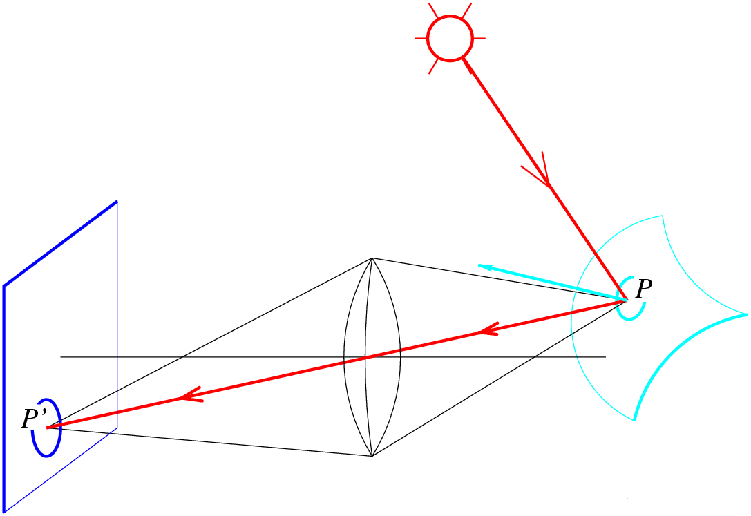
Image formation
How bright is the image of a scene point?

Slide 5
Outline
Light and Shade
  Radiance and irradiance
  Radiometry of thin lens
  Bidirectional reflectance distribution function (BRDF)
  Photometric stereo
Color
  What is color?
  Human eyes
  Trichromacy and color space
  Color perception

Slide 6
Radiometry: Measuring light
The basic setup: a light source is sending radiation to a surface patch
What matters:
  How big the source and the patch “look” to each other
source
patch
Notes:
Consider the hemisphere of directions at a given point on the surface. Light can only arrive at the point along these directions. If two different sources result in exactly the same amount of radiation arriving along every incoming direction, they must have the same effect on the surface.

Slide 7
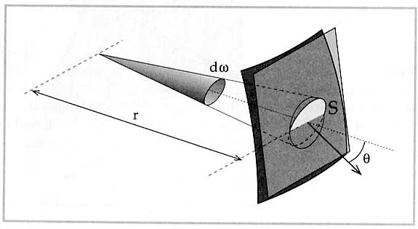
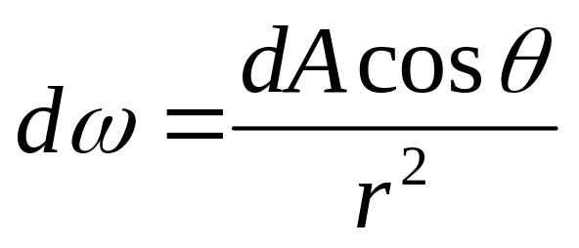
Solid Angle
The solid angle subtended by a region at a point is the area projected on a unit sphere centered at that point
  Units: steradians
The solid angle dω subtended by a patch of area dA is given by:
A
Notes:
dA projected onto surface of the sphere of radius r: dA cos theta
Ratio of surface areas of spheres of radii 1 and r: 4 pi / (4 pi r^2) = 1/r^2

Slide 8
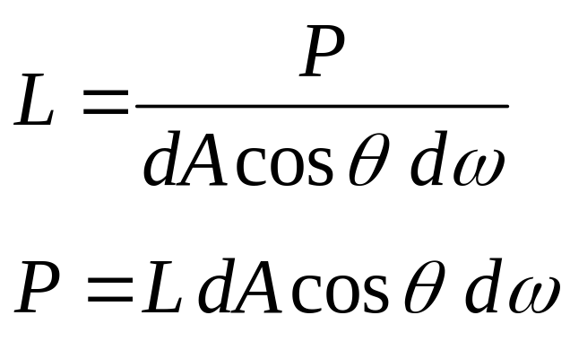

Radiance
Radiance (L): energy carried by a ray
  Power per unit area perpendicular to the direction of travel,
  per unit solid angle
  Units: Watts per square meter per steradian (W m⁻² sr⁻¹)
n
dω
θ
dA

Slide 9
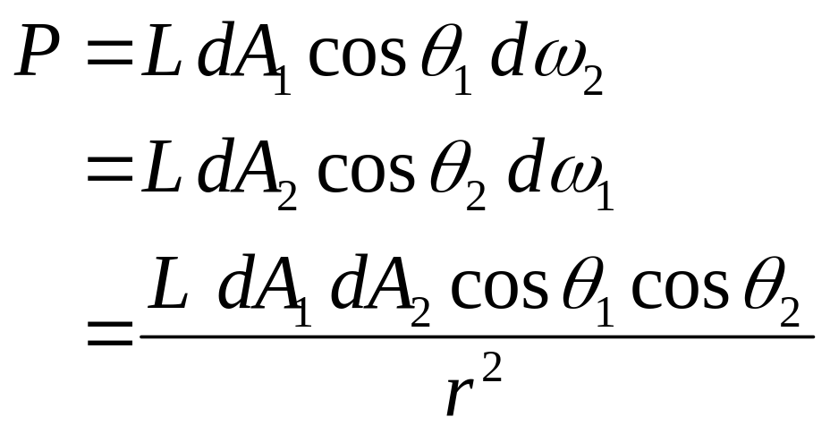
Radiance
The roles of the patch and the source are essentially symmetric
dA₂
θ₂
r
θ₁
dA₁
Notes:
dw2 is the solid angle subtended by patch 2 at patch 1. dw1 is the solid angle subtended by patch 1 at patch 2.

Slide 10
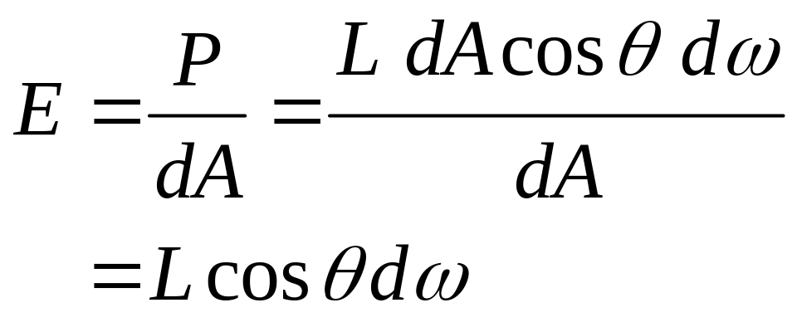
Irradiance
Irradiance (E): energy arriving at a surface
  Incident power per unit area not foreshortened
  Units: W m⁻²
  For a surface receiving radiance L coming in from dω the corresponding irradiance is
n
dω
θ
dA

Slide 11
Outline
Light and Shade
  Radiance and irradiance
  Radiometry of thin lens
  Bidirectional reflectance distribution function (BRDF)
  Photometric stereo
Color
  What is color?
  Human eyes
  Trichromacy and color space
  Color perception

Slide 12
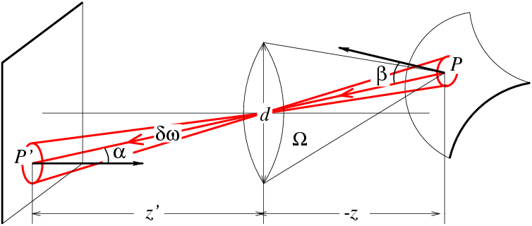
Radiometry of thin lenses
L: Radiance emitted from P toward P’
E: Irradiance falling on P’ from the lens
What is the relationship between E and L?
Forsyth & Ponce, Sec. 4.2.3

Slide 13
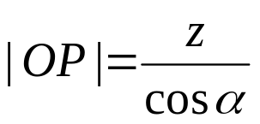
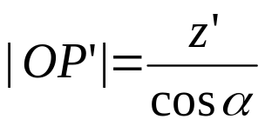
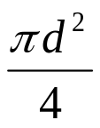
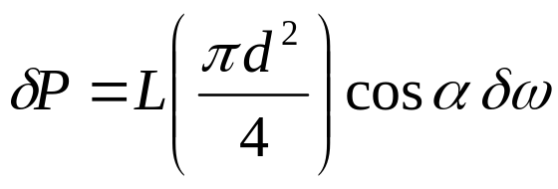
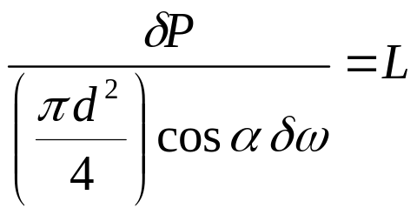
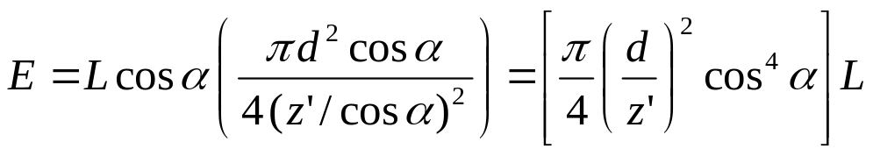
Radiometry of thin lenses
dA
dA’
o
Area of the lens:
The power δP received by the lens from P is
The radiance emitted from the lens towards P’ is
The irradiance received at P’ is
Solid angle subtended by the lens at P’
Notes:
See section 4.2.3 of F&P
Explanation of last equation:
Use the definition of irradiance from slide 7
Compute the solid angle subtended by the lens at P’ using the definition on slide 4

Slide 14
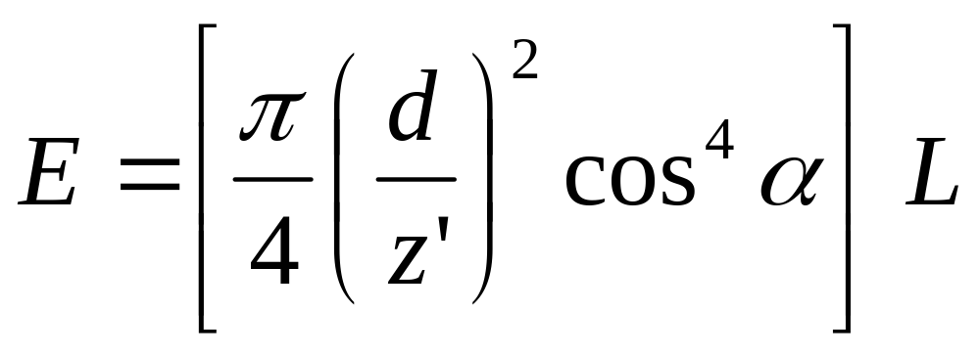
Radiometry of thin lenses
Image irradiance is linearly related to scene radiance
Irradiance is proportional to the area of the lens and inversely proportional to the squared distance between the lens and the image plane
The irradiance falls off as the angle between the viewing ray and the optical axis increases
Forsyth & Ponce, Sec. 4.2.3
Notes:
Explain the difference between the cos^4 alpha effect and vignetting: the former effect has nothing to do with light getting lost in the lens system but is a basic radiometric property even of a perfect lens; vignetting is usually much stronger.

Slide 15

Radiometry of thin lenses
Application:
  S. B. Kang and R. Weiss, Can we calibrate a camera using an image of a flat, textureless Lambertian surface? ECCV 2000.
Notes:
The brightest point corresponds to the principal point (where the optical axis intersects the image plane). The shape of the curves of constant brightness tells us about the shape (scaling factors) of the pixels. The equation also includes the focal length (z’). Thus, we can in principle figure out all the intrinsic camera parameters using the constraints given by this equation.

Slide 16
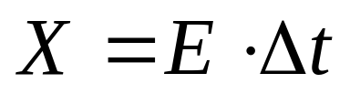
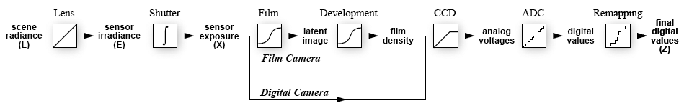
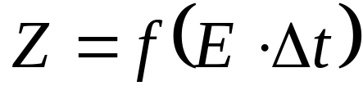
From light rays to pixel values
Camera response function: the mapping f from irradiance to pixel values
  Useful if we want to estimate material properties
  Enables us to create high dynamic range images
Source: S. Seitz, P. Debevec

Slide 17
From light rays to pixel values
Camera response function: the mapping f from irradiance to pixel values
For more info
  P. E. Debevec and J. Malik. Recovering High Dynamic Range Radiance Maps from Photographs. In SIGGRAPH 97, August 1997
Source: S. Seitz, P. Debevec

Slide 18
Outline
Light and Shade
  Radiance and irradiance
  Radiometry of thin lens
  Bidirectional reflectance distribution function (BRDF)
  Photometric stereo
Color
  What is color?
  Human eyes
  Trichromacy and color space
  Color perception

Slide 19
The interaction of light and surfaces
What happens when a light ray hits a point on an object?
  Some of the light gets absorbed
    converted to other forms of energy (e.g., heat)
  Some gets transmitted through the object
    possibly bent, through “refraction”
    Or scattered inside the object (subsurface scattering)
  Some gets reflected
    possibly in multiple directions at once
  Really complicated things can happen
    fluorescence
Let’s consider the case of reflection in detail
  Light coming from a single direction could be reflected in all directions. How can we describe the amount of light reflected in each direction?
Slide by Steve Seitz

Slide 20
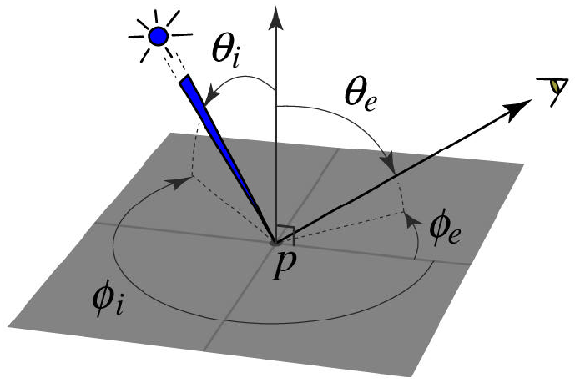
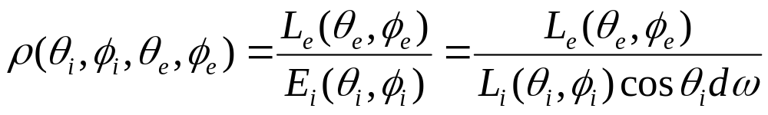
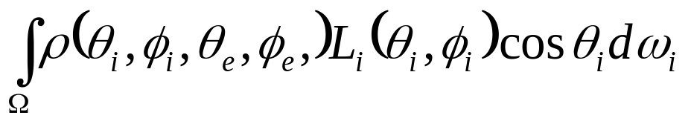
Bidirectional reflectance distribution function (BRDF)
Model of local reflection that tells how bright a surface appears when viewed from one direction when light falls on it from another
Definition: ratio of the radiance in the emitted direction to irradiance in the incident direction
Radiance leaving a surface in a particular direction: integrate radiances from every incoming direction scaled by BRDF:
Notes:
The main purpose of the BRDF is to enable us to compute the radiance leaving the surface in a particular direction (e.g., towards the camera), given the distribution of the radiances received by that surface point over the incoming hemisphere. These kinds of computations are done in graphics by raytracing and global illumination algorithms.

Slide 21
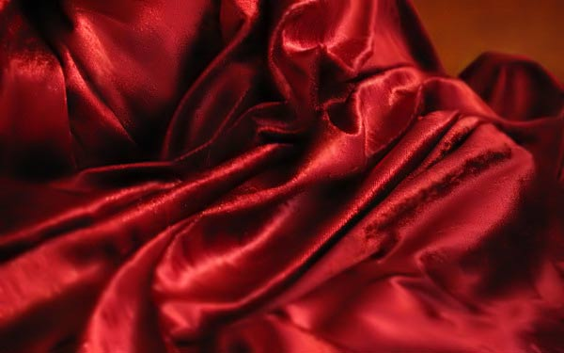
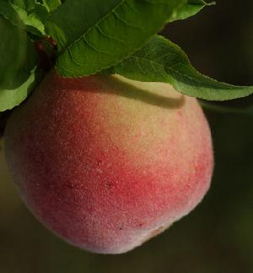
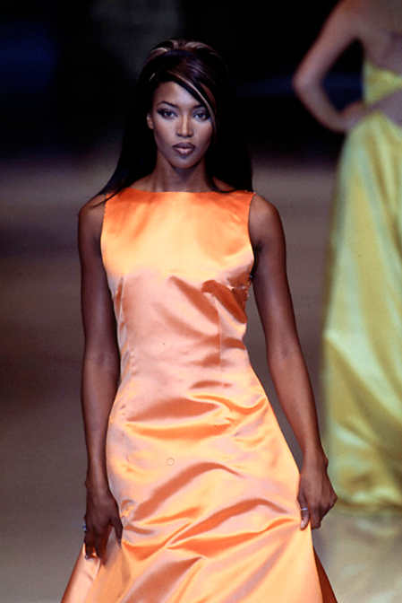
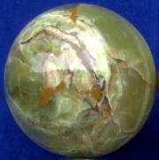
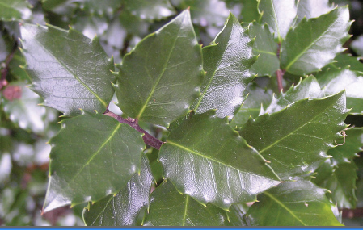
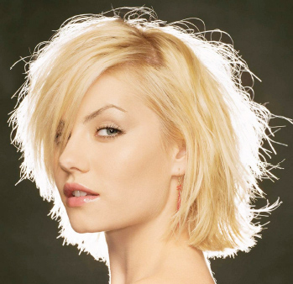
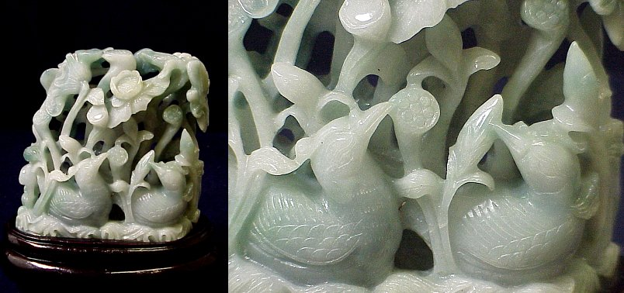
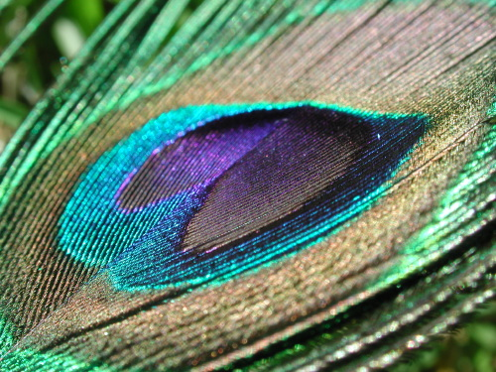
BRDFs can be incredibly complicated…

Slide 22
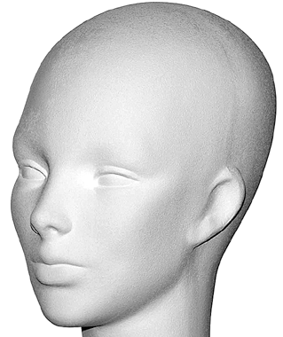
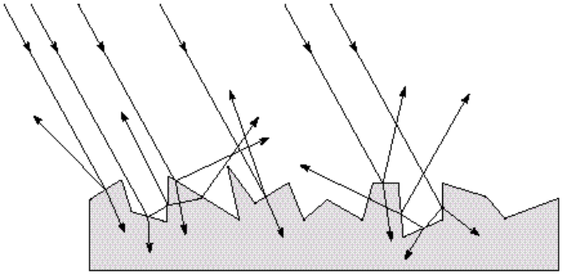
Diffuse reflection
Light is reflected equally in all directions
  Dull, matte surfaces like chalk or latex paint
  Microfacets scatter incoming light randomly
BRDF is constant
  Albedo: fraction of incident irradiance reflected by the surface
  Radiosity: total power leaving the surface per unit area (regardless of direction)

Slide 23
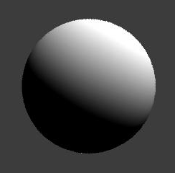
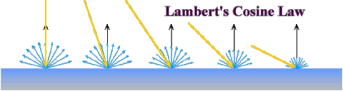


Diffuse reflection: Lambert’s law
Viewed brightness does not depend on viewing direction, but it does depend on direction of illumination
B: radiosity
ρ: albedo
N: unit normal
S: source vector (magnitude proportional to intensity of the source)
N
S
x

Slide 24
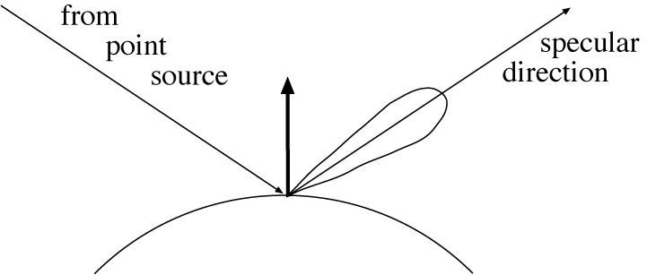
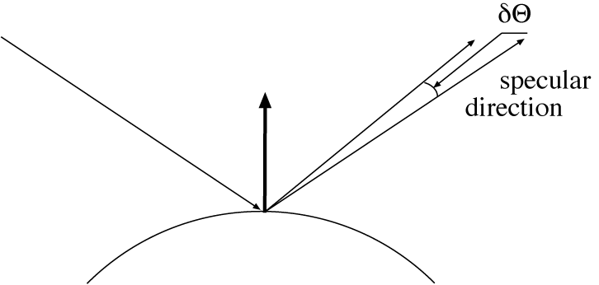
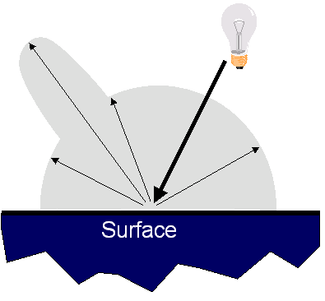

Specular reflection
Radiation arriving along a source direction leaves along the specular direction (source direction reflected about normal)
Some fraction is absorbed, some reflected
On real surfaces, energy usually goes into a lobe of directions
Phong model: reflected energy falls of with
Lambertian + specular model: sum of diffuse and specular term

Slide 25
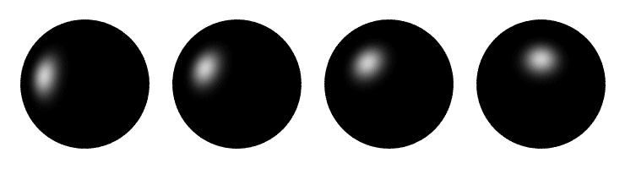
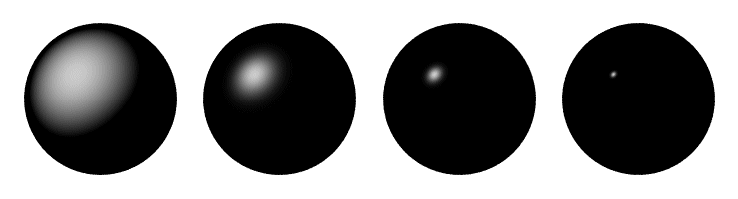
Specular reflection
Moving the light source
Changing the exponent

Slide 26
Outline
Light and Shade
  Radiance and irradiance
  Radiometry of thin lens
  Bidirectional reflectance distribution function (BRDF)
  Photometric stereo
Color
  What is color?
  Human eyes
  Trichromacy and color space
  Color perception

Slide 27
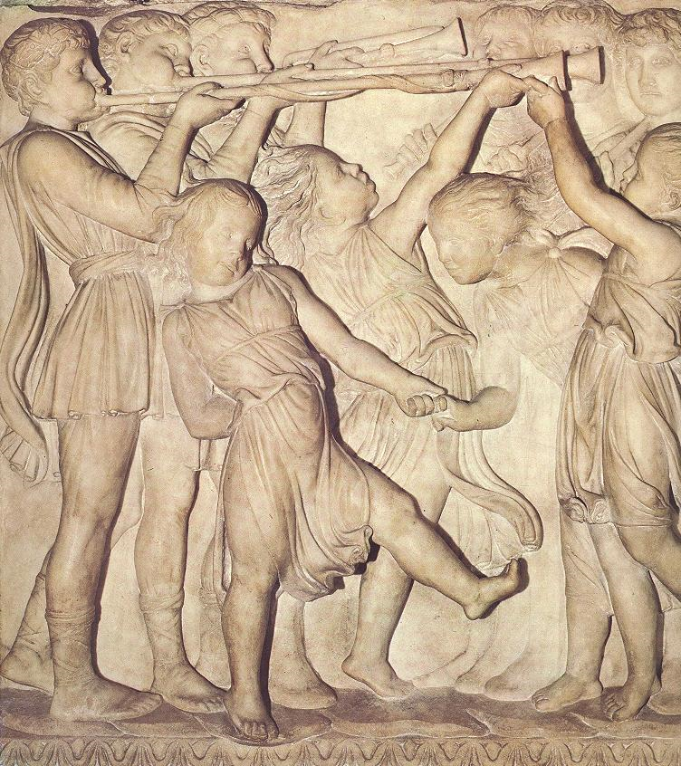
Photometric stereo (shape from shading)
Can we reconstruct the shape of an object based on shading cues?
Luca della Robbia,
Cantoria, 1438

Slide 28
Photometric stereo
Assume:
  A Lambertian object
  A local shading model (each point on a surface receives light only from sources visible at that point)
  A set of known light source directions
  A set of pictures of an object, obtained in exactly the same camera/object configuration but using different sources
  Orthographic projection
Goal: reconstruct object shape and albedo
S₂
S_{n}
S₁
???
Forsyth & Ponce, Sec. 5.4

Slide 29
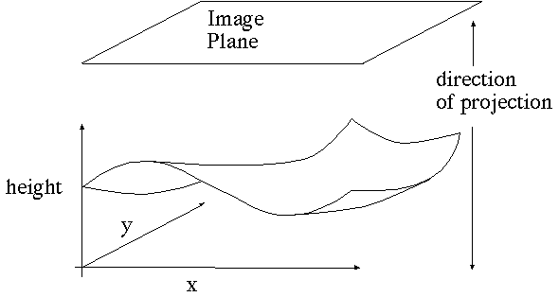
Surface model: Monge patch
Forsyth & Ponce, Sec. 5.4

Slide 30
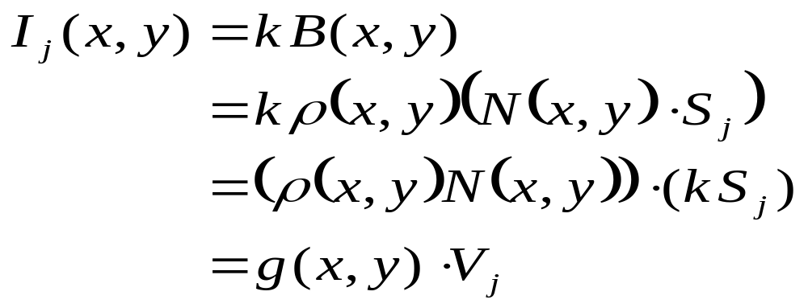
Image model
Known: source vectors S_{j} and pixel values I_{j}(x,y)
We also assume that the response function of the camera is a linear scaling by a factor of k
Combine the unknown normal N(x,y) and albedo ρ(x,y) into one vector g, and the scaling constant k and source vectors S_{j} into another vector V_{j}:
Forsyth & Ponce, Sec. 5.4

Slide 31
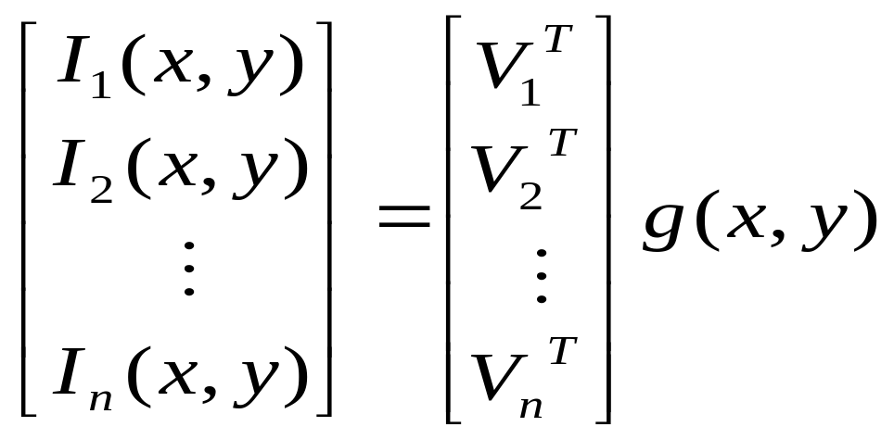
Least squares problem
For each pixel, we obtain a linear system:
(n × 1)
(n × 3)
(3 × 1)
known
known
unknown
Obtain least-squares solution for g(x,y)
Since N(x,y) is the unit normal, ρ(x,y) is given by the magnitude of g(x,y) (and it should be less than 1)
Finally, N(x,y) = g(x,y) / ρ(x,y)
Forsyth & Ponce, Sec. 5.4

Slide 32
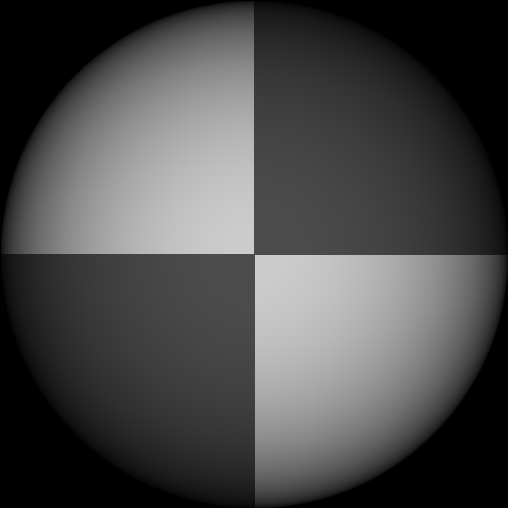
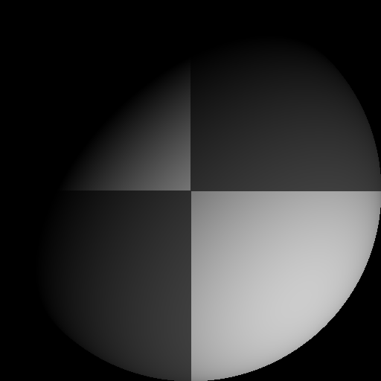
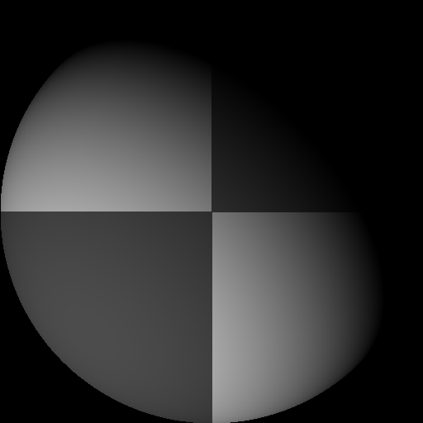
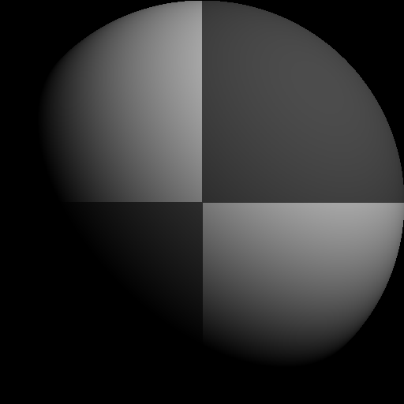
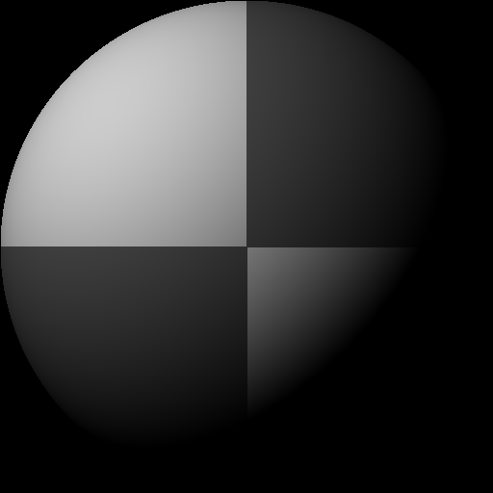
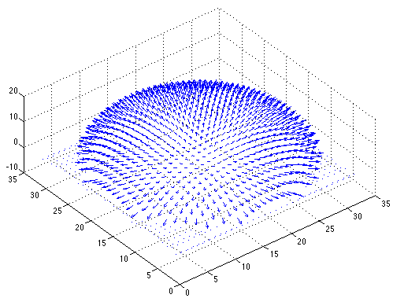

Example
Recovered albedo
Recovered normal field
Forsyth & Ponce, Sec. 5.4

Slide 33

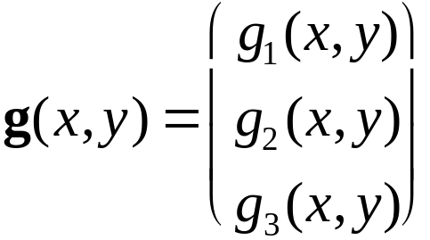
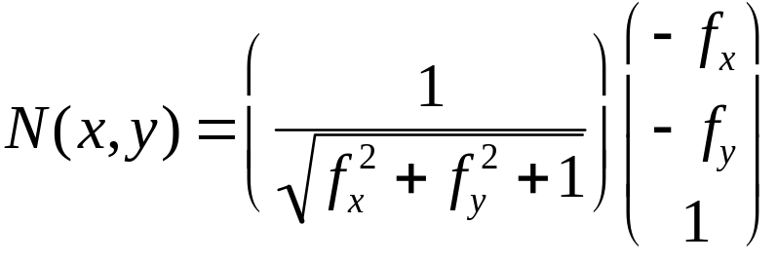


Recovering a surface from normals
Recall the surface is written as
This means the normal has the form:
If we write the estimated vector g as
Then we obtain values for the partial derivatives of the surface:
Forsyth & Ponce, Sec. 5.4

Slide 34
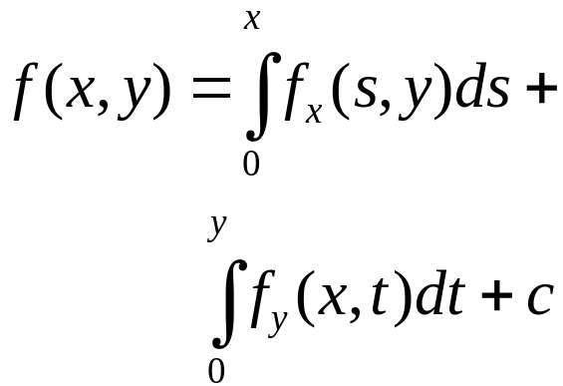

Recovering a surface from normals
We can now recover the surface height at any point by integration along some path, e.g.
Integrability: for the surface f to exist, the mixed second partial derivatives must be equal:
(in practice, they should at least be similar)
(for robustness, can take integrals over many different paths and average the results)
Forsyth & Ponce, Sec. 5.4

Slide 35

Surface recovered by integration
Forsyth & Ponce, Sec. 5.4

Slide 36
Limitations
Orthographic camera model
Simplistic reflectance and lighting model
No shadows
No interreflections
No missing data
Integration is tricky

Slide 37



Finding the direction of the light source
I(x,y) = N(x,y) ·S(x,y) + A
Full 3D case:
N
S
For points on the occluding contour:
P. Nillius and J.-O. Eklundh, “Automatic estimation of the projected light source direction,” CVPR 2001

Slide 38

Finding the direction of the light source
P. Nillius and J.-O. Eklundh, “Automatic estimation of the projected light source direction,” CVPR 2001

Slide 39


Application: Detecting composite photos
Real photo
Fake photo

Slide 40
Outline
Light and Shade
  Radiance and irradiance
  Radiometry of thin lens
  Bidirectional reflectance distribution function (BRDF)
  Photometric stereo
Color
  What is color?
  Human eyes
  Trichromacy and color space
  Color perception

Slide 41

What is color?
Color is the result of interaction between physical light in the environment and our visual system
Color is a psychological property of our visual experiences when we look at objects and lights,
not a physical property of those objects or lights
(S. Palmer, Vision Science: Photons to Phenomenology)

Slide 42



Electromagnetic spectrum
Human Luminance Sensitivity Function

Slide 43

The Physics of Light
Any source of light can be completely described
physically by its spectrum: the amount of energy emitted
(per time unit) at each wavelength 400 - 700 nm.
Relative
spectral
power
© Stephen E. Palmer, 2002

Slide 44

The Physics of Light
Some examples of the spectra of light sources
Rel. power
Rel. power
Rel. power
Rel. power
© Stephen E. Palmer, 2002

Slide 45








The Physics of Light
Some examples of the reflectance spectra of surfaces
Red
Yellow
Blue
Purple
% Light Reflected
400 700
400 700
400 700
400 700
Wavelength (nm)
© Stephen E. Palmer, 2002

Slide 46


Interaction of light and surfaces
Reflected color is the result of interaction of light source spectrum with surface reflectance

Slide 47


Interaction of light and surfaces
What is the observed color of any surface under monochromatic light?
Olafur Eliasson, Room for one color

Slide 48
Outline
Light and Shade
  Radiance and irradiance
  Radiometry of thin lens
  Bidirectional reflectance distribution function (BRDF)
  Photometric stereo
Color
  What is color?
  Human eyes
  Trichromacy and color space
  Color perception

Slide 49

The Eye
The human eye is a camera!
  Iris - colored annulus with radial muscles
  Pupil - the hole (aperture) whose size is controlled by the iris
  Lens - changes shape by using ciliary muscles (to focus on objects at different distances)
  Retina - photoreceptor cells
Slide by Steve Seitz

Slide 50


Rods and cones
pigment
molecules
Rods are responsible for intensity, cones for color perception
Rods and cones are non-uniformly distributed on the retina
  Fovea - Small region (1 or 2°) at the center of the visual field containing the highest density of cones (and no rods)
Slide by Steve Seitz

Slide 51

Rod / Cone sensitivity
Why can’t we read in the dark?
Slide by A. Efros

Slide 52



Physiology of Color Vision
Three kinds of cones:
Ratio of L to M to S cones: approx. 10:5:1
Almost no S cones in the center of the fovea
© Stephen E. Palmer, 2002

Slide 53
Color perception
M
L
Power
S
Wavelength
Rods and cones act as filters on the spectrum
  To get the output of a filter, multiply its response curve by the spectrum, integrate over all wavelengths
    Each cone yields one number
  Q: How can we represent an entire spectrum with 3 numbers?
  A: We can’t! Most of the information is lost.
    As a result, two different spectra may appear indistinguishable
      such spectra are known as metamers
Slide by Steve Seitz

Slide 54

Metamers

Slide 55

Spectra of some real-world surfaces
metamers

Slide 56
Outline
Light and Shade
  Radiance and irradiance
  Radiometry of thin lens
  Bidirectional reflectance distribution function (BRDF)
  Photometric stereo
Color
  What is color?
  Human eyes
  Trichromacy and color space
  Color perception

Slide 57

Standardizing color experience
We would like to understand which spectra produce the same color sensation in people under similar viewing conditions
Color matching experiments
Foundations of Vision, by Brian Wandell, Sinauer Assoc., 1995

Slide 58
Color matching experiment 1
Source: W. Freeman

Slide 59
Color matching experiment 1
p₁ p₂ p₃
Source: W. Freeman

Slide 60
Color matching experiment 1
p₁ p₂ p₃
Source: W. Freeman

Slide 61
Color matching experiment 1
The primary color amounts needed for a match
p₁ p₂ p₃
Source: W. Freeman

Slide 62
Color matching experiment 2
Source: W. Freeman

Slide 63
Color matching experiment 2
p₁ p₂ p₃
Source: W. Freeman

Slide 64
Color matching experiment 2
p₁ p₂ p₃
Source: W. Freeman

Slide 65
Color matching experiment 2
The primary color amounts needed for a match:
We say a “negative” amount of p₂ was needed to make the match, because we added it to the test color’s side.
p₁ p₂ p₃
p₁ p₂ p₃
p₁ p₂ p₃
Source: W. Freeman

Slide 66
Trichromacy
In color matching experiments, most people can match any given light with three primaries
  Primaries must be independent
For the same light and same primaries, most people select the same weights
  Exception: color blindness
Trichromatic color theory
  Three numbers seem to be sufficient for encoding color
  Dates back to 18th century (Thomas Young)

Slide 67
Grassman’s Laws
Color matching appears to be linear
If two test lights can be matched with the same set of weights, then they match each other:
  Suppose A = u₁ P₁ + u₂ P₂ + u₃ P₃ and B = u₁ P₁ + u₂ P₂ + u₃ P₃. Then A = B.
If we mix two test lights, then mixing the matches will match the result:
  Suppose A = u₁ P₁ + u₂ P₂ + u₃ P₃ and B = v₁ P₁ + v₂ P₂ + v₃ P₃. Then A + B = (u₁+v₁) P₁ + (u₂+v₂) P₂ + (u₃+v₃) P₃.
If we scale the test light, then the matches get scaled by the same amount:
  Suppose A = u₁ P₁ + u₂ P₂ + u₃ P₃.
  Then kA = (ku₁) P₁ + (ku₂) P₂ + (ku₃) P_{3.}

Slide 68
Linear color spaces
Defined by a choice of three primaries
The coordinates of a color are given by the weights of the primaries used to match it
mixing two lights produces
colors that lie along a straight
line in color space
mixing three lights produces
colors that lie within the triangle
they define in color space

Slide 69

How to compute the weights of the primaries to match any spectral signal
Given: a choice of three primaries and a target color signal
Find: weights of the primaries needed to match the color signal
?
p₁ p₂ p₃
p₁ p₂ p₃
Matching functions: the amount of each primary needed to match a monochromatic light source at each wavelength

Slide 70



RGB space
Primaries are monochromatic lights (for monitors, they correspond to the three types of phosphors)
Subtractive matching required for some wavelengths
RGB primaries
RGB matching functions

Slide 71

How to compute the weights of the primaries to match any spectral signal
Let c(λ) be one of the matching functions, and let t(λ) be the spectrum of the signal. Then the weight of the corresponding primary needed to match t is
Matching functions, c(λ)
Signal to be matched, t(λ)
λ

Slide 72

Comparison of RGB matching functions with best 3x3 transformation of cone responses
Foundations of Vision, by Brian Wandell, Sinauer Assoc., 1995

Slide 73


Linear color spaces: CIE XYZ
Primaries are imaginary, but matching functions are everywhere positive
The Y parameter corresponds to brightness or luminance of a color
2D visualization: draw (x,y), where
x = X/(X+Y+Z), y = Y/(X+Y+Z)
Matching functions
http://en.wikipedia.org/wiki/CIE_1931_color_space

Slide 74


Uniform color spaces
Unfortunately, differences in x,y coordinates do not reflect perceptual color differences
CIE u’v’ is a projective transform of x,y to make the ellipses more uniform
McAdam ellipses: Just noticeable differences in color

Slide 75



Nonlinear color spaces: HSV
Perceptually meaningful dimensions:
Hue, Saturation, Value (Intensity)
RGB cube on its vertex

Slide 76
Outline
Light and Shade
  Radiance and irradiance
  Radiometry of thin lens
  Bidirectional reflectance distribution function (BRDF)
  Photometric stereo
Color
  What is color?
  Human eyes
  Trichromacy and color space
  Color perception

Slide 77

Color perception
Color/lightness constancy
  The ability of the human visual system to perceive the intrinsic reflectance properties of the surfaces despite changes in illumination conditions
Instantaneous effects
  Simultaneous contrast
  Mach bands
Gradual effects
  Light/dark adaptation
  Chromatic adaptation
  Afterimages
J. S. Sargent, The Daughters of Edward D. Boit, 1882

Slide 78
Chromatic adaptation
The visual system changes its sensitivity depending on the luminances prevailing in the visual field
  The exact mechanism is poorly understood
Adapting to different brightness levels
  Changing the size of the iris opening (i.e., the aperture) changes the amount of light that can enter the eye
  Think of walking into a building from full sunshine
Adapting to different color temperature
  The receptive cells on the retina change their sensitivity
  For example: if there is an increased amount of red light, the cells receptive to red decrease their sensitivity until the scene looks white again
  We actually adapt better in brighter scenes: This is why candlelit scenes still look yellow
http://www.schorsch.com/kbase/glossary/adaptation.html

Slide 79


White balance
When looking at a picture on screen or print, we adapt to the illuminant of the room, not to that of the scene in the picture
When the white balance is not correct, the picture will have an unnatural color “cast”
incorrect white balance
correct white balance
http://www.cambridgeincolour.com/tutorials/white-balance.htm

Slide 80

White balance
Film cameras:
  Different types of film or different filters for different illumination conditions
Digital cameras:
  Automatic white balance
  White balance settings corresponding to
  several common illuminants
  Custom white balance using a reference
  object
http://www.cambridgeincolour.com/tutorials/white-balance.htm

Slide 81
White balance
Von Kries adaptation
  Multiply each channel by a gain factor

Slide 82

White balance
Von Kries adaptation
  Multiply each channel by a gain factor
Best way: gray card
  Take a picture of a neutral object (white or gray)
  Deduce the weight of each channel
    If the object is recoded as r_{w}, g_{w}, b_{w}
    use weights 1/r_{w}, 1/g_{w}, 1/b_{w}

Slide 83
White balance
Without gray cards: we need to “guess” which pixels correspond to white objects
Gray world assumption
  The image average r_{ave}, g_{ave}, b_{ave} is gray
  Use weights 1/r_{ave}, 1/g_{ave}, 1/b_{ave}
Brightest pixel assumption
  Highlights usually have the color of the light source
  Use weights inversely proportional to the values of the brightest pixels
Gamut mapping
  Gamut: convex hull of all pixel colors in an image
  Find the transformation that matches the gamut of the image to the gamut of a “typical” image under white light
Use image statistics, learning techniques

Slide 84

White balance by recognition
Key idea: For each of the semantic classes present in the image, compute the illuminant that transforms the pixels assigned to that class so that the average color of that class matches the average color of the same class in a database of “typical” images
J. Van de Weijer, C. Schmid and J. Verbeek, Using High-Level Visual Information for Color Constancy, ICCV 2007.

Slide 85


Mixed illumination
When there are several types of illuminants in the scene, different reference points will yield different results
Reference: moon
Reference: stone
http://www.cambridgeincolour.com/tutorials/white-balance.htm

Slide 86



Spatially varying white balance
Input
Alpha map
Output
E. Hsu, T. Mertens, S. Paris, S. Avidan, and F. Durand, “Light Mixture Estimation for Spatially Varying White Balance,” SIGGRAPH 2008

