Slide 1
CS558 Computer Vision

Slide 2
Recap. Of Lecture I
What is computer vision?
Why should we care about it?
Why is it challenging?
What are the real-world applications?
What are the goals of this class?

Slide 3
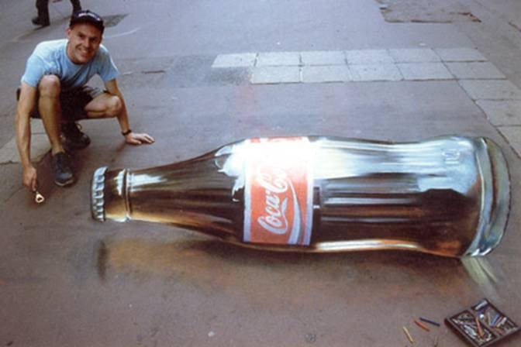
The illusion of projection

Slide 4
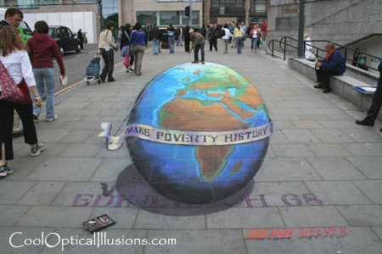
Illusion of projection
Slide by Steve Seitz

Slide 5
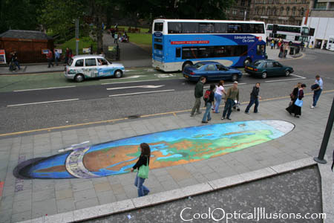
Illusion of projection
Slide by Steve Seitz

Slide 6

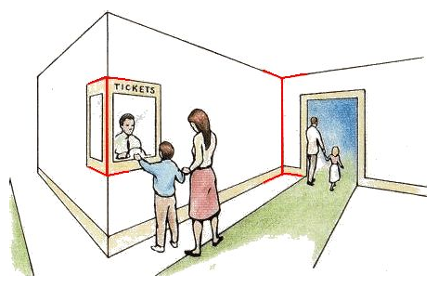
Müller-Lyer illusion
by Pravin Bhat
http://www.michaelbach.de/ot/sze_muelue/index.html
Slide by Steve Seitz

Slide 7
Lecture II: Camera and Projective Geometry

Slide 8
Overview
The pinhole camera
Modeling the projections
Cameras with lenses
Digital cameras

Slide 9
Overview
The pinhole camera
Modeling the projections
Cameras with lenses
Digital cameras

Slide 10
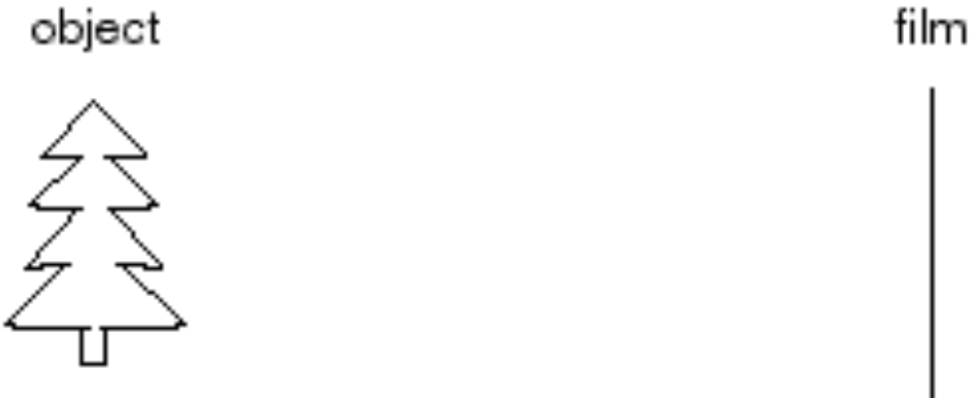
Let's design a camera
Idea 1: put a piece of film in front of an object
Do we get a reasonable image?
Slide by Steve Seitz

Slide 11
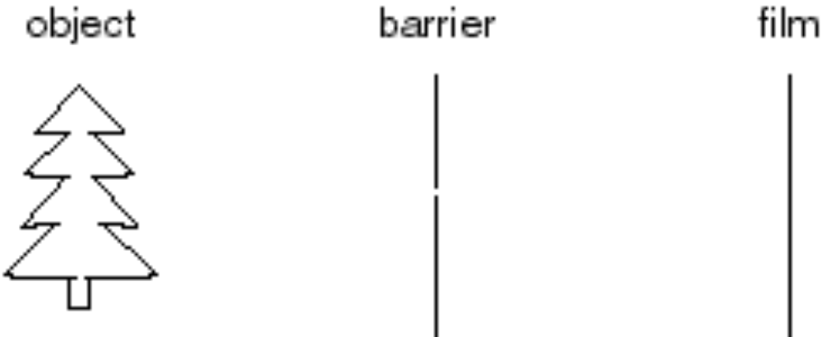
Pinhole camera
Add a barrier to block off most of the rays
  This reduces blurring
  The opening is known as the aperture
  How does this transform the object?
Slide by Steve Seitz
Notes:
It gets inverted

Slide 12
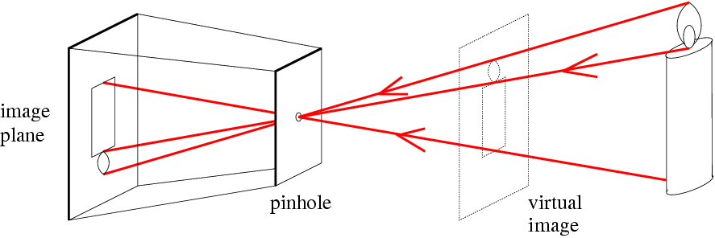
Pinhole camera
f
c
f = focal length
c = center of the camera
Figure from Forsyth

Slide 13
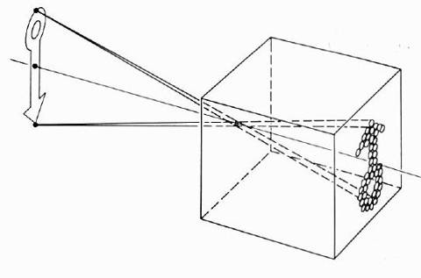
Pinhole camera model
Pinhole model:
  Captures pencil of rays – all rays through a single point
  The point is called Center of Projection (focal point)
  The image is formed on the Image Plane
The first camera
  Known to Aristotle
  What is the effect of the aperture size?
Slide by Steve Seitz

Slide 14
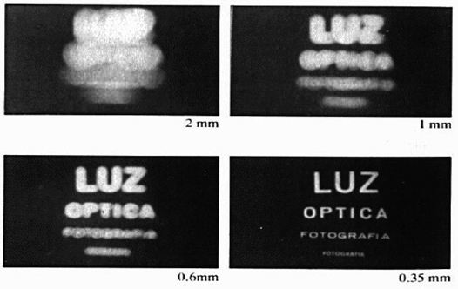
Shrinking the aperture
Why not make the aperture as small as possible?
  Less light gets through
  Diffraction effects...
Slide by Steve Seitz

Slide 15
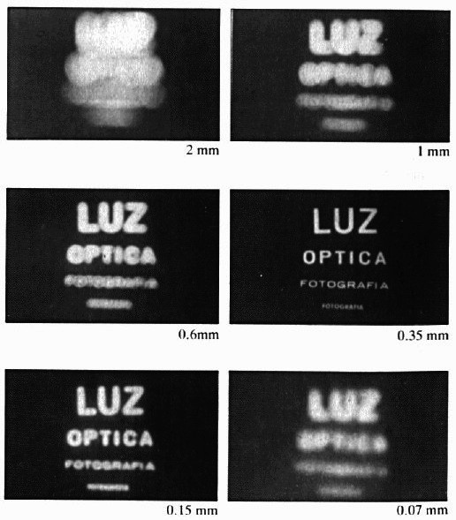
Shrinking the aperture
Slide by Steve Seitz

Slide 16
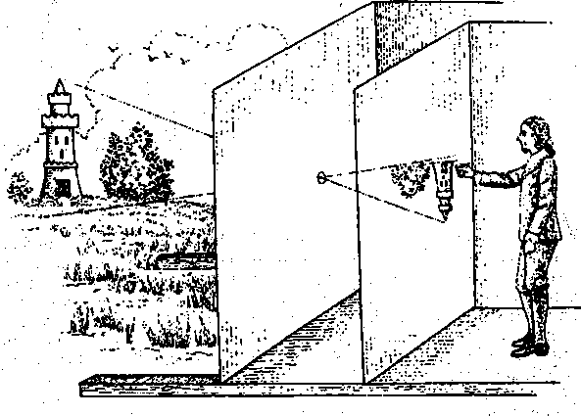
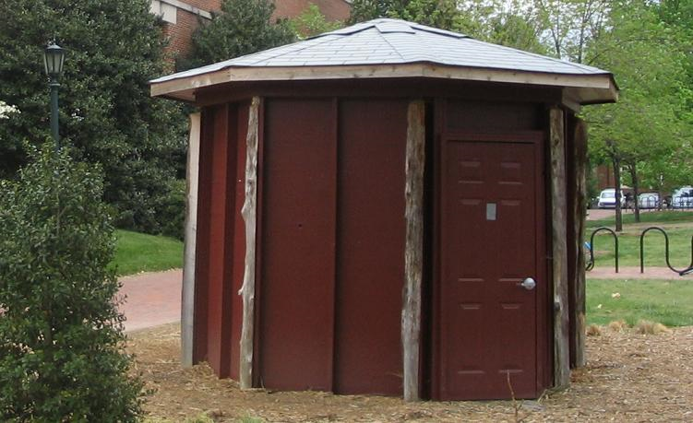
Camera obscura: the pre-camera
Known during classical period in China and Greece (e.g. Mo-Ti, China, 470BC to 390BC)
Illustration of Camera Obscura
Freestanding camera obscura at UNC Chapel Hill
Photo by Seth Ilys
Slide by J. Hays

Slide 17
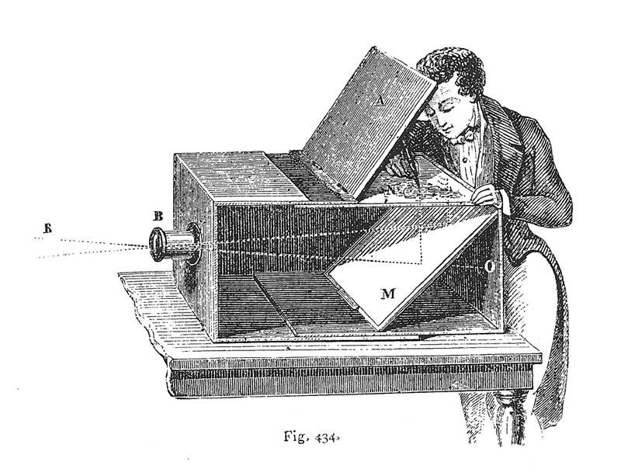
Camera Obscura used for Tracing
Lens Based Camera Obscura, 1568
Slide by J. Hays

Slide 18
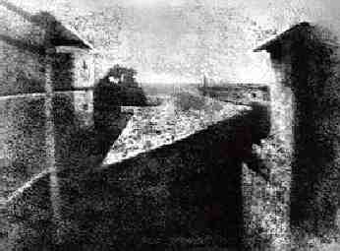
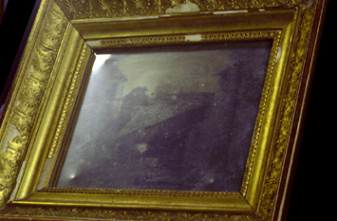
First Photograph
Oldest surviving photograph
  Took 8 hours on pewter plate
Photograph of the first photograph
Joseph Niepce, 1826
Stored at UT Austin
Niepce later teamed up with Daguerre, who eventually created Daguerrotypes
Slide by J. Hays

Slide 19
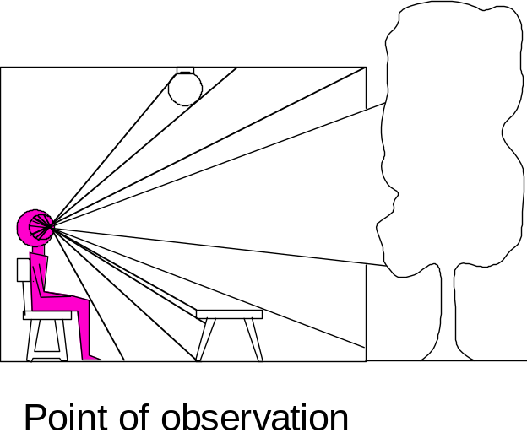

Information Collapse: From 3D to 2D
3D world
2D image
What is preserved?
  Straight lines, incidence
What have we lost?
  Angles, lengths
Slide by A. Efros
Figures © Stephen E. Palmer, 2002

Slide 20
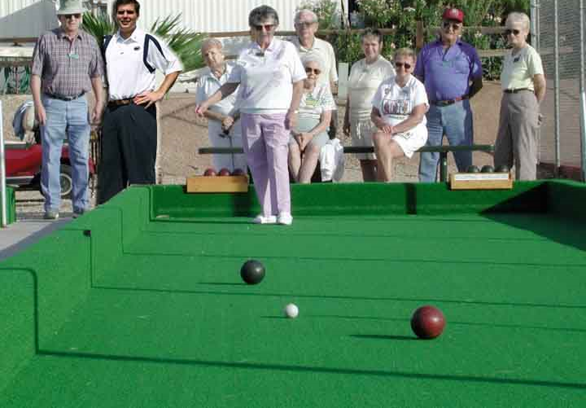
Projective Geometry
What is lost?
Length
Who is taller?
Which is closer?
Slide by J. Hays

Slide 21
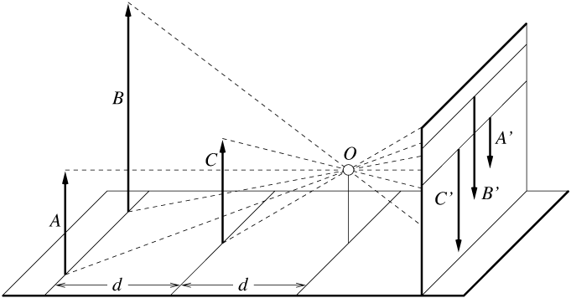
Length is not preserved
A’
C’
B’
Figure by David Forsyth

Slide 22
Projective Geometry
What is lost?
Length
Angles
Parallel?
Perpendicular?
Slide by J. Hays

Slide 23
Projective Geometry
What is preserved?
Straight lines are still straight
Slide by J. Hays

Slide 24
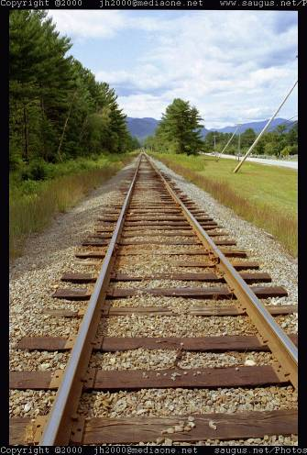
Vanishing points
Each direction in space has its own vanishing point
  All lines going in that direction converge at that point
  Exception: directions parallel to the image plane
Slide by S. Lazebnik

Slide 25
Vanishing points
Each direction in space has its own vanishing point
  All lines going in that direction converge at that point
  Exception: directions parallel to the image plane
How do we construct the vanishing point of a line?
  What about the vanishing line of a plane?
image plane
vanishing point
camera
center
line on ground plane
Slide by S. Lazebnik

Slide 26
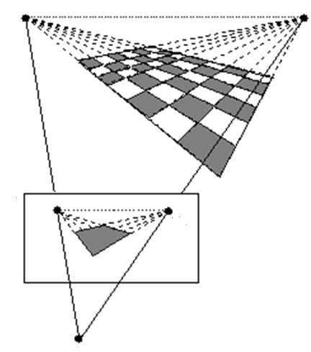
Varnishing lines
I₁
Ideal line
I₂
Plane
Varnishing line
V₁
V₂
C
Image source: http://homepages.inf.ed.ac.uk/rbf/CVonline/LOCAL_COPIES/BEARDSLEY/node5.html

Slide 27
Vanishing points and lines
Vertical vanishing
point
(at infinity)
Vanishing
line
Vanishing
point
Vanishing
point
Slide from Efros, Photo from Criminisi

Slide 28
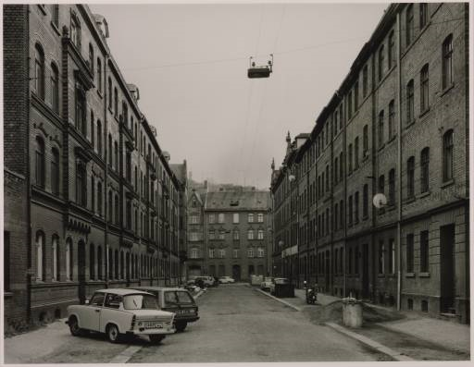
Vanishing points and lines
Photo from online Tate collection
Slide by J. Hays
Notes:
Where are the vanishing points? Do buildings on left and buildings on right have the same vanishing line? Which way is the camera tilted?

Slide 29
Note on estimating vanishing points
Slide by J. Hays

Slide 30
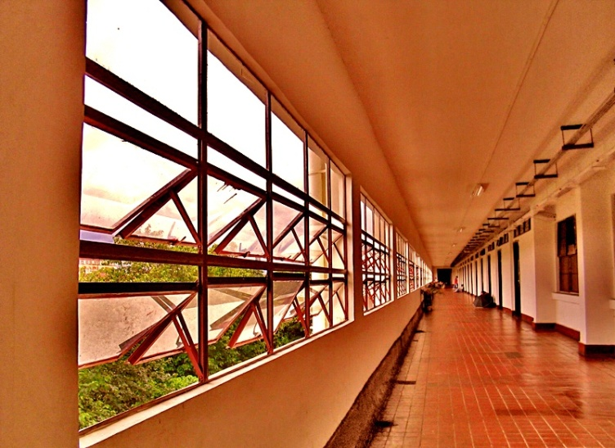
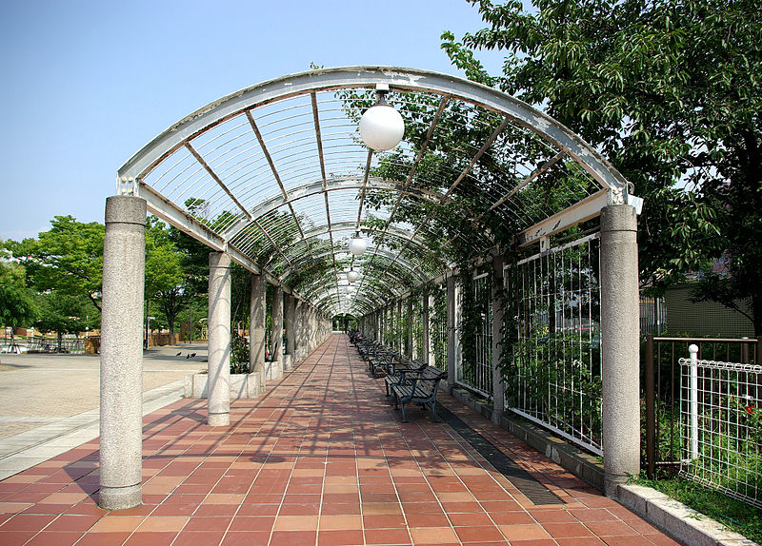
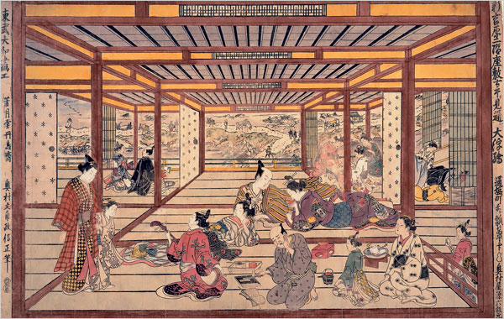
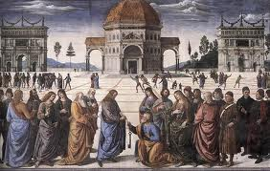
One-point perspective

Slide 31
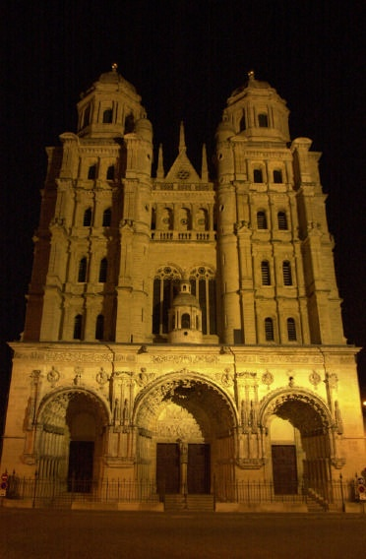
Perspective distortion
Problem for architectural photography: converging verticals
Source: F. Durand

Slide 32
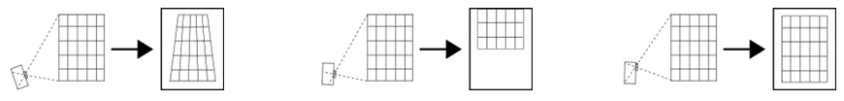
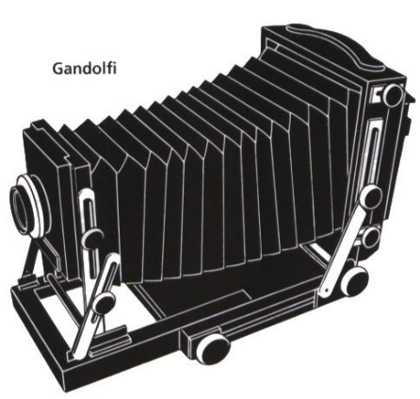
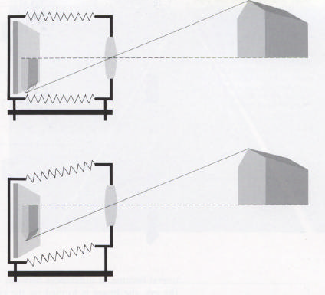
Perspective distortion
Problem for architectural photography: converging verticals
Solution: view camera (lens shifted w.r.t. film)
Tilting the camera upwards results in converging verticals
Keeping the camera level, with an ordinary lens, captures only the bottom portion of the building
Shifting the lens upwards results in a picture of the entire subject
http://en.wikipedia.org/wiki/Perspective_correction_lens
Source: F. Durand

Slide 33
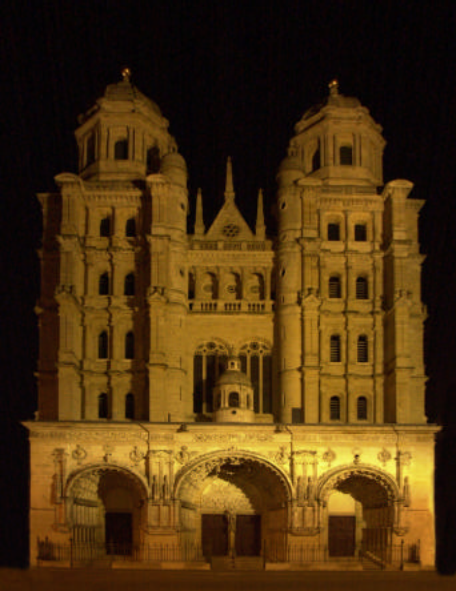
Perspective distortion
Problem for architectural photography: converging verticals
Result:
Source: F. Durand

Slide 34
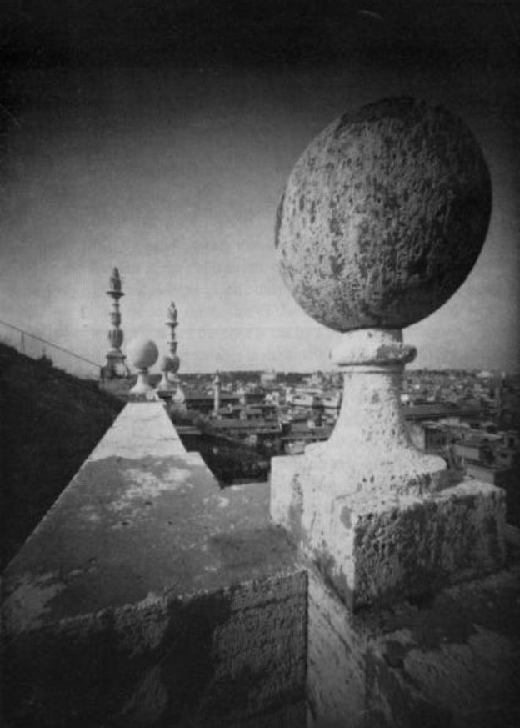
Perspective distortion
What does a sphere project to?
Image source: F. Durand
Slide by S. Lazebnik

Slide 35
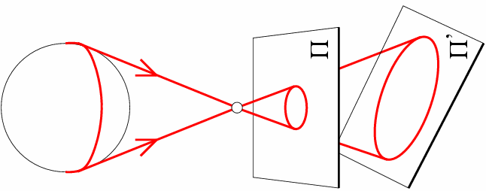
Perspective distortion
What does a sphere project to?
Slide by S. Lazebnik

Slide 36
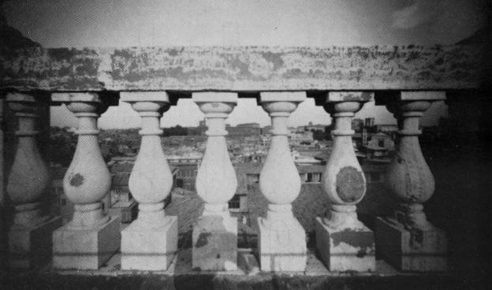
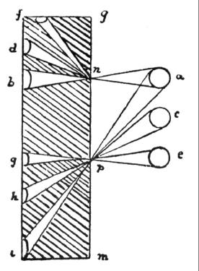
Perspective distortion
The exterior columns appear bigger
The distortion is not due to lens flaws
Problem pointed out by Da Vinci
Slide by F. Durand

Slide 37
Perspective distortion: People
Slide by S. Lazebnik

Slide 38
Overview
The pinhole camera
Modeling the projections
Cameras with lenses
Digital cameras

Slide 39
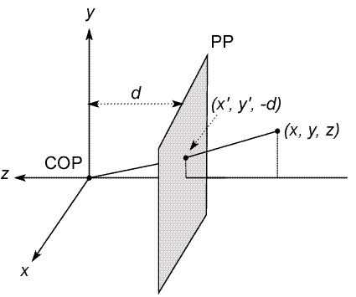
Modeling projection
The coordinate system
  We will use the pin-hole model as an approximation
  Put the optical center (Center Of Projection) at the origin
  Put the image plane (Projection Plane) in front of the COP
    Why can we do it?
  The camera looks down the negative z axis
    we need this if we want right-handed-coordinates
Slide by Steve Seitz
Notes:
This way the image is right-side-up

Slide 40
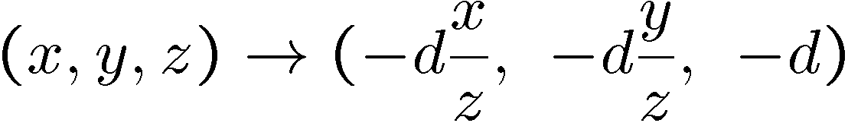
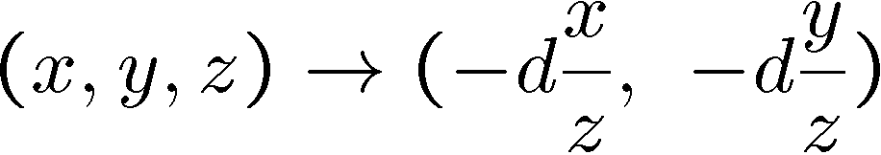
Modeling projection
Projection equations
  Compute intersection with PP of ray from (x,y,z) to COP
  Derived using similar triangles (on board)
  We get the projection by throwing out the last coordinate:
Slide by Steve Seitz

Slide 41
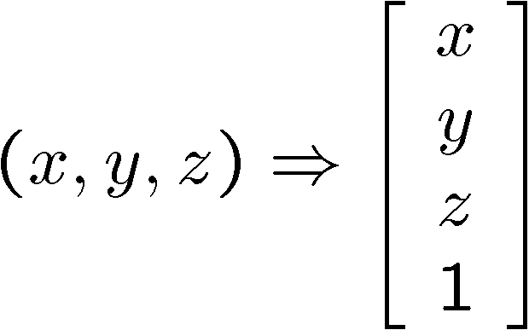
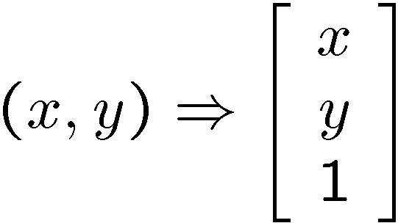
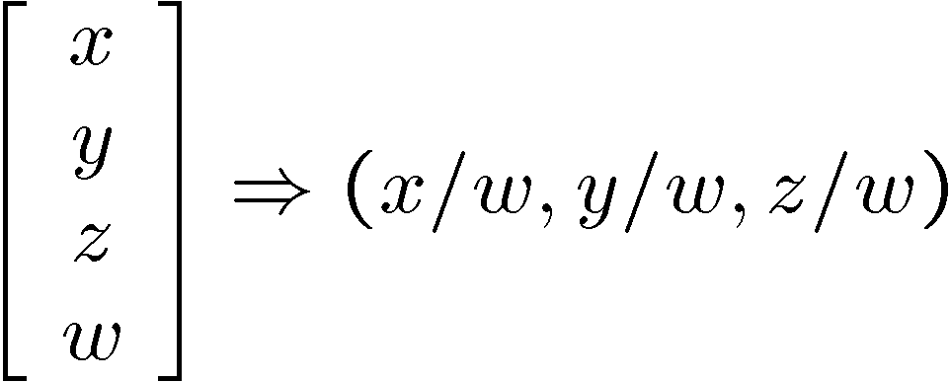
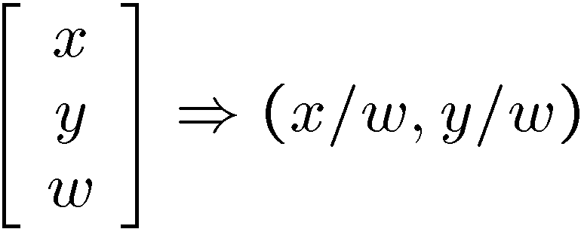
Homogeneous coordinates
Is this a linear transformation?
Trick: add one more coordinate:
  no—division by z is nonlinear
homogeneous image
coordinates
homogeneous scene
coordinates
Converting from homogeneous coordinates
Slide by Steve Seitz

Slide 42
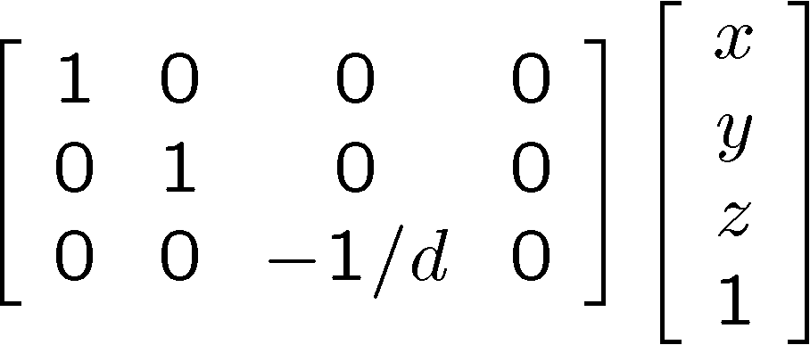
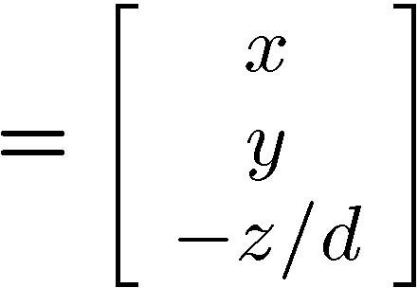
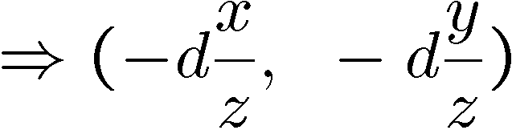
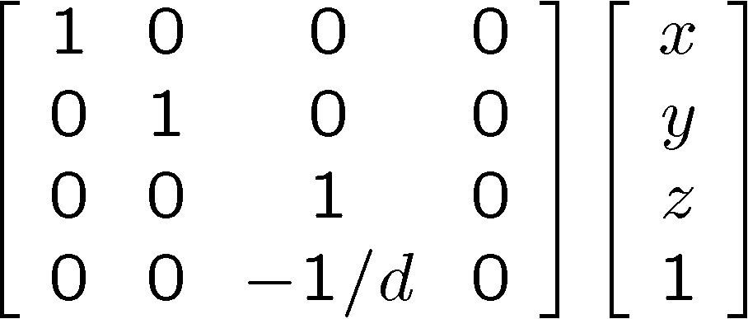
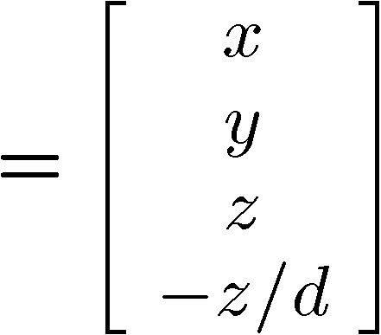
Perspective Projection
Projection is a matrix multiply using homogeneous coordinates:
divide by third coordinate
This is known as perspective projection
  The matrix is the projection matrix
  Can also formulate as a 4x4 (today’s reading does this)
divide by fourth coordinate
Slide by Steve Seitz

Slide 43
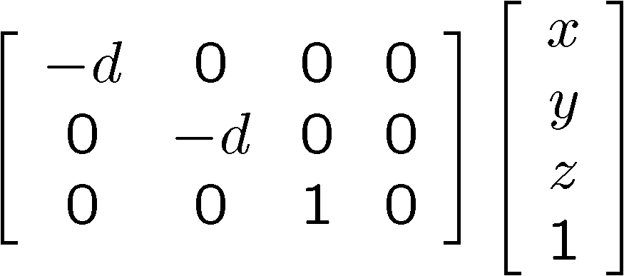
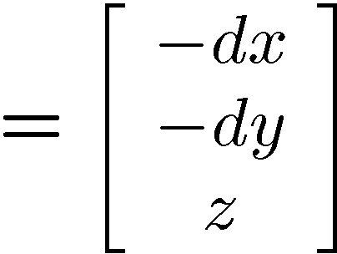
Perspective Projection
How does scaling the projection matrix change the transformation?
Slide by Steve Seitz

Slide 44
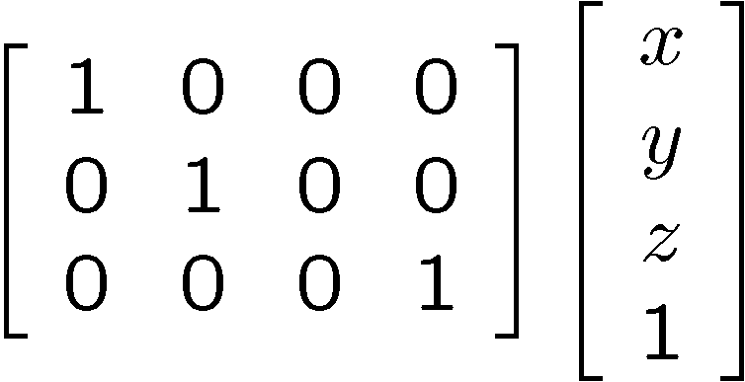
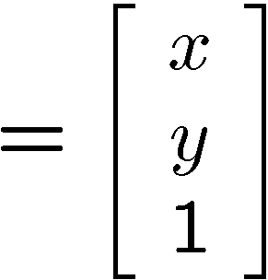

Orthographic projection
Special case of perspective projection
  Distance from the COP to the PP is infinite
  Good approximation for telephoto optics
  Also called “parallel projection”: (x, y, z) → (x, y)
  What’s the projection matrix?
Image
World
Slide by Steve Seitz

Slide 45


Orthographic (“telecentric”) lenses
Navitar telecentric zoom lens
http://www.lhup.edu/~dsimanek/3d/telecent.htm
Slide by Steve Seitz

Slide 46




Variants of orthographic projection
Scaled orthographic
  Also called “weak perspective”
Affine projection
  Also called “paraperspective”
Slide by Steve Seitz

Slide 47





Camera parameters
A camera is described by several parameters
  Translation T of the optical center from the origin of world coords
  Rotation R of the image plane
  focal length f, principle point (x’_{c}, y’_{c}), pixel size (s_{x}, s_{y})
  blue parameters are called “extrinsics,” red are “intrinsics”
Projection equation
  The projection matrix models the cumulative effect of all parameters
  Useful to decompose into a series of operations
identity matrix
intrinsics
projection
rotation
translation
  The definitions of these parameters are not completely standardized
    especially intrinsics—varies from one book to another
Slide by Steve Seitz

Slide 48
Overview
The pinhole camera
Modeling the projections
Cameras with lenses
Digital cameras

Slide 49

Adding a lens
A lens focuses light onto the film
  Thin lens model:
    Rays passing through the center are not deviated
    (pinhole projection model still holds)
Slide by Steve Seitz

Slide 50
Adding a lens
focal point
f
A lens focuses light onto the film
  Thin lens model:
    Rays passing through the center are not deviated
    (pinhole projection model still holds)
    All parallel rays converge to one point on a plane located at the focal length f
Slide by Steve Seitz

Slide 51
Adding a lens
“circle of
confusion”
A lens focuses light onto the film
  There is a specific distance at which objects are “in focus”
    other points project to a “circle of confusion” in the image
Slide by Steve Seitz

Slide 52
Thin lens formula
What is the relation between the focal length (f), the distance of the object from the optical center (D), and the distance at which the object will be in focus (D’)?
D’
D
f
image plane
lens
object
Slide by F. Durand
Notes:
This is the relation between the focal length (f), the distance of the object from the camera (D), and the distance at which the object will be in focus (D’)

Slide 53
Thin lens formula
Similar triangles everywhere!
D’
D
f
image plane
lens
object
Slide by F. Durand

Slide 54
Thin lens formula
y’/y = D’/D
Similar triangles everywhere!
D’
D
f
y
y’
image plane
lens
object
Slide by F. Durand

Slide 55
Thin lens formula
y’/y = D’/D
Similar triangles everywhere!
y’/y = (D’-f)/f
D’
D
f
y
y’
image plane
lens
object
Slide by F. Durand

Slide 56
Thin lens formula
1
1
1
+
=
Any point satisfying the thin lens equation is in focus.
D’
D
f
D’
D
f
image plane
lens
object
Slide by F. Durand
Notes:
And the set of all such points forms a plane parallel to the image (plane of focus).

Slide 57


Depth of Field
http://www.cambridgeincolour.com/tutorials/depth-of-field.htm
Slide by A. Efros
Notes:
Depth of field is the range of distance within the subject that is acceptably sharp.

Slide 58

How can we control the depth of field?
Changing the aperture size affects depth of field
  A smaller aperture increases the range in which the object is approximately in focus
  But small aperture reduces amount of light – need to increase exposure
Slide by A. Efros

Slide 59


Varying the aperture
Large aperture = small DOF
Small aperture = large DOF
Slide by A. Efros

Slide 60

Field of View
Slide by A. Efros
Notes:
The field of view is the angular extent of the world that is observed by the camera.

Slide 61

Field of View
What does FOV depend on?
Slide by A. Efros

Slide 62


Field of View
f
f
FOV depends on focal length and size of the camera retina
Smaller FOV = larger Focal Length
Slide by A. Efros

Slide 63



Field of View / Focal Length
Large FOV, small f
Camera close to car
Small FOV, large f
Camera far from the car
Sources: A. Efros, F. Durand

Slide 64



Same effect for faces
wide-angle
standard
telephoto
Source: F. Durand

Slide 65

Approximating an affine camera
Source: Hartley & Zisserman

Slide 66

The dolly zoom
Continuously adjusting the focal length while the camera moves away from (or towards) the subject
http://en.wikipedia.org/wiki/Dolly_zoom
Slide by S. Lazebnik

Slide 67

Real lenses
Slide by S. Lazebnik

Slide 68



Lens Flaws: Chromatic Aberration
Lens has different refractive indices for different wavelengths: causes color fringing
Near Lens Center
Near Lens Outer Edge
Slide by S. Lazebnik

Slide 69

Lens flaws: Spherical aberration
Spherical lenses don't focus light perfectly
Rays farther from the optical axis focus closer
Slide by S. Lazebnik

Slide 70



Lens flaws: Vignetting
Slide by S. Lazebnik

Slide 71


Radial Distortion
  Caused by imperfect lenses
  Deviations are most noticeable near the edge of the lens
No distortion
Pin cushion
Barrel
Slide by S. Lazebnik

Slide 72


Correcting radial distortion
from Helmut Dersch
Slide by Steve Seitz

Slide 73



Distortion
Slide by Steve Seitz

Slide 74




Modeling distortion
Project
to “normalized”
image coordinates
Apply radial distortion
Apply focal length
translate image center
To model lens distortion
  Use above projection operation instead of standard projection matrix multiplication
Slide by Steve Seitz

Slide 75
Overview
The pinhole camera
Modeling the projections
Cameras with lenses
Digital cameras

Slide 76


Digital camera
A digital camera replaces film with a sensor array
  Each cell in the array is light-sensitive diode that converts photons to electrons
  Two common types
    Charge Coupled Device (CCD)
    Complementary metal oxide semiconductor (CMOS)
  http://electronics.howstuffworks.com/digital-camera.htm
Slide by Steve Seitz

Slide 77



Color sensing in camera: Color filter array
Bayer grid
Estimate missing components from neighboring values
(demosaicing)
Why more green?
Human Luminance Sensitivity Function
Slide by Steve Seitz

Slide 78

Color sensing in camera: Prism
Requires three chips and precise alignment
More expensive
CCD(R)
CCD(G)
CCD(B)
Slide by S. Lazebnik

Slide 79



Digital camera artifacts
Noise
    low light is where you most notice noise
    light sensitivity (ISO) / noise tradeoff
    stuck pixels
In-camera processing
    oversharpening can produce halos
Compression
    JPEG artifacts, blocking
Blooming
    charge overflowing into neighboring pixels
Color artifacts
    purple fringing from microlenses,
    white balance
Slide by Steve Seitz

Slide 80


Historic milestones
Pinhole model: Mozi (470-390 BCE),
Aristotle (384-322 BCE)
Principles of optics (including lenses):
Alhacen (965-1039 CE)
Camera obscura: Leonardo da Vinci
(1452-1519), Johann Zahn (1631-1707)
First photo: Joseph Nicephore Niepce (1822)
Daguerréotypes (1839)
Photographic film (Eastman, 1889)
Cinema (Lumière Brothers, 1895)
Color Photography (Lumière Brothers, 1908)
Television (Baird, Farnsworth, Zworykin, 1920s)
First consumer camera with CCD
Sony Mavica (1981)
First fully digital camera: Kodak DCS100 (1990)
Alhacen’s notes
Niepce, “La Table Servie,” 1822
CCD chip
Slide by S. Lazebnik

