Slide 1
CS558 Computer Vision

Slide 2

Self-introduction
华刚
Prof. Gang Hua
  Associate Professor of Computer Science
  Stevens Institute of Technology
  Research Staff Member (07/2010—08/2011)
  IBM T J. Watson Research Center
  Senior Researcher (08/2009—07/2010)
  Nokia Research Center Hollywood
  Scientist (07/2006—08/2009)
  Microsoft Live Labs Research
  Ph.D. in ECE, Northwestern University, 06/2006

Slide 3
Course Information (1)
CS558 Computer Vision
Term: Spring 2014
Instructor: Prof. Gang Hua
Class time: Wednesday 6:15pm—8:40pm
Location: Babbio Center 320
Office Hour: Wednesday 4:00pm—5:00pm by appointment
Office: Lieb/Room305
Course Assistant: Benjamin Abruzzo
Course Website: http://www.cs.stevens.edu/~ghua/ghweb/Teaching/CS558Spring2014.htm

Slide 4
Course Information (2)
Text Book:
  Richard Szeliski, "Computer Vision: Algorithms and Applications", Springer, (Required)
  PDF downloadable version at http://szeliski.org/Book )
Recommended Reading
  David Forsyth and Jean Ponce, "Computer Vision: A Modern Approach", Second Edition, Prentice Hall, 2011.
Grading:
  Class participation: 10%
  Two written homework: 5% x 2= 10%
  4 course project:
    Project #0(5%), Project #1(10%), Project #2 (10%), Project #3 (15%)
  Final Project & Presentation: (10% competition, 5% presentation, 25% final report)
  Final grade: A-- 90% to 100%; B--80% to 89%; C-- 70% to 79%; D--60% to 69%; F -- < 60% .

Slide 5
Rules
Need to be absent from class?
  1 point per class: please send notification and justification at least 2 days before the class
Late submission of homework?
  The maximum grade you can get from your late homework decreases 50% per day
Zero tolerance on plagiarism!!
  The first time you receive zero grade for the assignment
  The second time you get “F” in your final grade
  Refer to Stevens honor system for your behavior

Slide 6
Lecture I: Introduction to Computer Vision

Slide 7
Outline
What is computer vision?
Why should we care about it?
Why is it challenging?
What are the real-world applications?
What are the goals of this class?

Slide 8
What is Computer Vision?

Slide 9

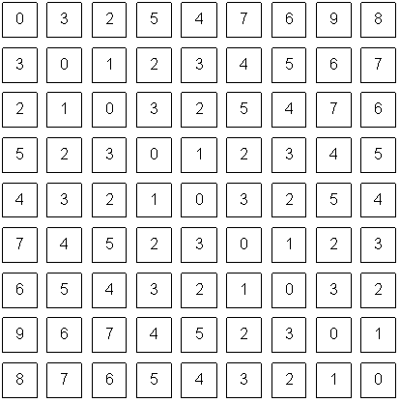
Computer vision:
To make sense from pixels
What we see
What a computer sees
A picture is worth a thousand words!!

Slide 10
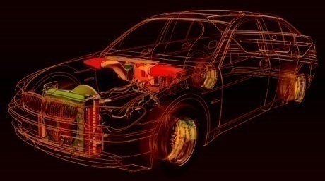
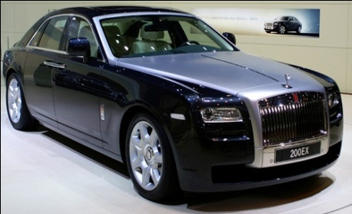
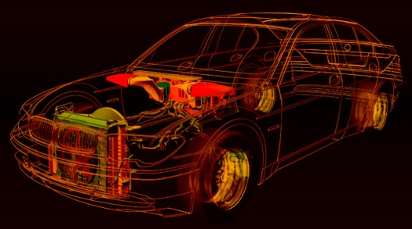
Vision vs. Graphics
Graphics: from models to images
Vision: from images to models

Slide 11
What is computer vision?
Computer vision is a field that includes methods for acquiring, processing, analyzing, and understanding images and, in general, high-dimensional data from the real world in order to produce numerical or symbolic information, e.g., in the forms of decisions.

Slide 12
Topics:
"Acquiring" : Image formation
  Cameras, Geometric camera models, Calibration, Radiometry, Color
"Processing" : Low-level vision
  Linear filters, Edge detection, Texture, Geometry of multiple views.
"Analyzing": Mid-level vision
  Motion, Segmentation, and Tracking
"Understanding": High level vision
  Model-based vision, Pose estimation, Appearance-based vision, Generic Object Recognition

Slide 13
What to sense from images?
Structure -- 3D geometry
  Vision for measurement
  Image based modeling
Semantics: who, what, where
  Who: Human sensing, e.g., human recognition
  What: Object/scene/action/event recognition
  Where: location recognition

Slide 14
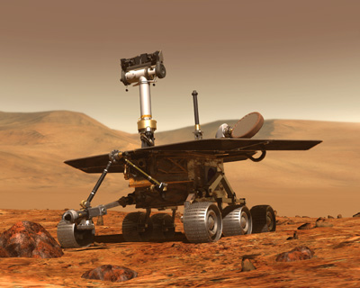
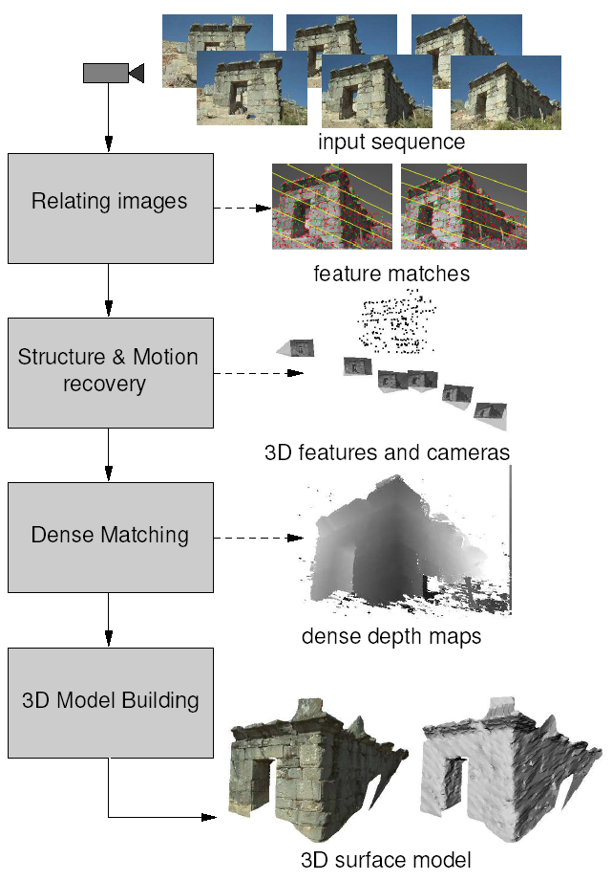

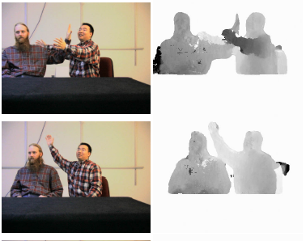
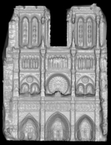
Vision for measurement
Real-time stereo
Structure from motion
Reconstruction from
Internet photo collections
NASA Mars Rover
Pollefeys et al.
Goesele et al.
Slide credit: Lazebnik

Slide 15
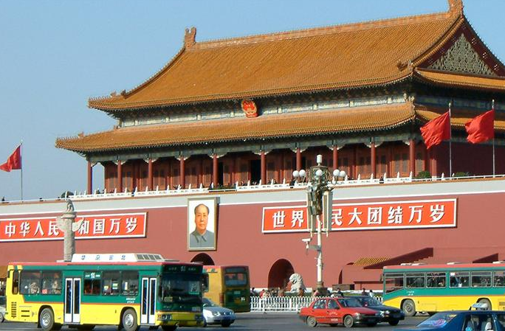
Vision for sensing semantic information
slide credit: Fei-Fei, Fergus & Torralba

Slide 16
Object category recognition
sky
building
flag
street lamp
banner
face
wall
bus
cars
bus
slide credit: Fei-Fei, Fergus & Torralba

Slide 17
Scene and context category recognition
outdoor
city
traffic
…
slide credit: Fei-Fei, Fergus & Torralba

Slide 18
Qualitative spatial information
slanted
non-rigid moving object
vertical
rigid moving object
rigid moving object
horizontal
slide credit: Fei-Fei, Fergus & Torralba

Slide 19

Dynamic semantics: hand gesture

Slide 20
Why should we care about computer vision?

Slide 21


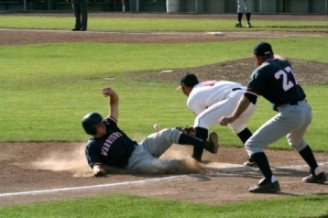



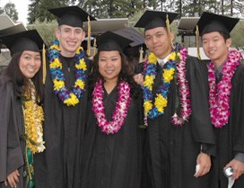
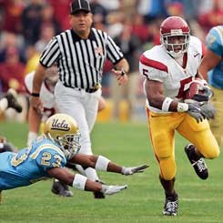

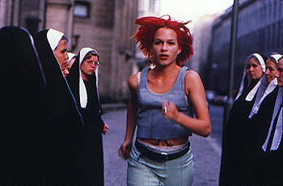
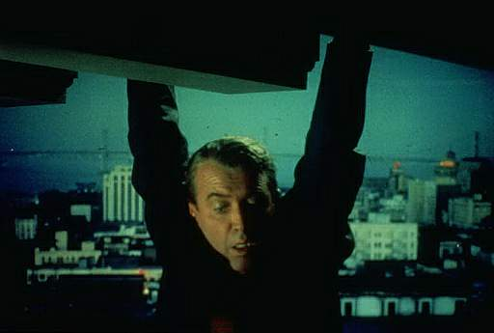
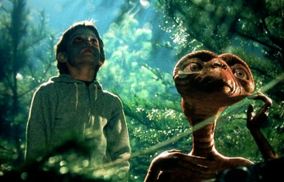




Images and videos are everywhere
Personal photo album
  380 billion photos are taken in 2011 (Good, 2011)
Photo and video sharing
  250 million photos are uploaded to Facebook daily
  48 hours videos are uploaded to YouTube minutes
image source: Lazebnik

Slide 22
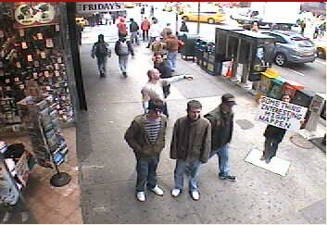
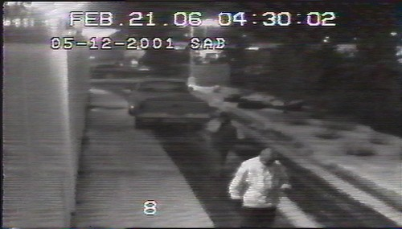
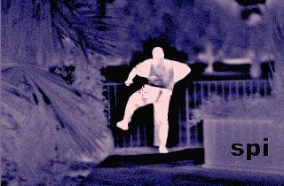
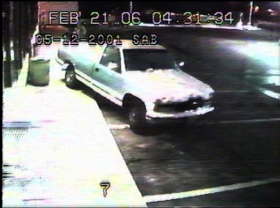
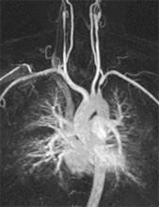
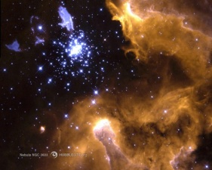
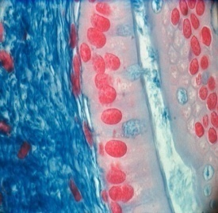
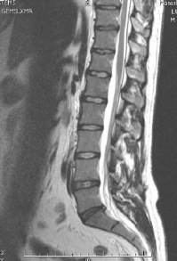
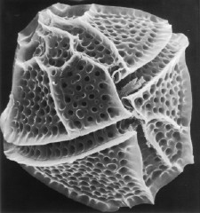
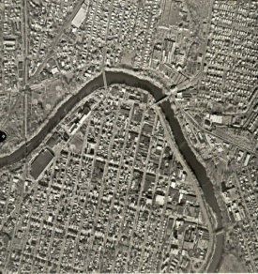
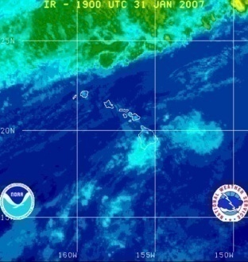
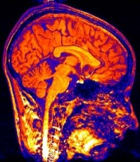
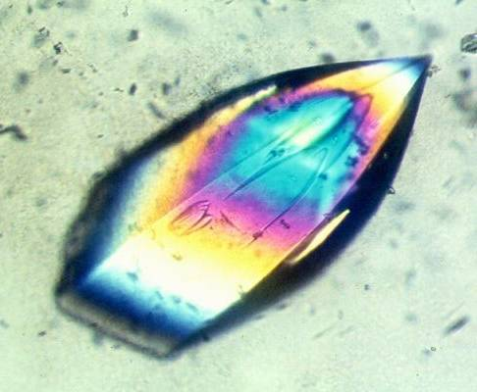
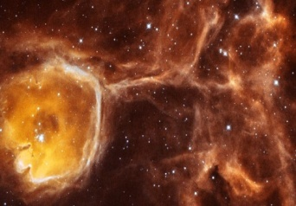
Images and videos are everywhere
Visual surveillance and security
  In Britain: 1 CCTV camera for 14 citizens [Davis, 2008]
Medical and other scientific
  X-ray, MRI, Ultra-sound
  Space, climate, satellite
image source: Lazebnik

Slide 23
Vision is useful
Computer vision is useful
  Enable new means of visual entertainment
  Relieve humans of easy but boring tasks
  Augment human capabilities and special functionality
  Enable new ways of human computer interaction and visualization
  Endow robots and autonomous agents with visual perception
  Facilitate organization, access, and search of visual content
  More … …

Slide 24

A demo of visual gesture based mobile HCI

Slide 25

Vision is fun?

Slide 26

Vision is fun?

Slide 27
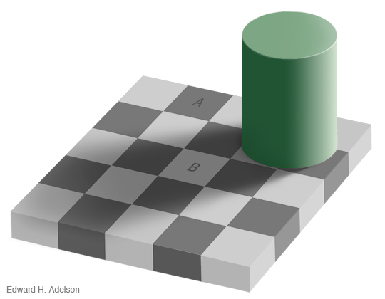
Vision is interesting
[Adelson et al., MIT]

Slide 28
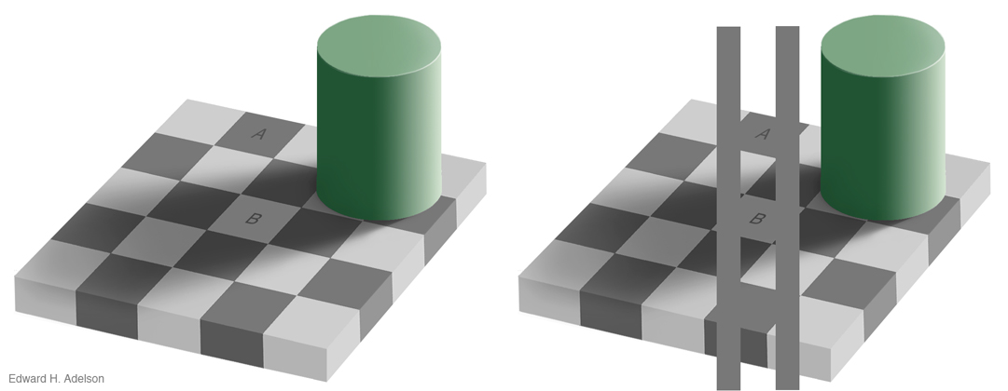
Vision is interesting
[Adelson et al., MIT]

Slide 29
Why is challenging?

Slide 30
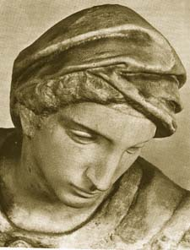
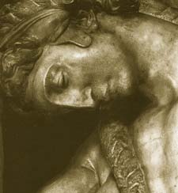
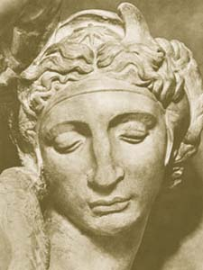
Challenges: viewpoint variation
Michelangelo 1475-1564
slide credit: Fei-Fei, Fergus & Torralba

Slide 31
Challenges: illumination
slide credit: Lazebnik

Slide 32
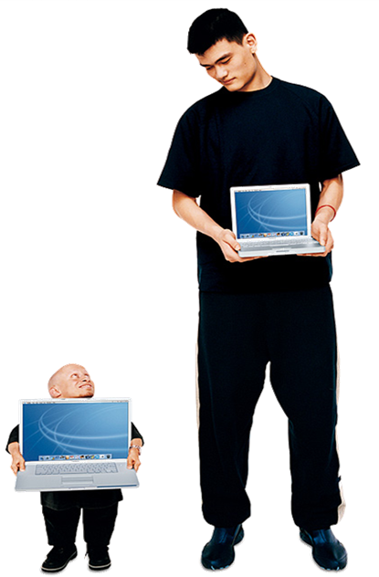
Challenges: scale
slide credit: Fei-Fei, Fergus & Torralba

Slide 33
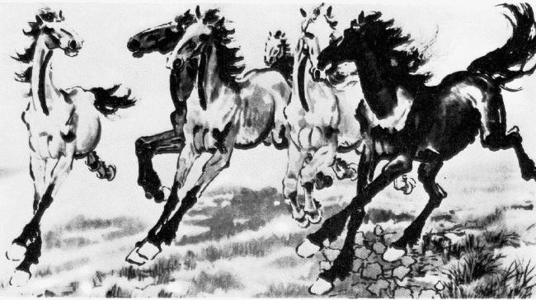
Challenges: deformation
Xu, Beihong 1943 (徐悲鸿)
slide credit: Fei-Fei, Fergus & Torralba

Slide 34
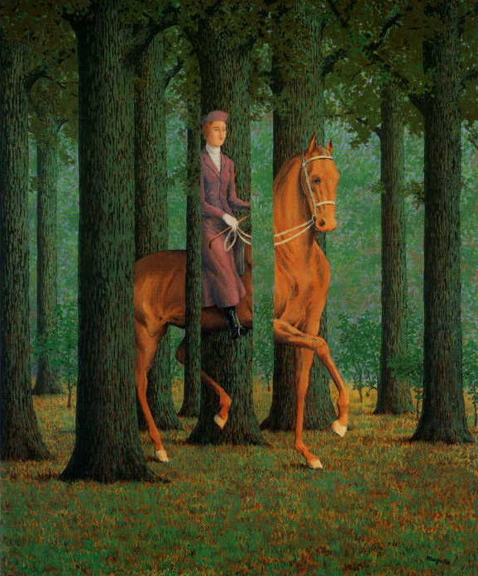
Challenges: occlusion
Magritte, 1957
slide credit: Fei-Fei, Fergus & Torralba

Slide 35
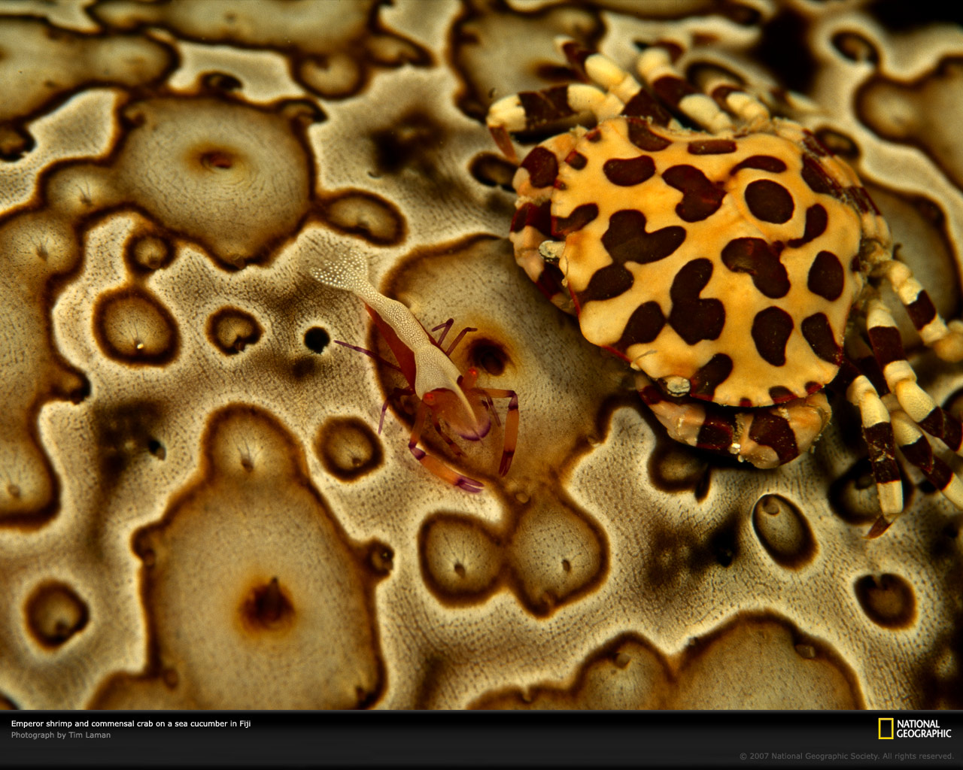
Challenges: background clutter
slide credit: Lazebnik

Slide 36

Challenges: Motion
slide credit: Lazebnik

Slide 37
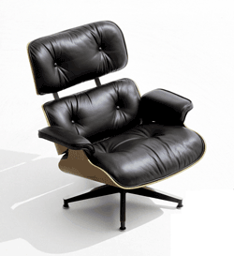
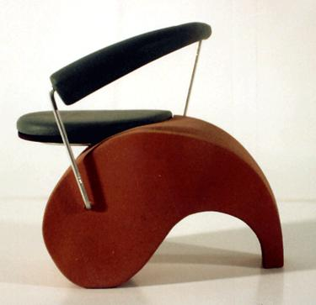
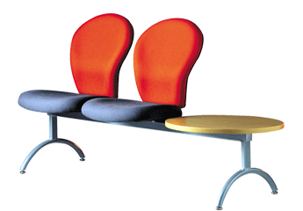
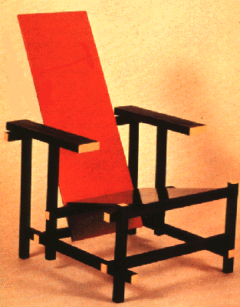
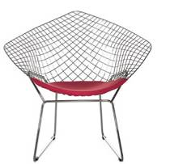
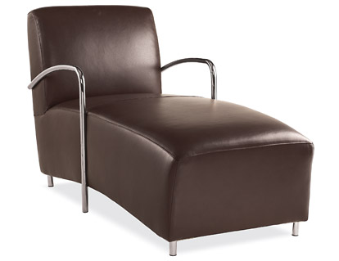
Challenges: object intra-class variation
slide credit: Fei-Fei, Fergus & Torralba

Slide 38




Challenges: local ambiguity
slide credit: Fei-Fei, Fergus & Torralba

Slide 39

Challenges: context
Source: Fergus and Torralba

Slide 40
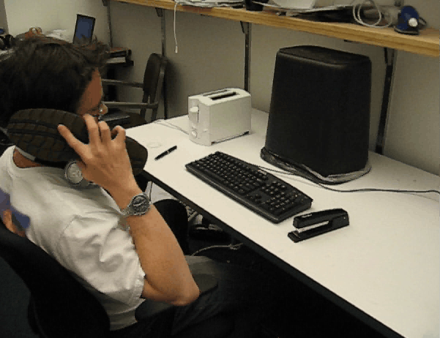
Challenges: context
Source: Rob Fergus and Antonio Torralba

Slide 41
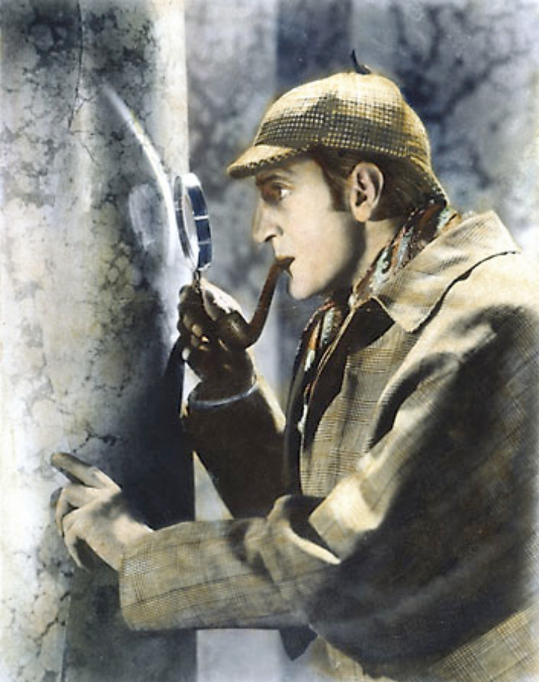
Challenges or opportunities?
Images are confusing, but they also reveal the structure of the world through numerous cues
Our job is to interpret the cues!
Image source: J. Koenderink
slide credit: Lazebnik

Slide 42

Depth cues: Linear perspective
slide credit: Lazebnik

Slide 43

Depth cues: Aerial perspective
slide credit: Lazebnik

Slide 44
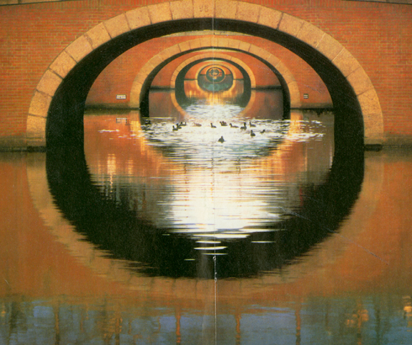
Depth ordering cues: Occlusion
slide credit: Lazebnik

Slide 45

Shape cues: Texture gradient
slide credit: Lazebnik

Slide 46
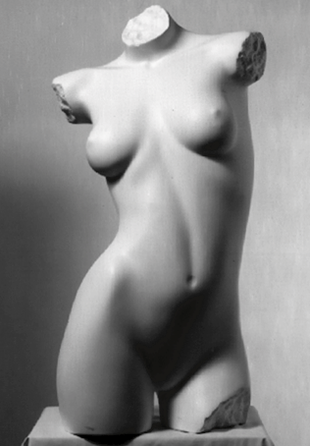
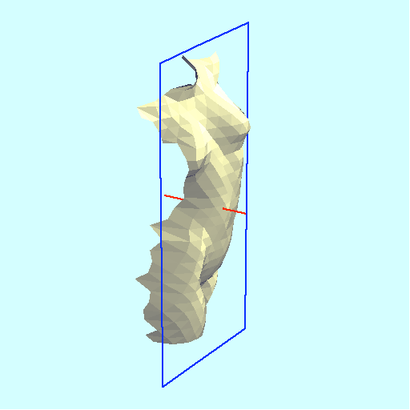
Shape and lighting cues: Shading
slide credit: Lazebnik

Slide 47
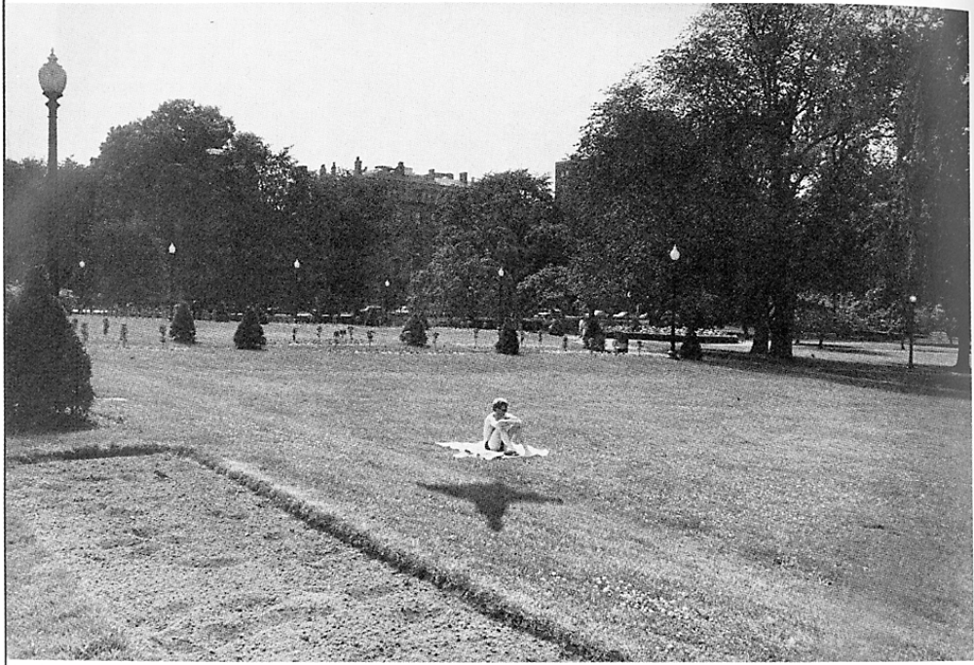
Position and lighting cues: Cast shadows
slide credit: Lazebnik

Slide 48

Grouping cues: Similarity (color, texture,proximity)
slide credit: Lazebnik

Slide 49

Grouping cues: “Common fate”
slide credit: Lazebnik

Slide 50


Inverse problem in nature
A 2D picture may be produced by many different 3D scenes
slide credit: Lazebnik

Slide 51
Connections to other areas
Visualization
Artificial Intelligence
Multimedia
Computer Vision
Robotics
Machine Learning
Computer Graphics
Cognitive science
Neuroscience
Image Processing

Slide 52
A rough history of computer vision (1)
1955: A vision of Computer Vision
  Selfridge: "… eyes and ears for the computer"
Late 1950's-early 1960's: First image enhancement application
  Space missions, aerial image processing
Early 1960's : Character recognition
  Pattern recognition paradigm
Late 1960's: Interpretation of blocks world
  Roberts 1965: 2D➔3D
1979: Natural scenes with motion
  Nagel: Digitization and analysis of traffic scenes
1988: Visual agents
  Bajcsy: active vision

Slide 53
A rough history of computer vision (2)
1980's-mid 1990's: multi-view geometry & segmentation
  Kass et al 1988: Snakes
1990's: face and gesture recognition, statistical methods
  Turk & Pentland 1991: Eigen-faces
1990's – early 2000's: visual tracking and motion analysis
  Isard & Blake 1998: particle filtering for visual tracking
2000's: more recognition, large scale image and video database
  Viola & Jones 2001: the first real-time face detector
  Lowe 2004: SIFT feature
Mid 2000's: computational photography branched out
2011: advancement made by new sensors
  Kinect

Slide 54

Origins of computer vision
L. G. Roberts, Machine Perception of Three Dimensional Solids, Ph.D. thesis, MIT Department of Electrical Engineering, 1963.
slide credit: Lazebnik

Slide 55
What are the real-world applications?
Success of computer vision to date

Slide 56




Optical character recognition (OCR)
Digit recognition
License plate readers
Sudoku grabber
Automatic check processing
Source: S. Seitz

Slide 57




Biometrics
Fingerprint scanners on many new laptops,
other devices
Face recognition systems now beginning to appear more widely
http://www.sensiblevision.com/
Source: S. Seitz

Slide 58




Biometrics
How the Afghan Girl was Identified by Her Iris Patterns
Source: S. Seitz

Slide 59




Mobile visual search
  Point & Find, Nokia
  Lincoln, Microsoft Research

Slide 60

Face detection
Many new digital cameras now detect faces
  Canon, Sony, Fuji, …
Source: S. Seitz
Notes:
Why would this be useful? Main reason is focus. Also enables “smart” cropping.

Slide 61


Smile detection
Sony Cyber-shot® T70 Digital Still Camera
Source: S. Seitz

Slide 62



Face annotation
Apple iPhoto
Google Picasa
Windows Live Photo Gallery

Slide 63

Automotive safety
Mobileye: Vision systems in high-end BMW, GM, Volvo models
  Pedestrian collision warning
  Forward collision warning
  Lane departure warning
  Headway monitoring and warning
Source: A. Shashua, S. Seitz

Slide 64




Special effects: shape and motion capture
Source: S. Seitz

Slide 65

3D visualization: Microsoft Photosynth
http://photosynth.net
Source: S. Seitz

Slide 66

Vision for robotics, space exploration
NASA'S Mars Exploration Rover Spirit captured this westward view from atop
a low plateau where Spirit spent the closing months of 2007.
Vision systems (JPL) used for several tasks
  Panorama stitching
  3D terrain modeling
  Obstacle detection, position tracking
  For more, read “Computer Vision on Mars” by Matthies et al.
Source: S. Seitz

Slide 67
List of computer vision companies
http://www.cs.ubc.ca/spider/lowe/vision.html

Slide 68




I. Image Formation
Cameras
Camera models
Calibration
Radiometry
Color

Slide 69





II. Early vision (1)
*
=
Linear filtering
Edge detection
Feature extraction: corner and blob detection
Texture

Slide 70






II. Early vision (2)
Stereo
Epipolar geometry
Tomasi & Kanade (1993)
Affine structure from motion
Projective structure from motion
slide credit: Lazebnik

Slide 71


III. “Mid-level vision”
Fitting and grouping
Alignment
Fitting: Least squares
Hough transform
RANSAC

Slide 72





III. “Mid-level vision”
Motion and tracking
Segmentation
Articulated models

Slide 73




IV. High level vision
Patch description and matching
Face detection
Clustering and visual vocabularies
Bag-of-features models
Classification
Object recognition
Sources: D. Lowe, L. Fei-Fei

